Slide 1
BASICS OF COUNSELLING
Please read article on this topic first.
This power point presentation is a gist of the article.

Slide 3
A TEACHER
“A student spends 25000 hours in the campus. The school must have the best of teachers who have ability to teach, love teaching and build moral quality.”
A.P.J .ABDUL KALAM.
Notes:
As students spend half their growing years in school and college, teachers have a significant role to play in shaping the personality of the students. It is important to understand that teachers in India literally hold the future of their students in their hands.

Slide 4
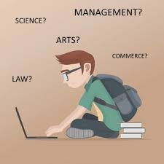
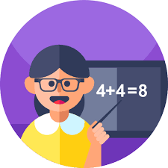
ROLE OF A TEACHER
Talented
Exemplary
Accurate
Creative
Hard-working
Educated
Resourceful
Notes:
In the past, parents were sending their children to school mainly for education in terms of careers and our teachers were tuned to teach subjects in terms of science, Maths etc. However with changing times ,lot of brhsvioral issues, mental health concerns & stress are rising. A teacher can be a primary giver of Mental First Aid in these areas.

Slide 5
WHY TEACHER AS COUNSELLOR ?
CHANGE IN LIFE STYLE
CHANGE IN EXPECTATIONS
CHANGE IN STUDENTS’ ISSUES
SO
NEED OF CHANGE IN ROLE OF A TEACHER
Notes:
But as the life style changes, more of nuclear families ,working and economically independent parents issues are changing. Students face many issues which needs addressing as it is affecting their career and emotional wellbeing. Role of a teacher in education can help to drastically change this, thus giving the students a chance to a better life. The contribution of a good teacher is therefore immeasurable.

Slide 6
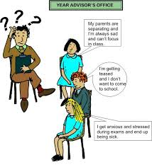
Notes:
We can see in the picture that nowadays students often want to talk about something apart from studies which may be bothering them.

Slide 7
WHY TEACHER AS COUNSELLOR ?
Range of issues of students such as growing conflicts with parents, self-esteem and body-image issues, exam anxiety , Stress ,addiction and thoughts of suicide or potential career paths NEEDS ADDRESSING at the earliest.
Non availability of Counselor in every school.
Hesitation of students to meet school counselors ( If there is one ) when they find themselves in troubled situations.
Teachers play an important role in bridging this gap as they are in constant touch with the students.
Notes:
Range of issues of students such as growing conflicts with parents, self-esteem and body-image issues, exam anxiety , Stress ,addiction and thoughts of suicide or potential career paths NEEDS ADDRESSING at the earliest. A teacher needs to know basic counseling skills to address these issues.
The cut throat competition and higher expectation from teachers ,parents, society creates anxiety and fear in the minds of children leading to
Though the Central Board for Secondary Education (CBSE) India recommends that schools employ a fulltime on-campus counselor, but may not be possible because of many reason.
The other challenge is to nudge students to meet school counselors ( If there is one ) when they find themselves in troubled situations.

Slide 8
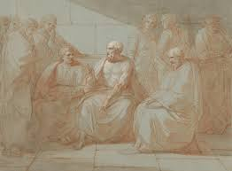
TEACHER AS A COUNSELOR
Taking the responsibility for a “Relationship Role” in teaching, gives “TEACHER AS A COUNSELOR” a new importance.
The historic nature of this role can be traced at least as far back as Socrates!
Notes:
Repeatedly in the writings of Plato we see Socrates involved in assisting his students and followers in a counseling posture.

Slide 9
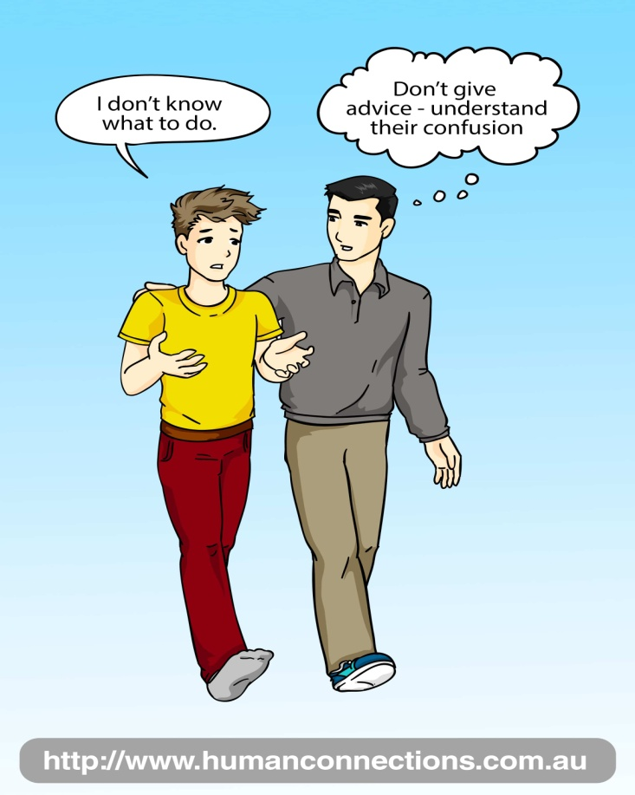
TEACHER AS COUNSELOR
Trustworthy / Tolerant
Energetic
Awesome
Caring
Helper / Humble
Encouraging
Responsible
Notes:
This also changes the acronym for teacher and redefines it with a new role as counselor. A teacher can pick subtle changes in behavior when students are facing difficulties. Good observational & Counseling skills help to do this effectively.

Slide 10
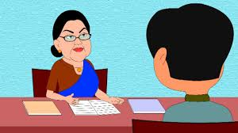
QUALITIES of a COUNSELOR
Positive Attitude
Trustworthy / Integrity
Non Judgmental
Confidentiality
Notes:
Attitude : Important attribute of teacher is his positive attitude. Ability to create a bond of love with his students and approachability helps students to seek him for help .
Trustworthy / Integrity. Reflecting truthfulness, honesty, sincerity and integrity in behavior ,dealing relationships and actions. Integrity is the basis of one’s action on internally consistent framework of principals. Building trust in the minds of students is essential if a teacher wants to be a confidant.
Empathy: The ability to put yourself in someone else shoes and walk a mile explains empathy. Also a will to extend one self for purpose of nurturing one’s or another’s spiritual growth has been defined as love by one well known author.
Non Judgemental : A teacher should view the student in an objective manner and without any personal bias, based on academic records or personality .It is not easy for students to share their issues with a teacher. It is important for teachers to be open-minded ,non judgemental, should be able to give unconditional positive regard.

Slide 11
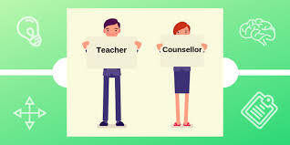
COUNSELLING SKILLS
Build Rapport by using following strategy
(2x10 Strategy)
Communication Skills :
(Active Listening & Paraphrasing)
Being Non judgmental
Self Disclosure
Humour & Patience
Interpersonal Skills
Notes:
These are some of the basic skills which a teacher needs to acquire to become an effective Counselor.

Slide 12
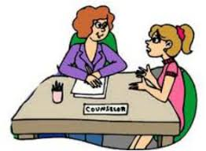
TWO-BY-TEN (2x10) STRATEGY
Strategy by Researcher Raymond Wlodkowski , an educator and psychologist
Teacher spend two minutes each day for ten days in a row to have a personal conversation with the most challenging students.
Teacher leave it to the student to talk about anything the student is interested in (as long as the conversation is appropriate for school).
Source: “Assuming the Best”, by R. Smith & M. Lambert, Educational Leadership, September 2008
© 2008, Debbie Rickards, www.worknotes.com/LA/Shreveport/DebbieRickards
Notes:
Though this seems counterintuitive, the students who seemingly deserve the most punitive consequences( punishments!) are actually the ones who most need a positive and personal connection with the teacher. Often when they act out, they are letting us know that they are seeking a positive connection with an adult authority figure and that they need that connection first, before they can or will focus on an academic content. One teacher using the Two-by-Ten strategy said, “Not only does it help with the toughest students, but also it helps the teachers remember their humanity.

Slide 13
Notes:
Communication Skills / Active Listening Skills ; Good communication is an essential tool of a teacher. Teacher can show friendly gestures, ( non verbal communication) with all the students and communicates with love to all. When the student starts talking about the challenges faced, allow them to vent. Listen to everything that the student has to say and do not interrupt the flow of thought. Also, as a teacher, you can paraphrase the student's thoughts to ensure that you have understood the problem correctly. This will provide clarity to their thought. Eg.“This is how I've understood your problem and I believe you can approach it through so-and-so method. What do you think?” This could be one of the ways. Assist the student to think about ways to overcome or address the problem instead of providing ready solutions.
Self Disclosure : As a teacher, the person should be consistent in their thoughts and emotions. They should try to not let their moods and emotions rub off on the student who comes to them for help. They should maintain their composure. But at times can share experience of his/her life to benefit the child.
Humour : Can be a useful skill if used appropriately.
Interpersonal Skills Draw parents into school involvement.Send positive messages about students to parents

Slide 14
TWO-BY-TEN (2x10) STRATEGY
The goal is to connect to the student and build trust.
By taking this time to really get to know at-risk student a teacher can uncover the reasons behind their misbehavior in class
Two minutes a day seems like a little investment of your time that can really go a long way in helping a child.
This strategy can help you focus on all
the good that is in the student.
Notes:
You may even find that you will view them more as a person versus only as the “Challenging student.” With a little planning

Slide 15
HOW CAN A TEACHER HELP ?
1 Identify the student in need for intervention and build rapport.
2 Provide an appropriate time to truly listen to the child.
3 Help him to identify the problem.
4 Show various alternatives for problem solving.
5 Help to set goals for improvement & Encourage to succeed
6 Involve parents if needed
7 Draw parents’ attention to the problem and involve in care
8 Refer to experts if more skills are needed
Notes:
These steps help a teacher to systematically address the issues in adolescents who are in need of help.

Slide 16
DO N’TS OF COUNSELLING
Preaching /Moralizing
Advising/ Too many suggestions
Criticizing /Ridicule/ Taunting
Unwarranted reassurance
Judging
Interrogating too much
Overconfidence
Notes:
These skills need to be polished time & again.

Slide 17
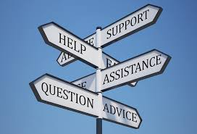
WHEN TO REFER TO OTHER PROFESSIONALS
If Risk to life or harm is identified..
If one is unable to understand a particular adolescent behavior.
If a child has constant disruptive behavior.
If notices change in behavior which is severe, long standing and disrupting daily /routine activities.
Notes:
Just as skillas of counseling are needed for basic counseling, a teacher should not go beyond her purview & must take help of professional experts in above situations.

Slide 18
BARRIERS TO COUNSELING
A teacher is not willing to take additional responsibility
Lack of time
Lack of privacy
No training facility
No monetary benefit
Find themselves overburdened
Management reluctance to take extra work
Notes:
Many teachers feel that subject matter and cognitive learning is the total focus of educators . The role as counselor suggests a deeper commitment than many teachers want. Some teachers resent additional responsibility & stress. Sometimes teachers may think ‘What is there for me ? How will I benefit?’ But, along with personal satisfaction, it promotes social prestige and recognition, deep affection, regard and love from family, friends & the beneficiaries. Doing things which really makes a difference to someone makes us feel good about ourselves . There may be many more hurdles as time constraints, privacy constraints, training etc; but these can be overcome by a willing and determined teacher. The school management can also spot teachers who can be trained to provide counseling to students. ‘YUVA Self help life skills’ is a training program run by SCERT for Delhi Government School teachers.

Slide 19
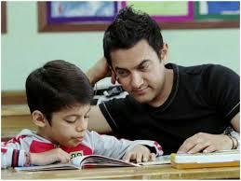
“Tarre Jamin Par” PERFECT EXAMPLE OF TEACHER AS COUNSELOR
He observes Ishaan's unhappiness and impassive participation in class activities. ( Notices different behaviour)
He reviews Ishaan's work and knows about dyslexia ( Give more time similar to our strategy)
He goes to Mumbai to visit Ishaan's parents (Extra Effort)
He discover his hidden interest in art ( Identifies His strength)
He brings up the topic of dyslexia in class by talking
about personalities.
( Undestanding and nonjudgemental)
Notes:
All of you must have seen this movie. Please close your eyes and recall yourself when you have helped a student that made a change in his life. I am sure everyone will have one example each.
he quickly observes Ishaan's unhappiness and impassive participation in class activities.
He reviews Ishaan's work and concludes that his academic shortcomings are indicative of dyslexia
he comforts Ishaan by telling him about his struggle as a child as well by facing similar problems

Slide 20
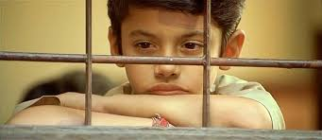
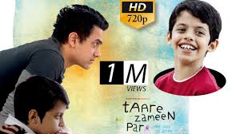
PERFECT EXAMPLE OF TEACHER AS COUNSELOR
He comforts Ishaan by telling him about his struggle as a child
(Self Disclosure and Empathy)
With gradual care, he attempts to improve Ishaan's reading and writing by using remedial techniques developed by dyslexia specialists.(Uses appropriate helping measures)
He organizes an art fair for staff and students.
( Giving encouragement)
Ishaan soon develops an interest in his Studies, gains self respect & eventually his grades improve and he is declared a winner !
END RESULT IS “NEW AND TRANSFORMED LIFE”

Slide 21
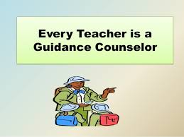
POWER OF A TEACHER
Every child may not be the brightest star, but they are still their own stars. Let them shine brightly, reflecting your love.
A teacher as a counselor has a power to make every child a star!

Slide 22
THANK YOU !
Notes:
Life is great. Together we can make our future generation productive, self confident and nice human beings. Right?

