Slide 1
Cognitive and Psychosocial Development in Adolescents
Dr Swati Ghate
D C H, PGDAP, M.A (Clinical Psychology)
Pediatrician, Adolescent specialist and counsellor
‘Bloom’ Adolescent Clinic
Babylon’s Newton Child Development and Support Centre, Jaipur
Notes:
Kindly read the corresponding PDF article. This ppt is the summary of the article.

Slide 2
Functional maturation of the brain to attain its full potential
Notes:
Adolescent cognitive and psychosocial development, in simple words, is development of brain functioning. It takes place in various stages. Just like the caterpillars, during these stages, they may not come up as very fascinating (to deal with). But, at the end, an independent and productive life ensues.
Just like the metamorphosing caterpillar in the picture, they need incessant support to attain their destination.

Slide 3
What is the aim of this Development?
Meeting the ’challenge’ of the adolescence:
‘Identity formation’ (Erik Erikson)
On Three Major Dimensions (Mercia)
Sexual Orientation
Set of
Values
and
Ideals
Vocational
Direction
Notes:
Through the cognitive and psychosocial development, adolescents attain their major goal of forming an identity of their own. It is independent of their parents but influenced by genes. Their surroundings, including family atmosphere, schooling, societal influence, opportunities available to them and many more factors, play major roles in shaping their identity. Nature plus nurture .Hence, the role of a caretakers is very crucial in this phase of life.
By the end of adolescence, the individual has chosen a path into these three domains.

Slide 4
How does an adolescent achieve the ‘self identity’?
Distances from authority figures
Explores oneself on various dimensions
Questions the established rules and norms
Breaks the boundaries
Tries to find out alternative goals and paths
Finally figures out his own unique persona
Notes:
For achieving self identity, an adolescent has to go through these steps. While doing so, he may appear selfish, secretive, arrogant, adamant, argumentative, quarrelsome, foolish, risk taking and the like. The caretakers of the adolescents need to empower themselves with the knowledge and strategies to deal with this so called
‘misbehaviour’.

Slide 5
Why teachers should know ?
Stakeholders in adolescent care
Planning of academic activities
Understanding the behaviour
Be more adolescent friendly
Notes:
Teachers spend a long time with adolescents. Their attitude and behaviour directly affects many aspects of adolescents’ lives, apart from academics. An empowered teacher is better able to design and deliver his academic lessons. He also is equipped with skills to interpret and address behavioural challenges of adolescents .He can be non judgemental about them and also identify lacunae, if any.
The teachers, without these insights get easily offended by the students
With these insights, the teachers truly become guides and mentors, and not merely a teacher.

Slide 6
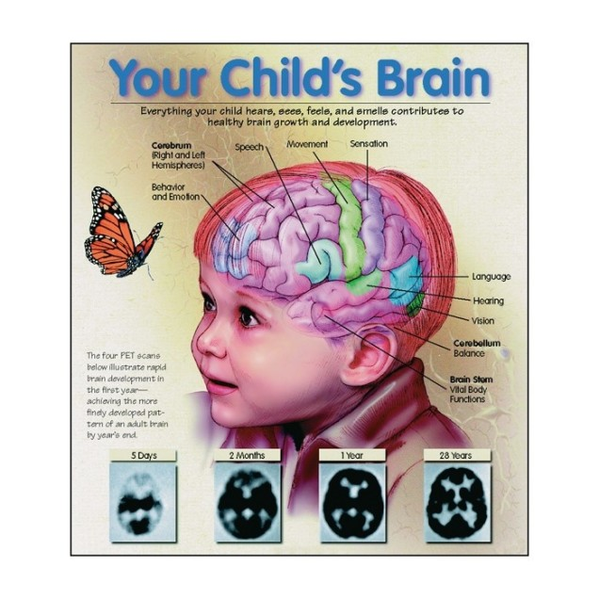
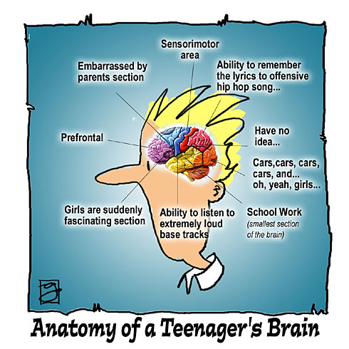
Comparing the brain functioning
Notes:
The areas shown in each one are way apart. This slide is to emphasise the different functions the brain handles in the two age groups.

Slide 7
Difference in Higher brain functions Children Adolescents
Limited thinking capacity
Concrete thinkers,
can think only of
‘observable’
Primitive emotions
Sexual orientation limited to ‘gender’
Need and embrace shelter of caretakers
Ever expanding capacities
‘Abstract’ thinking emerges
Complex emotionality
Explore and establish sexual orientation
Need, yet defy shelter
Notes:
Adolescents are growing in all spheres to attain the independence of adulthood. These basic differences between a child’s and adolescent’s higher functioning give an idea why we need to adapt a different strategy once the children enter adolescence.
Adolescents do need support and guidance, although their behaviour apparently speaks otherwise.

Slide 8
Cognitive
Types of Human Higher Functions
Non-cognitive (Psychosocial)
Seek information from the surrounding
Process it and store it
Retrieve it and use it as and when needed
Abilities that decide whether and how to use ‘cognitive ‘ functions
Notes:
Human brain works under the influence of two types of functions: the cognitive functions which enable the individual do the actual intellectual work like thinking, problem solving, decision making etc. The non cognitive functions like values, motivation, mood, etc. dictate if the person will apply and make use of his cognitive abilities.

Slide 9
Cognitive abilities:
1.
Sensory processes for gathering information
2.
Retention processes
3.
Application of information
Notes:
Gathering information needs that the individual pays attention to it. Then he uses his sense organs to get the feeling of it. Further he interprets it in his own unique way.
Thus, a diagram on the board, has to be attractive enough to draw the attention of the student and it should be properly visible to him. Further, he should interpret it in such a way that, he catches the message in the diagram correctly.
All these abilities enhance in adolescence and teacher can make use of them appropriately. Their attention gets drawn to things of their interest easily. They can sustain attention for longer times and can note the details. Their sense organs are sharper and they are better able to interpret wider and finer shades of things coming their way.

Slide 10
1. Sensory processes for gathering information:
,
Paying attention
Getting the sensory input from the surrounding (sensation)
Interpreting the sensation (perception)

Slide 11
2. Retention processes
Gathered information is processed appropriately by linking to previous information, categorising, coding etc.
Processed Information is stored in memory
Retrieving later as and when needed
Notes:
Capacity to handle and process loads of information is seen in adolescence. They may be guided on how to transform the information in convenient forms with the help of flow charts, tables, bar diagrams etc. For auditory learners, discussion, debates, enactments are good ways to teach. For sensory learner, actual experience like visit to a museum, strengthens this asset.

Slide 12
3. Application of information:
Takes place knowingly or unknowingly
For day to day living and in tough situations
For problem solving and decision making
Using language, reasoning and creativity
Notes:
During their growth spurt, adolescents also get empowered with the abilities of logical thinking, reasoning , thinking out of box, finding alternative styles to work etc. This makes them ready to accept challenges of adult life. The more the chance they get to use these abilities in varied ways, the more they flourish. Sports, fine and performing arts, organising different events and other extra curricular activities help in sharpening these skills. This in turn helps in betterment of academic performance.

Slide 13
Piaget’s Stages of Cognitive development
1.
Sensory motor stage: 0-2 yrs- Form ‘schema’– ‘comfort figure’
2.
Pre operational stage: 2-7 yrs - Comfort—mom—milk
3.
Concrete operational: 7-12 yrs - ‘Mom is bigger than me‘, ‘Mom hugs me’
4.
Formal operational: 12 yrs onwards- ‘Mom is dedicated ’, ‘Mom is concerned for me’
Notes:
Jean Piaget described stages of cognitive development. In the first stage, child stores natural experiences as ‘schema’ in his brain .For example, mother is inscribed in the brain as a comforting and soothing experience.
In the second, he connects schemas with symbols, thereby learning associations and language. He comes to understand that his comfort experience is called ‘Mom’.
In the third stage, he can handle and manipulate concrete observable objects. He can assign and understand physical properties and actions . He learns that the mom is a bigger figure and sees her hugging him. Early adolescents fall in this category.
In the final stage, after 12 yrs of age, during middle and late stages, adolescent slowly develops thinking related to abstract concepts and properties. That is, he can understand the concept of non observable objects and ideas, beyond the real concrete world. He now can interpret mom’s hard work as her dedication and her actions as her concern.

Slide 14
Stage wise Cognitive development Early Adolescence (9-12 yrs)
Thinking mainly concrete
Focus on ‘here and now’
Cannot plan for future
Cannot connect past experiences to present
Can not think of alternative ways to reach a goal
Notes:
At this stage, the adolescents live for the moment. They can not connect past or future with the present. Hence “study hard if you want to be a doctor” carries no meaning . Instead, they would happily study for an immediate reward like a pat from the teacher.
This poor connection makes them commit “silly” mistakes.
Since they can not find out alternate pathways, they get fumbled by small hurdles.

Slide 15
Middle adolescence: (13-16 yrs)
Abstract thinking starts taking shape
Thinking for future is possible
Experiences are better retained and connected
Refuse to accept facts as truths: start questioning
In stress and crisis, revert back to concrete thinking
Notes:
In this stage, adolescents start thinking beyond what is observable. They can understand abstract concepts of higher mathematics, science and literature.
They can think of possible consequences of current actions, but only in calm state of mind. During any type of stress, they revert back and are highly likely to commit mistakes. Peer pressure, exam anxiety, threat to self esteem, relationship issues etc are stressors which culminate into impulsive high risk behaviours.

Slide 16
Late Adolescence(17-19 yrs)
Abstract thought process well established
Think of what is ‘possible’, beyond what is ‘observable’
Multidimensional thinking
Understand long term consequences of current actions
Can plan for future
Can evaluate one’s own thought process
Notes:
By this time, equipped with the increasing abilities, adolescents are able to foresee future. They can now be motivated and guided on long term life goals.
They develop the power of imagination and can enjoy philosophy, mystery and other abstract art forms.
Multidimensional thinking helps them try out different ways of reaching a solution.
Metacognition or ability to evaluate one’s own thinking, may make the adolescent look too much self occupied. But, it helps him strengthen and sharpen his strategies, plans and moves.

Slide 17
Psycho social development
Development in Two non cognitive domains of mental processes
1. Psychological framework of the individual
2. The relationship of the person with his self and others
For Eg.: needs, drives, motives, emotions, attitudes, habits, interests, values, ethics, beliefs
Reflected on: Self, emotionality, sexuality, family, Peers, society
Notes:
Psychosocial development tells us about typical adolescent development in domains of personality including interpersonal relationships.
The factors that take shape here are the deciding factors for using cognitive processes. Hence, healthy psychosocial development is crucial for a fruitful life
In adolescents, it is studied stage wise in the context of Self, parents, peers and school. Self comprises of self concept, emotional development and sexuality development.

Slide 18
Emotional Development
Early
Middle
Late
Start experiencing different shades of emotions, hitherto unknown
Mood swings common
Easily triggered Emotions difficult to manage
Turbulence recedes
Composed with stable emotions
Notes:
The centre for emotions in brain, amygdala, develops faster than prefrontal cortex, the seat for cognition. Hence, they display a lot of emotional instability for long period.
Anger outbursts, arguments, crying spells, irritability are commonly seen as a result of poor emotional control.

Slide 19
Self Concept
Early
Middle
Late
Confused and apprehensive
Body image issues emerge
Self conscious
‘On stage’ phenomenon
Busy with Self exploration and introspection
Hence need a lot of privacy and independence
Figured out about ‘self’.
A stable self identity established
Notes:
Early adolescents are confused about their changing body and mind. They always have a feeling that the world is watching them. Hence, they are very much conscious of their looks and bearing.
In the process of defining self, the middle adolescents, try and explore different styles of thinking and behaviour. They demand a lot of independence, privacy and ‘me time’ for the same.
By late adolescence, they have found out what type of persona they hold and are comfortably adjusted with it.

Slide 20
Relationship with parents/ Family
Early
Middle
Late
Move away from parents
Do not wish to participate in family functions
Challenge family rules
Test boundaries set by the parents
Argue a lot
Major rift with parents
Join the family back as grown ups
share responsibilities
Show empathy for others
Notes:
For achieving self identity, adolescents need to break away the (emotional) shelter of the parents. Hence they start distancing.
In the middle adolescents, they use their cognitive skills, on the safest platforms, the home and the parents. They argue, misbehave, break the rules and try all sorts of power struggle, (basically and unknowingly to learn from it). They thus get confidence in their newly learnt abilities and feel equipped to face the larger world outside.
As late adolescents, they come back to family as independent persons and join hands with parents.

Slide 21
Relationship with peers
Early
Middle
Late
Peers act as a support group,
Same sex peers preferred
Share their concerns
Peers are the pillars,
Peer acceptance is a must
Follow the group rules
Both sex peers
Groups start dissolving,
Individual relationships emerge,
May last lifelong
Notes:
With the changing self, early adolescents are confused and they resort to their age and sex mates to get comfort of sharing their worries.
As they distance from parents, peers are needed to fall back upon. For the middle adolescents, a firm place in the group is very important. They follow the group rules blindly to show their comradery.
In late adolescents, few likeminded friends come closer and may stay connected for life.

Slide 22
Sexual Orientation
Early
Middle
Late
Confused about bodily changes and hormonal play,
Discuss with same sex friends
Self exploration
Start getting oriented about their sexual identity
Have crushes
Seek opportunities to indulge
Adult sexual orientation is finalized
May commit for long term relationship
Notes:
With the hormonal surges and the sexual urges, early adolescents seek solace in their peers. Sharing perceptions (presented as knowledge) is common, more so with wide media usage. Self exploration is almost universal.
Middle adolescents face even more of the hormonal dance within. Self gratification naturally follows. Simultaneously, they start getting idea of their homo, hetero, or bisexual orientation. They fall for their crushes accordingly . They indulge in a lot of sexual experimentation.
In late adolescence, the sexual orientation is well established. Long term commitments may follow.
.

Slide 23
Implications on Classroom Academics
Early
Middle
Late
Rote learning reduces
Concrete concepts like algebra, basic physics, grammar are comprehensible
Abstraction may be introduced,
Higher level Maths, science, powers of speech are appreciated
Abstraction further easy to understand
Trigonometry, Space science, molecular biology, Philosophy, complex art and literature become fascinating
a
Notes:
This slide explains how the curriculum could be designed according to cognitive stages.

Slide 24
Implications on classroom behaviour
Early
Middle
Late
Not as obedient as younger children,
Form close groups
Teacher is judged and commented upon.
Class room behaviour majorly decided by peer influence,
Fitting in the group is main concern
Appear undisciplined
Focused if areas of interest and aptitude are offered,
Can better work as a team,
Bubbling with confidence
Notes:
Early adolescents are looking forward for peer interaction, but are not fully carefree about teacher’s impression. They seesaw between the two.
Name calling of teachers begin and they do not blindly believe in what teachers say. Frequent questioning and challenging is seen.
A middle adolescent goes to any extent to be a part of his peer group. Disobedience is for testing limits.
Once they think of their future, late adolescents comply in academic activities provided, they are at the right place.

Slide 25
Case scenario -1.
How will a child and adolescents of the three different stages address the question:
Why does a mother feed her baby?
Notes:
Here, we are trying to recollect the thought processes of different stages of development, from primitive thinking to higher abstraction.

Slide 26
Likely Answers
Child:
Early Adolescents:
Middle Adolescents:
Late Adolescence:
Because he is crying (cause and effect)
Because he is hungry (here and now)
Because she cares for her baby (emergence of abstraction)
Maternal instinct for the survival of the species (advanced abstraction)

Slide 27
Case scenario -2
The teacher scolds the student in the class,
“Are you mad? How can you make such a silly mistake?”
What would be the emotional reaction in each stage?
Notes:
Here, we are revising the psychosocial framework of different developmental stages.

Slide 28
Likely Answers
Child:
Early Adolescents:
Middle Adolescents:
Late Adolescence:
Sad at losing teacher’s love
Ashamed, loses self esteem
Considers peer reaction, indifferent, in case they appear supportive…
if not, gets irritated and angry, may argue illogically, defends self vehemently
Hurt but introspects,
may put up his case logically,
may attribute scolding to teacher’s personal shortcomings

Slide 29
Wishing you all Happy Teaching…

