Slide 1


Understanding Adolescent behaviour
Adolescence : Period to bloom & blossom
Dr Swati Ghate
Dr Poonam Bhatia
IAP-Adolescent Health Academy: T-TEACH MODULE

Slide 2

IAP-Adolescent Health Academy: T-TEACH MODULE

Slide 3

Notes:
This module aims to empower teachers to enhance lesson delivery, address adolescent behavioral challenges non-judgmentally, and identify gaps effectively. Equipped with these skills, teachers become true mentors, positively impacting adolescents’ academic, emotional, and social growth

Slide 4

Understanding Adolescent behaviour
Adolescence : Period to bloom & blossom
It may look odd and ugly now
but be patient, nurture and see how
It metamorphoses into a
beautiful butterfly
that is vibrant, colourful, awesome and Wow!
Dr. Swati Ghate
Dr. Poonam Bhatia
Reviewer
Dr C .P Bansal
IAP-Adolescent Health Academy: T-TEACH MODULE

Slide 5

Objectives:
To know about brain changes in teens
To know about psychological development during adolescence
To know the resultant typical adolescent behaviours
To understand the difference between normal and abnormal
behaviours.
To introduce some adolescent friendly strategies to be applied in the school setting
IAP-Adolescent Health Academy: T-TEACH MODULE
Notes:
The objectives of this talk are to understand brain changes and psychological development during adolescence, identify typical adolescent behaviors, differentiate between normal and abnormal behaviors, and introduce adolescent-friendly strategies that can be effectively implemented in schools.

Slide 6

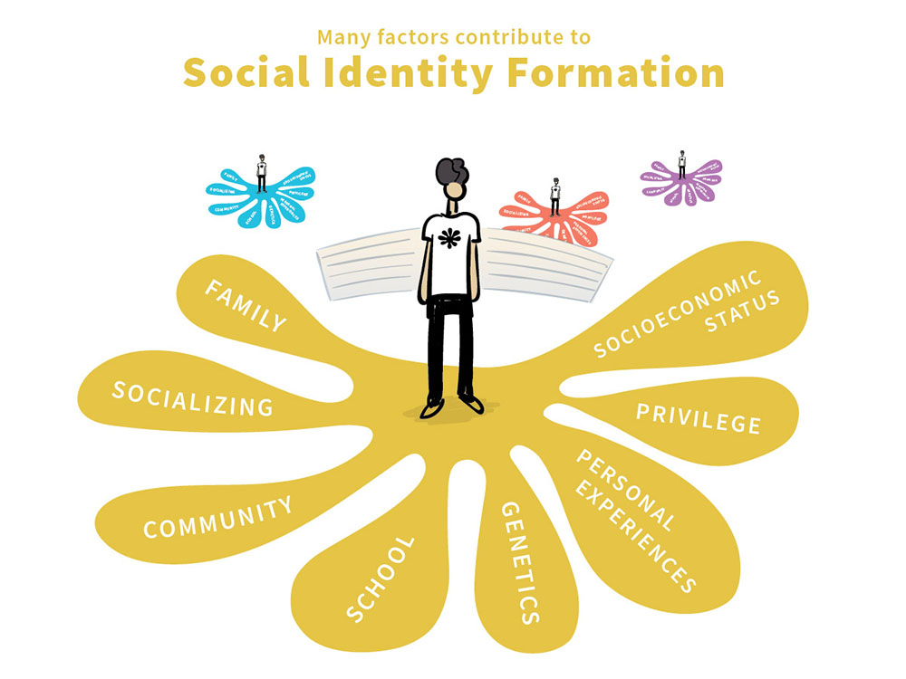

Aim of adolescence :
Identity formation
Physical including reproductive growth
Thinking & emotionality
Identity On Three Major Dimensions :
Sexual Orientation
Values and ideals
Vocational direction
IAP-Adolescent Health Academy: T-TEACH MODULE
Notes:
Through the thinking and psychosocial development, adolescents attain their major goal of forming an identity of their own. It is independent of their parents but influenced by genes. Their surroundings, including family atmosphere, schooling, societal influence, opportunities available to them and many more factors, play major roles in shaping their identity. Nature plus nurture .Hence, the role of a caretakers is very crucial in this phase of life.
By the end of adolescence, the individual has chosen a path into these three domains.

Slide 7
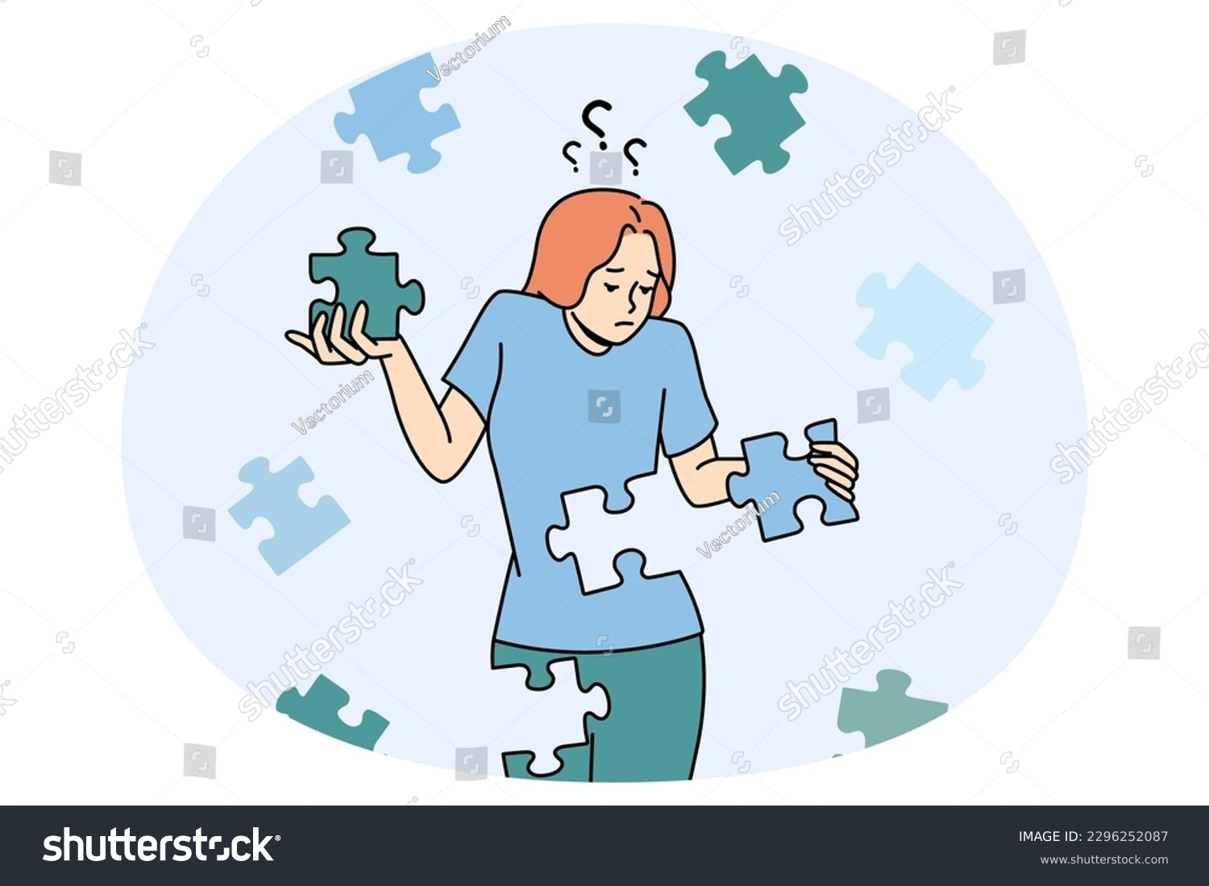
Journey of Identity formation :
Changes towards independence
How adults look at it
Distances from elders
Explores/experiments
Questions rules/norms
Breaks the boundaries
Tries to find out alternative
goals & paths
Lost in his own world
Risk taking behaviour
Disobedient, Defiant
Noncompliant, Undisciplined
Over smart
IAP-Adolescent Health Academy: T-TEACH MODULE
Notes:
Through the thinking and psychosocial development, adolescents attain their major goal of forming an identity of their own. It is independent of their parents but influenced by genes. Their surroundings, including family atmosphere, schooling, societal influence, opportunities available to them and many more factors, play major roles in shaping their identity. Nature plus nurture .Hence, the role of a caretakers is very crucial in this phase of life.
By the end of adolescence, the individual has chosen a path into these three domains.

Slide 8
Stages of adolescence: Age brackets may vary
Early (9-12 yrs)
Middle(13-16 yrs)
Late (17-19 yrs)
Bodily changes begin, earlier in girls than boys
Thinking /behaviour more like children
Curious about their growth
Bodily changes at peak
Expect recognition & importance as individuals
Nearly adult physique
Ready for self care in most domains
(ex. travel, planning, money)
IAP-Adolescent Health Academy: T-TEACH MODULE

Slide 9

Finally figures out his own unique persona
IAP-Adolescent Health Academy: T-TEACH MODULE
Notes:
Buds unfold themselves petal by petal while they bloom into flowers. They look different at different stages. Each one takes its own time and course to blossom. Similarly, children pass through their own unique ways of maturing on different domains. Their course is roughly the same, but speed may vary. Hence, we may come across children with different physical maturity and understanding capacity in the same class.

Slide 10
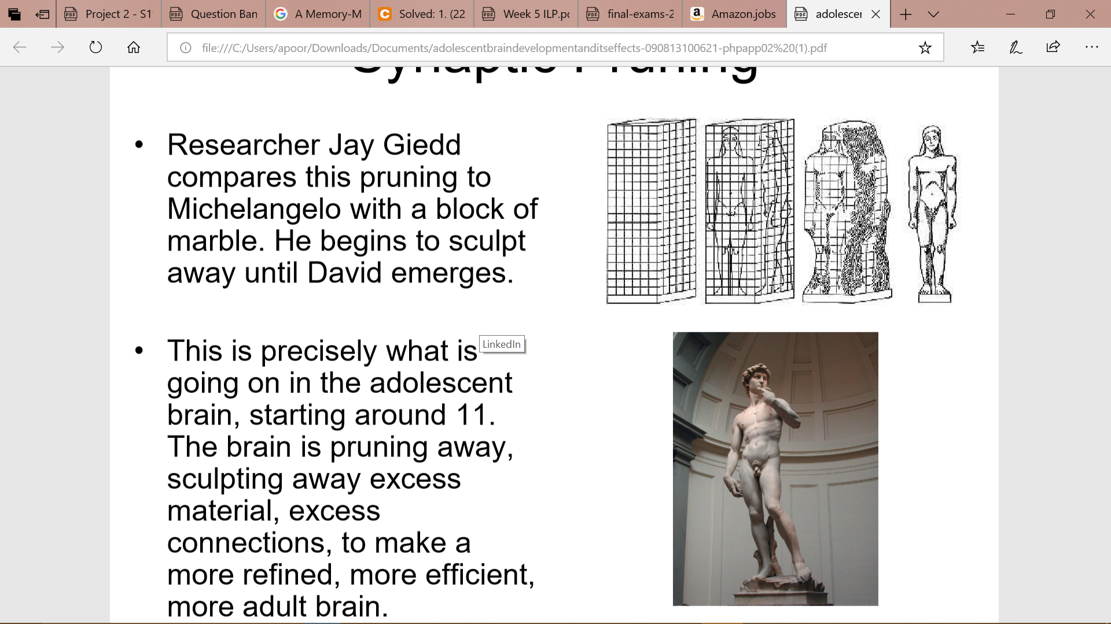
Brain – Most important part to Grow & Mature
Use it or lose it Policy:
Brain cells put to use during adolescence flourish and grow
Unused brain cells die away
Brain growth leads to acquisition of
- Higher mental functions
- Emotionality
- Socialization
Reflects as behaviours distinct from childhood
IAP-Adolescent Health Academy: T-TEACH MODULE
Notes:
There is sculpting of brain during teen years. The brain cells used during teen years become strong and parts of the brain not used during these formative years are lost. So what they learn and do, result in life time consequences. The habits, the lifestyles take their shape and the likes and dislikes make their impressions, which are difficult to erase.

Slide 11
Difference in Higher brain functions
Limited thinking capacity
Concrete thinkers, can think only of
‘observable’ things.
Primitive emotions
Sexual orientation limited to ‘gender’
Need and embrace shelter of
caretakers
Adolescents
Children
Ever expanding capacities
‘Abstract’ thinking emerges
Reading between the
lines/sarcasm
Complex emotionality
Explore and establish sexual
orientation
Need, yet defy shelter
IAP-Adolescent Health Academy: T-TEACH MODULE
Notes:
These are the differences in thought processes of children and adolescents. Children can understand only those things which have a physical existence like mass, weight, shape, size, colour, etc. As the brain develops, adolescents can think of some ideas which are only imaginary and beyond our five senses. They can understand what is an atom or how microscopic cells make our body. They understand the hidden meanings in languages like figures of speech or abstract mathematical concept. They can think of community, society beyond just a group of people and can appreciate their qualities as a group.
Children just know whether he is a boy or a girl, and the social expectations thereof, particularly for their own age. Sexuality comes into play in adolescents as an altogether different shade of personality, as the sex hormones start appearing.
Children need and desire for caretakers’ love and protection. Adolescents want to be independent, hence openly distance from the elders. But, from within, they need and desire a trustworthy place to seek comfort, during their bouncy journey to adulthood.

Slide 12

Brain is still underdeveloped
Under construction & accident prone
Actions are based on emotions
( risk taking/accident prone)
Learning new things easier than adults
(skill development is easier)
Behavioural pattern get set for life
(Habits, lifestyles, addictions )
Shape it the way you like but be careful
IAP-Adolescent Health Academy: T-TEACH MODULE
Notes:
Brain is moldable during teen years. It is like a sponge and absorbs new thing quickly.
So we have to be careful to what it is exposed and what it picks up.

Slide 13

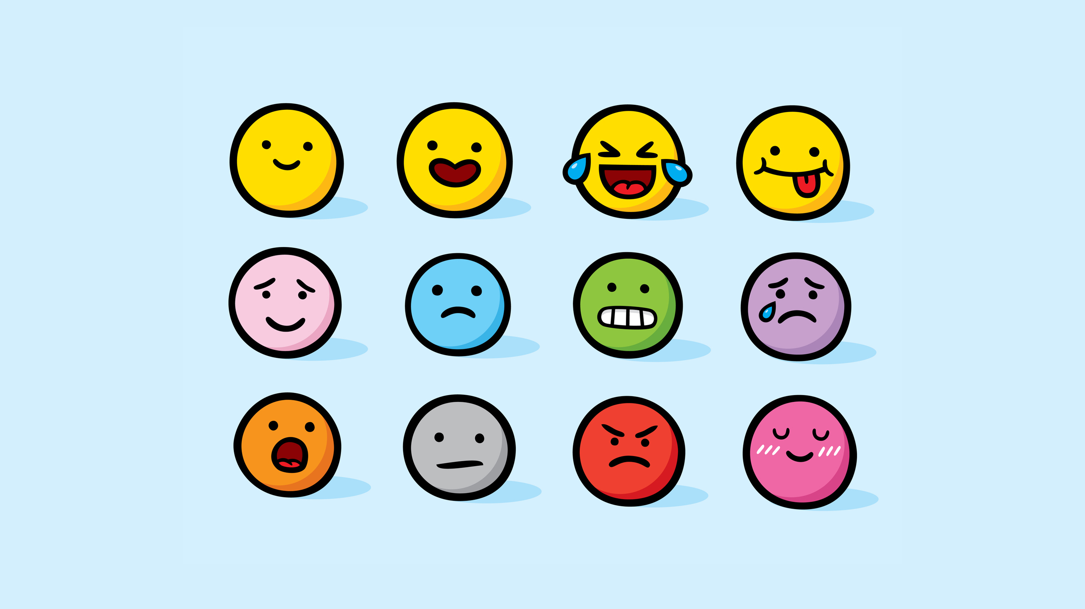

Emotional Development
Early
Middle
Late
Start experiencing different shades of emotions, hitherto unknown
Mood swings common
Easily triggered Emotions difficult to manage
Turbulence recedes
Composed with stable emotions
IAP-Adolescent Health Academy: T-TEACH MODULE
Notes:
The centre for emotions in brain ( amygdala), develops faster than, the seat for thinking (prefrontal cortex) . Hence, they display a lot of emotional instability for long period.
Anger outbursts, arguments, crying spells, irritability are commonly seen as a result of poor emotional control. Romantic love, attraction, possessiveness for persons outside of family is experienced. Getting markedly influenced by someone, a teacher, a mentor, a celebrity, a religious or social leader etc. and trying to achieve some virtues like him is common.
Mood swings last only for a few minutes to hours. Any mood deviation lasting persistently for more than two weeks needs to be addressed. Sad mood manifested by remaining aloof, not enjoying previously enjoyable activities, remaining silent, disinterested in surroundings, talking low about self, situation and future etc. I am worthless, future is hopeless, I am helpless etc.

Slide 14

Self Concept
Early
Middle
Late
Confused and apprehensive
Body image issues emerge
Self conscious
‘On stage’ phenomenon
Busy with Self exploration and introspection
Hence need a lot of privacy and independence
Dream world
Figured out about ‘self’.
Self aware about strengths and weaknesses
IAP-Adolescent Health Academy: T-TEACH MODULE
Notes:
Early adolescents are confused about their changing body and mind. They want repeated assurance that what they are going through is “ normal”. Hence they are curiously looking for knowledge in this regard, from friends and other available ( authentic/unauthentic) sources.
They always have a feeling that the world is watching them. Hence, they are very much conscious of their looks and bearing. On stage phenomenon.
In the process of defining self, the middle adolescents, they try and explore different styles of thinking and behaviour. They demand a lot of independence, privacy and ‘me time’ for the same.
By late adolescence, they have found out what type of persona they hold and are comfortably adjusted with it.

Slide 15

Relationship with parents/ Family
Early
Middle
Late
Move away from parents
Do not wish to participate in functioning of family
Challenge family rules
Test boundaries set by the parents
Argue a lot
Major rift with parents
Join the family back as grown ups
Share responsibilities
Show empathy for others
IAP-Adolescent Health Academy: T-TEACH MODULE
Notes:
For achieving self identity, adolescents need to break away from the (emotional) shelter of the parents. Hence they start distancing.
In the middle adolescents, they use their newly acquired skills on two safest platforms, the home and the school. They argue, misbehave, break the rules and try all sorts of power struggle, (basically and unknowingly to learn from it). They thus get confidence in their newly learnt abilities and feel equipped to face the larger world outside.
As late adolescents, they come back to family as independent persons and join hands with parents.
Early: Doesn’t like being instructed by parents, sulks
Middle: Openly questions and argues
Late: starts understanding parents’ intentions and view points

Slide 16
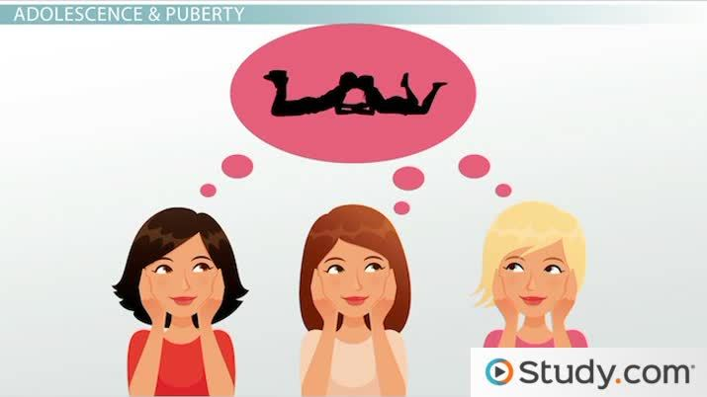

Sexual Orientation
Early
Middle
Late
Confused about bodily changes and hormonal play,
Discuss with same sex friends
Self-exploration
Start getting oriented about their sexual identity
Have crushes
Seek opportunities to indulge
Adult sexual orientation is finalized
May commit for long term relationship
IAP-Adolescent Health Academy: T-TEACH MODULE
Notes:
With the new hormonal surges and the sexual urges, early adolescents seek solace in their peers. Sharing perceptions (presented as knowledge) is common, more so with wide media usage. Self exploration is almost universal.
Middle adolescents face even more of the hormonal dance within. Self gratification naturally follows. Simultaneously, they start getting idea of their homo, hetero, or bisexual orientation. They fall for their crushes accordingly . They indulge in a lot of sexual experimentation.
In late adolescence, the sexual orientation is well established. Long term commitments may follow.

Slide 17

Implications on Classroom Academics
Early
Middle
Late
Rote learning reduces
Concrete concepts like algebra, basic physics, grammar are comprehensible
Abstraction may be introduced,
Higher level Maths, science, powers of speech are appreciated
Abstraction further easy to understand
Trigonometry, Space science, molecular biology, Philosophy, complex art and literature become fascinating
IAP-Adolescent Health Academy: T-TEACH MODULE
Notes:
This slide explains how the curriculum could be designed according to cognitive stages.

Slide 18
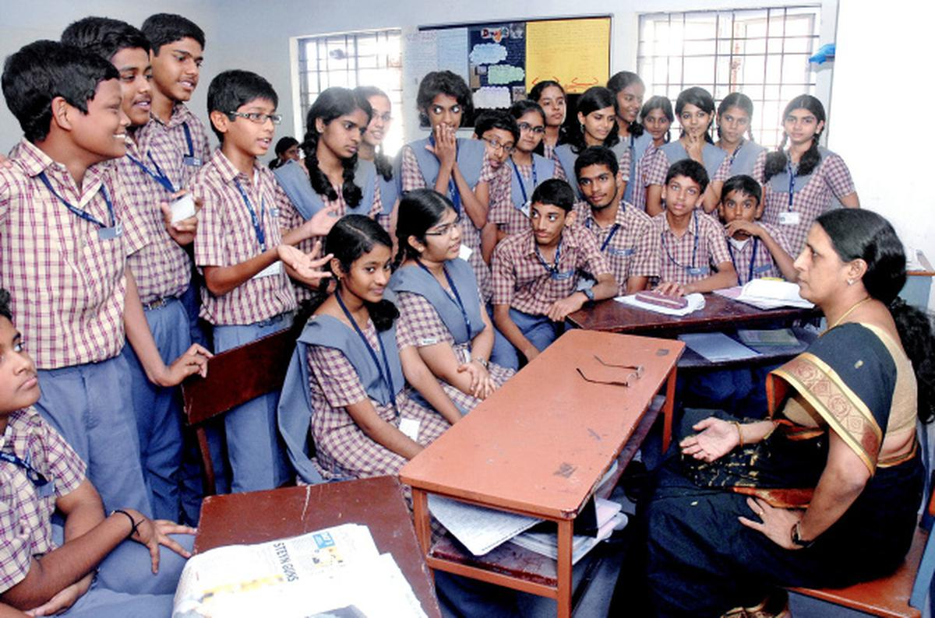
Implications on Classroom Behaviour
Early
Middle
Late
Not as obedient as younger children,
Form close groups
Teacher is judged and commented upon.
Class room behaviour decided by peer influence
Fitting in the group is main concern
Appear undisciplined
Focused if areas of interest and aptitude are offered,
Can better work as a team
Bubbling with confidence
IAP-Adolescent Health Academy: T-TEACH MODULE
Notes:
For children, teacher is an ideal person and follow her faithfully. It is no more so as adolescence sets in . They understand that teacher is not perfect.
Early teenager-Not as obedient as younger children,
Form close groups
Teacher is judged and commented upon.
Middle teenager -
Foster Inclusion: Create a supportive environment where all students feel accepted, reducing the pressure to "fit in" by celebrating diversity and individuality.
Set Clear Expectations: Establish and consistently enforce clear boundaries while explaining their importance, helping students balance group belonging with discipline.
Engage Actively: Incorporate interactive and relatable teaching methods that resonate with their need for social connection and reduce perceived undisciplined behavior.

Slide 19

Situation 1:
Class sixth students tease a new, intelligent classmate for being fat.
In spite of teacher’s requests, they do not allow him to be a part of their games and ridicule him.
Cliques and gangs – Restricted entry
Bullying
Outliers in any fields .. Physical, academic etc.
Most have been bullied earlier … chain continues
IAP-Adolescent Health Academy: T-TEACH MODULE
Notes:
Early adolescents form gangs. They are rigid regarding whom to accommodate and whom to refuse.
Students who are different from the average group members are less likely to be accommodated.
Toppers, achievers and bookworms are outcast by average students.
Accepting the differences is not very easy.

Slide 20
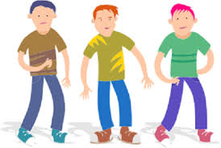
Early Adolescence (9-12 yrs)
Thinking pattern
Outcome
Mainly concrete thinking
Focus on ‘here and now’
Cannot connect past
experiences to present
Immature emotionality:
Unable to take a different stand from
the group.
Cannot foresee that he might be
helpful for someone else.
Not able to infer from experience of
self-bullying
Lacks empathy, Do not understand
how to express their feelings
IAP-Adolescent Health Academy: T-TEACH MODULE
Notes:
At this stage, the adolescents live for the moment. They can not connect past or future with the present.
Hence “study hard if you want to be a doctor” carries no meaning . Instead, they would happily study for an immediate reward like a pat from the teacher.
This poor connection makes them commit “silly” mistakes.
Since they can not find out alternate pathways, they get fumbled by small hurdles.

Slide 21

Situation 2:
Class eighth teacher notices that most of the boys in her class have grown long hair. She asks them to cut them short, but they pay no
heed to it. What could be the cause?
Peer affiliation --- fear of being left alone
Challenging the authority
Experimentation
Role modelling (? through media)
IAP-Adolescent Health Academy: T-TEACH MODULE
Notes:
Peer affiliation : following the group norm, is the most important for adolescents. They disobey the elders and choose to be with their peers.
They sometimes just want to test the waters… and check how the teacher reacts
Experimentation and trying out new styles, new ideas, new hobbies, new concepts is a part of growing up.
It might result from following the current trend.

Slide 22
Middle adolescence: (13-16 yrs)
Thinking pattern
Outcome
Abstract thinking starts taking shape
Thinking for future is possible
Craving for rewards
Start questioning
In stress and crisis, revert back to
concrete thinking
Looks matter
What if my friends leave me?
Appreciation by classmates
Who is the teacher to tell us?
Appear childish sometimes
IAP-Adolescent Health Academy: T-TEACH MODULE
Notes:
In this stage, adolescents start thinking beyond what is observable. They can understand abstract concepts of higher mathematics, science and literature.
They can think of possible consequences of current actions, but only in calm state of mind. During any type of stress, they revert back and are highly likely to commit mistakes. Peer pressure, exam anxiety, threat to self esteem, relationship issues etc are stressors which culminate into impulsive high risk behaviours.

Slide 23

Situation 3:
11th standard students agitate in front of the school office for not allowing them to participate in the district sports tournaments.
What could be the reasons behind this behaviour?
Faiths/beliefs/passion
Social justice
Teaming with likeminded people
Fight for the cause
IAP-Adolescent Health Academy: T-TEACH MODULE
Notes:
Abstraction widens and late teenagers can think beyond themselves.
As the likes and dislikes become more clear, late adolescents know for what they should fight.
They are also attached strongly to their chosen paths of thoughts and actions.
If sports is their passion, they will vehemently vouch for it.
They can now view the situation in the context of a group that is being dealt with by an authority. Concept of justice is understood and checked.
Social sense makes them think and act cohesively.
In case of children, team-work needs to be supervised by elders. Adolescents can navigate themselves in flocks.

Slide 24
Late Adolescence(17-19 yrs)
Thinking pattern
Outcome
Abstract thought process well
established
Multidimensional thinking
Can evaluate one’s own thought
process
Values & ethics take shape
Socially aware
Can make out hidden sense out of
situations
Decision making becomes easy
Self aware about strengths and
weaknesses
Act in accordance with beliefs,
enjoys teaming with likeminded
people
IAP-Adolescent Health Academy: T-TEACH MODULE
Notes:
Think of what is ‘possible’, beyond what is ‘observable’. Can derive meanings out of actions and intentions.
Can understand others’ point of views. Agrees to differ from others’ thought processes and prefers sticking to his own values and beliefs.
More aware of burning social issues, develops his own opinions about them.
Can think of pros and cons of actions.
Understand long term consequences of current actions

Slide 25
Behaviour
Normal Worrisome
Conscious about looks
Mood swings that last for few hours
Getting annoyed easily
Experimenting with substances
online games/porn
Romantic relationships
Vigorous gymming/dieting
Visiting beauty clinics frequently
Low or extremely high mood
lasting for >2weeks
Aggression/destruction
Habituated to thrill seeking
Abuse/sexual activities
IAP-Adolescent Health Academy: T-TEACH MODULE
Notes:
Recurrently looking in the mirror, dressing hair, styling like celebrities, wishing to have perfect figure etc. are all normal and a temporary phenomenon.
But when the thoughts actions and feelings keep the teen over occupied and disturb his daily routine, studies or relationship with others, it is a cause of concern.
Ups and downs of mood are normal as long as they subside in a span of hours and do not result into abrasive or harmful behaviours for self or others.
Most teens will try out some thrilling experiences like a substance abuse, speedy driving, breaking the rules, visiting night clubs, playing online games, watching porn. As long as they exert control and stop doing so timely, there is less likelihood of a long term consequence. It should be handled with an attitude of concern without being punitive. As caretakers, we should always promote total abstinence from these activities, better as an anticipatory guidance.
Crushes, attractions and sexual experimentations are part of growing up. They should be dealt with non- judgmentally. The risks of unprotected sexual activity and POCSO should be explained to them to save them from being a victim or a culprit. In India sexual intimacy among teenagers, even consensual, below the age of 18 is a crime.

Slide 26

Atypical Behaviour:
Recurrent/Sudden/Severe/Increasing/lasting for more than 15 days
Any behaviour that is not as per the developmental stage
Sudden changes in mannerisms/self talk/self laug
Overactivity/overtalkativeness/inattention
Destructive behaviours/lying/stealing/weapon use
Refusal/chronic absentism/Truancy from school
Anger, aggression : Recurrent/ Out of proportion for the cause
Low mood/Self harm/suicidal acts /thoughts
Addiction- substance abuse/gadget/porn
IAP-Adolescent Health Academy: T-TEACH MODULE
Notes:
These behaviours indicate significant mental health disturbances. They are discussed in details in other modules.

Slide 27

Activity: Case scenario -1
How will the adolescents of the three different stages react to the following situation?
Students hear teachers fighting inside the staff room.
Early ( 10-13 years)
Middle ( 14-16 years)
Late (17-19 years)
IAP-Adolescent Health Academy: T-TEACH MODULE
Notes:
Here, we are trying to recollect the thought processes of different stages of development, from primitive thinking to higher abstraction.
The presenter should read out the situation and ask the participants to narrate how the adolescents in three different stages would most likely respond?
The next slide should be shown at the end of the discussion.

Slide 28
Probable reactions
Early
Middle
Late
Might feel confused, scared, or anxious
Unrealistic fears about the teacher may leave the school
May blame self
Criticize the teachers
Taunt the teachers in groups
May create ruckus in the class
May feel less connected
Confront their teachers directly, may question their behaviour
Express their concerns openly.
Understand that disagreements between colleagues are normal.
IAP-Adolescent Health Academy: T-TEACH MODULE
Notes:
Early Adolescents : This age group is still developing a sense of security and understanding of relationships, so witnessing conflict can be particularly unsettling.
They may feel sad or guilty, may or may not fully understand the reasons behind the conflict, which can lead to misconceptions or unrealistic fears about the breaking apart.
Middle adolescents may experience a mixture of emotions, including anger, embarrassment, or sadness
They might react by distancing themselves emotionally from the teachers/school, , seeking solace with friends . Discuss with friends and family. Alternatively, some may engage in argumentative or defiant behavior, reflecting their internal conflict.
Adolescents in this group have a better understanding of relationships and may try to rationalize the arguments, sometimes blaming one teacher over the other something they should solve or mediate.
Late adolescents individuals have a more mature understanding of complex relationship dynamics They might choose to confront their parents directly about the conflict or express their concerns openly. Others may opt for avoidance, or immersing themselves in personal activities or relationships to cope.
They are more likely to view the conflicts in context, understanding that disagreements can be a normal part of relationships, but they may also critically assess how conflicts are managed.
Disheartened, as teachers are role models.

Slide 29

Activity: Case scenario - 2
The teacher scolds the student in the class,
“Are you mad? How can you make such a silly mistake?”
What would be the emotional reaction in a child and in adolescent of
each of the three stages?
IAP-Adolescent Health Academy: T-TEACH MODULE
Notes:
Here, we are revising the psychosocial framework of different developmental stages. The presenter should encourage the discussion, before showing the results on the next slide.

Slide 30
Likely answers:
Child:
Early
Middle
Late
Sad at losing teacher’s love
Ashamed
Loses
self esteem
Depends on peers
Indifferent, neutral if they appear supportive
If not, angry, may argue defends self
Hurt but introspects,
May put up his case logically
May attribute scolding to teacher’s personal shortcomings
IAP-Adolescent Health Academy: T-TEACH MODULE
Notes:
For children, teachers are very important. They seek attention, rewards and love from teachers.
Early adolescents are confused about self. They lose self esteem very easily, more so if if humiliated publicly. Such a remark makes them feel guilty and lose confidence.
For middle adolescents, peers are more important that teachers. They are fine with misbehaving as long as they get their peers’ approval. They may take irritating the teacher as an achievement. If teacher shouts at them in front of others and the peers distance from them on that issue, they feel insulted, get agitated or nervous.
Considers peer reaction, indifferent, neutral if they appear supportive…
if not, gets irritated and angry, may argue illogically, defends self vehemently
Late adolescents are mature to look into why teacher is getting angry. They are likely to understand and accept their mistake. They may feel hurt and sad but can think from other perspectives as well.

Slide 31

How to use this window of opportunity
Let them :
Explore their life
Decide for themselves
Learn through mistakes
Express through art
Know and nurture each other
Get together for a cause
Adolescent Development –
the last leap
IAP-Adolescent Health Academy: T-TEACH MODULE
Notes:
Adolescence is the last chance to help brain grow maximally. By systematically planning useful strategies, caretakers can help in enhancing their potentials and make them more productive.
Don’t stop them from taking new experiences.
Let them take decisions and feel; confident.
. Let them learn from mistakes. Just be by their side.
Offer various art forms and platforms. They express their concerns, emotions and find solace and solutions through writing, painting, drama, dance etc.
Let them spend a lot of time with their peers. That is how they learn socialization beyond family.
If they are teaming up for a good reason, they should be encouraged. They might not learn all these things through their curriculum and formal learning, but such experiences make them more competent to live by themselves and take their and others’ care.

Slide 32
Provide Learning Moments
Engage in hands-on STEM projects - (Science, Technology, Engineering, Math) Logical reasoning, creativity, experimentation, and technical skills
Creative Storytelling and Role-Playing
Imagination, empathy, narrative development, and situational analysis
Strategy Games and Board Games
Strategic thinking, planning, adaptability, and foresight
IAP-Adolescent Health Academy: T-TEACH MODULE
Notes:
Activity: Engage in hands-on STEM (Science, Technology, Engineering, Math) projects or experiments, such as building a simple robot, coding a basic game, or conducting a science experiment. For Logical reasoning, creativity, experimentation, and technical skills.
Sports, Strategy Games and Board Games
Strategic thinking, planning, adaptability, and foresight.
Utilize online platforms that offer simulations or problem-solving challenges, like coding challenges on Code.org or financial literacy simulations.
For Digital literacy, logical thinking, and adaptive learning

Slide 33

Offer Healthy Challenges
Peer Learning Connections: Allow peers to critique each other’s schoolwork, establish a peer governance system in school.
Affective Learning: Let them express their Emotions music, painting.
For Healthier PFC Development: Offer occasions to choose.
Brain is built for risks and sensations –Role-play different responses, discussing the potential outcomes of each decision.
IAP-Adolescent Health Academy: T-TEACH MODULE
Notes:
Play strategy games like chess, checkers, These games require players to think ahead, strategize, and make decisions based on limited information.
Encourage teens to volunteer or participate in community service projects. Working on projects like organizing a charity event or helping at a local shelter can involve problem-solving on the spot.

Slide 34
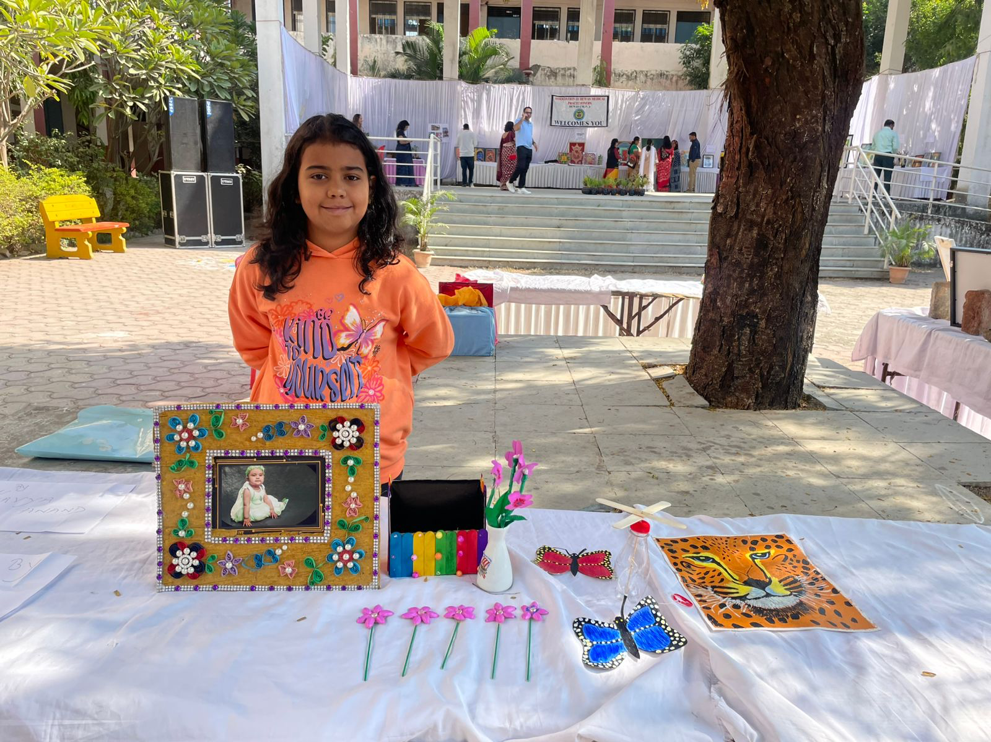
Life skills: Expressions through arts
Creative Storytelling and Role-Playing
Imagination, empathy, narrative development, situational analysis.
DIY and Craft Projects
Resourcefulness, creativity, practical problem-solving
Journaling and Reflection
Self-awareness, reflective thinking, emotional regulation
Affective Learning:
Emotional control through music, painting, murals, best out of waste etc.
IAP-Adolescent Health Academy: T-TEACH MODULE
Notes:
Organize storytelling or role-playing sessions where teens create and act out stories that require characters to solve a problem. This could be done in person or through writing exercises.
Do It Yourself
Skills Developed Engage teens in DIY projects, like building a birdhouse, crafting, or creating art from recycled materials. These projects require planning, creativity, and adaptability to complete.
Journaling and Reflection. Encourage teens to keep a journal where they write about challenges they face and brainstorm potential solutions. They can reflect on past experiences and how they handled them
Each of these activities provides a unique opportunity for teenagers to practice and enhance their problem-solving abilities in a fun and engaging

Slide 35

Collaborate with students
Peer Learning Connections: Make study groups to help each other
Per educators for adolescent health issues
Volunteer Work and Community Service for the needy
Gender Equality
Inculcating Civic sense : Traffic rules, Environment protection
Self care: Healthy habits, self connection, mindfulness, meditation
IAP-Adolescent Health Academy: T-TEACH MODULE
Notes:
Allow peers to critique each other’s schoolwork, establish a peer governance system in school.
Volunteer Work and Community Service
Resource management, empathy, leadership, and real-world problem-solving.

Slide 36

Further tips:
Simplify tasks and requests
Many things are incomprehensible for immature brain.
Repetition is imperative/necessary
Use your warmth, empathic caring, and positive regard
Aim for an environment that decreases negativity
Fosters learning … curricular as well as co curricular!
IAP-Adolescent Health Academy: T-TEACH MODULE

Slide 37

Lets Sum Up
Adolescence is a phase marked by growth & internal conflict
Teen behaviour reflects growing brain capacities.
Predominance of emotionality results in misbehaviour
Atypical behaviour needs to be picked up & addressed appropriately
Throughout their journey teenagers need compassionate support.
Teachers have obligation to use this window of opportunity for teens/societal well being.
IAP-Adolescent Health Academy: T-TEACH MODULE
Notes:
Adolescence is a transient phase of confusion while heading toward independence.
Teen behaviour reflects growing brain capacities
Predominance of Emotionality results in misbehaviour
Atypical behaviour falling beyond normalcy needs to be picked up and addressed appropriately.
Teenagers need compassionate support of care takers throughout their journey
Teachers should use this window of opportunity for societal well being .

Slide 38

Wishing you all Happy Teaching…
IAP-Adolescent Health Academy: T-TEACH MODULE

