Slide 1


T –Teach Module
T –Teach Module
(Teachers’ Training and Empowerment in Adolescent Care and Health)
IAP -AHA’s -Training Module for Teachers
IAP-Adolescent Health Academy: T-TEACH MODULE

Slide 2

IAP-Adolescent Health Academy: T-TEACH MODULE

Slide 3
Concept
Adolescence is a crucial stage in an individual's life marked by physical, social, emotional, and cognitive changes. During this period, adolescents require guidance and support from various sources, including teachers.
Teachers, as important stakeholders, play a significant role in the overall development of adolescents and their well being, as they spend a considerable amount of time with them in school settings.
Therefore, it is essential to equip teachers with the necessary skills and
knowledge to effectively support and care for adolescents.
IAP-Adolescent Health Academy: T-TEACH MODULE

Slide 4

IAP-Adolescent Health Academy: T-TEACH MODULE

Slide 5
T –Teach Module
Dr Shubhada Khirwadkar (National Convenor)
Dr Swati Ghate (Academic editor)
Dr Nishikant Kotwal (National Co-ordinator)
IAP-Adolescent Health Academy: T-TEACH MODULE

Slide 6
Topics &Contributors
Understanding Adolescent Behaviour: Dr Swati Ghate, Dr Poonam Bhatia
Handling Teens with problematic behaviour: Dr Sushma Desai, Dr Ashim Ghosh
Dealing with silently suffering Teens(Mental Health Concerns): Dr Sunita Manchanda, Dr Geeta Bansal
Dealing with disorders of Learning: Dr Newton Luiz, Dr Chitra Sankar
The good and the bad about Media: Dr Geeta Patil, Dr Prashant Karia
IAP-Adolescent Health Academy: T-TEACH MODULE

Slide 7
Topics &Contributors
Substance abuse - What teachers should know: Dr Chitra Dinakar Dr Shilpa C
Understanding Teen Sexuality: Dr Himabindu Singh, Dr Sushma Kirtani
Positive discipline: Dr Shubhada Khirwadkar, Dr Kalyani Patra
Promote Healthy Life Style: Dr Shamik Ghosh, Dr Shalini Bhasin
Communication Skills and self help: Dr Nishikant Kotwal, Dr Chitra Kulkarni
Prevent , Empower , Stand Strong (self defense): Dr. Jayashree Deshpande
IAP-Adolescent Health Academy: T-TEACH MODULE

Slide 8
Reviewers
Dr Swati Bhave
Dr C P Bansal
Dr Sukanta Chatterjee
Dr Preeti Galagali
Dr Samir Shah
Dr Piyali Bhattacharya
Dr Atul Kanikar
Dr Atanu Bhadra
Dr R G Patil
Dr R N Sharma
IAP-Adolescent Health Academy: T-TEACH MODULE

Slide 9

Substance Abuse
What teachers should know?
Dr Shilpa Chandrashekaraiah
Dr Chitra Dinakar
IAP-Adolescent Health Academy: T-TEACH MODULE

Slide 10

Learning objectives
What are Drugs?
What are the commonly misused drugs & their effects?
Why do adolescents take drugs?
Life skill education for substance abuse prevention
Role of an Adolescent friendly school to STOP DRUG ABUSE
IAP-Adolescent Health Academy: T-TEACH MODULE
Notes:
The non medical use of substance including drugs that changes an individual’s mental health and affects all dimensions of health adversely is known as substance misuse.

Slide 11
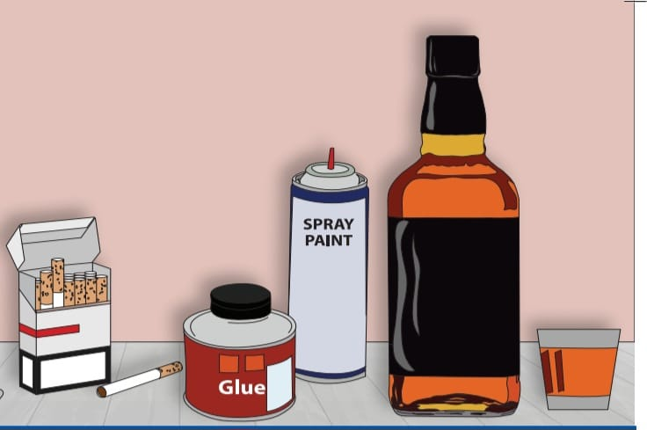
What are Drugs?
A chemical when taken into the body(for non medical purposes) changes mood or thinking process.
  Affects both mind and body.
Prolonged use
  may lead to physical and/or psychological dependence (called addiction)
An overdose of any drug may lead to death.
IAP-Adolescent Health Academy: T-TEACH MODULE
Notes:
The non medical use of substance including drugs that changes an individual’s mental health and affects all dimensions of health adversely is known as substance misuse. Substance use during adolescence interferes with health brain development, leads to adverse outcomes like injury, school dropouts, financial issues, criminality, loss of life, higher rates of physical and mental illness & also potential for progression to addiction.

Slide 12


Substances are divided into the following categories:
LICIT:
NOT prohibited (some regulations by law on
sale/advertisement/packaging and marketing)
Ex. tobacco, cigarettes, alcohol, khat and coffee
Not to be used under <18 /< 25yrs
(varies as per State)
ILLICIT:
ARE prohibited by law (penalty or consequences for use/possession/sale)
Ex. cocaine, heroine, cannabis (marijuana & hashish).
Not to be used ever
IAP-Adolescent Health Academy: T-TEACH MODULE
Notes:
All categories of drugs cause ill health and have potential for addiction. Different states in India have different cutoff ages for use of different licit substances. Example 18 yrs for smoking, 21 yrs for alcohol in some states and 25 yrs for alcohol in some other states. Some states are dry states for alcohol.

Slide 13
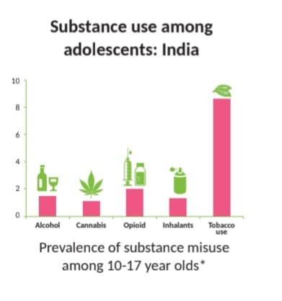
Substance use among adolescents (%): India
(RKSK guidelines, Participant’s handbook, for Training of Medical Officers on Adolescent Friendly Health Services, Substance Misuse, 2014)
IAP-Adolescent Health Academy: T-TEACH MODULE
Notes:
Slide bars show Alcohol, cannabis , opiod, inhalants (glue, thinner, petrol etc),(2-3% use) tobacco.(10% use) Common substances used in IndiaTobacco,Alcohol,Marijuana,Cannabis,Inhalants( fumes of household cleaners, glues, adhesives, paints, thinners, petrol, whiteners, nail polish removers, shoe polish and pens). Cannabis: bhang considered legal while ganja(marijuana) and charas( hashish) are illegal. Tobacco consumed as gutkha, khaini, zarda or smoking as cigarettes and e cigars. Alcohol such as beer, vodka, rum, whisky though society has approved in moderation REMEMBER the message should go out straight that NO SUBSTANCE USE AMONG ADOLESCENTS.

Slide 14
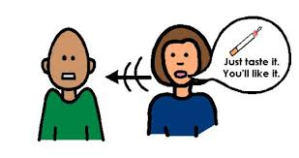
Why do teens try drugs?
To experiment/Curiosity - see what it’s like
To have a good time with friends/ due to peer pressure
To feel good or get high/enhance performance
To relax or relieve tension
To relieve physical pain
IAP-Adolescent Health Academy: T-TEACH MODULE
Notes:
Why are some teens more vulnerable? Though they know it is harmful? Usually they have poor positive coping , parents /family members may be using drugs, drugs may be freely available to them, close friends may be using and they may try drugs just to show that they are bold or can belong to the group. Sometimes they use to keep them awake for studies/sports participation too.The incidence among adolescence is increasing due to changes in lifestyle, family structure, peer pressure, lack of coping skills, lack of guidance, influence of media, lack of media literacy, easy availability and desire to experiment
The vulnerable groups being males, illiterate teens, unemployed, street children, school drop outs, college campuses, hostels, abused adolescents, those with mental disorders or chronic diseases.

Slide 15
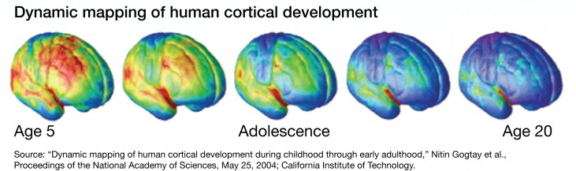
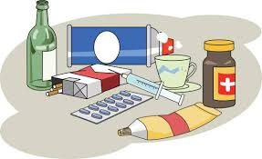
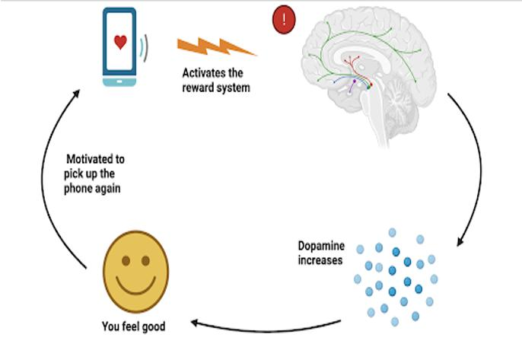
Why adolescents fall into the trap of Substance Misuse ?
Motivated to use again
Immature brain seeks reward centre activation . No maturity to judge consequences.
Addiction risk is 8 fold !
IAP-Adolescent Health Academy: T-TEACH MODULE
Notes:
Adolescence is a period of exploration and experimentation. Many risky behaviours like substance abuse have their onset in adolescence. Substance use before the age of 18 years is associated with an eightfold greater likelihood of developing substance dependence in adulthood. Even the first use of a substance may result in tragic consequences of injury/fatality/drug crime correlation or victimization e.g cannabis intake is linked with murder, inhalants with rape and opioids with snatching related crimes...When someone experiences something rewarding or uses an addictive substance, neurons in the dopamine-producing areas in the brain are activated and dopamine levels rise and makes them to feel good. Potential risks are likely to be greater in adolescence – a period of greater biological, social and psychological transitions, than in adulthood. Brain regions associated with a desire for attention, feedback, and reinforcement from peers (The limbic system) become increasingly sensitive beginnings in early adolescence and regions associated with mature self control: prefrontal cortex is not fully developed until adulthood. Parental monitoring and developmentally appropriate limit setting thus is critical.Addiction means inability to stop the use or craving! Substance controls the person rather than person controlling the substance(when to use/how much to use/not to use etc)

Slide 16
Harmful effects of Substance Misuse
PHYSICAL HEALTH
EMOTIONAL HEALTH
SOCIAL
Excessive Sleepiness
Unusual tiredness
Sudden weight loss/gain
Tremors
Slurred speech
Unsteady gait
Frequent colds/wheezing
Headache/stomach ache
Loss of memory
Poor concentration
Unable to complete school work on time
Aggression
Mood swings
Loss of interest in daily activities/studies/play
Unable to maintain regular schedule or routine
Withdrawal from friends & family
Making secretive phone calls/other secretive behavior
Breaking rules, stealing money or lying
Truancy from school
Spending a lot of time outside home
Demanding money
Spending excessively
Having substance using friends
IAP-Adolescent Health Academy: T-TEACH MODULE
Notes:
As you notice all symptoms(complaints) and signs(what you see) are nonspecific. If a teen has vague aches and pains and is suddenly doing badly in studies/play, getting into fights with friends/family/teachers/authority, you could suspect drug use. Teens don’t reveal the same. We need to get indirect clues as above

Slide 17

Red Flag Signs-Clues to Substance Misuse
Efforts to mask the smell
Avoiding eye contact and hug by parents
New set of (senior) friends
Social isolation with lack of interest in activities previously enjoyed
Scholastic deterioration
Poor hygiene, altered appetite and sleep pattern
Changed preference for movies and music which depict high action
Unexplained irritability and increasing conflicts
Spending extra time in the toilet
Stealing money or valuables from home.
Stains on teeth and clothing
IAP-Adolescent Health Academy: T-TEACH MODULE

Slide 18
Stages of Drug Abuse
Various stages can be memorized by the simple acronym T.R.A.P
T: TRIAL OR EXPERIMENTATION
R: REGULAR OR RISKY USE
A: ABUSE OR DEPENDENCE
P:PHYSICAL OR PSYCHOLOGICAL ADDICTION.
Catch it early to make a difference! Zero tolerance to any drug use is the best approach. Prevention is always better than cure
IAP-Adolescent Health Academy: T-TEACH MODULE
Notes:
TRIAL: experimentation can occur without the desire to continue drug use but may lead to regular use
REGULAR USE: loss of coping skills and social functioning decreases
ABUSE: Continued use despite the social and legal cosequences and preoccupation with the drug.
PHYSICAL/psychological ADDICTION: Withdrawal symptoms(headache,tremors,diarrhoea and irritability/unruly behaviour/anger

Slide 19

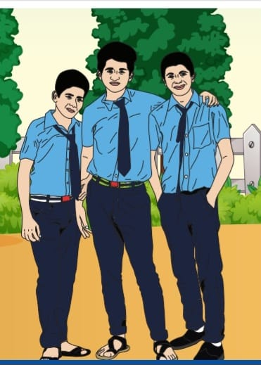
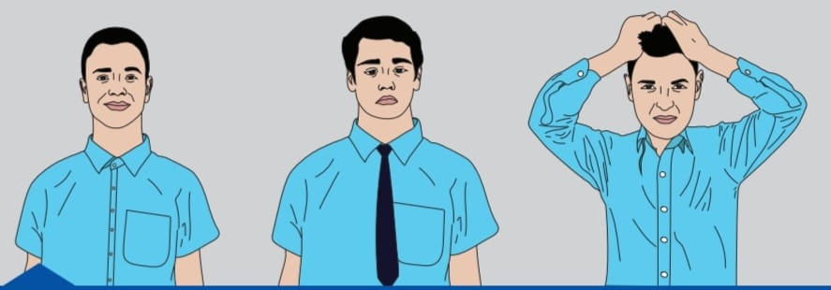
Amar’s Story: An allrounder, he was not able to say no to his friends, tried alcohol and faced the consequences
Did Amar make the right choice?
IAP-Adolescent Health Academy: T-TEACH MODULE
Notes:
Amar’s STORY: Amar studying in class X was a meritorious student, good in both academics and extracurricular activities. He had many friends too.. His friends suggested that he try alcohol. Wanting to fit into the group, under peer pressure, he yielded to his friends and it was found in his water bottle one day....when another student took a sip and complained to the teachers! How should we handle this? Can he be taught to say NO to peer pressure & how? Lets see....

Slide 20
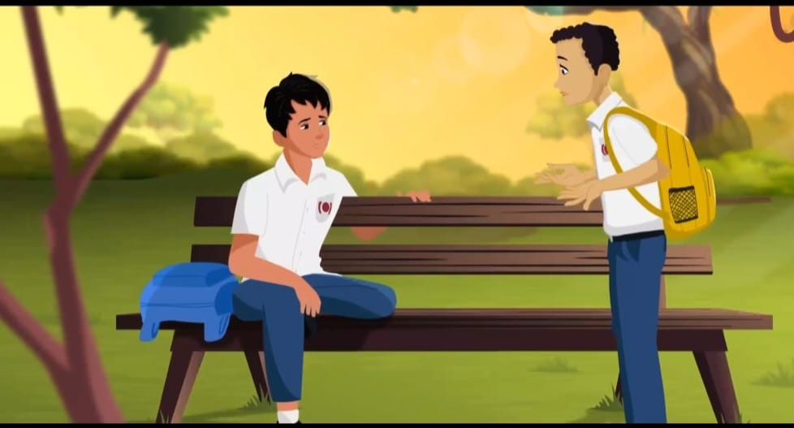
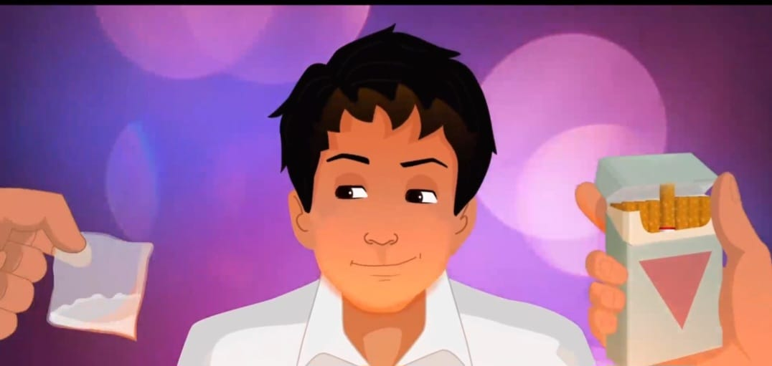
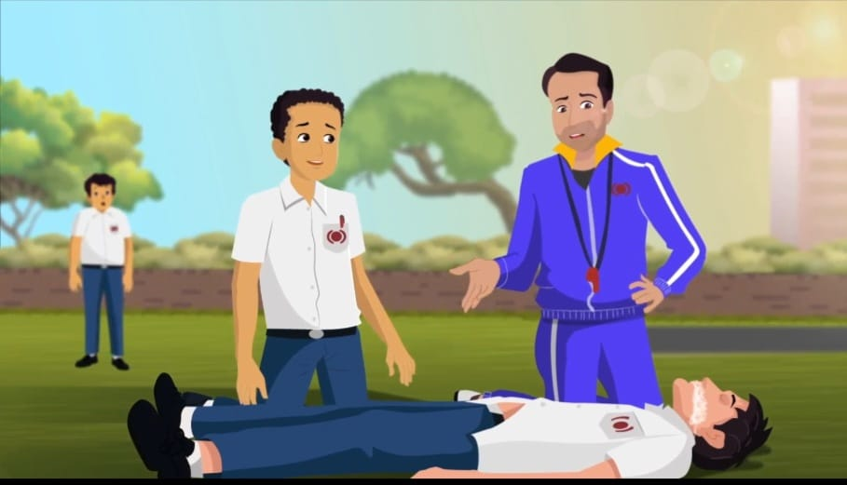
Sunil’s Story: A cricketer, started abusing drugs hoping to improve performance. Resulted in a serious outcome
Needed to be rushed to the hospital emergency !
IAP-Adolescent Health Academy: T-TEACH MODULE
Notes:
Sunil was a state level cricket player at his school. He was preparing for his upcoming tournament and was very stressed about his performance. With the intention to accomplish his dreams to perform better and to reduce his stress, he gave in to smoking (as suggested by a senior)and then to other drugs, which seemed to give him more energy and enthusiasm initially. This continued from days to weeks and then to months, when one day he was seen like this....unconscious in the field.

Slide 21
ACTIVITY
What do you understand by the term Drug use?
How will Drug use harm Sunil or Anil?
How can Anil and Sunil overcome this challenge and get back to normal life
What do you understand by the term Drug abuse?
Which aspects of health are affected by drugs abuse?
How can Amar overcome this challenge and get back to
normal life?
How can you help Sunil?
IAP-Adolescent Health Academy: T-TEACH MODULE
Notes:
Lets see answers to all these questions.....First of all any drug used for non medical use amounts to drug abuse. Drug ABUSE IS CONSUMPTION OF ANY illicit drugs < 18 years or any IILLICIT DRUGS irrespective of their age, it not just means reaching a point of addiction (when it interferes with health and normal functioning) Any drug use, even occasional, can lead to drug abuse or addictive use , when user has no control, and experiences harmful effects. Adolescents are more at risk for this due to their immature brain. Therefore we need zero tolerance for any drug use . All students should be taught to ‘say NO “ to drugs and never use it anytime, even in small quantity.
Do’s: If found to be using any substance, speak one on one to the student, explain the ill effects of Substance Misuse, risk of addiction and how to break the habit. Refer those already severely addicted(like Sunil), to a paediatric/adolescent doctor for help in stopping use .
Dont’s: Do not punish the child, don’t complain immediately to authorities without first talking to the child, don’t be judgemental, don’t make it shameful by using insulting words in public/in front of peers.
Remember that the adolescent is a victim of the drug and a victim of ignorance/poor coping and not a criminal. The true criminal is the drug and the circumstances of availability and sale.

Slide 22
ROLE OF TEACHER..What can a teacher do ?
Do’s
Don’ts
Talk one on one with adolescent
Be empathetic & find out the details
Be kind, helpful and supportive
Inform on immediate consequences
Be calm and inform parents & school authorities
Inform about and follow rules of institution
Shame or insult in front of peers
Judge the adolescent
Be rude and hurtful
Completely wash your hands off the matter
Don’t make a big issue out it
IAP-Adolescent Health Academy: T-TEACH MODULE

Slide 23
Prevention of Substance use in children
ROLE OF TEACHERS
What do you understand by the term Drug use?
How will Drug use harm Sunil or Anil?
How can Anil and Sunil overcome this challenge and get back to normal life
Teach life skills to enhance their self esteem and self confidence.
Help them develop positive coping, assertive skills, critical thinking and communication skills.
Have a good teacher student bond built on respect and understanding
To communicate and teach children about the risks of drug use/ misuse.
Establish rules and consequences.
Praise kids for appropriate behaviour.
IAP-Adolescent Health Academy: T-TEACH MODULE
Notes:
Life skills are a set of abilities that help people deal with everyday challenges and problems. The 10 essential WHO life skills include self awareness, empathy, effective communication, critical and creative thinking, decision making, problem solving, interpersonal skills, coping with stress and managing emotions.

Slide 24
Practicing refusing skills(NO) and assertiveness
METHODS OF SAYING NO.... To be enacted..
POLITE REFUSAL
GIVE A REASON
BE FRIM
WALK AWAY
COLD SHOULDER
GIVING AN ALTERNATIVE
REVERSE THE PRESSURE
AVOID THE SITUATION
STRENGTH IN NUMBERS
OWN YOUR OWN FEELINGS BE IN CONTROL
IAP-Adolescent Health Academy: T-TEACH MODULE
Notes:
Ask the teachers to enact each of the above situation..for e.g you have been called to a late night party where you are forced to take alcohol
Polite refusal: say no thanks
Give a reason: I don’t like beer/alcohol
Be firm: No thanks I don’t like it
Walk away: say No and walk away after you say it
Cold shoulder: keep going as if you did not hear the person. However not the best approach to use with friends
Give an alternative: I don’t like beer I will take juice instead
Reverse the pressure: What did I just tell you? Were you listening?
Avoid the situation: Just stay away from the situation if you know that people will pressurize you
Strength in numbers: Befriend people who will support your decision not to drink alcohol
Own your own feelings & Be in control: I am not comfortable doing this, it makes me unhappy.

Slide 25
TEACH: Positive and healthy ways of coping
What do you understand by the term Drug use?
How will Drug use harm Sunil or Anil?
How can Anil and Sunil overcome this challenge and get back to normal life
Healthy Life Style
Mental health
Relaxation
Connectedness
IAP-Adolescent Health Academy: T-TEACH MODULE
Notes:
LET’S MANAGE STRESS…cope with day to day challenges that can leave us overwhelmed/feel helpless
FASTEST STRESS BUSTERS: music / dance / sports /deep breathing.
Long term management:
Step 1 Healthy Lifestyle :
Eat well , Sleep 8-9 hours Exercise well – at least 1 hour / day
Big NO to Junk food & Substance abuse.
Step 2 Taking Care of your Mental Health :
Express Your Emotions: Talk / Write.
Positive self talk.
Time Management & Study Skills
Develop Self Confidence, Coping With Emotions, Solving Problems
Healthy Media Usage.
Step-3 Relaxation
Abdominal ( Bubble ) Breathing: Close your eyes ( even you can do it with your eyes open), slowly breath in for the count of six…then hold for the count of four…& then breath out slowly for the count of six ( as fully as possible). Repeat the cycle for at least 10 times.
Progressive Muscle Relaxation ( Shavaasan)
Visualization: imagine yourself at your favourite spot / try to recollect the happy times you spent with your family & friends.
Prayer, Meditation : focus on your breathing while letting go of other thoughts without getting attached to them.
Step- 4 Let’s work as a team, connectedness with friends and family. Involving in fun projects & group activities.
Make a resolution to eat healthy & exercise regularly.
e.g. Celebrate small victories go for group cycling / jogging
Encourage each other to share.

Slide 26
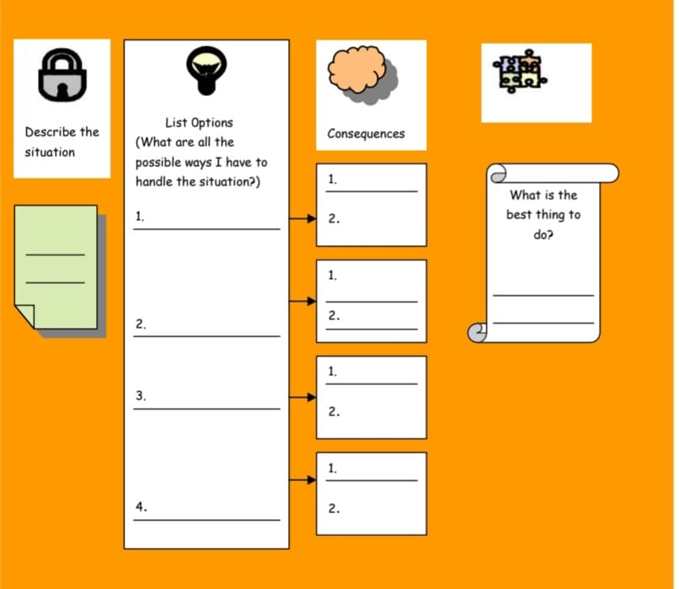
Simple Practical Problem Solving :
IAP-Adolescent Health Academy: T-TEACH MODULE
Notes:
LETS UNDERSTAND THIS WITH AN Example your friend calls you for a Rave party..the OPTIONS available are to go with the friend because you don’t wont to be felt left out/peer pressure; you can stay back at home as it already late and you don’t like such parties; give an option to your friend that we can go to a movie instead or watch a movie at home. CONSEQUENCES: attending the rave party late night is risky( drugs and its exposure can harm the growing brain, safety etc), staying back at home might make the friend feel bad which you don’t intend to do, watching movie together will be like a win win situation for both. So the best option is to spend time together watching a movie at home.

Slide 27
Prevention of Substance use in children
ROLE OF SCHOOLS
What do you understand by the term Drug use?
How will Drug use harm Sunil or Anil?
How can Anil and Sunil overcome this challenge and get back to normal life
Schools must aim to build emotional and social resilience in the child
Must ensure frequent awareness programs
Organize periodic school health check ups
Ensure no vendors of drugs in school vicinity
Lay down stringent rules for drug abuse prevention
IAP-Adolescent Health Academy: T-TEACH MODULE

Slide 28
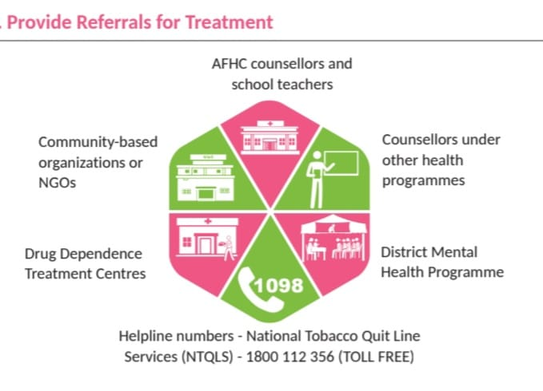
Next steps for severe addiction
IAP-Adolescent Health Academy: T-TEACH MODULE
Notes:
Ref: (RKSK guidelines, Participant’s handbook, for Training of Medical Officers on Adolescent Friendly Health Services, Substance Misuse, 2014)

Slide 29
Pick the true statement
Adolescents are less likely than adults to get addicted.
Immature brain of the adolescent makes them more prone for
addiction.
Mature brain in adults is less protective against addiction.
Maturity of brain does not influence Addiction.
IAP-Adolescent Health Academy: T-TEACH MODULE
Notes:
Ans: 2

Slide 30
Pick the wrong statement
When faced with a teenager using drugs, teachers should:
  1. Speak one to one with adolescent
  2. Be kind and non judgemental, offer to help
  3.Report immediately to authorities
  4.Explain the rules and what is expected.
IAP-Adolescent Health Academy: T-TEACH MODULE
Notes:
Ans:3

Slide 31
KEY MESSAGES
Adolescents are more susceptible to substance use and misuse
Frequent use can affect the developing brain with potential for addiction
Substance abuse can affect the academic performance & school drop out rates
Clues to substance misuse can be physical, emotional or social
Teachers and schools have a role in fostering positive healthy coping
Zero tolerance to drug use and prevention of use are the way forward
IAP-Adolescent Health Academy: T-TEACH MODULE

