Slide 1


T –Teach Module
T –Teach Module
(Teachers’ Training and Empowerment in Adolescent Care and Health)
IAP -AHA’s -Training Module for Teachers
IAP-Adolescent Health Academy: T-TEACH MODULE

Slide 2

IAP-Adolescent Health Academy: T-TEACH MODULE

Slide 3
Concept
Adolescence is a crucial stage in an individual's life marked by physical, social, emotional, and cognitive changes. During this period, adolescents require guidance and support from various sources, including teachers.
Teachers, as important stakeholders, play a significant role in the overall development of adolescents and their well being, as they spend a considerable amount of time with them in school settings.
Therefore, it is essential to equip teachers with the necessary skills and
knowledge to effectively support and care for adolescents.
IAP-Adolescent Health Academy: T-TEACH MODULE

Slide 4

IAP-Adolescent Health Academy: T-TEACH MODULE

Slide 5
T –Teach Module
Dr Shubhada Khirwadkar (National Convenor)
Dr Swati Ghate (Academic editor)
Dr Nishikant Kotwal (National Co-ordinator)
IAP-Adolescent Health Academy: T-TEACH MODULE

Slide 6
Topics &Contributors
Understanding Adolescent Behaviour: Dr Swati Ghate, Dr Poonam Bhatia
Handling Teens with problematic behaviour: Dr Sushma Desai, Dr Ashim Ghosh
Dealing with silently suffering Teens(Mental Health Concerns): Dr Sunita Manchanda, Dr Geeta Bansal
Dealing with disorders of Learning: Dr Newton Luiz, Dr Chitra Sankar
The good and the bad about Media: Dr Geeta Patil, Dr Prashant Karia
IAP-Adolescent Health Academy: T-TEACH MODULE

Slide 7
Topics &Contributors
Substance abuse - What teachers should know: Dr Chitra Dinakar Dr Shilpa C
Understanding Teen Sexuality: Dr Himabindu Singh, Dr Sushma Kirtani
Positive discipline: Dr Shubhada Khirwadkar, Dr Kalyani Patra
Promote Healthy Life Style: Dr Shamik Ghosh, Dr Shalini Bhasin
Communication Skills and self help: Dr Nishikant Kotwal, Dr Chitra Kulkarni
Prevent , Empower , Stand Strong (self defense): Dr. Jayashree Deshpande
IAP-Adolescent Health Academy: T-TEACH MODULE

Slide 8
Reviewers
Dr Swati Bhave
Dr C P Bansal
Dr Sukanta Chatterjee
Dr Preeti Galagali
Dr Samir Shah
Dr Piyali Bhattacharya
Dr Atul Kanikar
Dr Atanu Bhadra
Dr R G Patil
Dr R N Sharma
IAP-Adolescent Health Academy: T-TEACH MODULE

Slide 9
DEALING WITH SILENTLY SUFFERING TEENS
(MENTAL HEALTH CONCERNS)
Dr Sunita Manchanda
Dr Geeta Bansal
IAP-Adolescent Health Academy: T-TEACH MODULE

Slide 10

LEARNING OBJECTIVES
To understand Mental Health Spectrum in Adolescent
What are the Issues behind Silently Suffering Teens?
Early Identification, Timely Intervention and Appropriate Referrals
What is Mental Health First Aid?
IAP-Adolescent Health Academy: T-TEACH MODULE
Notes:
This slide tells us a very important fact. Teachers are the pillars behind a child’s progress and mental health as well.
If teachers are trained to identify and timely handle the mental health issues of their students, many lives can be improved, and at times even saved, by timely identification and prompt referral to an adolescent pediatrician, who are especially trained to handle these problems.
The objective of this presentation is to provide teachers with some basic facts about the Mental Health Spectrum. What does it mean. In which part of the spectrum their students should fall? How to know if a child is no more in the healthy mental spectrum?
Another objective is to give the teachers an idea, about what issues could be behind the silently suffering teens, who fail to seek help.
The objective of this presentation is to help teachers identify early, also intervene to a certain extent, to help their student, and then to refer them appropriately.
How teachers can intervene, will be covered in the later part which tells us about the Mental Health First Aid, what it is and how to provide it at the earliest possible, even before za professional help can be arranged.

Slide 11
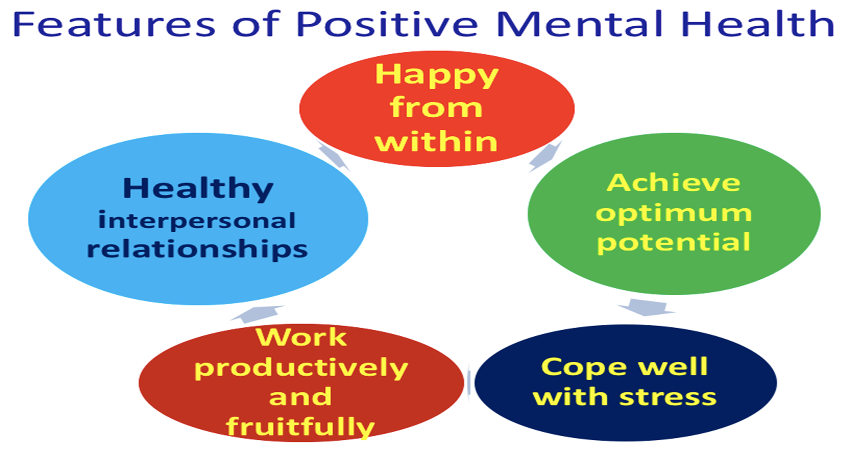
IAP-Adolescent Health Academy: T-TEACH MODULE
Notes:
A Teacher can easily identify a student having a Positive Mental Health:
The child will appear Happy from within, and be able to achieve their potential. They can perform to the best of their ability.
They are able to handle stressful situations with healthy coping strategy.
At the same time, they work productively, and fruitfully.
They also build healthy relationships, and are able to maintain them well.

Slide 12
The Mental Health Spectrum
IAP-Adolescent Health Academy: T-TEACH MODULE
Notes:
These are the different Mental Health Zones.
Your students should be in the Green Zone or the Yellow Zone.
But if you find a student in the Orange or Red zone, you have a very important role to play.
A child in the Green zone, will be cheerful, energetic, and will show good academic performance too.
In the Yellow zone- your student will be positive, calm, performing normal functions well. At the same time, they are able to sleep well, eat well, and normally, and have a normal social life too.
On the other hand, a student who has a deteriorating mental health, and is in the Orange Zone of mental spectrum will be: Anxious, depressed, sad, tired, having poor sleep, and disturbed normal activities. He might have suddenly withdrawn from friends, and might be sitting alone. You may find their academic performance going down. They might not be eating their tiffin, and may not be concentrating in your class anymore.
If you find a student looking extremely sad, or worried, who has started skipping classes, looks exhausted, and unkempt, you may consider them being in the Red Zone of the mental health spectrum. Such children need urgent help, from professionals.
Your role while being their teacher is to detect the changes timely, call them to you after class, ask them if they had a problem, listen to them carefully, and arrange help.

Slide 13
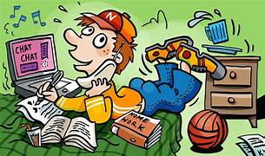


Adolescents Under stress
Teens under stress suffer Silently
Some teens, who are in mental health trouble, do not open up or show it to others, through overt outward behaviour. They keep it to themselves , and suffer in silence.
There are other type of teens, who express overtly, may be hyperactive, distracted, disturbing other students ,
Or they may be retaliatory, or even defiant towards teachers or others.
IAP-Adolescent Health Academy: T-TEACH MODULE
Notes:
You may see many different types of students. There may be some who are overactive, talking and disturbing the class and other students in class. They may be distracted from work, doing multi tasking at the same time and also social- chatting, through pop-ups on their devices.
At the same time, you may have to handle students who are retaliatory or even defiant towards teachers or persons in authority. These may be children or teens having externalizing behaviour disorders.
At some other time, you may see a student looking sad, worried, withdrawn, who doesn’t talk about their problems to anyone. They could be suffering from internalizing behaviour disorders.
As their teacher, you are always the first one or after the parents to detect and identify these issues in your students.
When you see extremes of such issues, which are causing problems in their life or their academic performance, you can be the first to identify a problem and help the child.

Slide 14
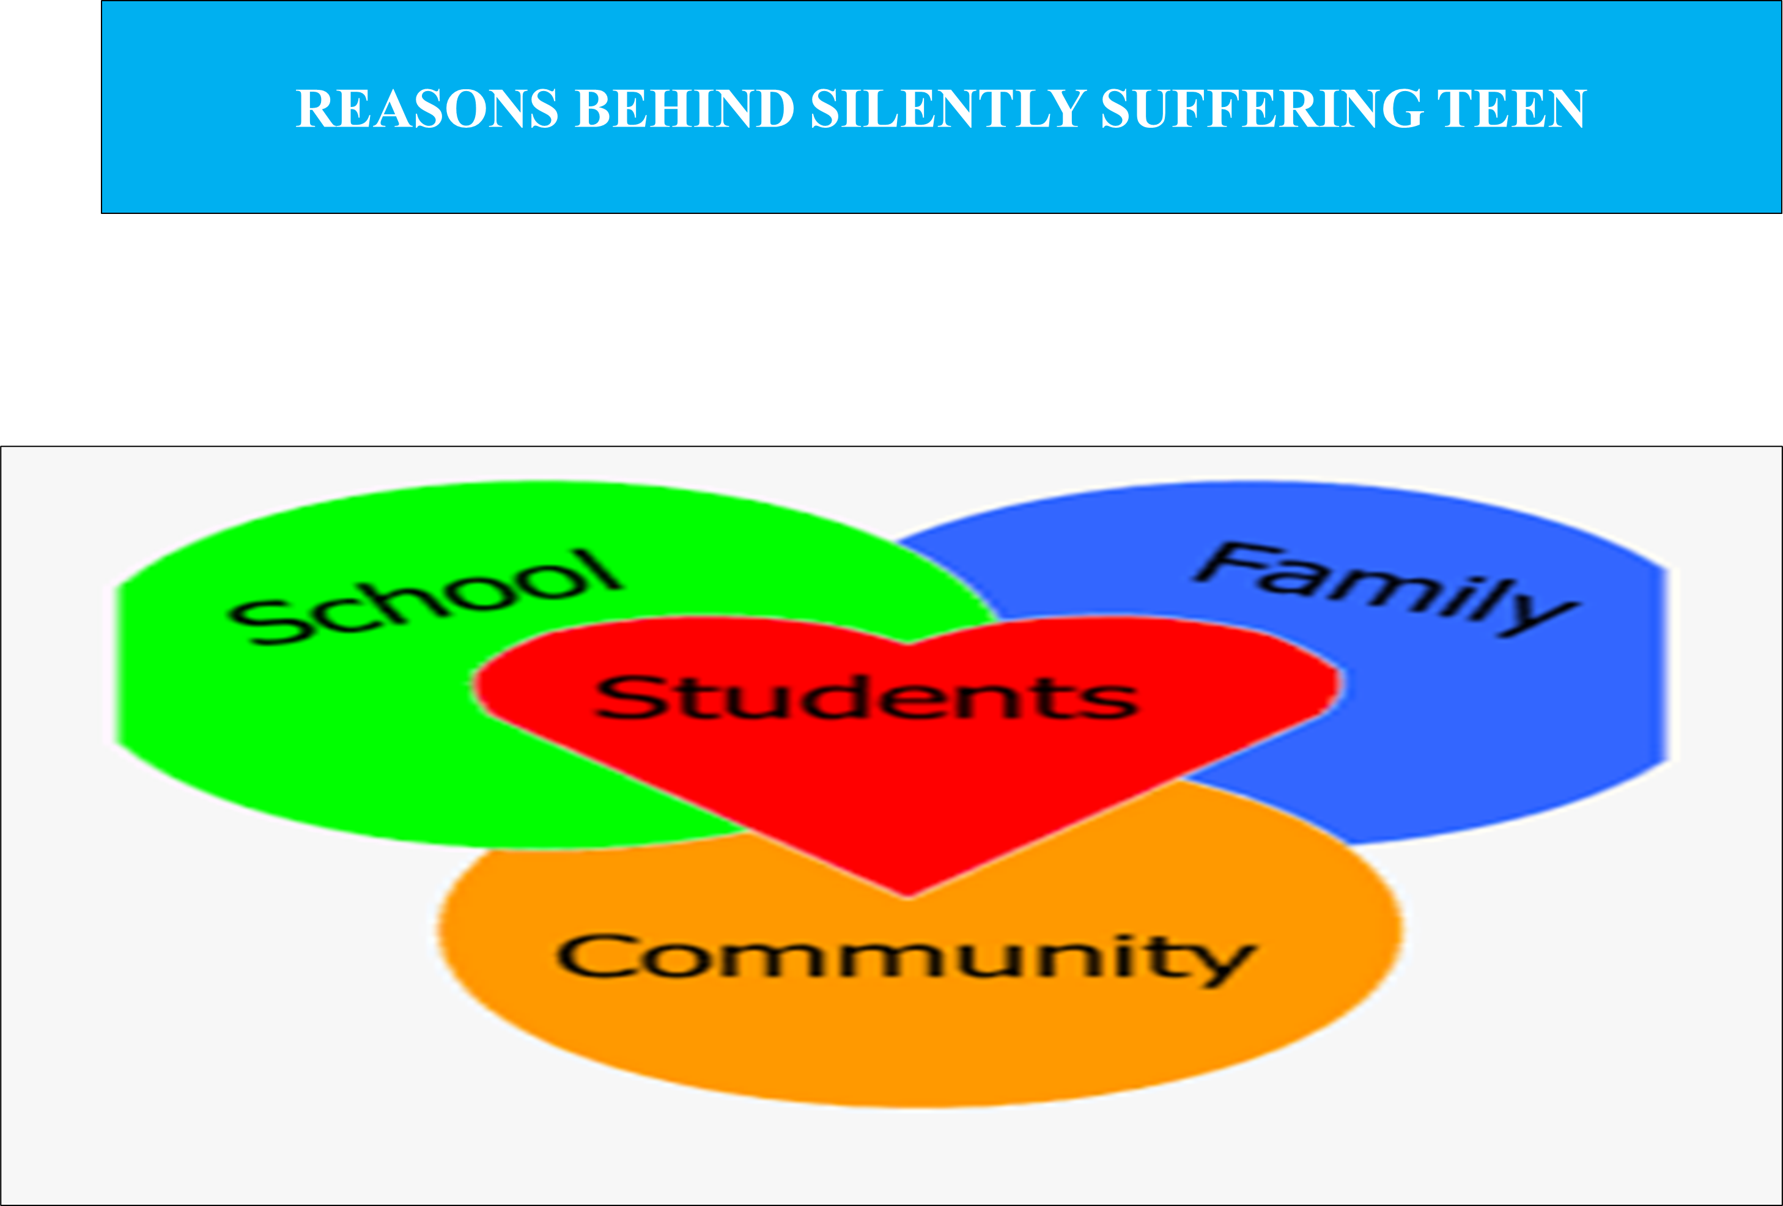
IAP-Adolescent Health Academy: T-TEACH MODULE
Notes:
Various risk factors can predispose a teenager to develop mental health difficulties. Knowledge about risk factors may guide in identifying adolescents at risk and help in formulating prevention and intervention strategies to pursue with them. Risk factors can be discussed in following domains and enumerated in table 1
1 Individual
2 Family
3 School
4 Community
Individual Factors
Family Factors
School Factors
individual Community Factor
Female gender
Genetic Predisposition
Perinatal Insult
H/o Birth Asphyxia and NICU Hospitalization
Head Injury
Conduct problems
Behavioural issues
Develomental Disorders (ADHD,Autism)
Chronic Diseases
Low self-esteem,
Insecure attachment
Poor social and communication skills:
Early substance use
Poverty
Family Dysfunction
Domestic Violence
Parent-child conflict
Inconsistent discipline style
Negative family environment
Child abuse/maltreatment
Single-parent family
Divorce
Marital conflict
Family conflict
Parent with mental health issues
Parental drug/alcohol use
Parental unemployment
Lack of adult supervision
Poor attachment with parent
SCHOOL Factor
Academic Pressure
School-level stressful or traumatic events
School violence
Peer rejection
Peer Pressure
Bullying
Poor student-teacher relationship
Breakdown or lack of positive friendship
Community
Socio-economic
Disadvantage
Homelessness
Discrimination
Disaster,war survuivours
Lack of access to support system

Slide 15
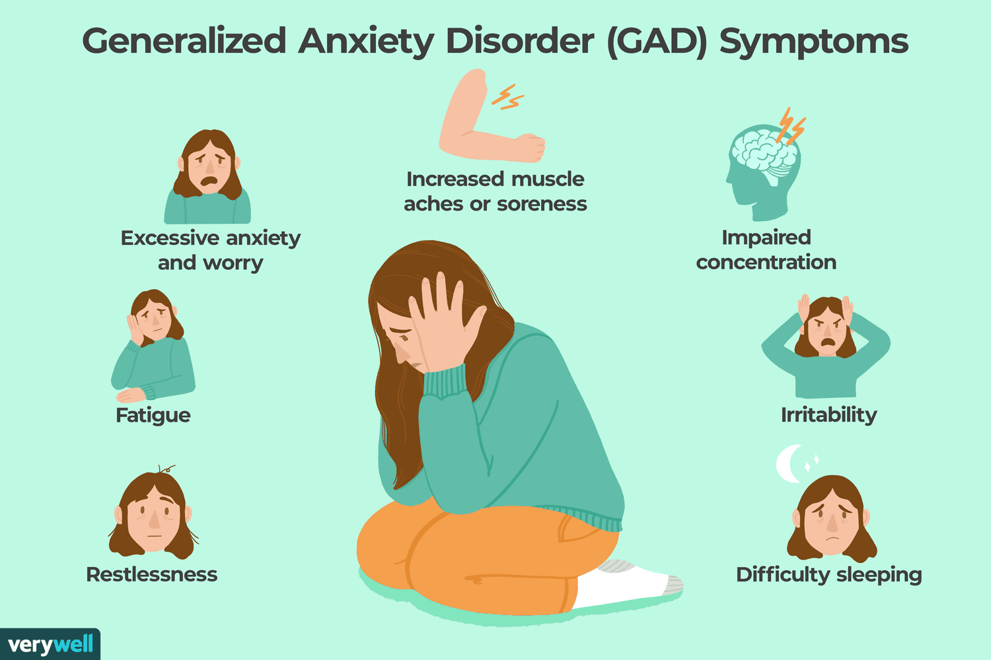
Reena Story
Case Scenario-1
Reena was brought to me by her parents on teacher’s advice ,Teacher also called me to tell that :
Reena appears to be worried all the time.
She cannot concentrate in class, and fiddles with her pen, and is very restless.
She was a good student till the last semester, and used to take a lot of interest in class as well as in extra-curricular activities. Now her grades are falling!
When the Teacher asked about her symptoms, and listened to her attentively , Reena said that
She felt nervous and restless, as if “ on an edge”. And her muscles become tensed.
She can’t sleep at night, and sometimes wakes up frequently.
Her palms sweat a lot, and her hands tremble,
She also felt her heart beating rapidly, or ghabrahat , in her chest.
All this was becoming so excessive that she could not concentrate on her studies.
By the timely intervention of a teacher and doctor Reena was helped . Soon, her grades improved, and she was able to participate in school activities too.
ACTIVITY: WHAT APPROPRIATE ACTIONS DID THE TEACHER TAKE FOR REENA?
If you notice all or any of these symptoms in your students ,
Give them extra attention
IAP-Adolescent Health Academy: T-TEACH MODULE
Notes:
This is a story told by the doctor
The slide can be read directly, as the whole case is on the slide itself.
Reena was later found to be suffering from Anxiety disorder, and was appropriately treated.
This story tell us a very important fact. If teachers are trained to identify and timely handle the mental health issues of their students, many lives can be improved, and at times even saved, by timely identification and prompt referral to an adolescent pediatrician, or concerned physician, who are especially trained to handle these problems.

Slide 16
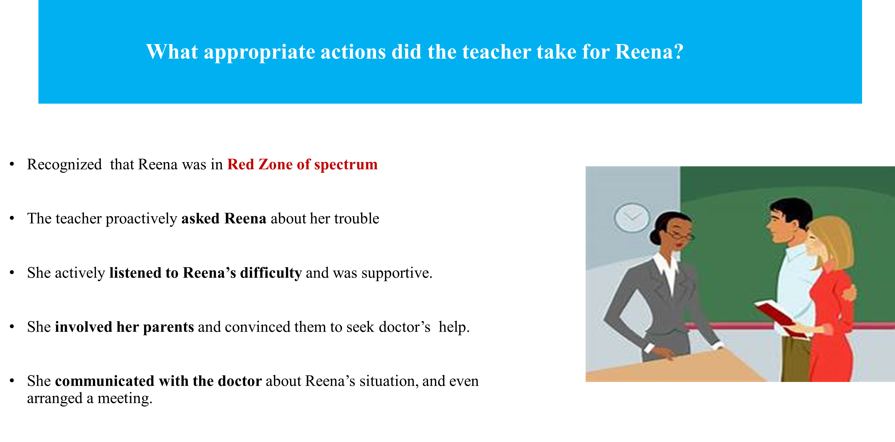
IAP-Adolescent Health Academy: T-TEACH MODULE
Notes:
The presentor can facilitate the discussion with the teachers and generate responses. After the discussion the appropriate answers will appew
Will appear on screen with the click .

Slide 17
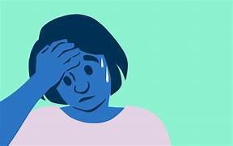
Why do students feel Anxious ?
Sheena’s Unrealistic thoughts, when teacher is asking questions in class
Increased Risk perception
If I can’t answer, the class will laugh at me, behind my back
The teacher is going to judge me.
The whole class will know, how foolish I am!
No one will want to be my friend
--------------------------------------------------------------------
Decreased Perception of Self ability to handle the situation
I don’t know what to do!
Better if I don’t look at the teacher, and look the other way. Then she may not ask me any question.
What if I say I am unwell and leave the class!
She starts thinking of Avoidance Techniques to lessen her Anxiety.
Worrying or Fearful of a situation so much; that it is out of proportion to the actual threat.
( Perceiving too much threat, when actually it is not so…)
Feeling of Inadequacy to handle the situation.
IAP-Adolescent Health Academy: T-TEACH MODULE
Notes:
Generally speaking anxiety is a very normal emotion. We all experience it in some way or the other, in our daily lives. It is reasonable, when it is in response to an actual threat. But when it becomes disproportionate to the actual threat, it becomes pathological.
How does a person develop Anxiety??
According to Dr.Beck the Father of Cognitive-Behaviour Therapy,
when people overestimate the severity of a threat, OR SOME DANGER, and at the same time they underestimate their own ability to cope up with the situation, or to handle the situation, they feel anxious.
For example:
A girl, Sheena , is very anxious that the teacher is asking questions.
She has started overestimating the threat: She thinks, the class will laugh at me, that the teacher will judge me.
The whole class will get to know that I am a very foolish person, and then no one will want to be my friend.
She does not focus on thinking about the answer to the questions, rather she thinks, I do not know what to do.
Then she starts to think of avoidance behaviours, if I don’t look at the teacher, she might not ask me anything! like I should perhaps make some excuse, and walk out of the class.
Focusing on anxiety symptoms, internally: Intensifies their anxiety ,
Interferes with - performance,
Leads to negative outcomes and poor coping.
So, People with Anxiety, start using Avoidance Behaviours, to feel more safe.
This lessens their worry for sometime, but in turn increases their stress all the more! This can lead to Anxiety disorder, when they need help from an expert.
A Teacher can be the first to notice these behaviours and talk to their student. If they feel that the worries of the student are out of proportion to the actual threat, leading to disturbance in her academic performance, and other things, the student might be in need of professional help.

Slide 18
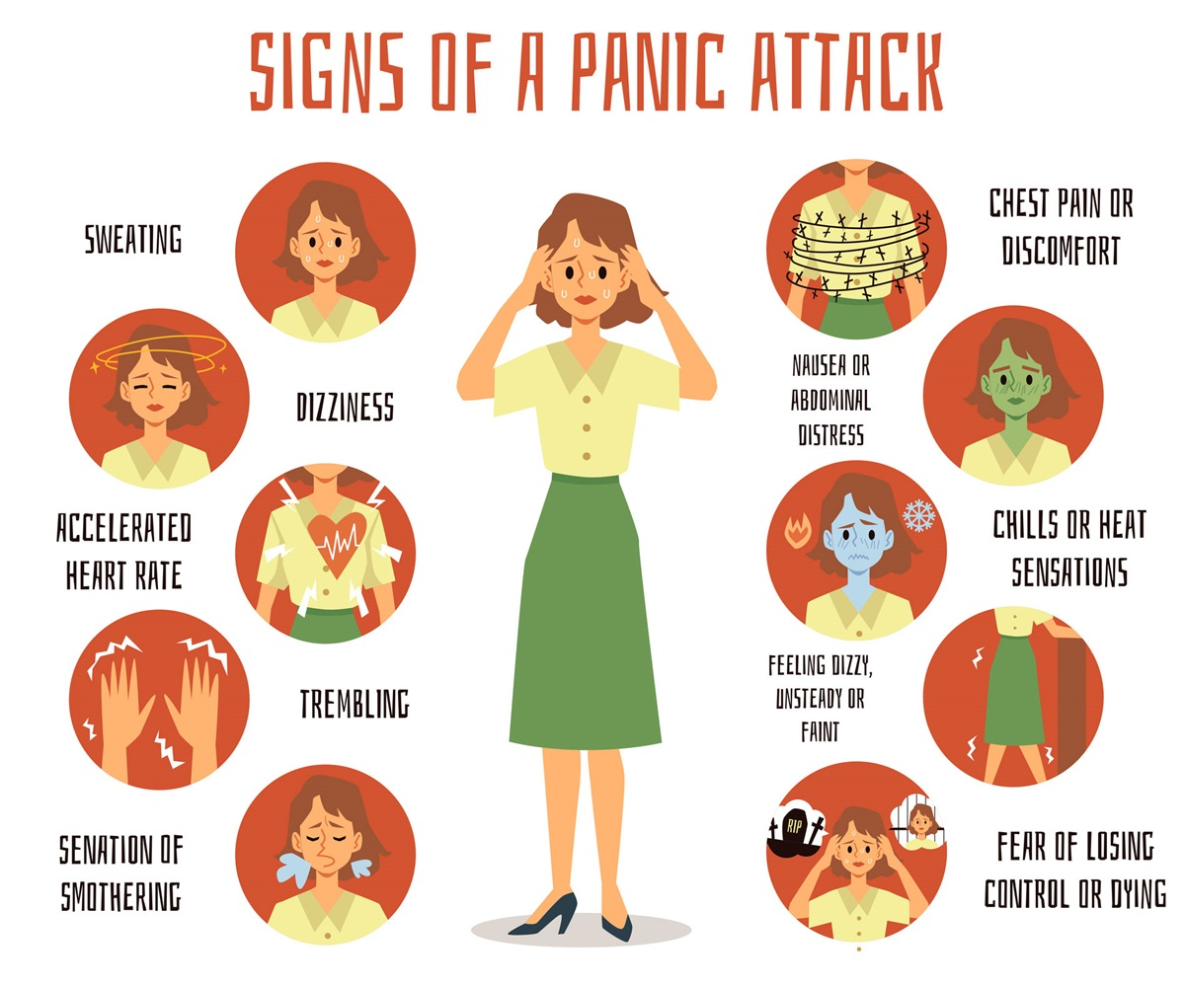
Other Common Anxiety Issues
Social Anxiety : When a person has an intense fear or dread of social situations. This can happen before, during or after an event.
Panic attack : An overwhelming sense of dread or fear, which involves bodily symptoms.
Obsessive compulsive disorder (OCD): Unwanted Thoughts can be disturbing, which can make the person, feel too distressed and anxious.
They may feel a compulsion to think about or do something repeatedly to help relieve their anxiety.
Phobia: A phobia is an overwhelming fear of an object, place, situation, feeling or animal. Phobias are a more intense feeling than fear.
IAP-Adolescent Health Academy: T-TEACH MODULE
Notes:
A little about each of these:
Social anxiety disorder:
It’s normal to worry about social or performance situations.
But, Social anxiety disorder, also known as social phobia, is when a person has an intense fear or dread of social situations. This can happen before, during or after an event.
For example:
Speaking in public or in groups
Meeting new people or strangers
Dating
Eating or drinking in public
The person may be worried that they will do something or act in a way that is embarrassing.
They may also feel aware of the physical signs of anxiety, such as:
Sweating
Racing heartbeat
Shaky voice
Blushing
They may worry that others will notice or judge them and so try to avoid certain situations.
They may be aware that their fears aren’t logical , but it’s difficult to control them.
Panic Disorder:
Fear of certain situations can cause panic attacks, for example,
Panic disorder symptoms can include:
An overwhelming sense of dread or fear
Chest pain or a sensations of heart beating irregularly
Feeling that the person may be dying or having a heart attack
Sweating and hot flushes, or chills and shivering
A dry mouth, shortness of breath or feeling of choking
Nausea, dizziness and feeling faint
Numbness, pins and needles or a tingling sensation in the fingers
A need to go to the toilet
A churning stomach
Ringing in the ears
Obsessive compulsive disorder (OCD)
A person with OCD will have obsessions and/or compulsions.
An obsession is a repeated unwelcome thought or image. These can be difficult to ignore. These thoughts can be disturbing, which can make the person, feel distressed and anxious.
A compulsion is something that the person will think about or do repeatedly to help relieve anxiety.
For example: Saying a phrase in your head to calm yourself. Or checking that the front door is locked, again and again, for multiple number of times.
The person gets such thoughts and might believe that something bad will happen, to their loved ones, if they don’t do these compulsions.
The person may realise that their thinking and behaviour is not logical but they still find it very difficult to stop.
There are different types of OCD including:
Contamination – An impulse to clean or wash because they perceive something as contaminated.
Checking – The constant need to check things in their environment to prevent damage, for eg - fire, leaks or locks.
Intrusive thoughts – Repetitive thoughts which may be horrific and upsetting
Hoarding – Not feeling able to throw away useless or worn out items
Phobias
A phobia is an overwhelming fear of an object, place, situation, feeling or animal.
Phobias are a more intense feeling than fear.
They develop when a person has heightened feelings of danger towards a situation or object.
Someone with a phobia may avoid the thing that’s causing them anxiety.
Common examples of phobias include:
Animals – Such spiders, snakes or rodents
Environmental – Such as heights and germs
Situational – Such as going to the dentist
Body – Such as blood or being sick
Sexual – Such as performance anxiety
GAD (Generalised Anxiety Disorder) is the most common type of anxiety disorder. The main symptom of GAD is excessive worrying about different activities and events. The person may feel anxious a lot of the time. Might feel ‘on edge’ and hyper-alert to their surroundings.
GAD can affect their day-to-day life, in many areas, for example;
The ability to work or hold down employment.
Travel, or leave the house.
Energy, sleep or concentration.
They might also have physical symptoms, such as muscle tension and sweating.
It is common to have other conditions such as depression or other anxiety disorders along with GAD.
GAD can be difficult to diagnose because it doesn’t have some of the unique symptoms of other anxiety disorders.
A doctor is likely to diagnose GAD if the person has felt anxious for most days over six months and it has had a negative impact on multiple areas of their life.
Animals – Such spiders, snakes or rodents
Environmental – Such as heights and germs
Situational – Such as going to the dentist
Body – Such as blood or being sick
Sexual – Such as performance anxiety
Agoraphobia is a fear of being in situations where escape might be difficult. Or situations where help wouldn’t be available if things go wrong.
For Example, This could be:
Leaving home
Being in public spaces
Using public transport
Being in crowded spaces
These situations affect the daily routine, of the person, as they actively start avoiding them for fear of getting distressed, panicked or anxious.
Post-traumatic stress disorder (PTSD)
PTSD is caused by a threatening situation, such as a car crash or abuse. The affected person can feel anxious for months or years after the event, even if they themselves weren’t physically harmed at the time.
They get Nightmares, or Flashes of recall about the event, and get up with symptoms of panic or anxiety.
They start avoiding the place, the persons involved, or even the persons who may remind them of the episode.

Slide 19

Case Scenario -- 2
Description Showing Collaboration Between Teacher And Parent
A mother of an adolescent once approached me, about her 16 year old son.
She told me that she had been referred to me by his teacher. When I asked her the problem, she said- Doctor, I don’t know what’s wrong with my son !
He doesn’t wake up in the mornings as he used to, Then he frequently misses his school, He doesn’t even go out to play with his friend; earlier he enjoyed playing Badminton with him, and I had to tell them to stop, but he doesn’t play, anymore. He says he doesn’t have any energy and is feeling very tired.
He can’t sleep at night, and keeps lying on his bed, or keeps roaming in his room. He is unable to finish his meal, and says I am not hungry!
My son, doesn’t even take care of his hygiene, his clothes, or hair and complains of body aches, all day long.
On asking her about their family, she said, She had recently separated from her husband, and both her children, her daughter and son, both adolescents, had moved to another flat. Father had moved to some other country.
The boy missed his father, as well as friends in the previous locality. He is unable to make any new friends.
The teacher had noticed his absences from school, the behavior changes in him, and his falling grades, and recently called her to school, and told her to consult an Adolescent Pediatrician
If you notice all or any of these symptoms in your students ,
Give them extra attention
IAP-Adolescent Health Academy: T-TEACH MODULE
Notes:
No Notes: Read case directly from the slide
An alert and prompt teacher was able to help an adolescent in recovering from early signs of Depression.
She noticed the changes, talked to the boy, felt something was wrong, involved the mother, and advised her to take help from experts.
A life could be saved, from going down hill and the student was helped from going into severe depression.
By good treatment, he was able to recover, catch up with his studies, and later this boy went on and got selected in the JEE exams.
Today he is doing well in his profession as well as his family, and knows that there is help available, if any such stressful things come up again in his life.

Slide 20
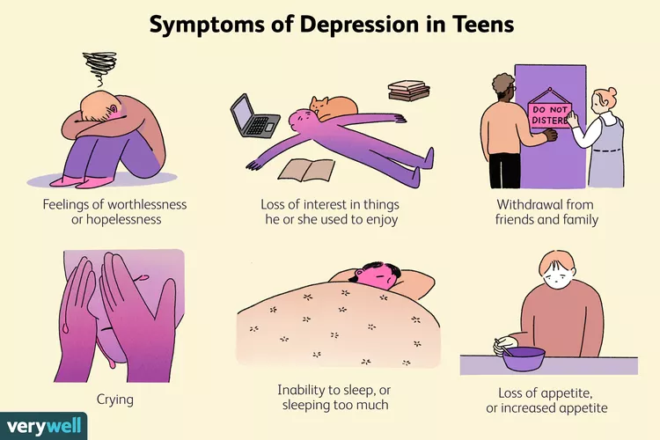
Key Features of Depression
Depression can have many symptoms.
Mood: Feeling sad, anxious, emptiness , hopeless or pessimistic
Activities: Losing interest in activities that used to be fun , such as
hobbies, sex or sports
3Behavior: Feeling irritable, frustrated, restless or easily angered.
4 Energy: Feeling very tired, lacking energy
5 Sleep: Having trouble sleeping, waking up too early, or even over
sleeping.
6.Appetite: Changes in appetite, reduced hunger, weight loss, or increased
cravings
7Concentration: Difficulty in concentrating, memory problems
8 Others: Feelings of guilt, worthlessness, helplessness, unexplained body aches, or pains.
The symptoms should have persisted for at least 2 weeks,
Should not be explained by substance abuse, or any other physical or mental illness.
IAP-Adolescent Health Academy: T-TEACH MODULE
Notes:
Depression may present in the form of many symptoms. But the first two of these, are almost always there. Key Features of Depression:
Mood: The person suffering from depression, feels intensely sad, very anxious, a feeling of emptiness, pessimism, on most of the days, for a prolonged period of time, at least for two weeks.
Activities: The person is no more interested in doing the activities, which were previously pleasurable to him, for example, he may have been playing Badminton with friends, or some other sport, other hobbies, like music, or painting or drawing. But now, refuses to go out and play with them.
Behavior: There are changes in their behavior, and they are irritable, restless, and may get angry easily.
Energy: A person in Depression may say, that he doesn’t have any energy at all.
Sleep: Their sleep is affected, they may not be able to sleep at all, or they may wake up too early, and then be unable to sleep after that. Sometimes, they may even oversleep.
Appetite: They also experience changes in their appetite, they may not feel at all hungry, may not eat at all, and even lose weight. But at times they may start to eat more.
Concentration: A person in Depression has difficulty in concentrating on their work and may even complain of memory loss, or unable to memorise things, which they could do well before.
Then there are some other symptoms: feelings of hopelessness, worthlessness, helplessness, which may drive them towards suicidal ideations, or thoughts.
A depressed person may complain of body aches, or pains which cannot be explained by any other pathological disease process.
To Identify a person with having Depression, the above symptoms should have persisted for a period of at least 2 weeks, and should not be explainable by any other disease, or substance abuse.

Slide 21
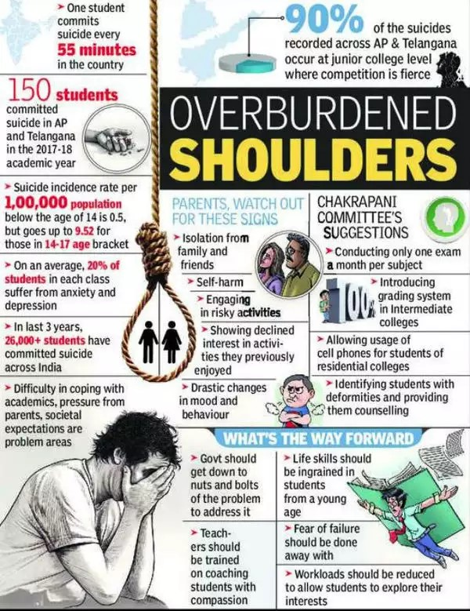
The Surge In Teen Suicide
Case Scenario: 3
Sanjay shared concerns about his close friend Ravi: with their favourite teacher; Mrs Ayyar
“Ma’m, Ravi has been very sad, ever since he got bad grades in the test. Yesterday he told me- “ I wish I did not exist”, “This nightmare will only be over when I die!” What will I tell my parents? They expect so much from me!”
Mrs. Ayyar discussed the issue with Principal and also with his parents and guided them to seek help from Doctor.
The teacher told him to consult a professional, as it was a serious matter. The teacher had also told him to remove any means of committing suicide, from his friend’s room, and also not to leave him alone.
Adolescents may start thinking of dying by suicide.
Teachers have a very important role to detect changes timely; and identify the Red-Flag signs of Suicide
IAP-Adolescent Health Academy: T-TEACH MODULE
Notes:
We have lately been hearing a lot about cases of suicide, especially from the coaching hubs of the country. The News papers are full of such news!
Most of these are adolescents, who could not cope up with the stress of studies, or broken relationships.
Adolescents suffering from depression may start thinking of suicide. Some of them may actually go through with it.
Teachers again have a very important role in timely detection, and must be aware of the Red Flag Signs, by which they can quickly be alerted themselves.
Case- Read directly from the slide.
This episode highlights, what teachers can really do, by just guiding the children and telling them what they can do as friends, and by referring the adolescent for timely help. In this case the teacher had also set up an appointment with the professional.

Slide 22
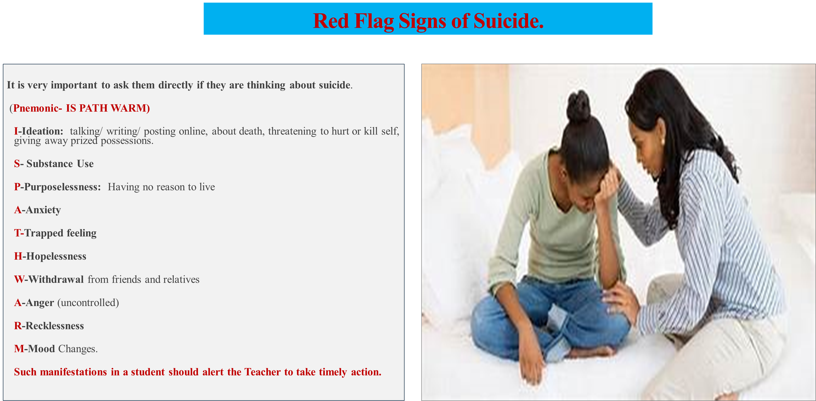
IAP-Adolescent Health Academy: T-TEACH MODULE
Notes:
So, What are the Red Flag Signs of Suicidal Ideation?
You can Remember them with the help of a Pnemonic_ IS PATH WARM.
Where I stands for Ideation.
I-The person thinking about suicide may leave cues while talking, or by writing somewhere, or posting online, about their thoughts for dying.
S- Substance Abuse can be a very important reason, which should alert you.
P- The person starts feeling as if there is no purpose to his life.
A- Anxiety symptoms may be so intense that the person can bear it no longer, and wishes to end life.
T- The person feels trapped in a situation, that only dying can solve in their mind.
W-They tend to withdraw themselves from their family and friends.
They get
Angry quickly, and start behaving
Recklessly. and sudden
Mood changes can be noticed in their changed personality.

Slide 23
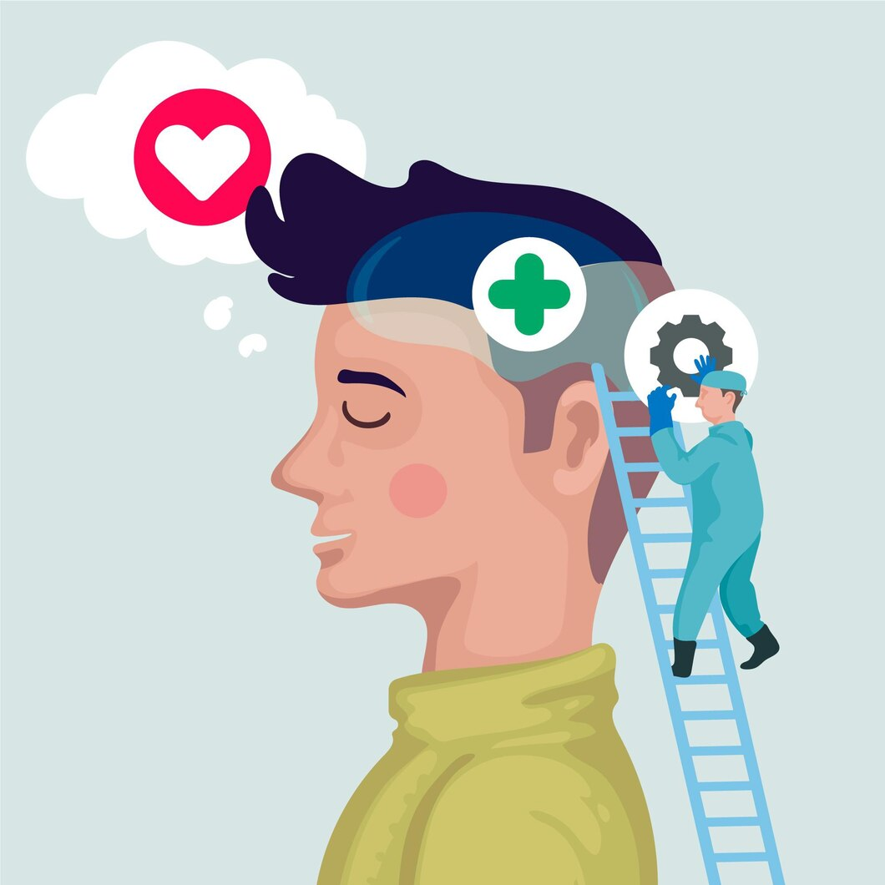
HOW SHOULD WE HELP A TEENAGER WHO IS SUFFERING SILENTLY
BY
PROVIDING MENTAL HEALTH FIRST AID ( MHFA )
IAP-Adolescent Health Academy: T-TEACH MODULE
Notes:
This is a slide –can be read as it is. Actually it is joining slide between 1st & 2nd half of presentation. The first mental health first aid training program was developed in Australia in 2001 by a research team led by Betty Kitchener and Anthony Jorm.
The program was created to teach members of the general public how to provide initial support to people experiencing mental health problems, as well as to connect them with appropriate professional help and community resources.
In 2017, MHFA India became a Licensed Provider of Mental Health First Aid training authorized by MHFA International, Australia. Mental health first aid training programs are provided by different organizations around the world, many of them non-profit.

Slide 24
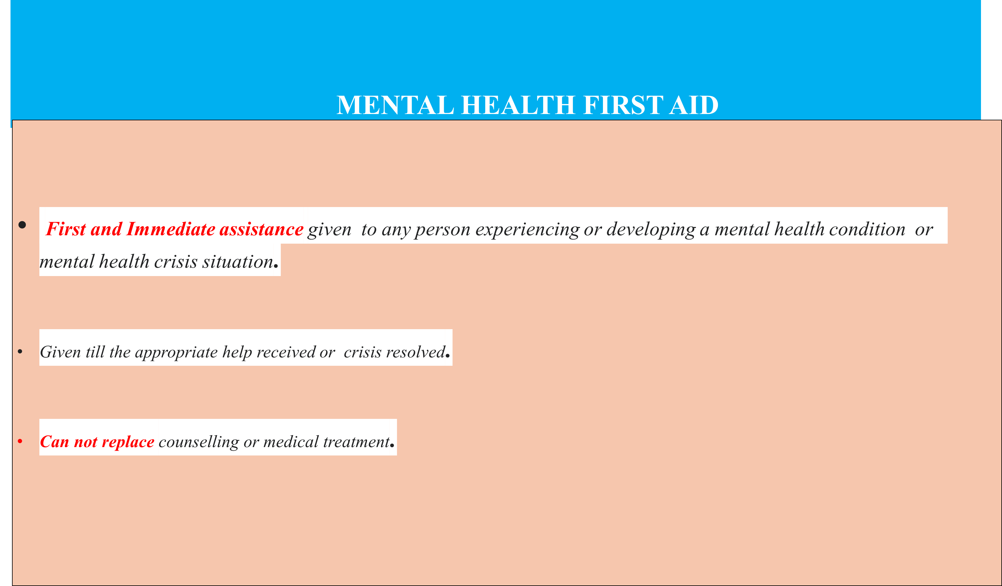

IAP-Adolescent Health Academy: T-TEACH MODULE
Notes:
Mental health first aid is the first and immediate assistance given any person experiencing or developing a mental health condition or experiencing a mental health crisis situation.
It is given till the appropriate help received or crisis resolved.
Not a substitude of ,counselling or support or treatment.
Mental health first aid training teaches members of the public how to help a person who is experiencing varying degrees of worsening mental health issues

Slide 25

MHFA:AIM
MHFA AIM
TO
Preserve life when in danger to self or others
Prevent the problem from becoming serious.
Provide comfort and support.
Promote and enhance recovery.
IAP-Adolescent Health Academy: T-TEACH MODULE
Notes:
Self Explanatory
MHFA Aim to provide comfort,support to anyone who is experiencing the mental health issue so that problem does not turn into serious mental disorder .And we can save a life and help them to recover faster . And individual can resume back to his previous life.

Slide 26
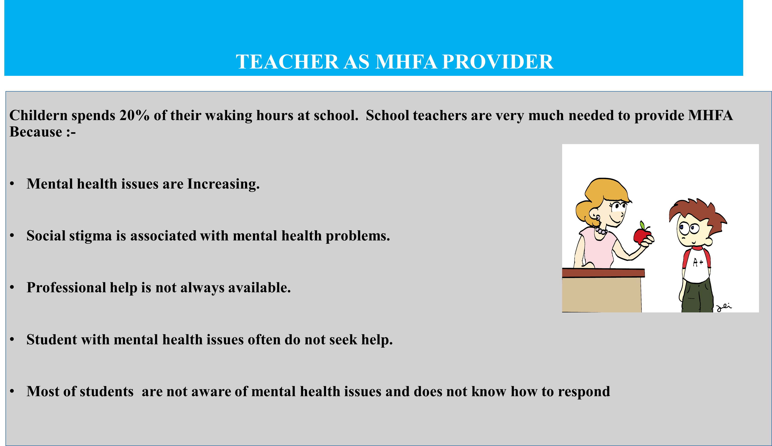
IAP-Adolescent Health Academy: T-TEACH MODULE
Notes:
Role of teachers is important as students spends significant hours in school. We know that mental health issues are increasing.
Globally, one in seven 10-19-year-olds experiences a mental disorder, accounting for 13% of the global burden of disease in age group. Anxiety disorder : 3.6% (10–14) & 4.6% (15–19yr) Depression : 1.1% (10–14 yrs)& 2.8% of (15–19-yrs)
By 2030, depression alone will likely to be the second- and third-leading contributors to disease burden in low-income and middle-income countries, respectively
School teachers can help students by early identification of mental health issues and providing support as per need.

Slide 27
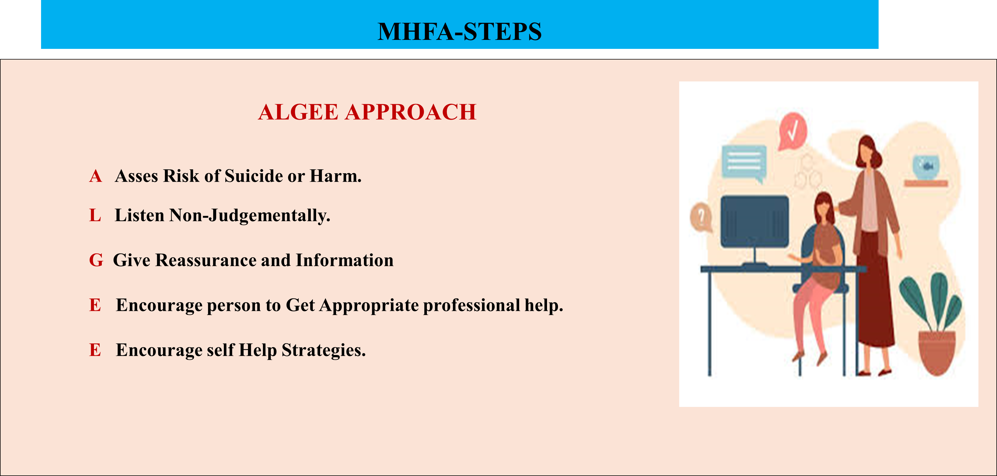
IAP-Adolescent Health Academy: T-TEACH MODULE
Notes:
The steps of mental health first aid (MHFA) are based on the ALGEE action plan:
Approach
Assess the situation for risk of harm or suicide, and look for signs of high anxiety or trauma.
Listen
Listen without judgment, and use phrases that help the person feel understood and hopeful.
Give support
Provide information and reassurance, and show dignity and respect.
Encourage
Encourage the person to seek professional help, and to use self-help and other support strategies.
Encourage others
Talk about family and friends who can support the person, and discuss how they can approach these people.
As it will be difficult for the teacher to asses risk of suicide or harm. We can say that officially training can be achieved . If not trained even then they can help the child by using 2x10 strategy to build a relationship with child and offer Extra socio emotional support.

Slide 28

IAP-Adolescent Health Academy: T-TEACH MODULE
Notes:
As it will be difficult for the teacher to asses risk of suicide or harm. We can say that officially training can be achieved . If not trained even then they can help the child by using 2x10 strategy to build a relationship with child and offer Extra socio emotional support
The 2x10 strategy involves spending two minutes per day for 10 consecutive school days connecting with an individual student to build authentic relationships and offer extra social-emotional support. The 2x10 strategy, also known as the Two-Minute Interview, was developed by educational researcher Raymond Wlodkowski. Wlodkowski originally tested the strategy and found it to be effective in reducing negative behaviors in students
Keep conversations focused on the student's personal interests, maintain consistency in engaging with the student, ask open-ended questions, and be a persistent, positive role model. Consistency and authenticity are key to the success of the intervention

Slide 29


HOW TO TALK TO SOMEONE IN NEED
WHAT TO SAY
WHAT NOT TO SAY
You are not in this world
You are important to me
When these feeling subside ,I will still be there and so will you
I cant really understand what you are feeling but I can offer my compassion.
I am not going to leave you
I love you.( Say only if you mean it)
I know you are in pain. I am going to take care of myself, so you donot need to worry that your pain can hurt me.
Stop feeling sorry for yourself
So you are depressed, Are not you always?
Snap out of it,
It is your own fault
Believe me ,I know how you feel ,as I was also sad last week
You should move/ socialize more
You should start doing meditation
Have you tried green tea.
IAP-Adolescent Health Academy: T-TEACH MODULE
Notes:
Listen to them Empathetically and in Non Judgmentally .(2nd step of ALGEE Approach)
Avoid giving too many Suggestions.
Keep Listening even if they are talking same thing again and again -

Slide 30
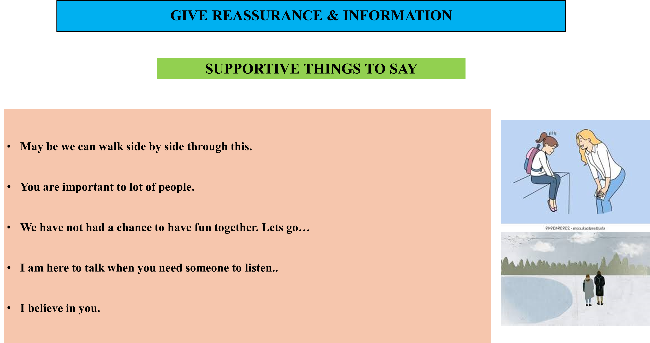
IAP-Adolescent Health Academy: T-TEACH MODULE
Notes:
3rd Step of AlGEE Approach
May be we can walk side by side through this.( You donot have to fix anything for them)
You are important to lot of people. ( Gentle reminding someone that he is part of life of many people)
We have not had a chance to have fun together.(This shows you enjoy being with him)
I am here to talk when you need someone to listen..( This helps someone to open without much pressurizing)
I believe in you.( You want to help him to believe in himself)

Slide 31
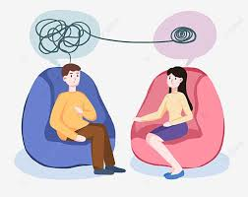
SEEKING PROFESSIONAL HELP
A teacher should refer the teen to professional
IF
Identifies Risk to life.
Notice change in behaviour which is severe, frequent and disrupting daily activities
.
Suspect substance abuse/ Internet addiction
See poor response to counselling by school counsellor.
Notice significant academic underperformance
WHOM TO REFER
Paediatrician
Adolescent Specialist
Psychologist
Psychiatrist
Counsellor
Special Educator
IAP-Adolescent Health Academy: T-TEACH MODULE
Notes:
4th Step of ALAGEE Approach. Encourage them to seek professional help.
Self Explanatory

Slide 32
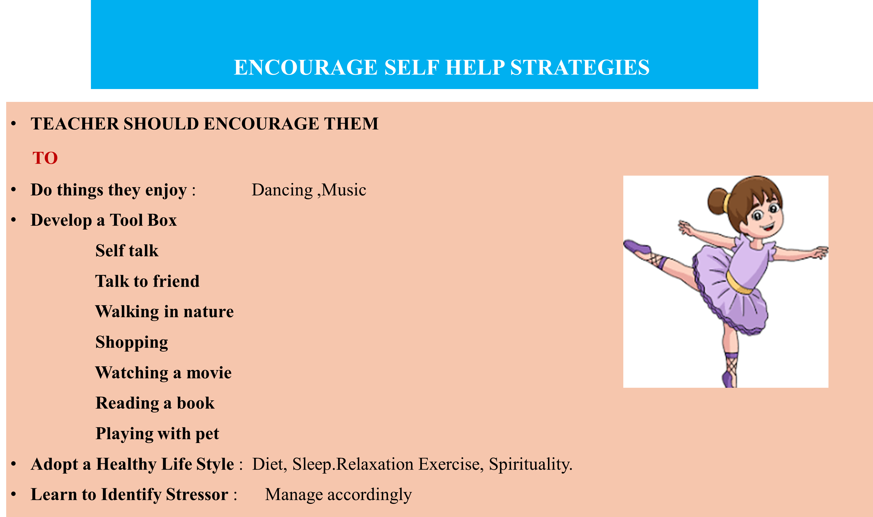
IAP-Adolescent Health Academy: T-TEACH MODULE
Notes:
A teacher should encourage students to develop self help strategies at individual level.
Encourage then to actively involve in group activities.
Help them to learn life skills education.

Slide 33

TAKE HOME MESSAGE
Teacher plays an important part in students life.
He/She can provide a significant support to silently suffering teen.
Early identification of students having mental health issues and timely help can preserve a precious life.
Learning and Providing Mental Health First Aid is need of an hour.
Every teen should be made resilient by encouraging self help strategies.
IAP-Adolescent Health Academy: T-TEACH MODULE

Slide 34
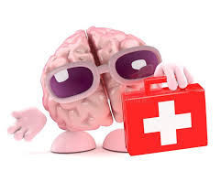


RESOURCE MATERIAL
.
Teachers are Important Gatekeepers in Preventing Suicide
Gatekeeper Trainings are available at:
www.zerosuicidealliance.com
NIMHANS
www.nimhans.co.in
Suicide Prevention India-
www.spif.in
MHFA https://www.mhfaindia.com
Emergency Referral: When immediate threat to life
Urgent Mental Health Referral: within 48-72 hours, in patients with low risk.
Contact Helpline Number- 14416- National number;
All cases of Suicidal ideation or attempts, should be taken very seriously , and require referral to a mental health specialist.
IAP-Adolescent Health Academy: T-TEACH MODULE
Notes:
We must know that Suicide is a Disease, and it is 100% preventable. So, Speak out to them , Reach out to them, and save a life.
Teachers are important Gatekeepers in preventing suicide.
Here we have given some important websites, where you can learn more.
The referral is an Emergency when you see an immediate threat to life.
In patients with a low risk you can make an urgent mental health referral within 48-72 hours.
It is very important to know that all cases of suicidal ideation, or attempts, should be taken very seriously and require referral to a mental health specialist.

Slide 35

IAP-Adolescent Health Academy: T-TEACH MODULE

Slide 36
MCQ
MCQ I
A Person in the Red Spectrum of Mental Health has the following features:
1.Worries all the time
2. Has Anxiety or Depression
3. Needs Emergency Attention and help
4. All of the above.
MCQ2
The Major features of Depression are: (any two)
Loss of interest in previously pleasurable activities.
Feeling of extreme sadness on most of the days.
Feeling elated and happy
Having good relationships.
MCQ 3 Answer True or False:
It can be dangerous to talk about suicide and its plans to a person who is depressed and giving cues about suicidal ideation. T/F
It is better to show disbelief, and laugh away, when a friend talks about planning to self-harm or die. T/F
IAP-Adolescent Health Academy: T-TEACH MODULE

Slide 37
MCQ
MCQ
MCQ 4 MHFA covers all except
Mental health first aid is the first and immediate assistance
It is given till the appropriate help received or crisis resolved.
It is substitute of counselling or support or treatment.
4 Help the person who is experiencing mental health issue
MCQ 5 What should not to say to depressed person
You are not alone .
You are important to us.
Stop feeling sorry for yourself
Do you want a hug
IAP-Adolescent Health Academy: T-TEACH MODULE

