Slide 1


T –Teach Module
T –Teach Module
(Teachers’ Training and Empowerment in Adolescent Care and Health)
IAP -AHA’s -Training Module for Teachers
IAP-Adolescent Health Academy: T-TEACH MODULE

Slide 2

IAP-Adolescent Health Academy: T-TEACH MODULE

Slide 3
Concept
Adolescence is a crucial stage in an individual's life marked by physical, social, emotional, and cognitive changes. During this period, adolescents require guidance and support from various sources, including teachers.
Teachers, as important stakeholders, play a significant role in the overall development of adolescents and their well being, as they spend a considerable amount of time with them in school settings.
Therefore, it is essential to equip teachers with the necessary skills and
knowledge to effectively support and care for adolescents.
IAP-Adolescent Health Academy: T-TEACH MODULE

Slide 4

IAP-Adolescent Health Academy: T-TEACH MODULE

Slide 5
T –Teach Module
Dr Shubhada Khirwadkar (National Convenor)
Dr Swati Ghate (Academic editor)
Dr Nishikant Kotwal (National Co-ordinator)
IAP-Adolescent Health Academy: T-TEACH MODULE

Slide 6
Topics &Contributors
Understanding Adolescent Behaviour: Dr Swati Ghate, Dr Poonam Bhatia
Handling Teens with problematic behaviour: Dr Sushma Desai, Dr Ashim Ghosh
Dealing with silently suffering Teens(Mental Health Concerns): Dr Sunita Manchanda, Dr Geeta Bansal
Dealing with disorders of Learning: Dr Newton Luiz, Dr Chitra Sankar
The good and the bad about Media: Dr Geeta Patil, Dr Prashant Karia
IAP-Adolescent Health Academy: T-TEACH MODULE

Slide 7
Topics &Contributors
Substance abuse - What teachers should know: Dr Chitra Dinakar Dr Shilpa C
Understanding Teen Sexuality: Dr Himabindu Singh, Dr Sushma Kirtani
Positive discipline: Dr Shubhada Khirwadkar, Dr Kalyani Patra
Promote Healthy Life Style: Dr Shamik Ghosh, Dr Shalini Bhasin
Communication Skills and self help: Dr Nishikant Kotwal, Dr Chitra Kulkarni
Prevent , Empower , Stand Strong (self defense): Dr. Jayashree Deshpande
IAP-Adolescent Health Academy: T-TEACH MODULE

Slide 8
Reviewers
Dr Swati Bhave
Dr C P Bansal
Dr Sukanta Chatterjee
Dr Preeti Galagali
Dr Samir Shah
Dr Piyali Bhattacharya
Dr Atul Kanikar
Dr Atanu Bhadra
Dr R G Patil
Dr R N Sharma
IAP-Adolescent Health Academy: T-TEACH MODULE

Slide 9
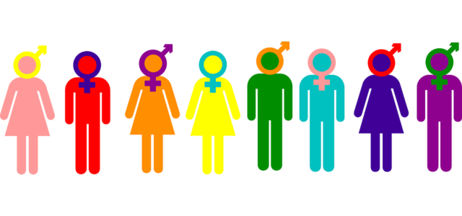
Understanding Teen SEXUALITY
Dr. Himabindu Singh
Dr. Sushma Kirtani
IAP-Adolescent Health Academy: T-TEACH MODULE

Slide 10
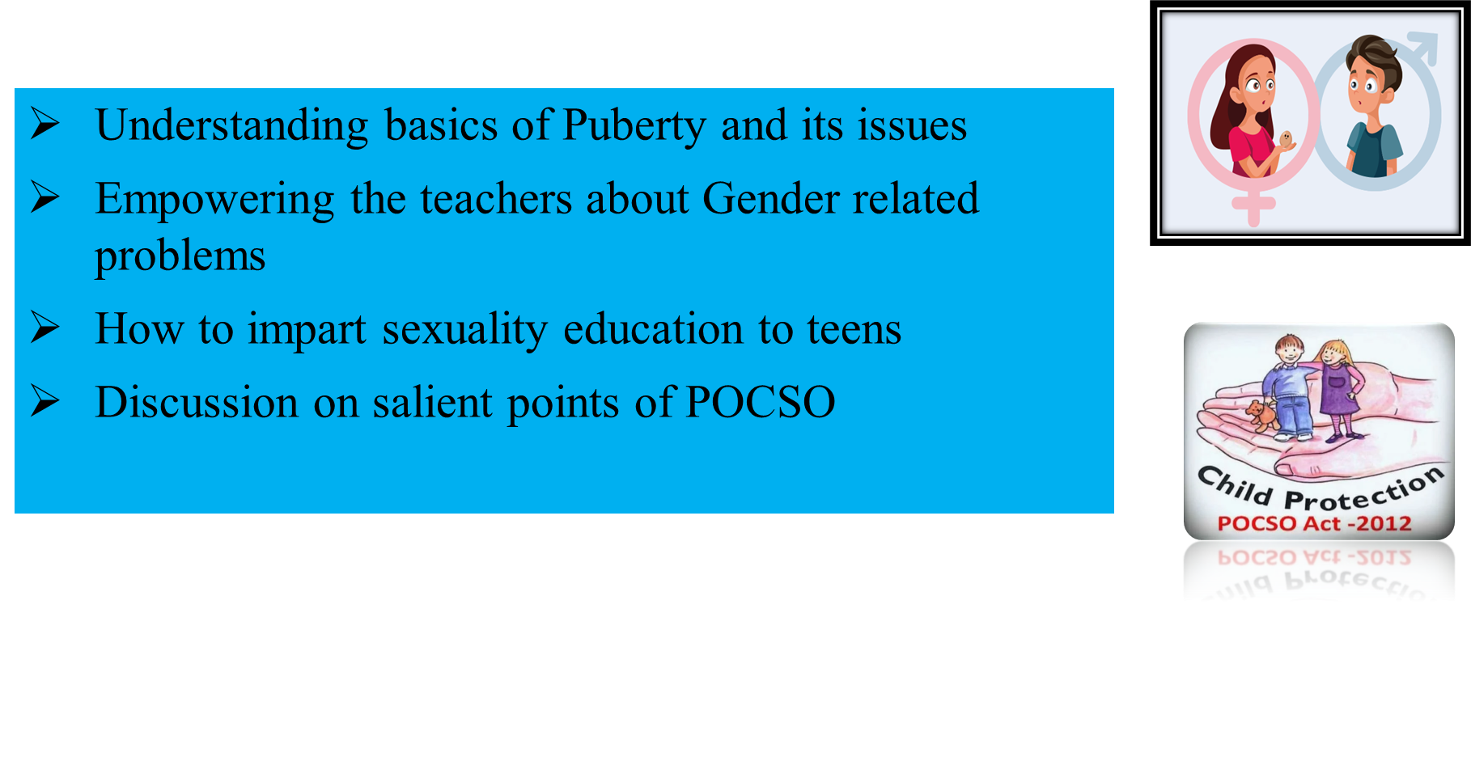
LEARNING OBJECTIVES
IAP-Adolescent Health Academy: T-TEACH MODULE

Slide 11
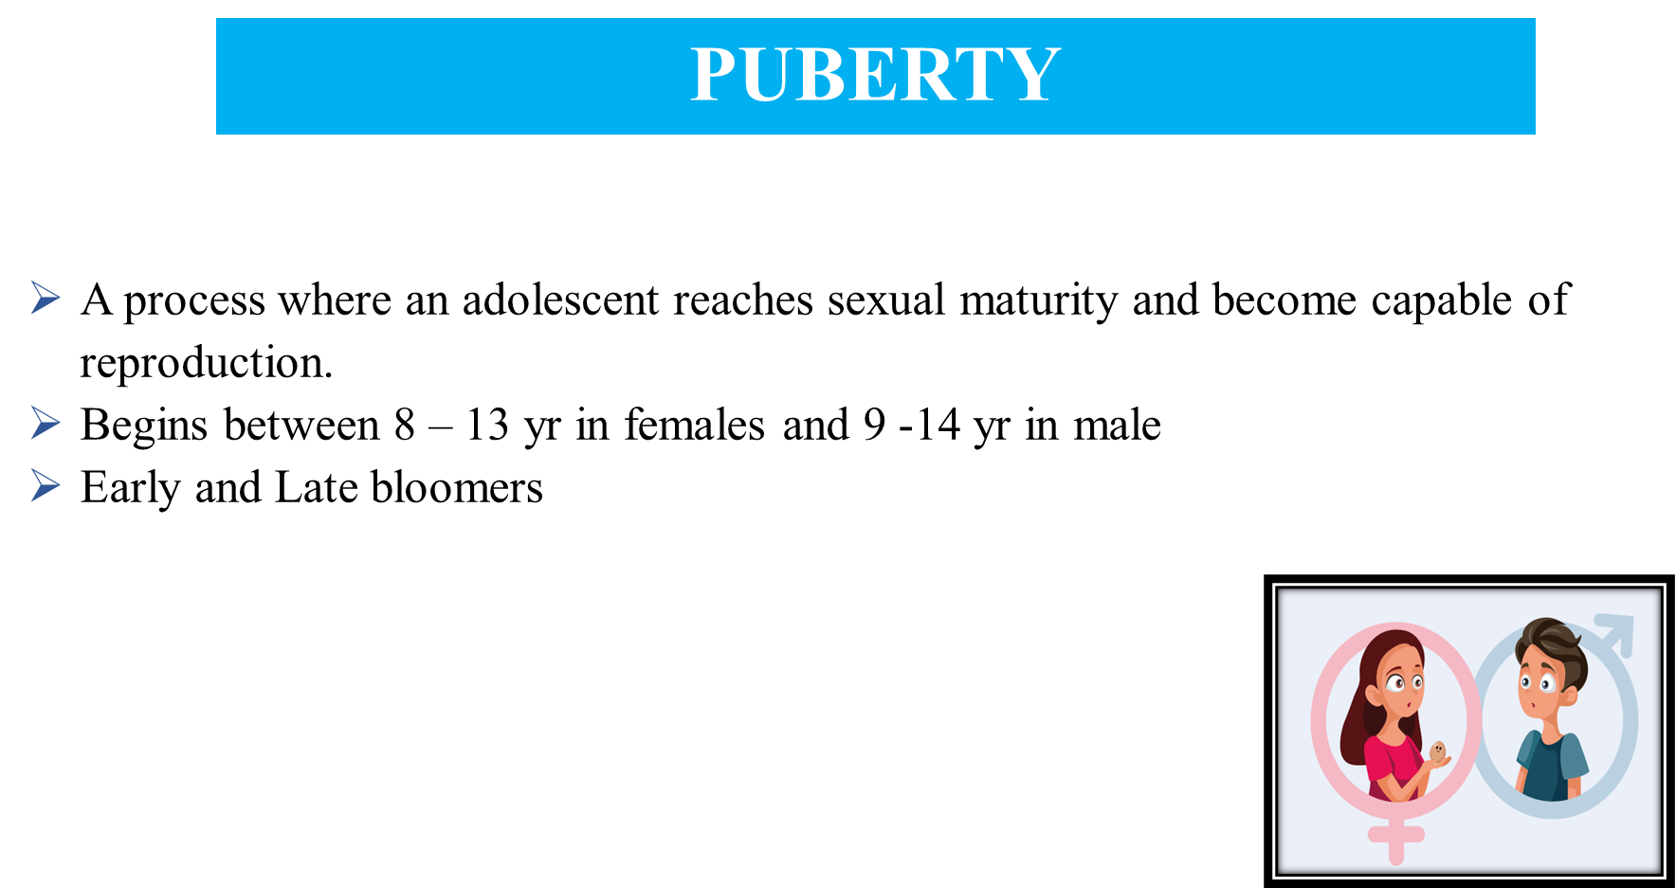
IAP-Adolescent Health Academy: T-TEACH MODULE
Notes:
Puberty is the process where an adolescent reaches sexual maturity and become capable of reproduction.
Puberty begins between 8 – 13 yr in females and 9 -14 yr in males
Puberty is considered early if it starts before 8 yrs in girls or before 9 yrs in boys. Puberty is the word derived from Latin word Pubertum (age of maturity). It describes physical changes to sexual maturation.
Onset of puberty is associated with high GNRH pulsing which precedes rise in sex hormones LH & FSH. LH stimulates Leydig cells in male testes to produce testosterone between 9 to 14 years. In females both LH/FSH contribute to the development of secondary Sexual characters.
Testosterone also is responsible for Pubertal growth spurt, deepening of voice, closure of epiphyseal plates, enlargement of penis, testes and muscle growth.
Puberty is also marked by a period when adrenal androgen also increases and is called as adrenarche which occurs around 6 years. Estrogens acts on ductal and stromal tissue and development of breasts takes place. As estrogen dominates throughout puberty 40% of the boys develop gynecomastia.
DHEA & DHEAS both result in the production of pubic and axillary hair growth. They act on the hair follicles causing thickening and darkening of pubic hair.
Puberty is considered late if there are no signs of puberty by 13 yrs in girls and 14 yrs in boys.

Slide 12
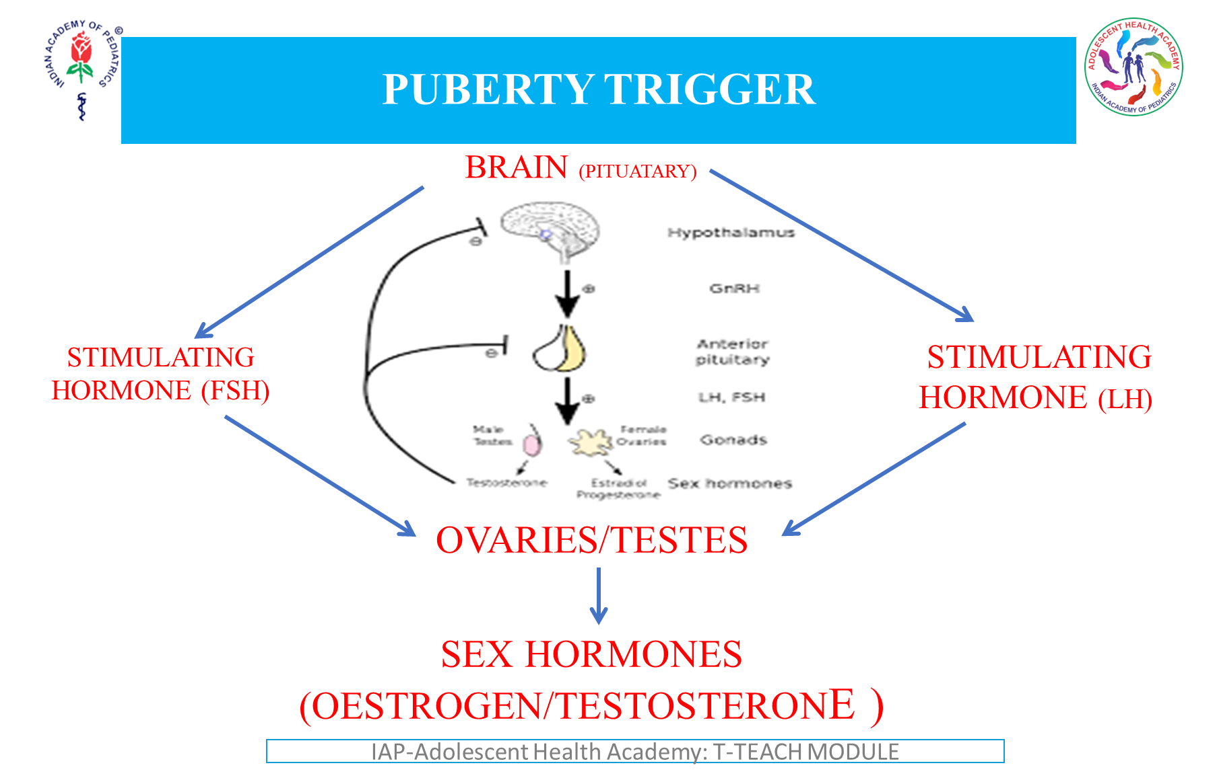
Notes:
The GNRH pulses from hypothalamus acts on pituitary to release FSH and LH
This in turn acts on ovaries and testes to release sex hormones estrogen and testosterone necessary for sexual maturation . Neurotransmitters GABA and kiss Peptin inhibit the release of GNRH. As the individual matures hypothalamus becomes less sensitive to this inhibition and eventually shifts towards pulsatile surges.

Slide 13
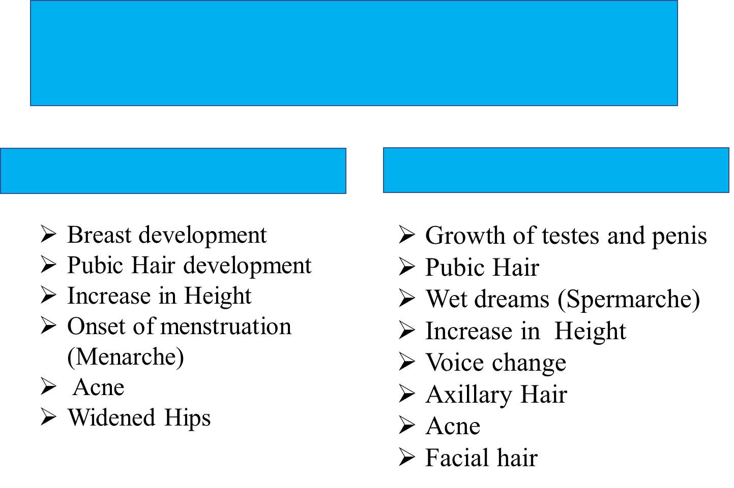
Stepwise Physical Changes
Girls
Boys
IAP-Adolescent Health Academy: T-TEACH MODULE
Notes:
Generally, two years after breast development, menstruation starts.
Increase in height precedes
Thelarche: Physical Changes - Refers to breast growth, first sign of puberty in girls occurs around 9 to 10 years. Increase in Estrogen causes the lactiferous duct system to develop. Increase in progesterone causes lobular alveoli at the end of lactiferous ducts to increase in number.
Pubarche – 6 months after breast development (Breast Bud) growth of Pubic hair (Pubarche) starts. Initially they are light, sparse and straight but will become coarse thick and dark throughout the course of puberty.
2 years after pubarche axillary hair will begin to grow, a secondary sexual characteristic mediated by testosterone.
Menarche
Females first menstrual period caused by increased in FSH and LH. Occurs 1.5 to 3 years after the thelarche. uterine endometrium goes through cycles of proliferation and regression due to fluctuation of plasma estradiol levels. At a certain point estrogen is withdrawn results in menarche. First ovulation takes place after 6 to 9 months of menarche due to an immature positive feedback mechanism of estrogen.
For Boys
Increase in testicular size is first sign of puberty in boys. Increase LH stimulates the synthesis of testosterone by Leydig cells and increased FSH stimulation production of sperms by Sertoli cells.
Increase in testicular size causes the scrotal skin to become darker & thinner.
Boys experience ejaculation one years after testicles begin to grow. First ejaculation does not automatically signal an ability to Procreate.
Fertility on an average is achieved one year after the first ejaculation.

Slide 14
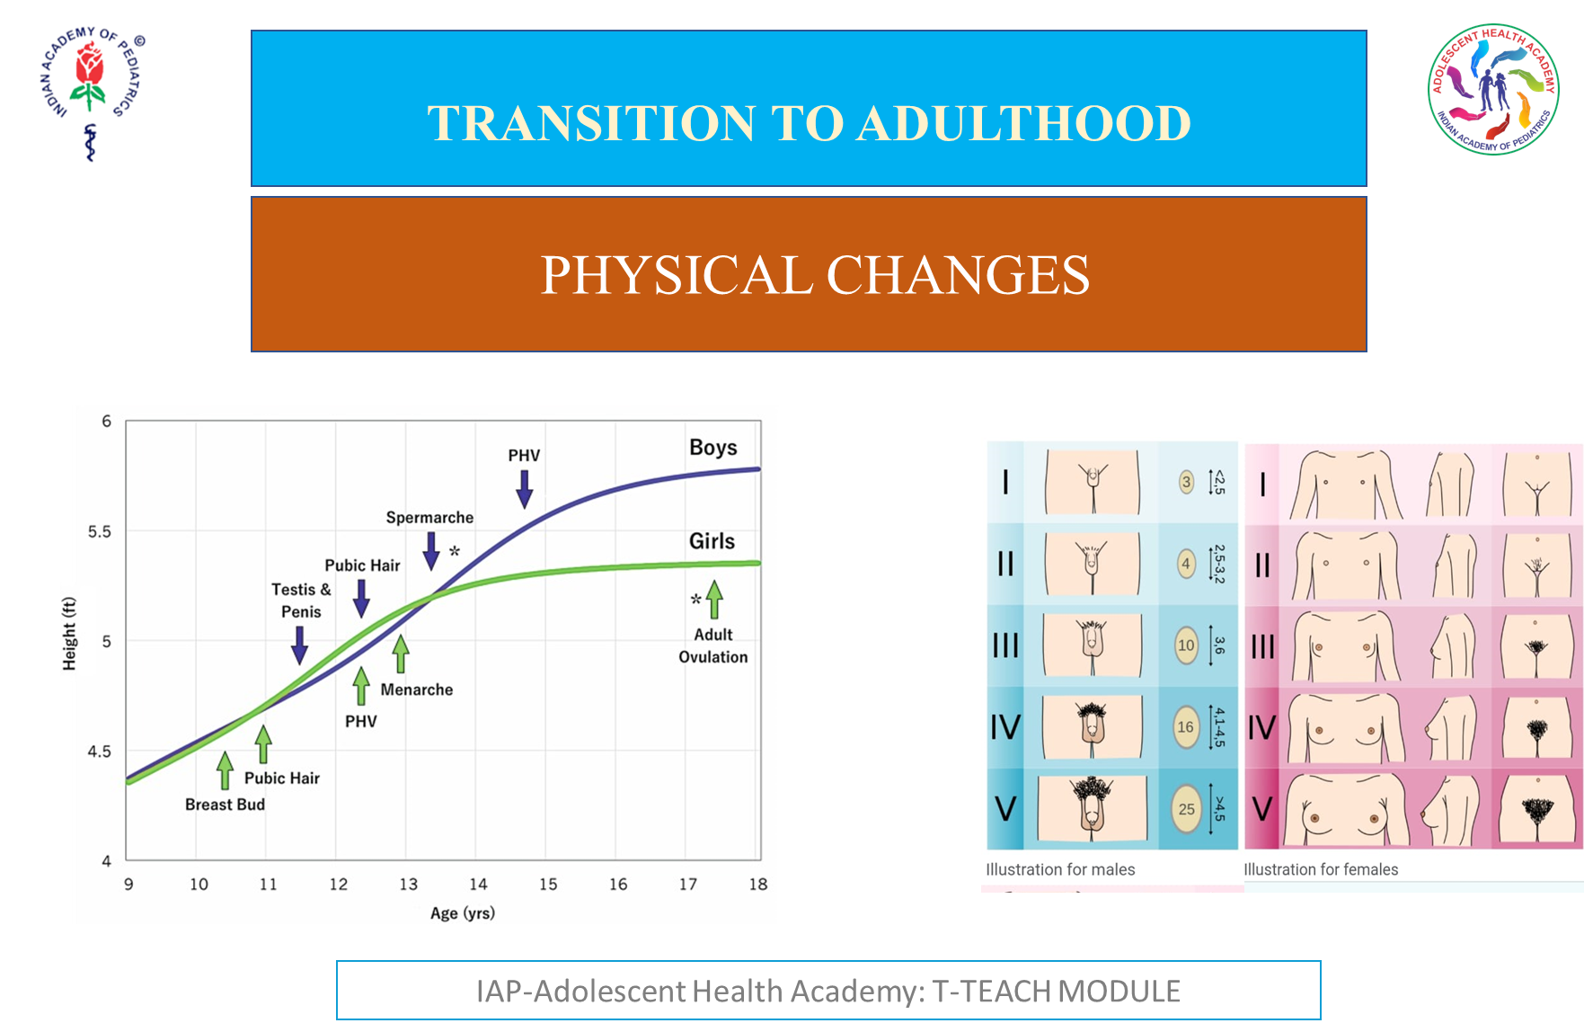
Notes:
Sequence of events is fixed. Age may vary.
The tanner charts are shown by the doctors to the teens to assess their pubertal stage. They can thus certain diagnose medical conditions. Tanner scale is a scale of physical development as children transition into adolescence and then adulthood: It focuses on size of the breasts, genitals, testicular volume and growth of pubic Tanner Staging or SMR Scoring
female’s normal onset of puberty is from 8 to 13. breast bud develops under the areola and is called the thelarche and represent entry into tanners stage 2.
Thelarche is followed in 1 to 1.5 years by onset of pubarche (Pubic and axillary hair).
Menarche comes by 2.5 years of Thelarche (Tanner 2/3) also breast development (Tanner 2/3) and girls experience peak height velocity.
In males’ puberty ranges from 9 to 14 when testicular volume reaches 4 ml (Tanner stage 2) Tanner 3 – genital development.
Increase in peak height velocity , spermarche - counter part of menarche in female occurs in tanner Stage - 4

Slide 15
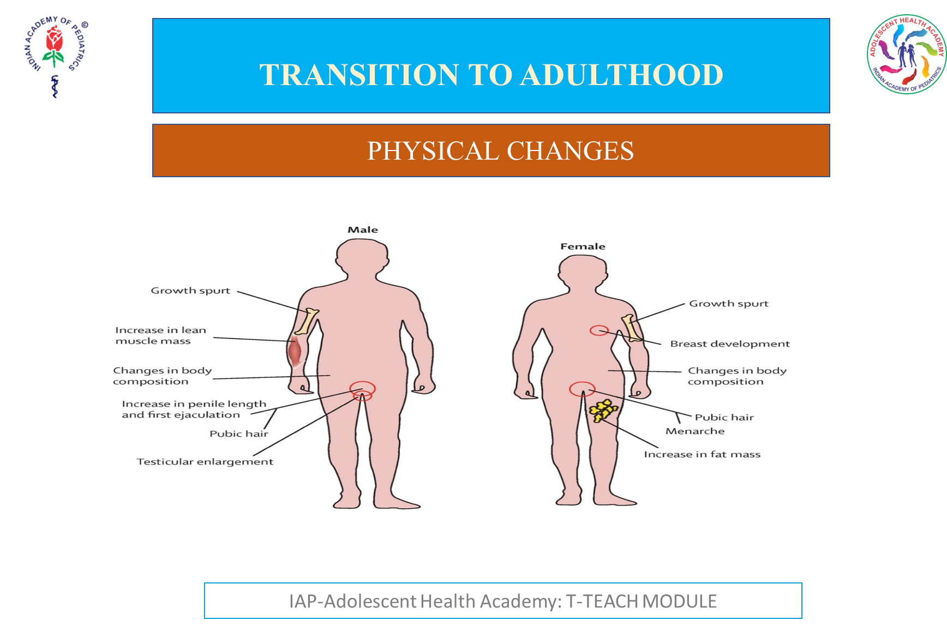
Notes:
Boys: increase in lean muscle mass
Changes in body composition
Growth spurt
In Girls:
Growth spurt
Changes in body composition
Increase in fat mass Adolescent growth is from distal to proximal
Gawky look and myopia with need for spectacles
Increase in weight and height
In boys:
Growth of testes, penis, scrotum, spermarche
or first ejaculation (11 to 15 yrs)
broader shoulder, voice change
dev. Of pubic hair, face, underarms.
In girls:
Growth spurt
Widening of hips
Acne
Increase muscle strength
Growth of uterus
Menarche

Slide 16
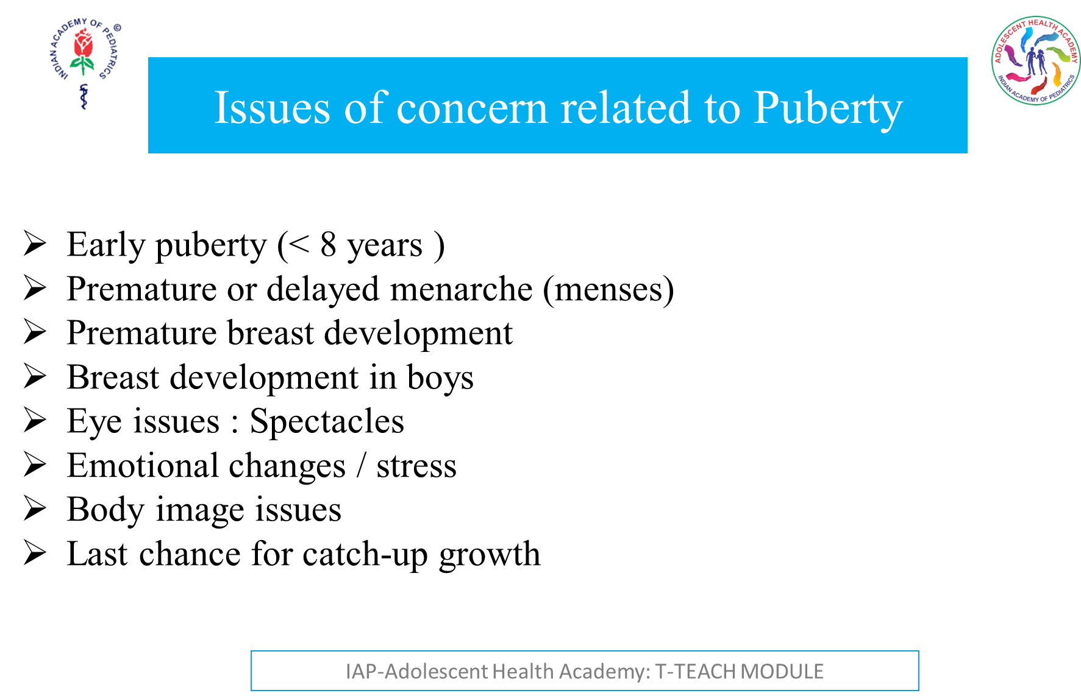
Notes:
Precocious Puberty: Appearance of secondary sexual characteristics prior to the age of 8 years in girls and nine years in boys.
2 types : central where there activation of HPG axis.
More common in girls, mostly idiopathic can also be due to neoplasm, radiation, genetic, head trauma.
Peripheral precocious puberty. There is no activation of HPGAxis. There is increase in sex steroids.
Delayed Puberty:
In boys considered a period longer than 4 years between the first signs of testicular enlargement and the end of puberty or absence of testicular growth by 14 years. In girls delayed puberty is considered by absence of breast growth by 13 years of age or more than 4 years between thelarche and menarche.
Premature breast development: Most common pubertal disorder in girls. It denotes isolated breast development before 8 years in girls who do not manifest other signs of pubertal development. This is prevalent during first two years of life. Majority cases are idiopathic. Enlargement involves only one breast, both breasts asymmetrically or both breasts symmetrically
There should be no significant changes in nipples or areola, no pubic or axillary hair. The vulva, labia Majora, Labia Minora or vagina remain prepubertal. Rest all puberty & menarche & pattern of adolescent sexual development remain normal.
It is benign, no investigation or therapy is necessary parental reassurance must. Follow up till 3 to 6 months and close monitoring of other pubertal events and growth is indicated. One needs to keep central precocious puberty in mind.
Breast development in Adolescent Boys
Enlargement of the male breast. It is a benign condition and source of significant embarrassment & psychological distress. No treatment. observation and reassurance are mainstay of therapy as condition resolves naturally. It is a glandular proliferation in the male breast and can occur in males of all ages.
Gynecomastia may present as early as 10 Years & peaks at 13 to 14 years. Decline by 17 years and 10% of boys have persistent Gynecomastia at puberty transient proliferation of ducts & surrounding tissue occurs. Due to greater physiological effects of estrogen on breast tissue seen as a normal physiological phenomenon at tanner 3-4 pubic hair & testicular volume of 5 to 10 ml.
Pubertal Gynecomastia is self-limited in 75 to 90% of adolescents and regresses over 1 to 3 years.
Body image issues slide 4: It is the perception of his body regarding its physical appearance, competence, and biological integrity. On stage phenomena where the adolescent feels he is constantly watched by the world around makes him highly conscious about his looks and style. He desires body to fit in his peer group. He is exposed to increased media influence, body shaming and bullying and adolescent high initially makes him feel low about his short comings.
Body image distortion:
A cause of persistent worry
Focus goes off at home or academics.
Affects daily routine and interpersonal relationship
Negative body image is linked to various mental health issues such as low self-esteem, depression, anxiety and substance use. Disturbance of body image is a core component of anorexia nervosa, bulimia, body dysmorphic disorder, suicide.
Early puberty in girls and late puberty in boys increase the risk. Neurodevelopmental immaturity makes them susceptible to body image issues and poor coping skills leading to excessive preoccupation and dissatisfaction with body image.
BODY DISSATISFACTION:
Girls 35% to 81%
Boys 16% to 55%
Girls worry for Boys worry for
Body build
Muscularity
Height
Genitalia
Thinning of hair
Weight
Breasts
Complexion
Buttocks
Excessive hair
With this girl show social anxiety, depressive behavior
Eating disorders’
Boys go on work out spree or indulges in substance abuse.
HIGH RISK FACTORS:
Female gender
High BMI
Media consumption
Lack of physical activity
Poor self esteem
Perfectionism
Poor parental attachment
Peer influence
SYMPTOMS:
Low self esteem
Low mood
Irritability
Low motivation
Low confidence
school refusal
academic drop
interpersonal conflict
RED FLAG SIGNS:
Looks for imperfections
Cover face, use excessive cosmetics
Wear scarfs, caps, bulky clothes to mask the body
Unhealthy weight control measures
BODY DISSATISFACTION:
Is a precursor of major psychopathologies like
Body dysmorphic disorder
Anorexia nervosa/bulimia
Depression
Anxiety
Suicidality
Substance abuse
MANAGEMENT:
CBT
Positive focus
Pharmacotherapy
KEY MESSAGES:
Body image issues are common
Family, society, media are major contributors
They are associated with major psychiatric disorders.
STRESS IN ADOLESCENTS:
Adolescence is a period of storm and they have heightened stress response. They have immature prefrontal cortex and limbic system. Brain is responsive to glucocorticoids. High o levels of ACTH and cortisol as a response to stress than any other age.
A little bit of stress is normal. Distress is the stress that negatively affects you. Eustress is the stress that has positive effect on you and energizes and motivates the teen .It gives positive outlook and makes us capable of overcoming obstacles and sickness.
EFFECTS OF STRESS:
Sleep issues
Tiredness
Conflicts with family members
Irritable /argumentative
Anorexia
Binge eating
Excess junk food
Deterioration of grades
Lack of interest in studies
Addictions
STRESS MANAGEMENT:
Healthy life style
Role of parents
Relaxation technique
Stress management tools
STRESS MANAGEMENT TOOLS:
Grounding
Unhooking
Acting on values
Being kind
Making room

Slide 17
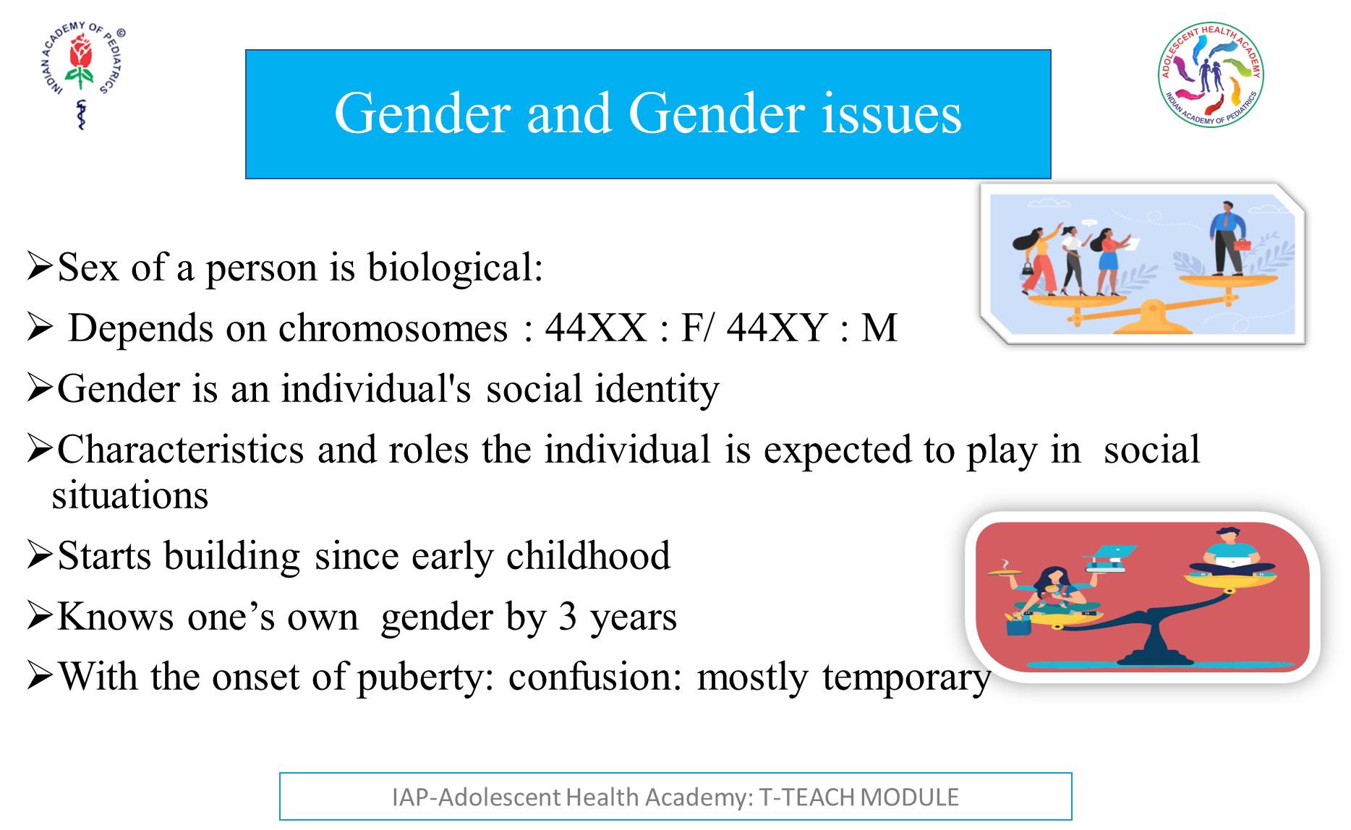

Slide 18
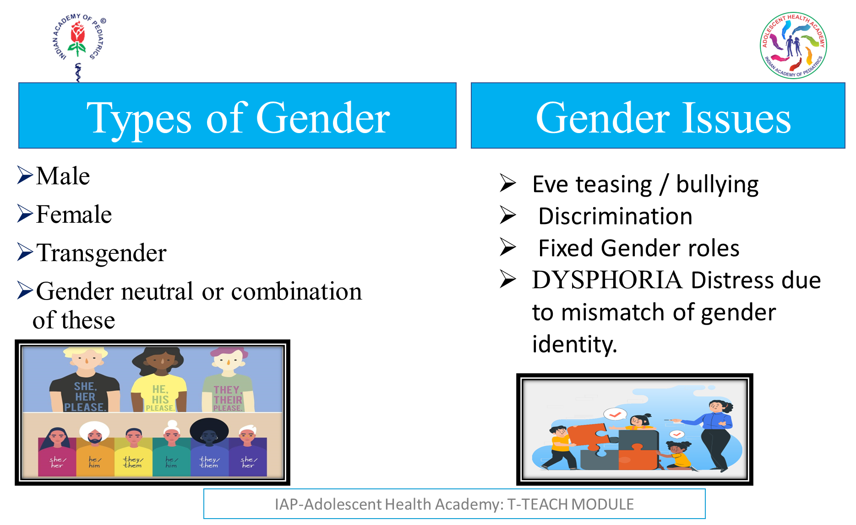
Notes:
30% of girls facing violence, 33% School dropouts and not completing higher education
70 to 80% of girls experience Eve teasing in India.

Slide 19
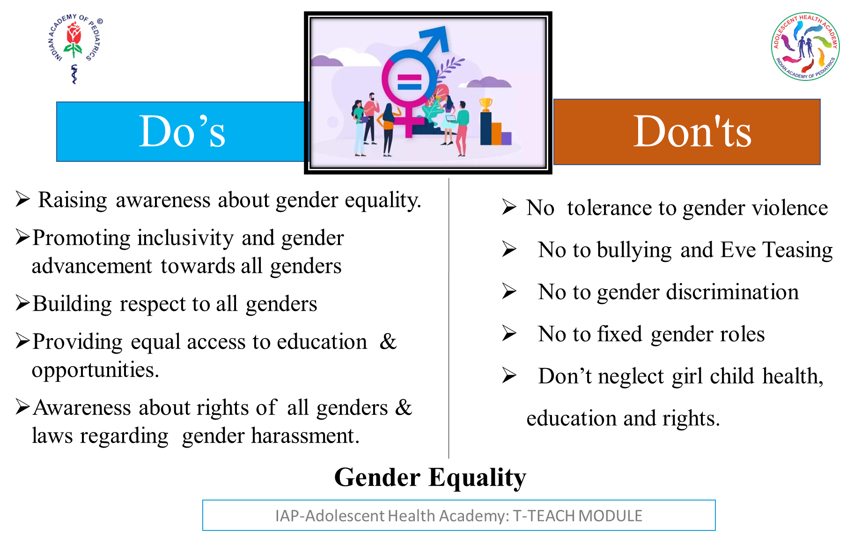

Slide 20
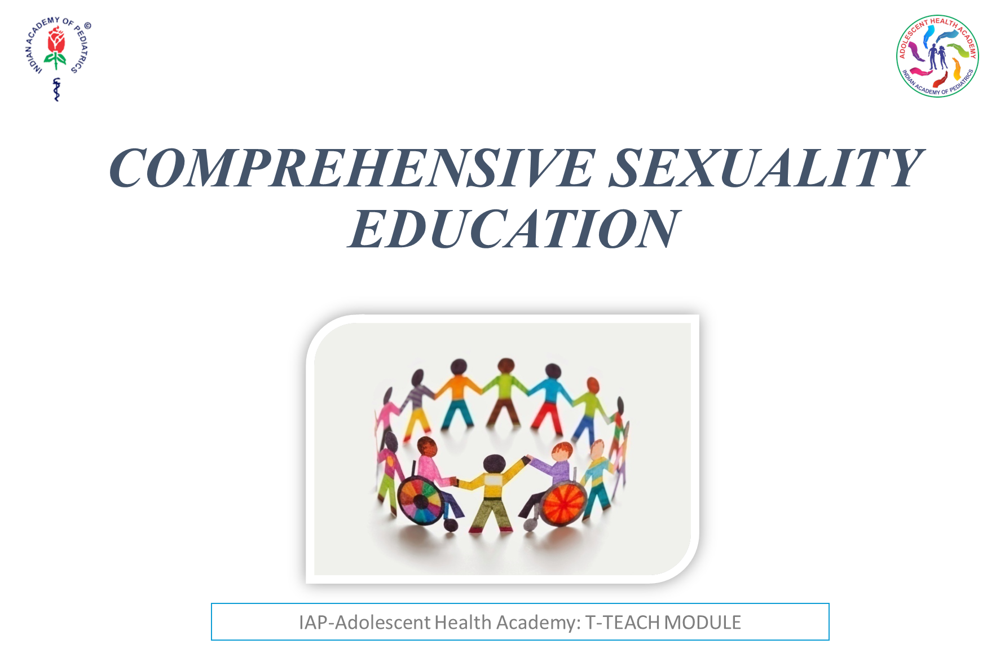

Slide 21
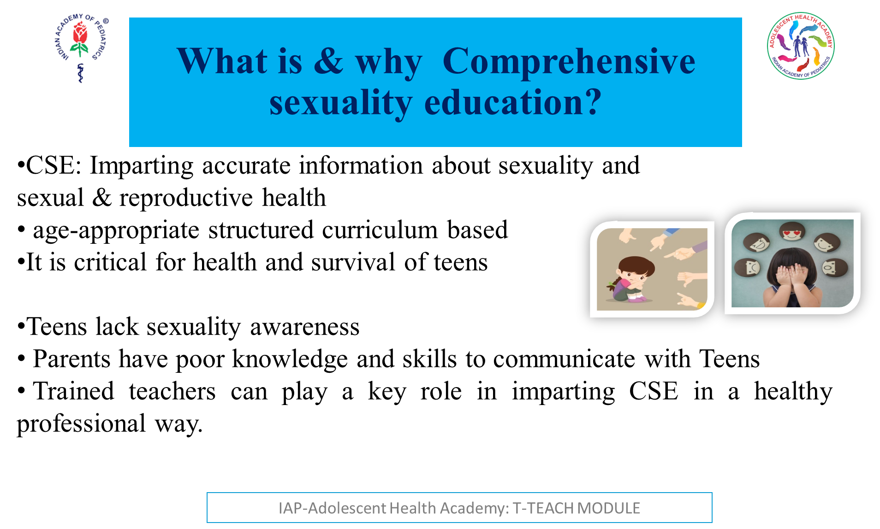
Notes:
There is a lack of Comprehensive knowledge about sexuality in Teens
Parents also have poor knowledge and skills to communicate with Teens
Teachers need training to impart sexuality education in a healthy professional way.

Slide 22
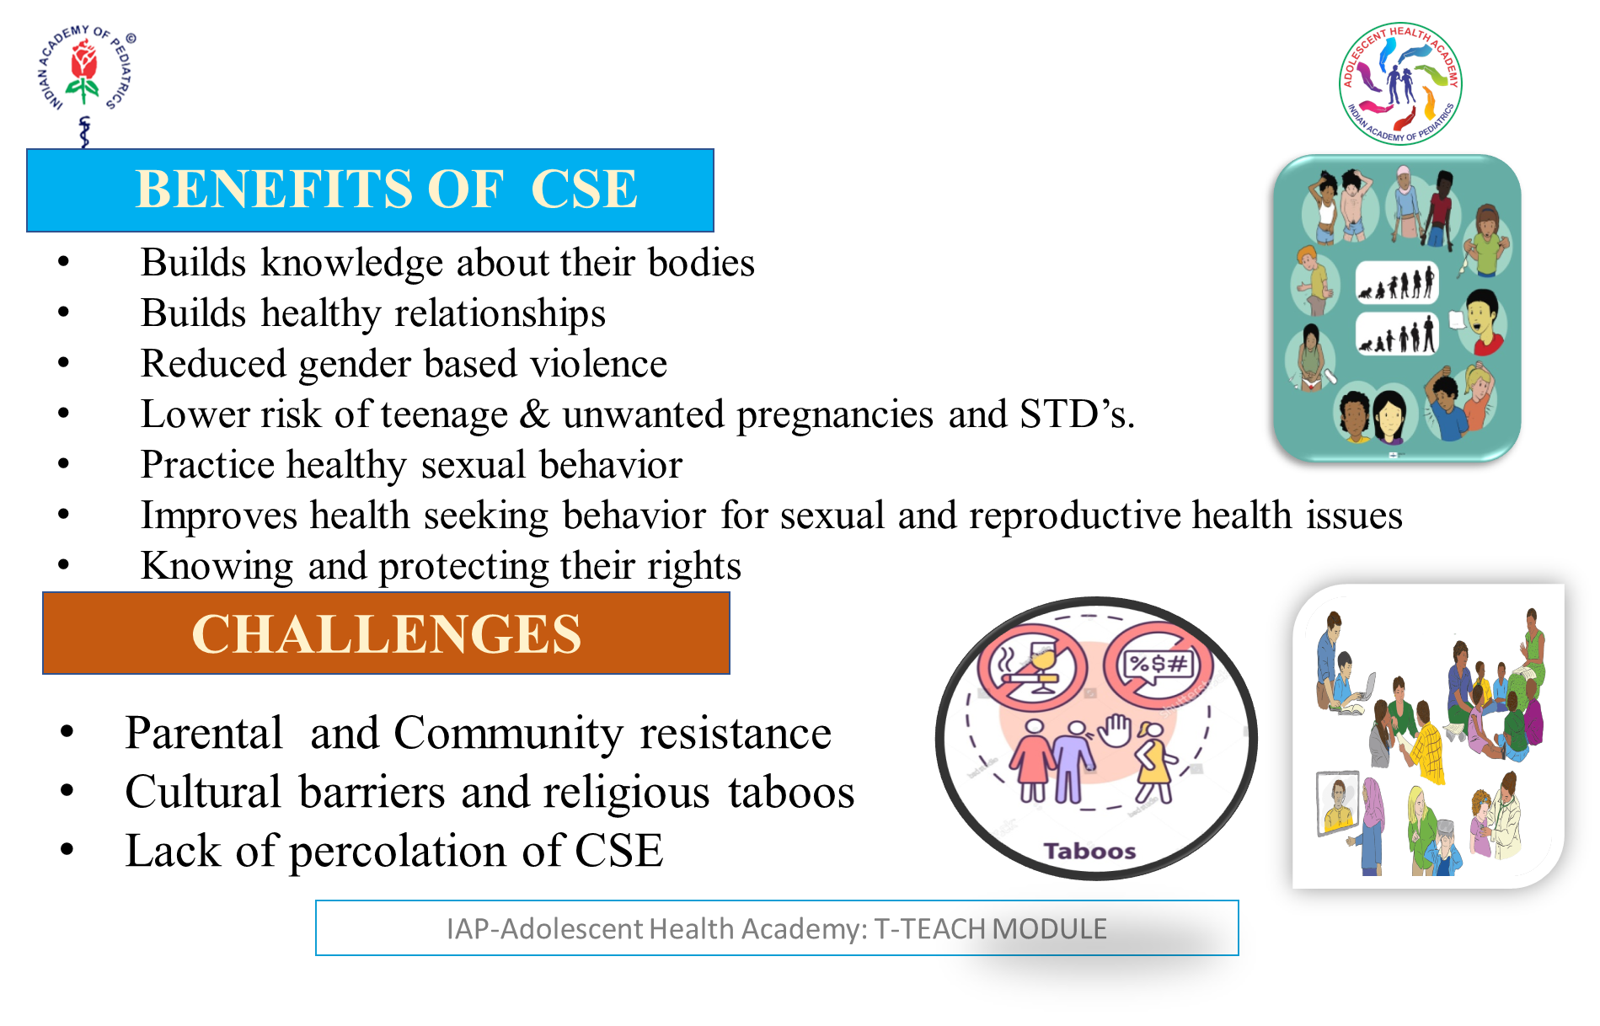

Slide 23
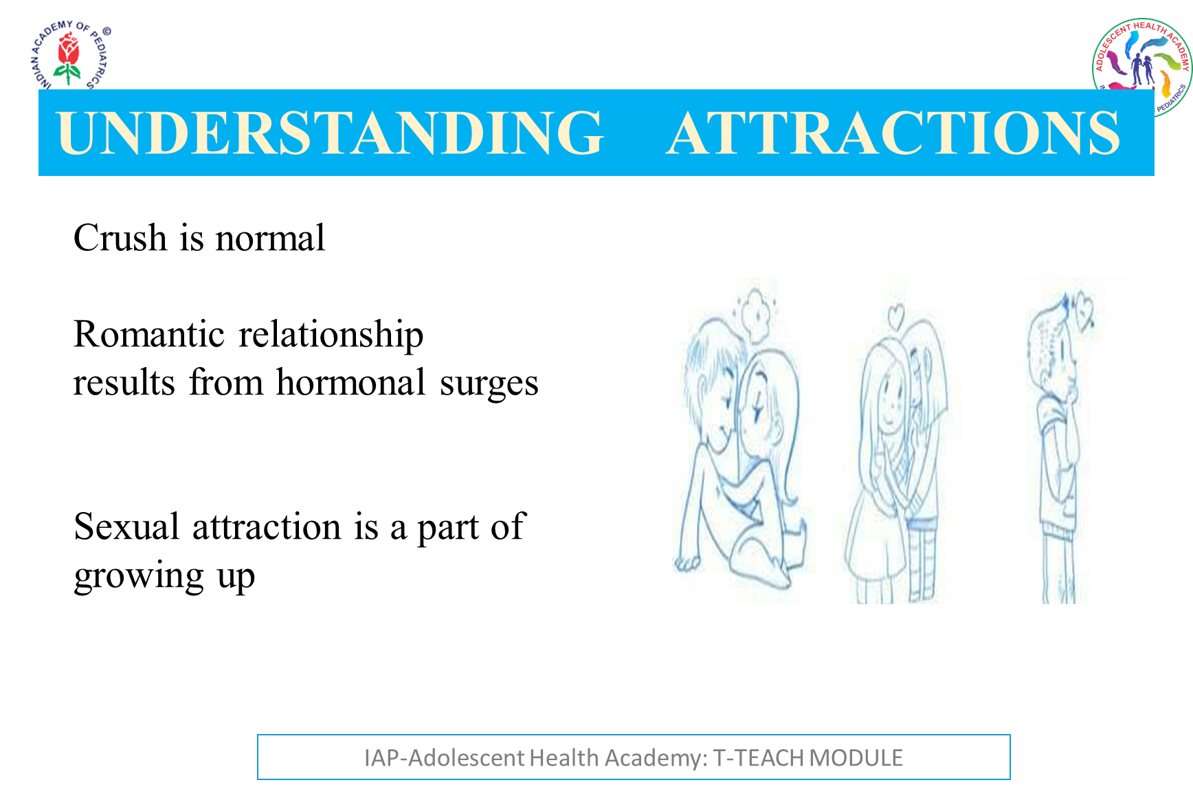

Slide 24
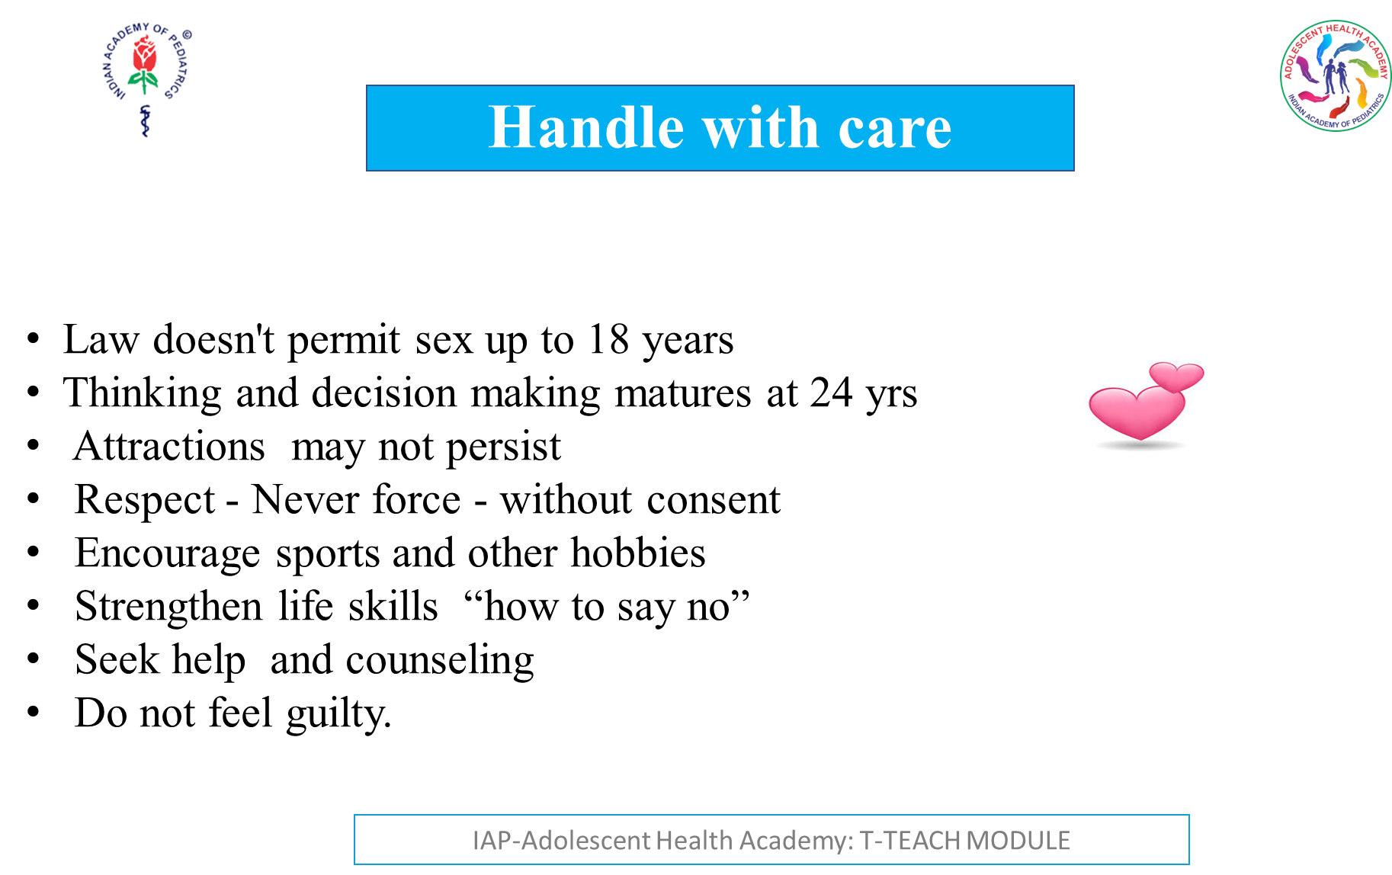

Slide 25

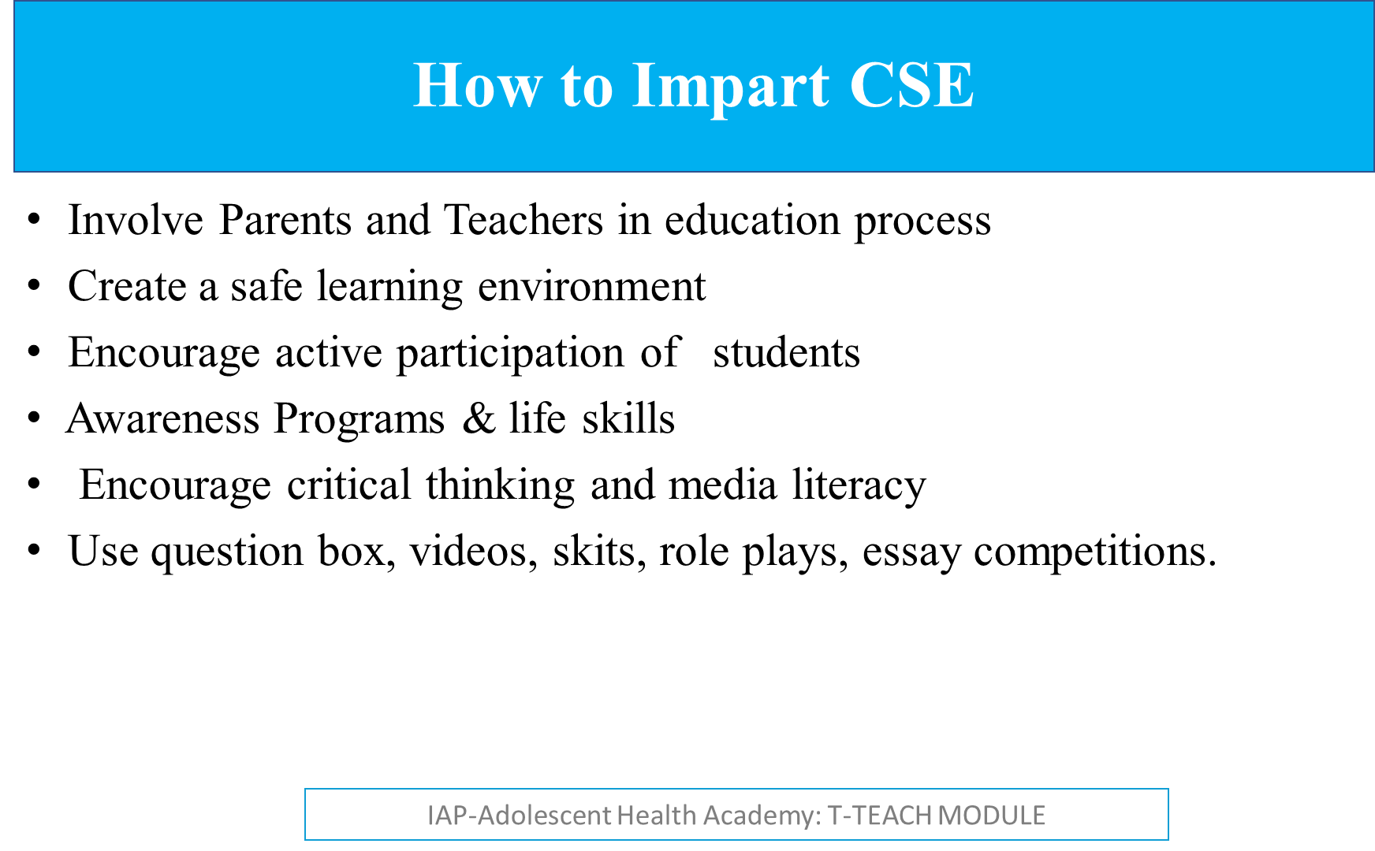

Slide 26

Notes:
A little about each of these:
Social anxiety disorder:
It’s normal to worry about social or performance situations.
But, Social anxiety disorder, also known as social phobia, is when a person has an intense fear or dread of social situations. This can happen before, during or after an event.
For example:
Speaking in public or in groups
Meeting new people or strangers
Dating
Eating or drinking in public
The person may be worried that they will do something or act in a way that is embarrassing.
They may also feel aware of the physical signs of anxiety, such as:
Sweating
Racing heartbeat
Shaky voice
Blushing
They may worry that others will notice or judge them and so try to avoid certain situations.
They may be aware that their fears aren’t logical , but it’s difficult to control them.
Panic Disorder:
Fear of certain situations can cause panic attacks, for example,
Panic disorder symptoms can include:
An overwhelming sense of dread or fear
Chest pain or a sensations of heart beating irregularly
Feeling that the person may be dying or having a heart attack
Sweating and hot flushes, or chills and shivering
A dry mouth, shortness of breath or feeling of choking
Nausea, dizziness and feeling faint
Numbness, pins and needles or a tingling sensation in the fingers
A need to go to the toilet
A churning stomach
Ringing in the ears
Obsessive compulsive disorder (OCD)
A person with OCD will have obsessions and/or compulsions.
An obsession is a repeated unwelcome thought or image. These can be difficult to ignore. These thoughts can be disturbing, which can make the person, feel distressed and anxious.
A compulsion is something that the person will think about or do repeatedly to help relieve anxiety.
For example: Saying a phrase in your head to calm yourself. Or checking that the front door is locked, again and again, for multiple number of times.
The person gets such thoughts and might believe that something bad will happen, to their loved ones, if they don’t do these compulsions.
The person may realise that their thinking and behaviour is not logical but they still find it very difficult to stop.
There are different types of OCD including:
Contamination – An impulse to clean or wash because they perceive something as contaminated.
Checking – The constant need to check things in their environment to prevent damage, for eg - fire, leaks or locks.
Intrusive thoughts – Repetitive thoughts which may be horrific and upsetting
Hoarding – Not feeling able to throw away useless or worn out items
Phobias
A phobia is an overwhelming fear of an object, place, situation, feeling or animal.
Phobias are a more intense feeling than fear.
They develop when a person has heightened feelings of danger towards a situation or object.
Someone with a phobia may avoid the thing that’s causing them anxiety.
Common examples of phobias include:
Animals – Such spiders, snakes or rodents
Environmental – Such as heights and germs
Situational – Such as going to the dentist
Body – Such as blood or being sick
Sexual – Such as performance anxiety
GAD (Generalised Anxiety Disorder) is the most common type of anxiety disorder. The main symptom of GAD is excessive worrying about different activities and events. The person may feel anxious a lot of the time. Might feel ‘on edge’ and hyper-alert to their surroundings.
GAD can affect their day-to-day life, in many areas, for example;
The ability to work or hold down employment.
Travel, or leave the house.
Energy, sleep or concentration.
They might also have physical symptoms, such as muscle tension and sweating.
It is common to have other conditions such as depression or other anxiety disorders along with GAD.
GAD can be difficult to diagnose because it doesn’t have some of the unique symptoms of other anxiety disorders.
A doctor is likely to diagnose GAD if the person has felt anxious for most days over six months and it has had a negative impact on multiple areas of their life.
Animals – Such spiders, snakes or rodents
Environmental – Such as heights and germs
Situational – Such as going to the dentist
Body – Such as blood or being sick
Sexual – Such as performance anxiety
Agoraphobia is a fear of being in situations where escape might be difficult. Or situations where help wouldn’t be available if things go wrong.
For Example, This could be:
Leaving home
Being in public spaces
Using public transport
Being in crowded spaces
These situations affect the daily routine, of the person, as they actively start avoiding them for fear of getting distressed, panicked or anxious.
Post-traumatic stress disorder (PTSD)
PTSD is caused by a threatening situation, such as a car crash or abuse. The affected person can feel anxious for months or years after the event, even if they themselves weren’t physically harmed at the time.
They get Nightmares, or Flashes of recall about the event, and get up with symptoms of panic or anxiety.
They start avoiding the place, the persons involved, or even the persons who may remind them of the episode.

Slide 27
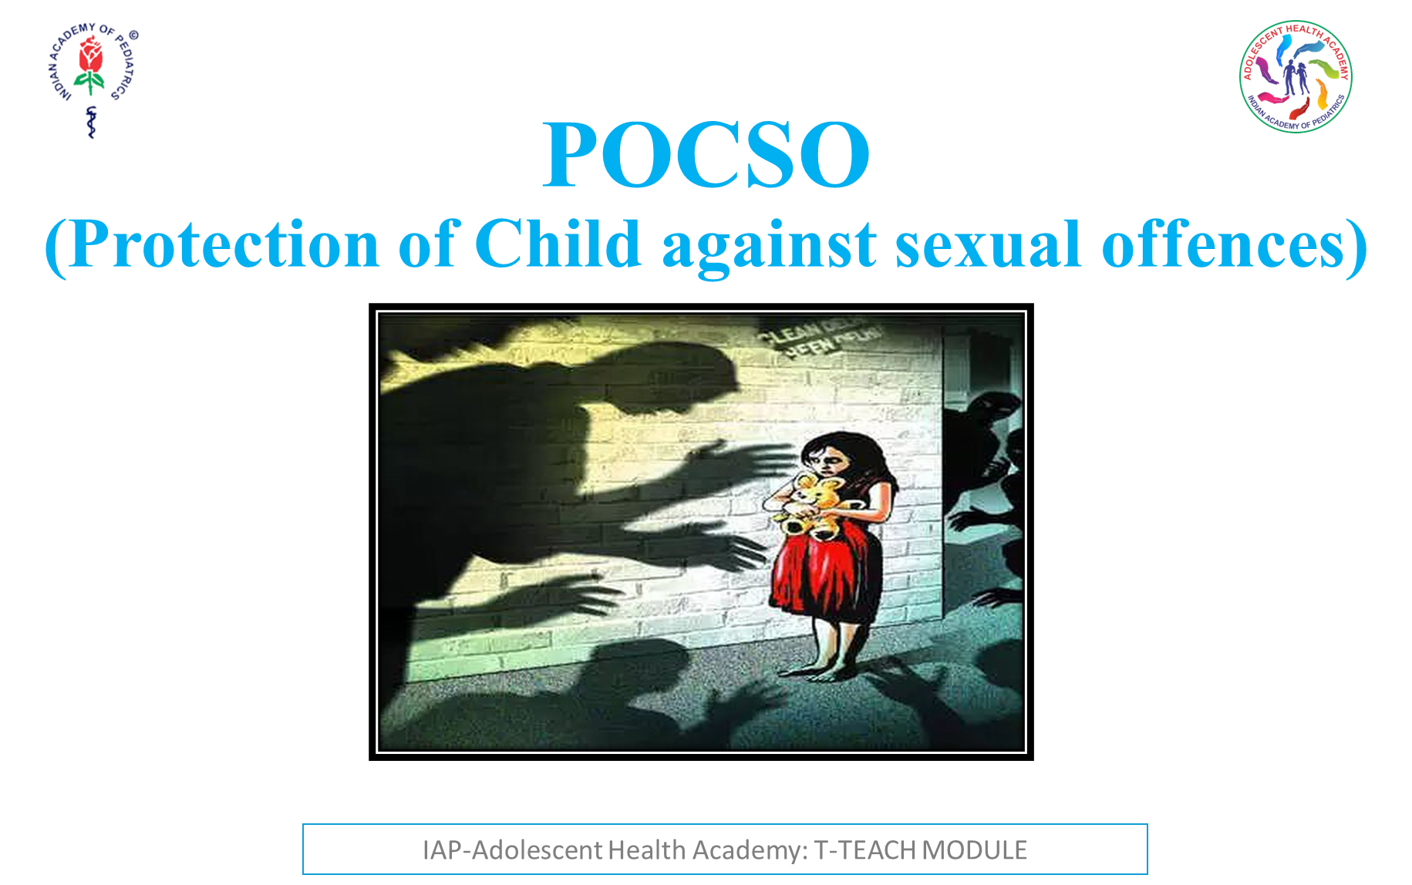

Slide 28
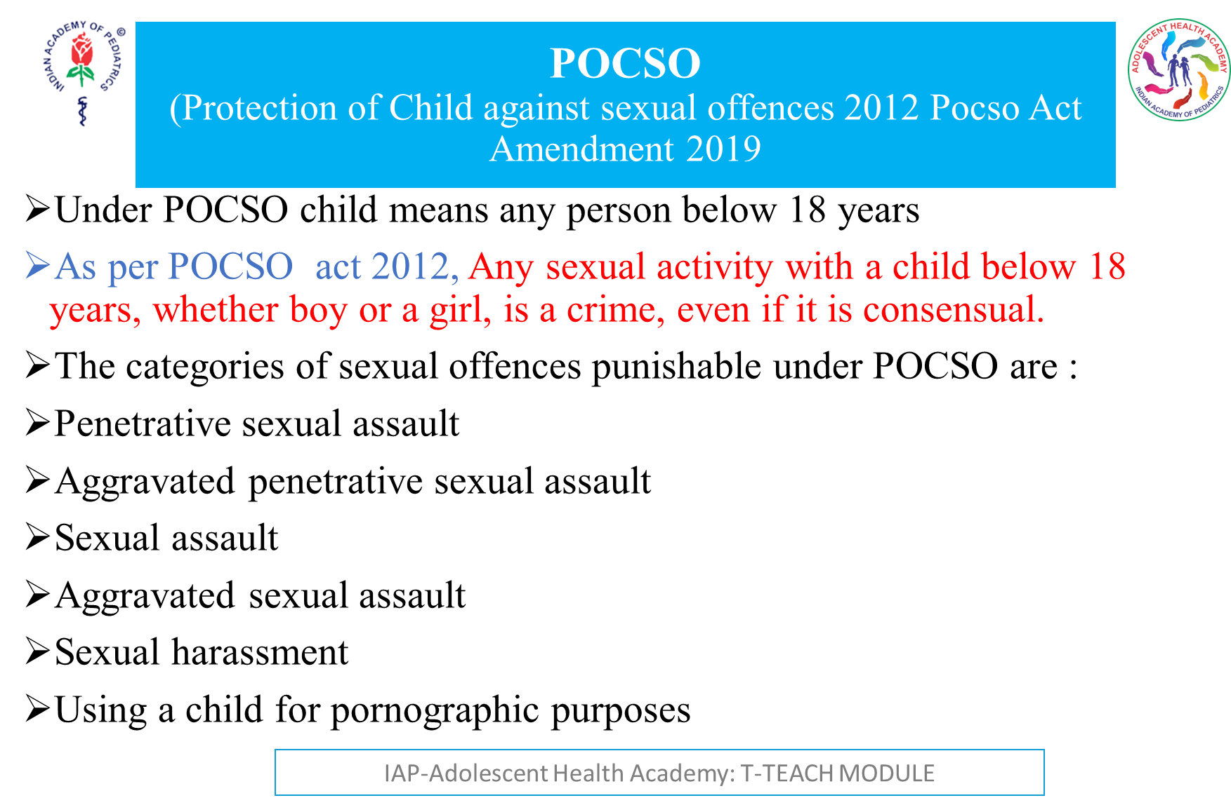
Notes:
Sexual assault does not involve penetration where an object or part of a body is inserted into the child. Penetration is more serious offence and dealt with separately under POCSO.
Any act done with sexual intent on a child involving physical contact is also sexual assault. Whoever commits
Sexual assault the imprisonment is for 3 years which may extend to 5 years and shall also be liable to fine.
Penetrative sexual assault (PSA) is penetrating his penis to any extent into the vagina, mouth, anus or urethra of a child or make the child do so with him or any other person. Applying one’s mouth or penetrating any object is also PSA.
The punishment for same is 7 years with an extent to life imprisonment as well as fine. Aggravated sexual assault is the offence. Sexual assault or PSA committed by certain person in certain circumstances it is called aggravated. It is more serious & punishment is greater. If committed by Police officers, armed forces, staff of hospitals, educational or religious institution.
Offense also caused by dangerous weapon to harm or kill the child, caused disability, offence committed on mentally or physically disabled child or on a pregnant child.
Punishment is 5 years imprisonment and extended to 7 years and payment of fine. The punishment for aggravated PSA is 20 Years of rigorous imprisonment which can extend to life imprisonment as well as payment of fine.
AGGRAVATED SEXUAL ASSAULT:
Police officer commits sexual assault on a child within the limits of police station or where he is appointed, or a member of armed forces, securities commits SA on the child where the person is deployed like jail, remand home, education institution, religious institution.
Punishment is for 5 years and may extend to 7 years and shall be liable to fine.

Slide 29
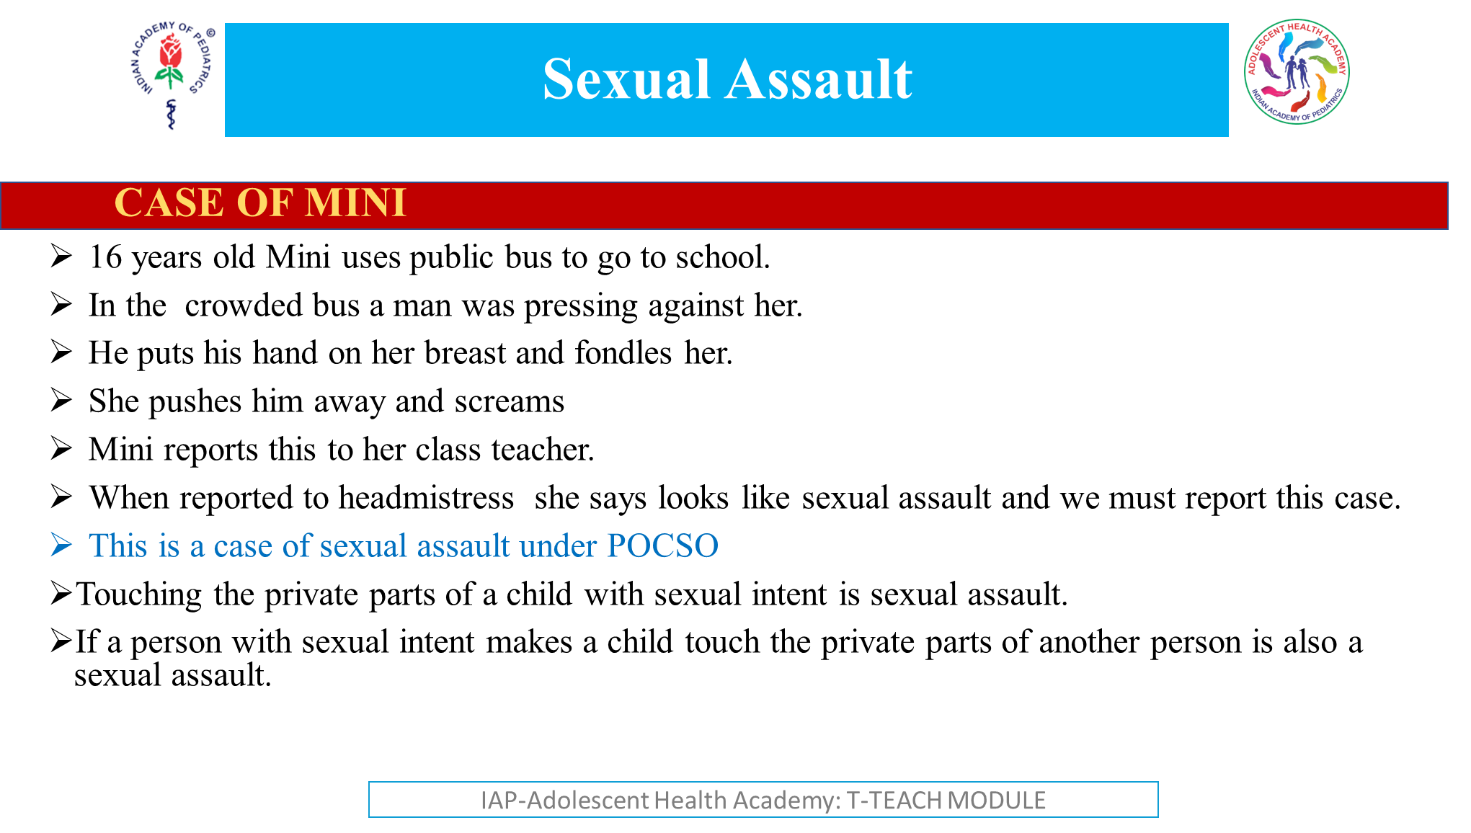

Slide 30
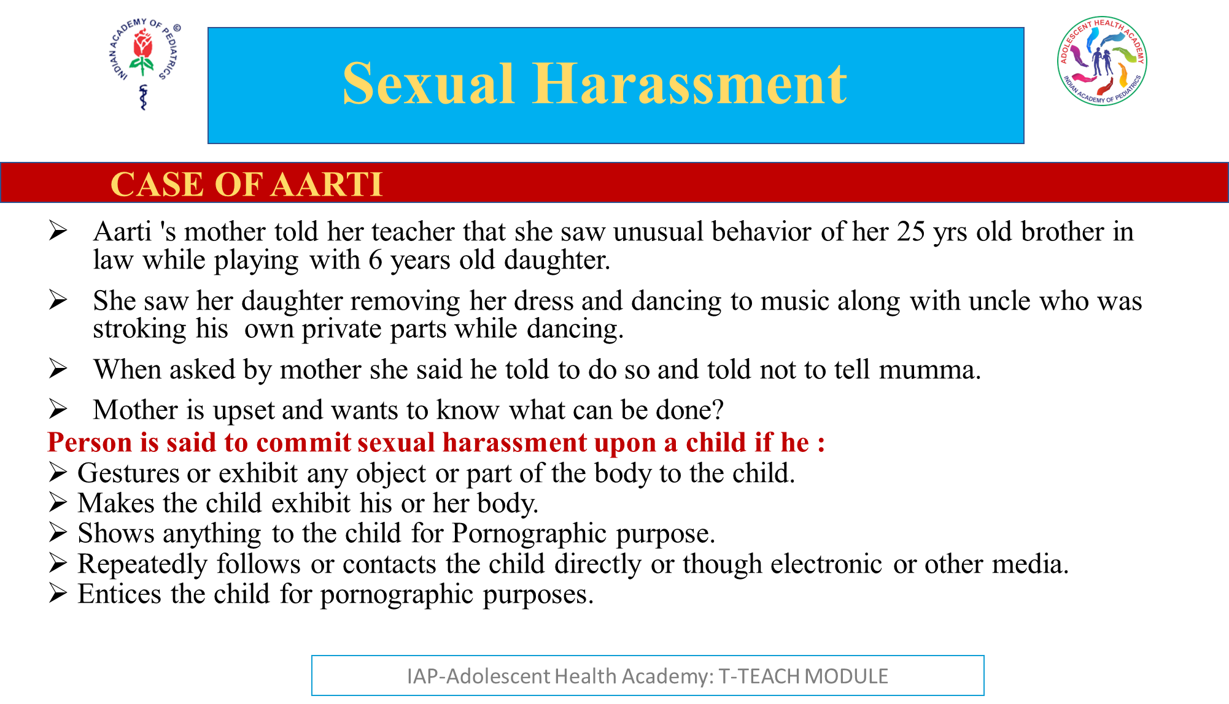

Slide 31
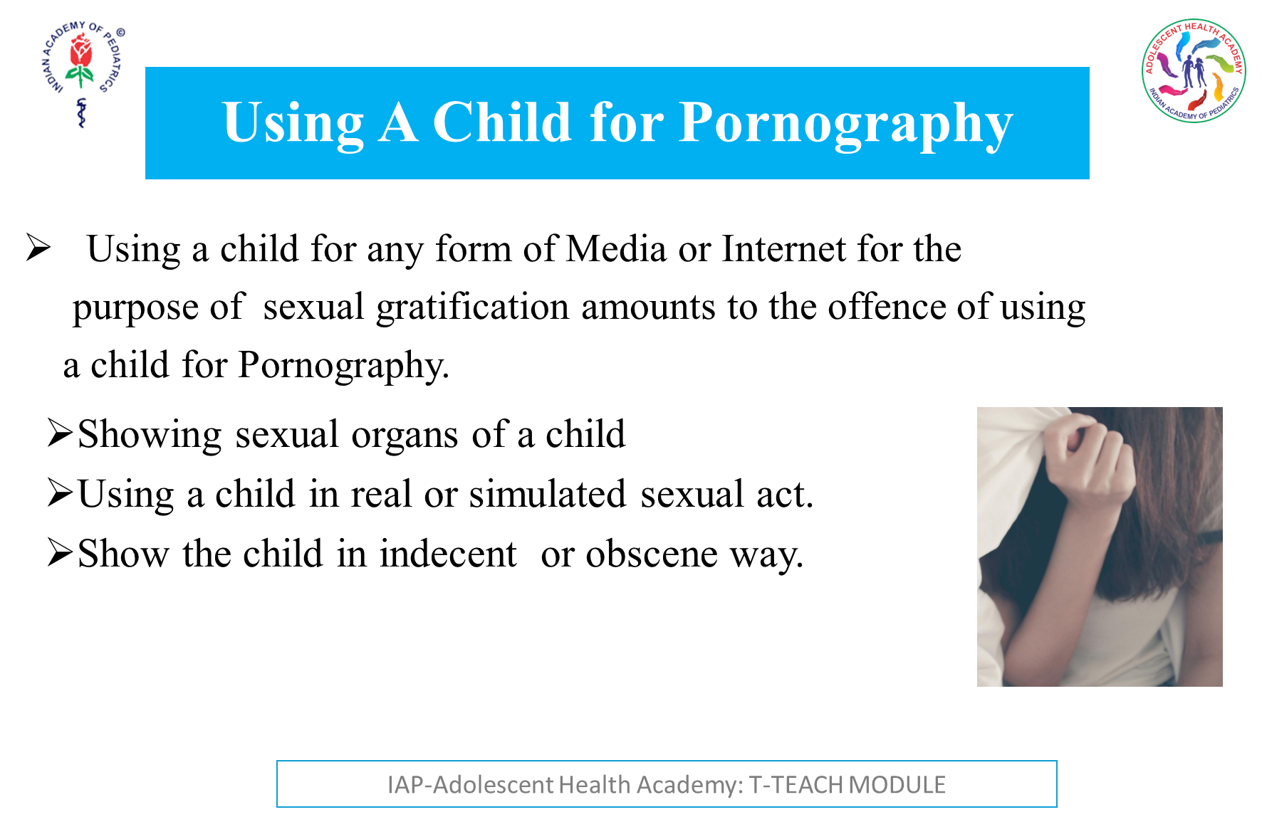

Slide 32
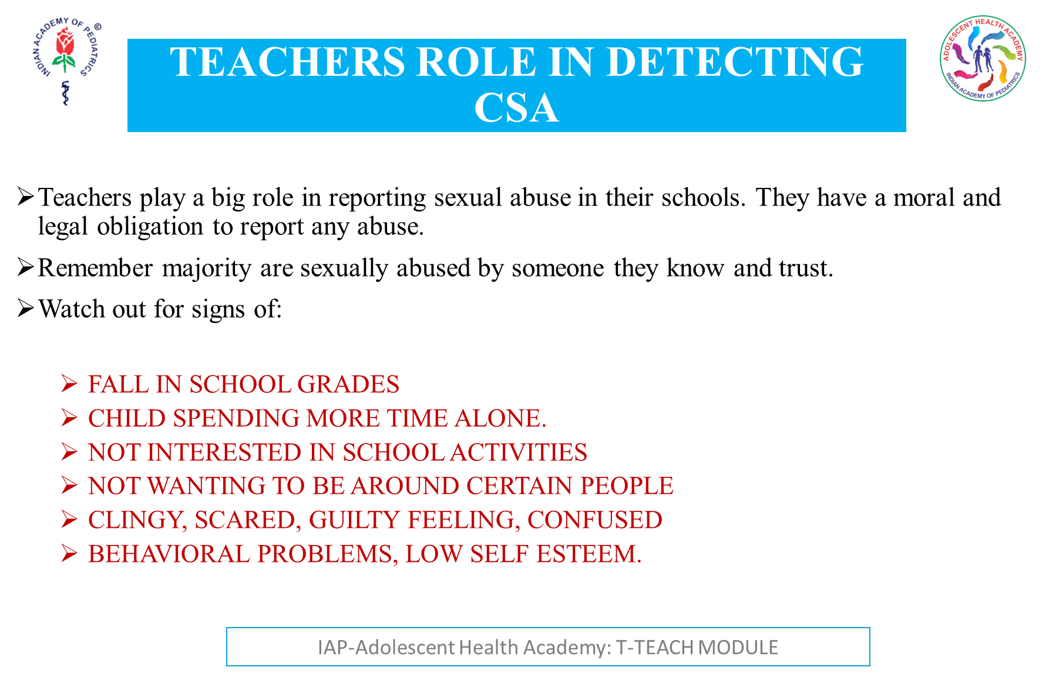

Slide 33
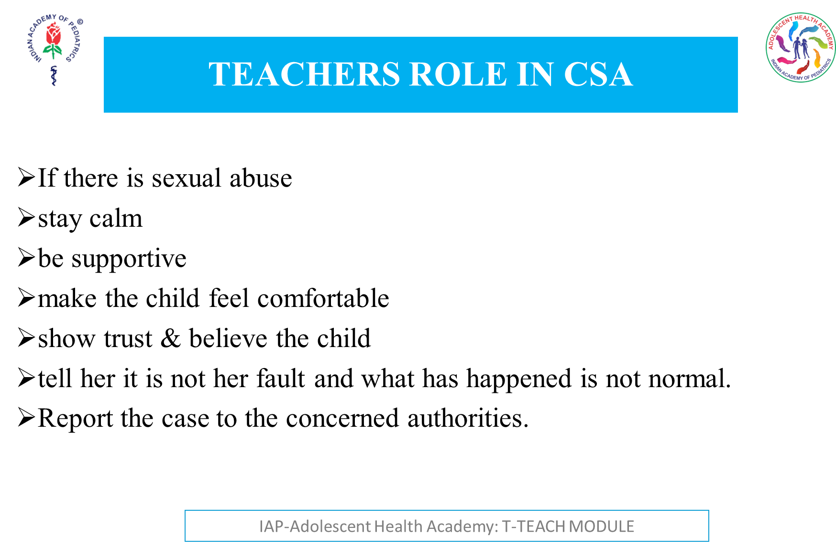

Slide 34
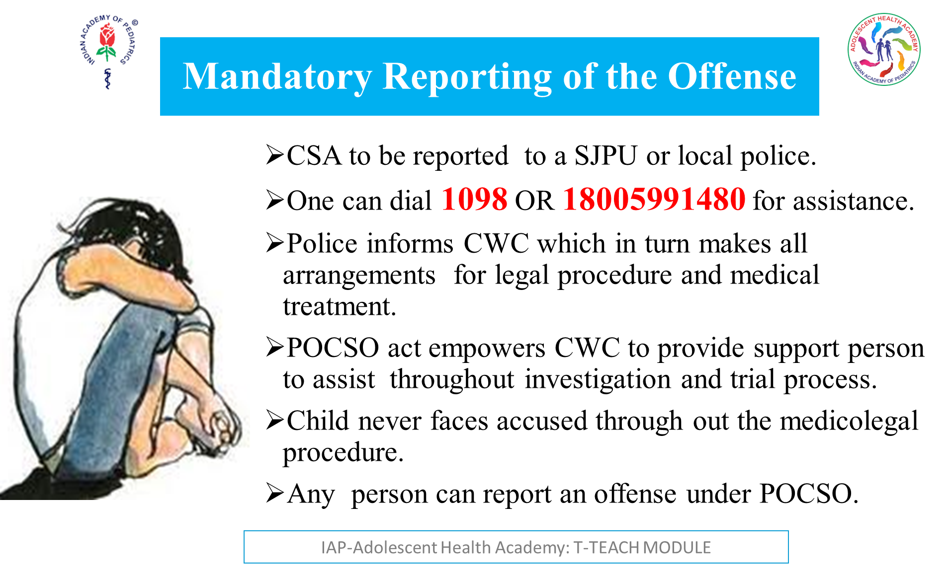
Notes:
SJPU :special juvenile police unit
CWC: child welfare committee

Slide 35
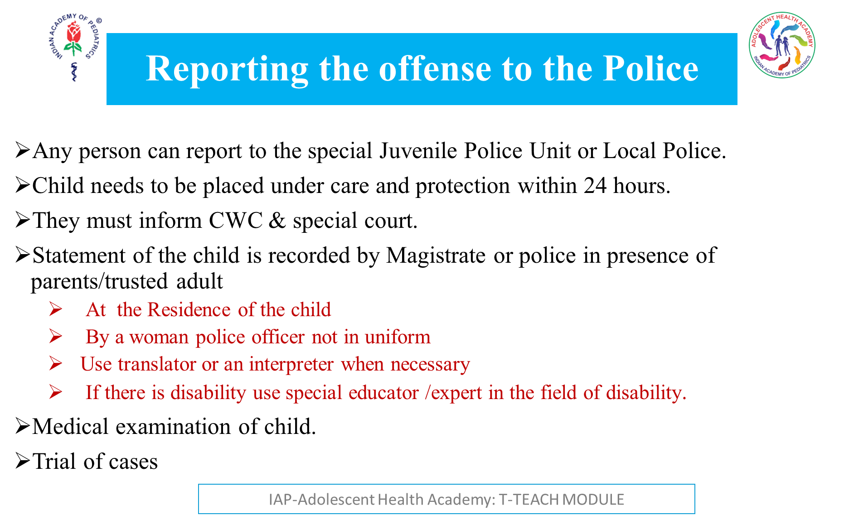
Notes:
If sexual offence has occurred or might occur against a child any person can report to the special Juvenile Police Unit or Local Police. Child needs to be placed under care and protection within 24 hours. They must inform CWC & special court.
When offence under POCSO is registered the statement of the child is recorded by Magistrate or police in presence of parents or any person whom the child trusts.
Medical examination to be done ASAP at the very first instance when it comes to light without formal recording of complaint or FIR.
Girl child to be examined by a women doctor
Examination to be done only in the presence of parents or some other person child has trust Trial of Cases to be tried in special court with special public prosecutors.
Trial to be held in camera and without revealing the identity of the child.
Use of Translator or interpreter is allowed to record the statement of the child.
Cases under POCSO to be disposed of within one year from the date of the offense is reported.

Slide 36
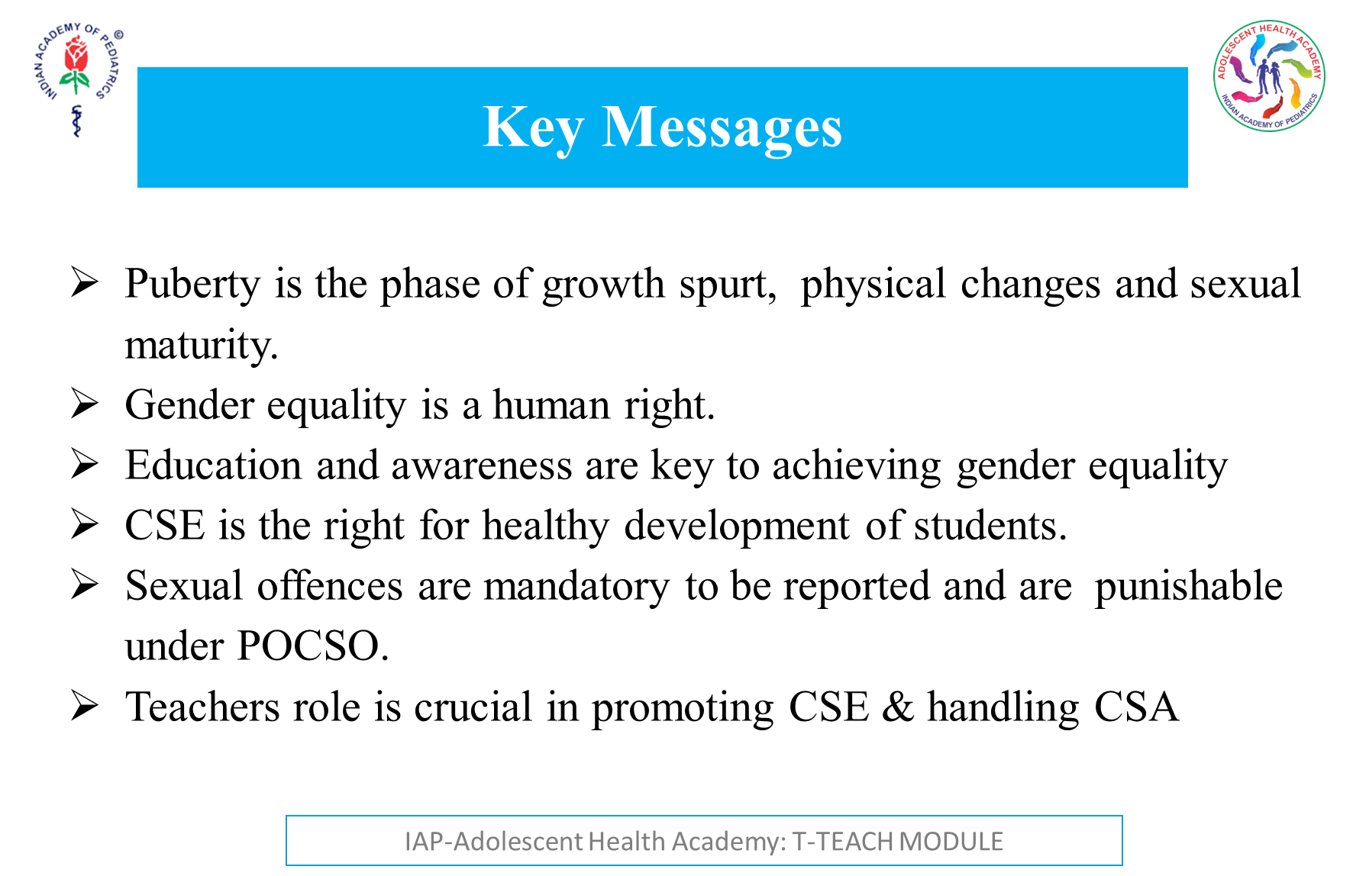

Slide 37


