Slide 1


T –Teach Module
T –Teach Module
(Teachers’ Training and Empowerment in Adolescent Care and Health)
IAP -AHA’s -Training Module for Teachers
IAP-Adolescent Health Academy: T-TEACH MODULE

Slide 2

IAP-Adolescent Health Academy: T-TEACH MODULE

Slide 3
Concept
Adolescence is a crucial stage in an individual's life marked by physical, social, emotional, and cognitive changes. During this period, adolescents require guidance and support from various sources, including teachers.
Teachers, as important stakeholders, play a significant role in the overall development of adolescents and their well being, as they spend a considerable amount of time with them in school settings.
Therefore, it is essential to equip teachers with the necessary skills and
knowledge to effectively support and care for adolescents.
IAP-Adolescent Health Academy: T-TEACH MODULE

Slide 4

IAP-Adolescent Health Academy: T-TEACH MODULE

Slide 5
T –Teach Module
Dr Shubhada Khirwadkar (National Convenor)
Dr Swati Ghate (Academic editor)
Dr Nishikant Kotwal (National Co-ordinator)
IAP-Adolescent Health Academy: T-TEACH MODULE

Slide 6
Topics &Contributors
Understanding Adolescent Behaviour: Dr Swati Ghate, Dr Poonam Bhatia
Handling Teens with problematic behaviour: Dr Sushma Desai, Dr Ashim Ghosh
Dealing with silently suffering Teens(Mental Health Concerns): Dr Sunita Manchanda, Dr Geeta Bansal
Dealing with disorders of Learning: Dr Newton Luiz, Dr Chitra Sankar
The good and the bad about Media: Dr Geeta Patil, Dr Prashant Karia
IAP-Adolescent Health Academy: T-TEACH MODULE

Slide 7
Topics &Contributors
Substance abuse - What teachers should know: Dr Chitra Dinakar Dr Shilpa C
Understanding Teen Sexuality: Dr Himabindu Singh, Dr Sushma Kirtani
Positive discipline: Dr Shubhada Khirwadkar, Dr Kalyani Patra
Promote Healthy Life Style: Dr Shamik Ghosh, Dr Shalini Bhasin
Communication Skills and self help: Dr Nishikant Kotwal, Dr Chitra Kulkarni
Prevent , Empower , Stand Strong (self defense): Dr. Jayashree Deshpande
IAP-Adolescent Health Academy: T-TEACH MODULE

Slide 8
Reviewers
Dr Swati Bhave
Dr C P Bansal
Dr Sukanta Chatterjee
Dr Preeti Galagali
Dr Samir Shah
Dr Piyali Bhattacharya
Dr Atul Kanikar
Dr Atanu Bhadra
Dr R G Patil
Dr R N Sharma
IAP-Adolescent Health Academy: T-TEACH MODULE

Slide 9


Promoting a Healthy Lifestyle
Dr. Shamik Ghosh Dr. Shalini Bhasin
IAP-Adolescent Health Academy: T-TEACH MODULE

Slide 10
Learning Objectives
What is meant by Life Style disorders
Why is there a rising trend of Life Style disorders
What is a Healthy Diet for Children & Adolescents
What are guidelines about Healthy Life Style for school children

Slide 11


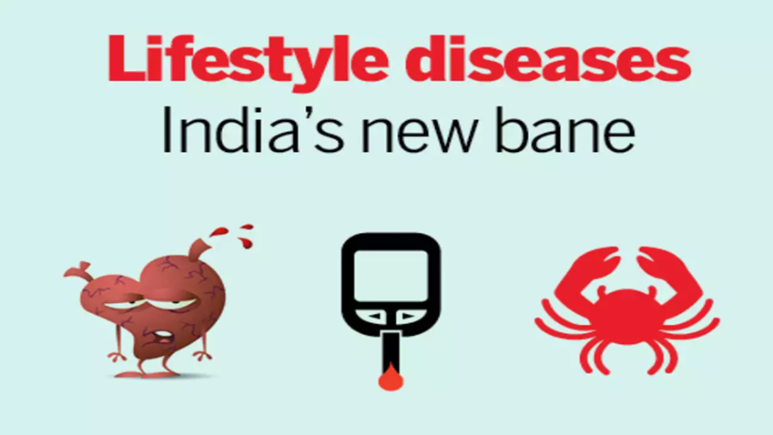
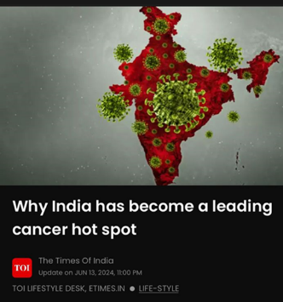
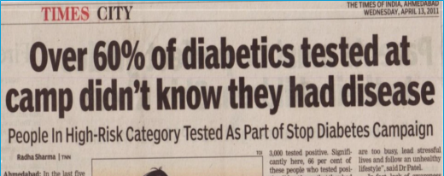
Life Style Disorders are on the Rise in India
Notes:
India became the World Capital of Diabetes in 2020
However most people are unaware of having Diabetes / High BP
India has Rising Rates of Cancer
In 2024-India declared that Childhood Cancer is on the Rise here

Slide 12
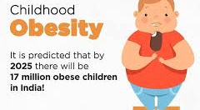
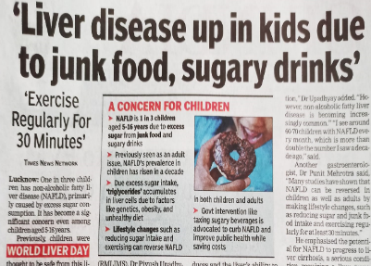
Obesity: The rising epidemic
(India ranked 3rd)
Notes:
Approximately 8 crore Indians are obese, with 1 crore aged 5-19.
Excess weight and obesity, two common lifestyle problems that plague nearly 17% of India's population, are costing the country 1.02% of its GDP

Slide 13
Life Style Disorders
Life Style Disorders are Medical conditions that cannot be passed from person to person by Air, Water, Touch or vectors like Mosquito
They are caused by a combination of Lifestyle factors, environment & genetics
Examples are Heart disease, Diabetes, Cancer, High BP, Obesity, Stroke, Chronic Lung diseases, Mental health conditions
They are preventable by Lifestyle modifications & timely interventions

Slide 14
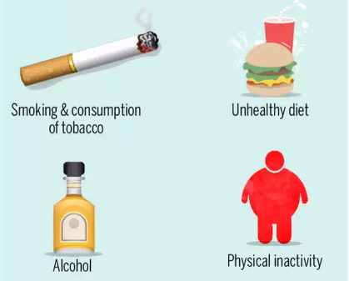
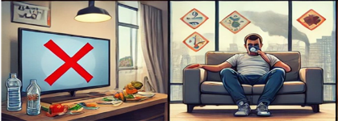
Preventable Causes of Life Style Disorders
Unhealthy food
Sedentary habits
Improper sleep & poor Sleep Hygiene
Excess Screen time & Social media
Tobacco & Alcohol Abuse
Poor Air quality
Mental stress & Anxiety
Notes:
ICMR Survey advises to embrace traditional Indian lifestyle, food & recipes

Slide 15





Every School a Health Promoting School
UGC advisory (2024) to all universities, Prohibiting sales of Unhealthy food in Canteen & Promoting Healthy Food
International & National Organizations urge Schools to take Action
Notes:
Bad habits are laid down in young age, and we pay the price when we grow old- beej bachpan me, phal bade hone par
International agencies like WHO, Unicef & UNESCO, AND india Academy of Pediatrics, Adolescent Health Academy & the IAP flagship program SSS: Snkalp sampoorna Swasthya… ALL URGE the Schools to Become Health Promoting Schools & urge CALL FOR HCP/ COMMITMENT of GOI to help them

Slide 16

Dietary Guidelines for Indians by ICMR-2024
56.4%of total disease burden in India is due to unhealthy diets
Healthy diets & physical activity reduce Lifestyle disorders & prevent 80% Diabetes
Balanced diet:
40%-Nuts, milk, vegetables, fruits
15%-pulses, beans and meat
45% calories from cereals & millets
Notes:
The dietary habits of Indians have undergone significant changes over the past few decades, leading to an increase in the prevalence of Life Style Disorders, while some of the problems of undernutrition continue to persist
Dietary Guidelines for Indians (DGIs) by ICMR in May 2024 were given- to meet the requirements of essential nutrients and prevent non-communicable diseases (NCDs) such as obesity and diabetes
We shall go over some of the Guidelines relevant to Adolescents
56.4%of total disease burden in India is due to unhealthy diets
-Healthy diets and physical activity can reduce a substantial proportion of coronary heart disease (CHD) and hypertension (HTN) and prevent up to 80 per cent of type 2 diabetes-
-A balanced diet should provide not more than 45% calories from cereals, and millets and up to 15% of calories from pulses, beans and meat. Rest of the calories should come from nuts, vegetables, fruits and milk, the guidelines said.

Slide 17

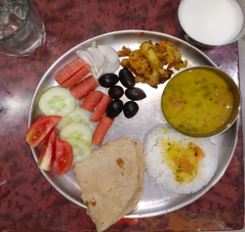
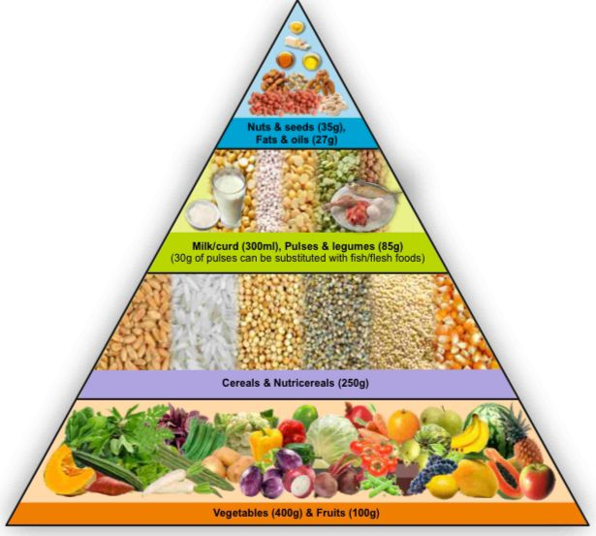
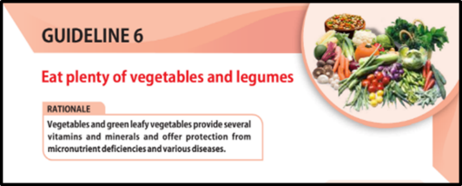

Balanced Diet, 50%Vegetables & Fruit
1/2
1/2
1/2
Composition of meal:
Cereals
Pulses
+/-Nonveg foods
Fruits
Vegetables
Dairy Products
Water
FOOD PYRAMID
Notes:
Half the days consumption of food should comprise of Vegetables & Fruits
The FOOD PYRAMID now shows excess consumption of Vegetables & Fruits and is placed at the bottom of the chart, the earlier one advised higher use of cereals

Slide 18
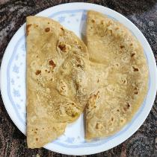
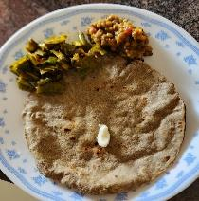
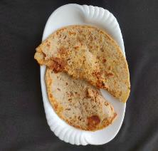
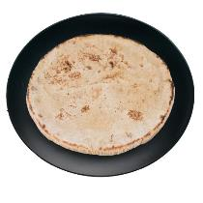
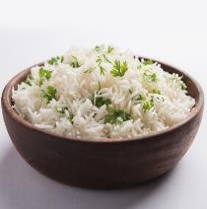
Cereals Should Include Millets
Cereals provide energy and several nutrients
Cereals eg. rice & wheat
Millets eg. Ragi, Bajra, Jowar, Jau
Vegetable Paratha
Roti
Bajra Roti
Bhakri
Rice

Slide 19
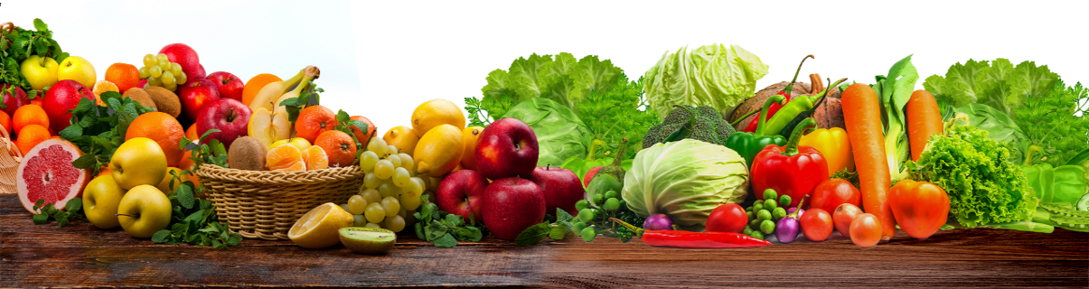
Vegetables & Fruits
Good source of fibre, iron, vitamins, minerals
Different natural colours offer different vitamins, minerals
Have 2.5/ 5 cups of 5 different coloured vegetables & fruits per day
Fruit should be washed properly & eaten. Avoid fruit juice

Slide 20
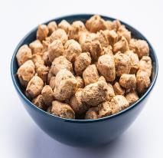
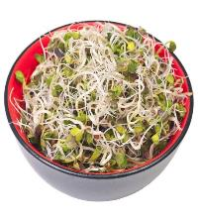
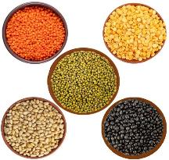


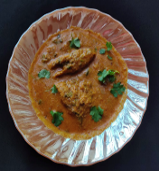
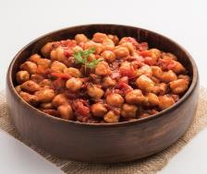
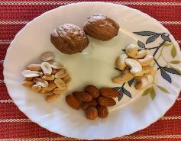
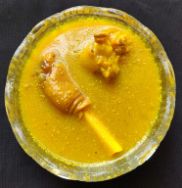
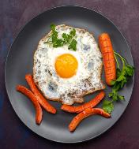
Proteins: Vegetarian & Non-Veg. Sources
PULSES
SOYABEAN
SPROUTS
CHICKEN
FISH
CHHOLE / CHANA
NUTS
EGG
MEAT
Notes:
Adequate Protein should be consumed but Protein Supplements should not be used

Slide 21
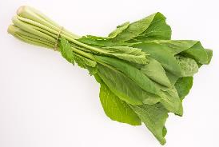
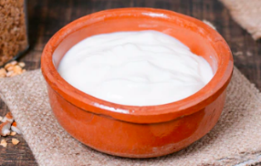
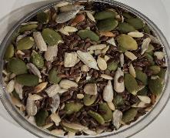
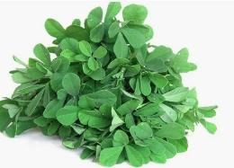
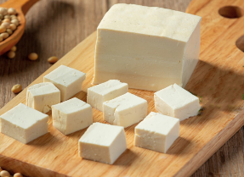


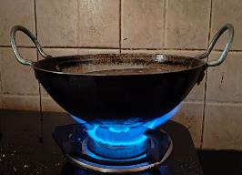
Action Time!!
Name Few Foods Rich In Calcium
Name Few Foods Rich In Iron
All dairy products, seeds eg. Curd, milk, paneer, chia seeds,
Pumpkin seeds, Ragi
Foods cooked in iron utensils, Non veg foods, Green leafy vegetables eg.Fenugreek leaves (methi), spinach (palak), Dry fruits
Curd
Fenugreek
Seeds
Spinach
Iron Vessel
Paneer
Mutton Liver
Milk

Slide 22
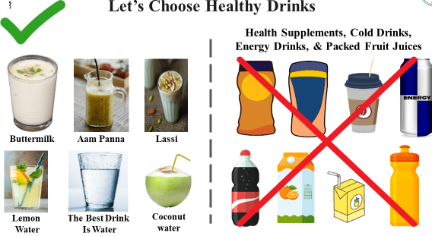
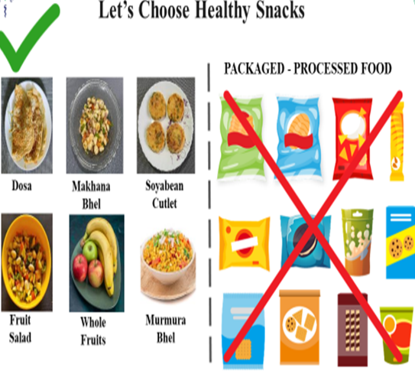
Let’s Choose Healthy Drinks & Snacks
Ref: SSS Presidential Action program of IAP

Slide 23
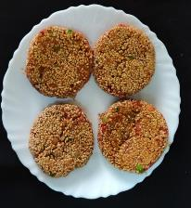
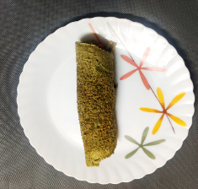
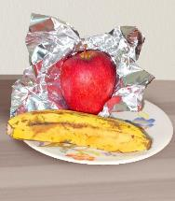
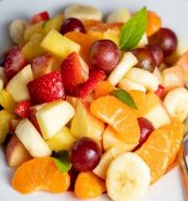

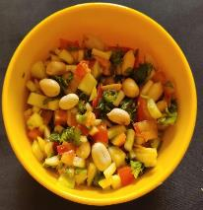
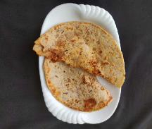
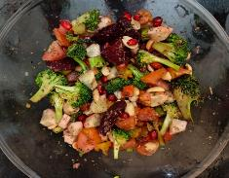
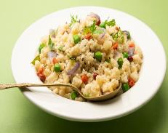

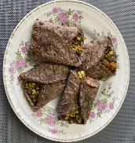
Let’s Choose Healthy Options For School Tiffin:
VEG. CUTLETS
MOONG DAL CHILLA
WHOLE FRUIT
FRUIT SALAD
DOSA
Prefer home cooked meals , they are healthy & tasty too!
VEG. PARATHA
SAUTED VEGETABLES
UPMA
CHEELA
ROTI WRAPS
Ref: SSS Presidential Action program of IAP

Slide 24
Few More Diet Related Guidelines…
Use oils in moderate quantity and use a variety of them
Restrict salt intake
Minimize consumption of High fat, Sugar Salt & Ultra processed food
Drink adequate quantity of water
Try to eat some foods raw
Embrace traditional Indian lifestyle, food & recipes

Slide 25
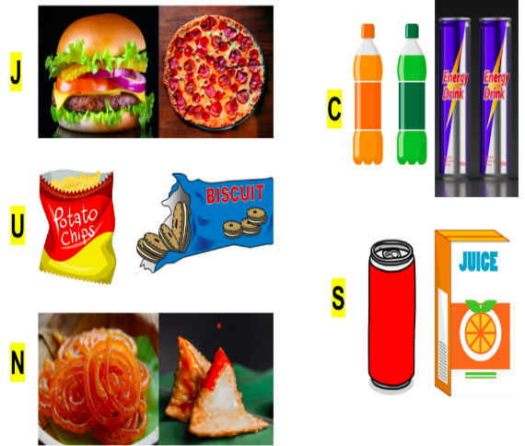
JUNCS: Main Cause of Life Style Disorders
Makes us dull, weak, fat, causing low performance in studies & sports
JUNK
CARBONATED CAFFIENATED DRINKS
Junk
Causes Lifestyle disorders, Digestive issues & Reduces Immunity
ULTRA PROCESSED
Ultra processed
SUGAR SWEETENED BEVERAGE
NUTRITIONALLY DEICIENT
Ref: SSS Presidential Action program of IAP
Notes:
Acronym JUNCS has been created signifying food that is Junk, Ultra processed, Nutritionally deficient, Carbonated & Caffeinated drinks, Sugar sweetened beverages
It causes High cholesterol clogs arteries, increases blood pressure, and strains the heart.
Diabetes- blood sugar levels spike, leading to insulin resistance and weight gain.
Obesity d/t high calories, fat, and sugar
Depression- 40% higher rate of depression
Cancer- stomach, colorectal & lung Cancers
Skin problems- skin dull and acne-prone.
Digestive issues.
Immunity reduced

Slide 26


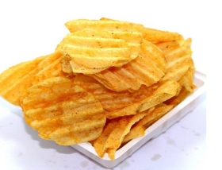
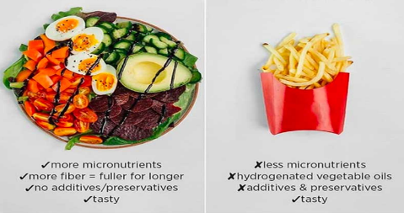
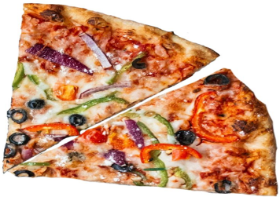
‘FOOD’ for Thought…
2 Samosa 524 Cal.
Walk 137 min/
Run 40min
50gm Chips
280 Calories, Walk 73 min/
Run 21min
200 calories of chocolate vs. 200 calories of melons
400gms Healthy v/s 400gms Junk food equiv.
2Slices Pizza 600 Cal. Walk 157 minutes/
Run 45 min
Notes:
Just 2 Samosa/ 2 slices of Pizza/ small packet of chips, looks just a snack to nible on, BUT a lot of exercise is needed to burn it off
Similarly a few chocolate pieces has same Calories as a large fruit!!

Slide 27

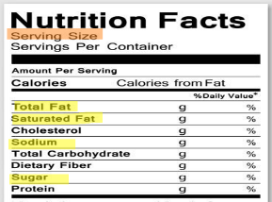

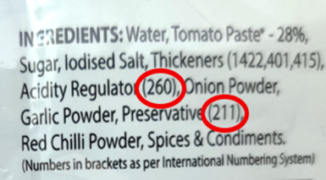
Read Food Label for Healthy Choice
Read Nutrient information: Fat, Sugar, Salt, Calories (per 100 gms or per serving size)
Serving Size
Calculations- apply to > 10 years age
Ignore False Claims
Read e-Codes for Preservatives
Look for safety Logos
Ref: SSS Presidential Action program of IAP
Notes:
Teach Kids to read food labels to make informed choices about their nutrition, helping them develop healthy eating habits early on. It empowers them to understand what they're consuming, avoid harmful ingredients, and maintain a balanced diet.
Key things kids should know about reading food labels:
Serving size: Helps them understand portion control and how much they're actually eating.
Calories: Awareness of energy intake to balance with activity levels.
Nutrients: Focus on key nutrients like fiber, protein, vitamins, and avoid excess sugar, sodium, and unhealthy fats.
Ingredients list: Identify processed additives or allergens, and choose foods with whole, natural ingredients.

Slide 28
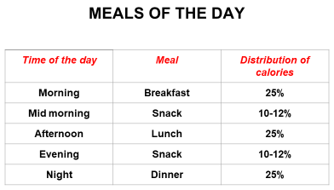
Average Permissible Daily Requirements >10 yrs age:
2000 Calories 10-14yrs
25 gms Sugar, better less
5 gms salt = 2gms Sodium
2490C Girls 16-18yrs
3300C Boys 16-18yrs
Notes:
Children should have 3 Major Meals & 2 Minor meals
As Adolescents’ bodies are growing, their energy intake is also high, but should be balanced

Slide 29
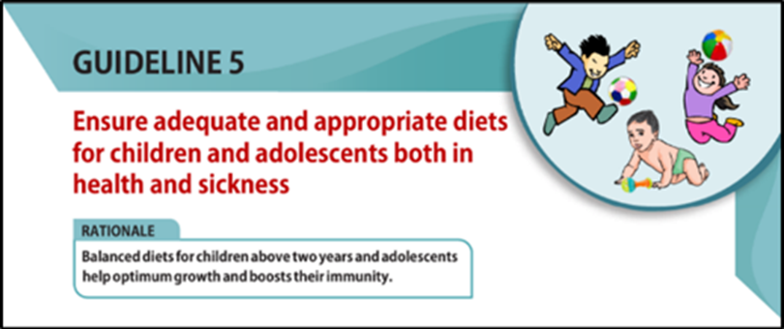
Undernutrition
Weakens immune system
Stunts growth
Impairs mental development
Suboptimal school performance
Increases risk of Life Style Disorders
Causes vitamin and mineral deficiency
Anemia & Osteoporosis develops later
Notes:
Proper nutrition supports the Adolescents’ physical and mental health during this critical stage of development.
Undernutrition is deleterious for their health and leads to many problems

Slide 30
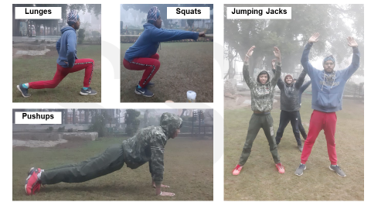



Encourage Regular Physical Activity
Most exercises should be moderate/vigorous
At least one hour of any form of exercise/ play everyday whether at school/ home
Except sleep, avoid sitting / lying down for more than 1 hr at a stretch
Notes:
Physical activity is essential for adolescents to maintain a healthy lifestyle as it promotes proper growth, strengthens muscles and bones, and improves cardiovascular health. It also enhances mental well-being, reducing stress and boosting mood. Regular exercise fosters lifelong habits that prevent obesity and chronic diseases

Slide 31


Ensure Proper Sleep & Sleep Hygiene
At least 8-10 hours daily
Afternoon naps max. 30-45 mins
Same bedtime every night around 10 pm
Switch off screen 1 hour before bed time
Keep cell phones min. 4 ft from bedside
Switch off lights, avoid noise
Dinner should be Light
Ref: SSS Presidential Action program of IAP
Notes:
Good sleep is vital for adolescents as it supports physical growth, brain development, and emotional well-being. Adequate rest enhances focus, learning, and memory, which are crucial for academic performance. It also helps regulate mood and reduces the risk of mental health issues, ensuring overall well-being during this critical developmental stage.
Avoid glowing screens, disturbing shows at least 1 hour before but child Can read book/ listen to light music
Avoid heavy dinner, chocolate/ caffeinated/ sugary drinks before bedtime

Slide 32




Improve Air Quality
Air pollution is one of the main Life Style Disorder risk factors
Noise pollution and use of Ear plugs also contribute to Health Disorders
Notes:
Improving air quality is essential for a healthy lifestyle in adolescents, as clean air reduces the risk of respiratory issues like asthma and allergies. Exposure to pollutants can hinder lung development and negatively affect overall health. Ensuring better air quality supports their physical well-being and promotes active outdoor lifestyles

Slide 33



Other Lifestyle modifications needed:
Awareness & Avoidance of Substance Abuse
Learning to handle Mental Stress & Reduction of Screen time
Learning to address Sexual and Reproductive Health Concerns
Need for regular School health check-ups & Anticipatory Guidance
Notes:
There are other Lifestyle modifications needed for healthy Lifestyle, but THESE WILL BE COVERED IN DETAIL IN OTHER MODULES

Slide 34


How can Schools help prevent Life Style Disorders
Teach about Healthy Life Style in School
Physical Activity & exercise programs in school
Healthy Eating options in Canteen
Stress management prog. & Mental Health Counseling
Anti Tobacco and Substance Abuse campaigns
Clean & Green Environment, Awareness Campaigns
Community and Parental Involvement & Field trips
Regular Health check-ups in School
Notes:
Health Education: Integrate lessons on nutrition, physical activity, and substance abuse prevention into the curriculum.
Physical Activity: Implement regular exercise programs and active breaks during the school day.
Healthy Eating: Offer nutritious school meals and promote healthy eating habits through campaigns.
Mental Health Support: Provide counseling services and stress management programs like mindfulness and meditation.
Tobacco and Substance Abuse Prevention: Run anti-tobacco campaigns and enforce strict no-smoking policies.
Community and Parental Involvement: Engage parents and collaborate with local health organizations to reinforce healthy behaviors.
Supportive Environment: Create a healthy school environment with clean water, safe spaces for activity, and accessible health resources.

Slide 35
Key Messages
Ensure Balanced diet with variety of food, 50%veg.-fruits & adequate water
Minimize consumption of salt, sugar, fat & ultra-processed food
Ensure 1 hour of moderate to vigorous physical activity which they enjoy
Proper sleep hygiene with 8-10hrs./ night sleep should be ensured
Improve air quality & ensure safe environment
Need for regular health check-ups & screening to be understood

Slide 36
Case on Life Style Diseases
Kamlesh, a 15 yr. boy of class IX, frequented the washroom repeatedly and despite the teachers checking him, he would repeatedly drink water. One teacher recognised there was some problem and advised his parents to visit a doctor.
The doctor figured that he had Obesity & Diabetes and started medicines along with Lifestyle modifications.
School authorities were entrusted with:
Active exercise responsibility, lasting at least 30 minutes, on every school attendance day.
Monitoring dietary intake as per strict diet plans.
More programs Promoting Healthy Lifestyle for all students.

Slide 37



Lifestyle Disorders:
Prevention is Better Than Cure
Prevention Through Healthy Habits Works Best
When Started At A Young Age

