Slide 1


T –Teach Module
T –Teach Module
(Teachers’ Training and Empowerment in Adolescent Care and Health)
IAP -AHA’s -Training Module for Teachers
IAP-Adolescent Health Academy: T-TEACH MODULE

Slide 2

IAP-Adolescent Health Academy: T-TEACH MODULE

Slide 3
Concept
Adolescence is a crucial stage in an individual's life marked by physical, social, emotional, and cognitive changes. During this period, adolescents require guidance and support from various sources, including teachers.
Teachers, as important stakeholders, play a significant role in the overall development of adolescents and their well being, as they spend a considerable amount of time with them in school settings.
Therefore, it is essential to equip teachers with the necessary skills and
knowledge to effectively support and care for adolescents.
IAP-Adolescent Health Academy: T-TEACH MODULE

Slide 4

IAP-Adolescent Health Academy: T-TEACH MODULE

Slide 5
T –Teach Module
Dr Shubhada Khirwadkar (National Convenor)
Dr Swati Ghate (Academic editor)
Dr Nishikant Kotwal (National Co-ordinator)
IAP-Adolescent Health Academy: T-TEACH MODULE

Slide 6
Topics & Contributors
Understanding Adolescent Behaviour: Dr Swati Ghate, Dr Poonam Bhatia
Handling Teens with problematic behaviour: Dr Sushma Desai, Dr Ashim Ghosh
Dealing with silently suffering Teens(Mental Health Concerns): Dr Sunita Manchanda, Dr Geeta Bansal
Dealing with disorders of Learning: Dr Newton Luiz, Dr Chitra Sankar
The good and the bad about Media: Dr Geeta Patil, Dr Prashant Karia
IAP-Adolescent Health Academy: T-TEACH MODULE

Slide 7
Topics & Contributors
Substance abuse - What teachers should know: Dr Chitra Dinakar Dr Shilpa C
Understanding Teen Sexuality: Dr Himabindu Singh, Dr Sushma Kirtani
Positive discipline: Dr Shubhada Khirwadkar, Dr Kalyani Patra
Promote Healthy Life Style: Dr Shamik Ghosh, Dr Shalini Bhasin
Communication Skills and self help: Dr Nishikant Kotwal, Dr Chitra Kulkarni
Prevent , Empower , Stand Strong (self defense): Dr. Jayashree Deshpande
IAP-Adolescent Health Academy: T-TEACH MODULE

Slide 8
Reviewers
Dr Swati Bhave
Dr C P Bansal
Dr Sukanta Chatterjee
Dr Preeti Galagali
Dr Samir Shah
Dr Piyali Bhattacharya
Dr Atul Kanikar
Dr Atanu Bhadra
Dr R G Patil
Dr R N Sharma
IAP-Adolescent Health Academy: T-TEACH MODULE

Slide 9

Prevent , Empower ,
Stand Strong (self defense)
DR. JAYASHREE DESHPANDE
DR. CHITRA KULKARNI
DR. ARCHANA JOSHI
DR. HEMANT JOSHI
DR.SATISH TIWARI
DR.GIRISH CHARADE
IAP-Adolescent Health Academy: T-TEACH MODULE

Slide 10
Situations which can create danger
Harassment at school / college place with bad touch
Harassment from relatives taking advantage of the relation & authority
Auto driver taking wrong route
Bus/Train taking advantage of the crowd for a bad touch
Late night / Night shift travelling , facing molesters
Isolated road / place attack
Attack by delivery / courier boy ( Asking for water )
Girl hostel employees stalking inappropriately ( Repeated bell ringing )
School / College ragging by senior students ( Give introduction )
School friends taking advantage of the relation / Gang rape
( Boys Locker room )
Physical Harassment at workplace
These situations are gender neutral – both boys and girls are at risk
Not only sexual offenders, it may also be physical assault
IAP-Adolescent Health Academy: T-TEACH MODULE

Slide 11

BELIEVE IN YOURSELF
IAP-Adolescent Health Academy: T-TEACH MODULE

Slide 12
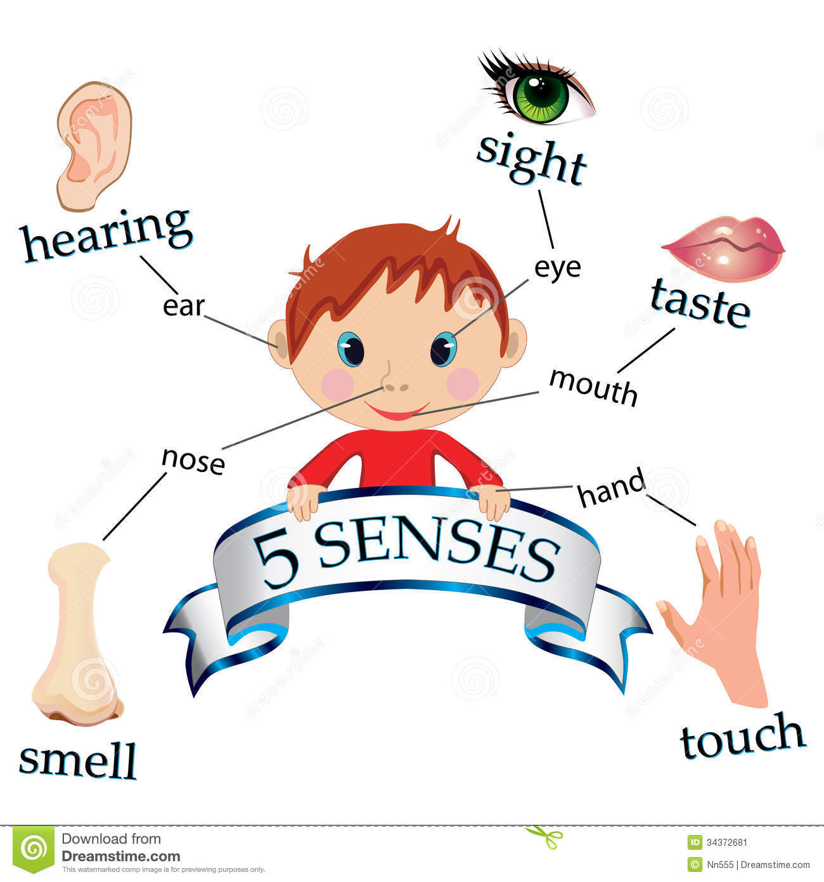

Understanding situations
FIVE SENSES & SIXTH SENSE
IAP-Adolescent Health Academy: T-TEACH MODULE

Slide 13
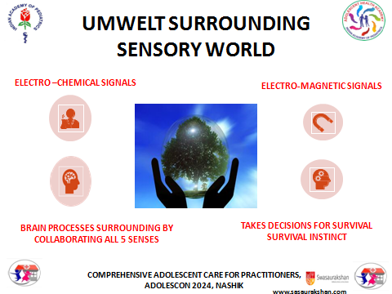
Do you know UMWELT?
( Surrounding Sensory World ) Aura
IAP-Adolescent Health Academy: T-TEACH MODULE

Slide 14
PURPOSE OF DEVELOPING SIXTH SENSE
TRUST - TRUST YOUR INNER INSTINCT
SET - SET VERBAL AND PHYSICAL BOUNDARIES
PREVENT- PREVENT POSSIBLE ATTACK
AVOID – AVOID DANGEROUS SITUATION
IAP-Adolescent Health Academy: T-TEACH MODULE

Slide 15
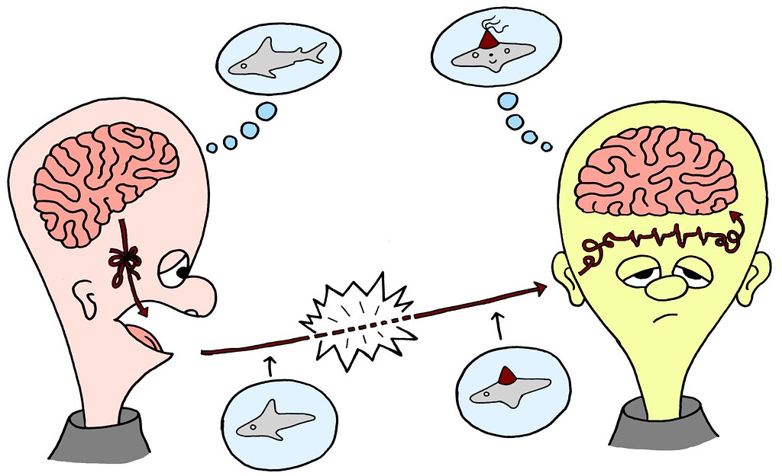
Body language
Non-verbal signals
Eyes – looking at which body parts
Expression
Hand movements
Leg direction
Speed of advancement
State of mouth ( open / closed )
Single / group
Suspicious – lingering and hovering
IAP-Adolescent Health Academy: T-TEACH MODULE

Slide 16
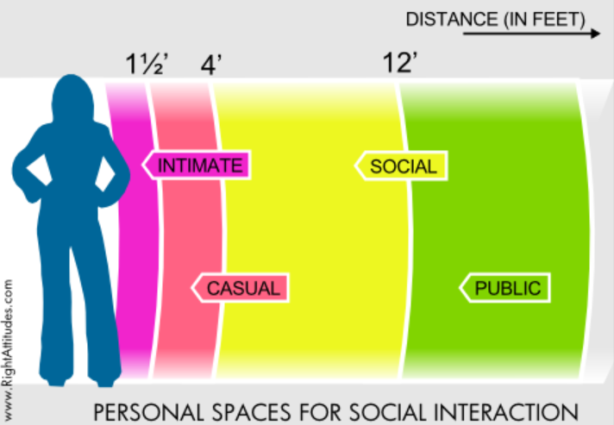
PERSONAL SPACE
IAP-Adolescent Health Academy: T-TEACH MODULE

Slide 17
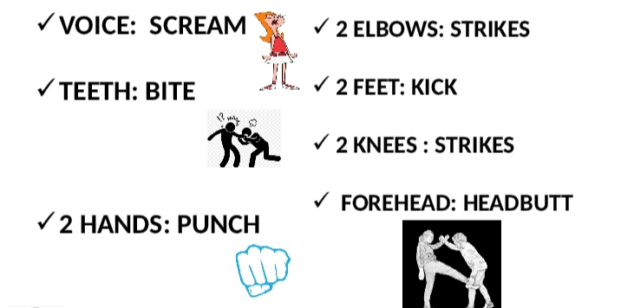
Options - TOOLS GIVEN BY GOD
FOR PREVENTION
IAP-Adolescent Health Academy: T-TEACH MODULE

Slide 18
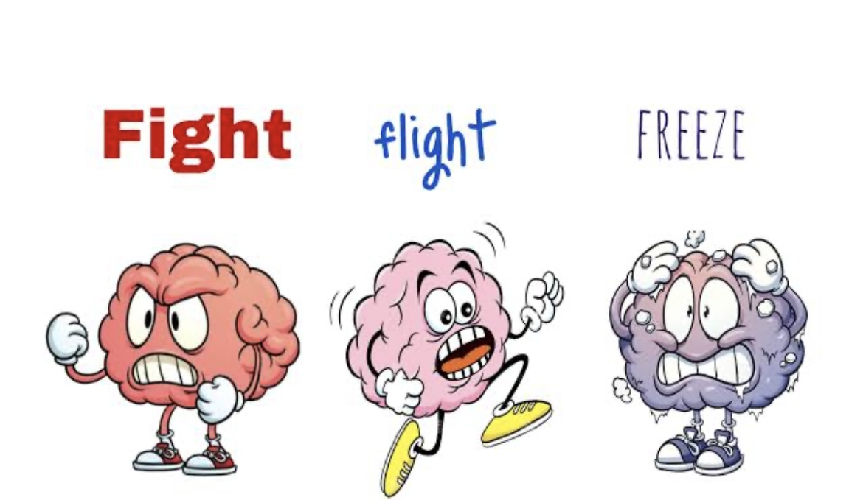
ALWAYS FLIGHT OR FIGHT BUT NEVER FREEZE
IAP-Adolescent Health Academy: T-TEACH MODULE

Slide 19

Preparedness - Physical fitness
अपने दिल से पहले अपने दिमाग की सुनो
REGULAR EXERCISE
MINDFUL EATING
SLEEPING ON TIM
IAP-Adolescent Health Academy: T-TEACH MODULE

Slide 20
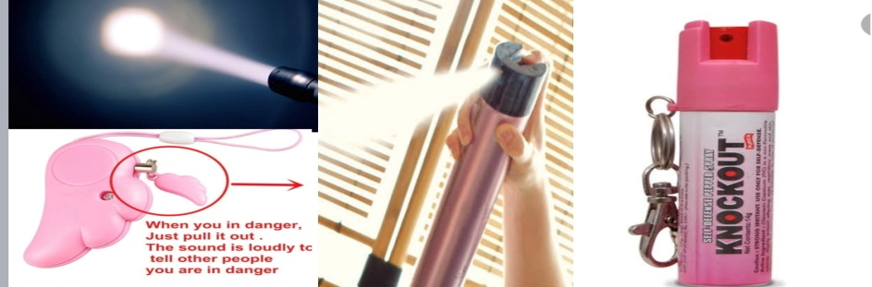
Implementation
ARTICLES IN YOUR PURSE
PEN/PENCIL
SAFETY PINS
CAR KEYS
CREDIT/GIFT CARDS
PERFUME
BLACK PEPPER
MIRCHI POWDER
IAP-Adolescent Health Academy: T-TEACH MODULE

Slide 21
10 BEST NON-LETHAL
SELF-DEFENSE WEAPONS
PEPPER SPRAY
STUN GUN
KEYCHAIN KNUCKLE WEAPON
BATON
FLASHLIGHT
TACTICAL PEN
KUBOTAN
PERSONAL SAFETY ALARMS. IN LIEU OF A PHYSICAL WEAPON, THESE NOISE-BASED WEAPONS CAN BE QUITE EFFECTIVE IN DEFENDING AN ATTACK
IAP-Adolescent Health Academy: T-TEACH MODULE

Slide 22

Implementation
WOMEN SAFETY APPS
My Safetipin
Shake2Safety
bSafe
iGoSafety
Family Locator - GPS Tracker
Himmat Plus
IAP-Adolescent Health Academy: T-TEACH MODULE

Slide 23
SELF DEFENCE: 10“A”s
Avoid Risky Situation
Prevent Access to offenders
Attitude: Don’t mess with me
Aware of surroundings
Anticipate something is wrong
Be Assertive
Agile : Run
Draw Attention- to get help
Act: Appear Non- compliant
Armed: Be prepared
IAP-Adolescent Health Academy: T-TEACH MODULE

Slide 24

REPERCUSSION AND SOLUTION
CALL-112
IAP-Adolescent Health Academy: T-TEACH MODULE

Slide 25
LEGAL ASPECTS
Everyone has right of self-defense, so practice bouncer restraint – Never instigate but be alert and ready to strike anytime when situation arises – show your power !!
IPC Section 96 to 106, Defense of person & property
Section 100: right of private defense to body,
defense of body extends even causing death of attacker
Sections for Grievous injuries
Section 326A: offence of causing hurt by acid attack
IAP-Adolescent Health Academy: T-TEACH MODULE

Slide 26
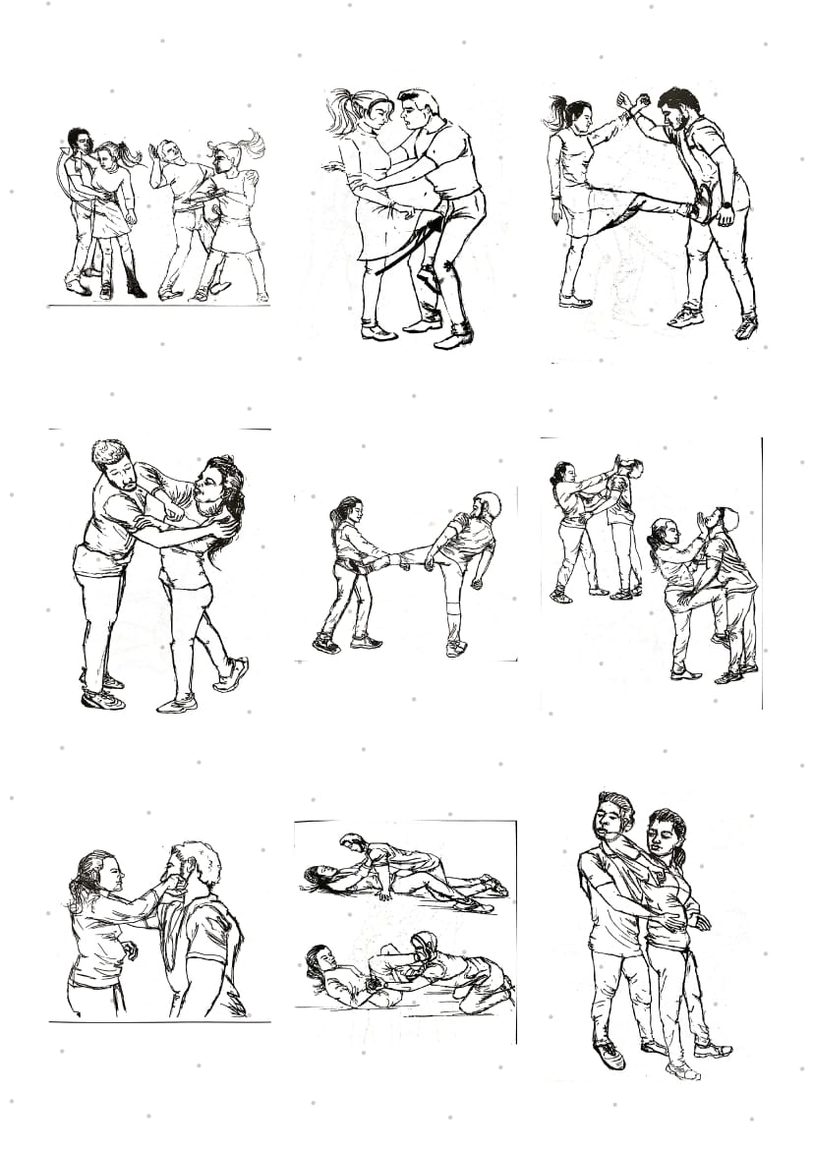
DEMONSTRATION
IAP-Adolescent Health Academy: T-TEACH MODULE

Slide 27

VIDEO
IAP-Adolescent Health Academy: T-TEACH MODULE

Slide 28

Booklet QR code
IAP-Adolescent Health Academy: T-TEACH MODULE

Slide 29

THANK YOU
IAP-Adolescent Health Academy: T-TEACH MODULE

