Slide 1


T –Teach Module
T –Teach Module
(Teachers’ Training and Empowerment in Adolescent Care and Health)
IAP -AHA’s -Training Module for Teachers
IAP-Adolescent Health Academy: T-TEACH MODULE

Slide 2
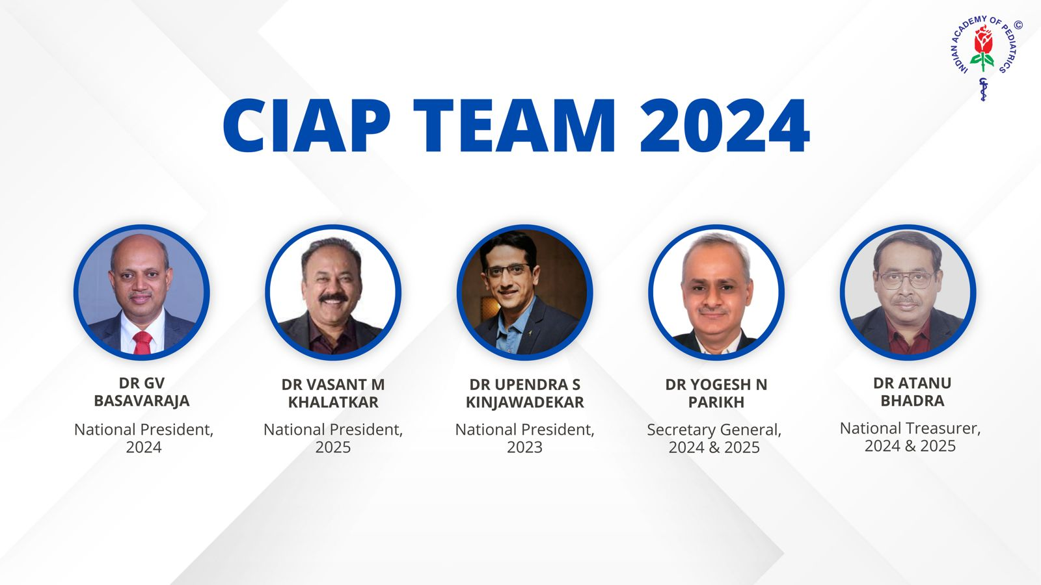
IAP-Adolescent Health Academy: T-TEACH MODULE

Slide 3
Concept
Adolescence is a crucial stage in an individual's life marked by physical, social, emotional, and cognitive changes. During this period, adolescents require guidance and support from various sources, including teachers.
Teachers, as important stakeholders, play a significant role in the overall development of adolescents and their well being, as they spend a considerable amount of time with them in school settings.
Therefore, it is essential to equip teachers with the necessary skills and
knowledge to effectively support and care for adolescents.
IAP-Adolescent Health Academy: T-TEACH MODULE

Slide 4

IAP-Adolescent Health Academy: T-TEACH MODULE

Slide 5
T –Teach Module
Dr Shubhada Khirwadkar (National Convenor)
Dr Swati Ghate (Academic editor)
Dr Nishikant Kotwal (National Co-ordinator)
IAP-Adolescent Health Academy: T-TEACH MODULE

Slide 6
Topics &Contributors
Understanding Adolescent Behaviour: Dr Swati Ghate, Dr Poonam Bhatia
Handling Teens with problematic behaviour: Dr Sushma Desai, Dr Ashim Ghosh
Dealing with silently suffering Teens(Mental Health Concerns): Dr Sunita Manchanda, Dr Geeta Bansal
Dealing with disorders of Learning: Dr Newton Luiz, Dr Chitra Sankar
The good and the bad about Media: Dr Geeta Patil, Dr Prashant Karia
IAP-Adolescent Health Academy: T-TEACH MODULE

Slide 7
Topics &Contributors
Substance abuse - What teachers should know: Dr Chitra Dinakar Dr Shilpa C
Understanding Teen Sexuality: Dr Himabindu Singh, Dr Sushma Kirtani
Positive discipline: Dr Shubhada Khirwadkar, Dr Kalyani Patra
Promote Healthy Life Style: Dr Shamik Ghosh, Dr Shalini Bhasin
Communication Skills and self help: Dr Nishikant Kotwal, Dr Chitra Kulkarni
Prevent , Empower , Stand Strong (self defense): Dr. Jayashree Deshpande
IAP-Adolescent Health Academy: T-TEACH MODULE

Slide 8
Reviewers
Dr Swati Bhave
Dr C P Bansal
Dr Sukanta Chatterjee
Dr Preeti Galagali
Dr Samir Shah
Dr Piyali Bhattacharya
Dr Atul Kanikar
Dr Atanu Bhadra
Dr R G Patil
Dr R N Sharma
IAP-Adolescent Health Academy: T-TEACH MODULE

Slide 9
Positive Discipline
Dr. Shubhada Khirwadkar
Dr. Kalyani Patra
IAP-Adolescent Health Academy: T-TEACH MODULE

Slide 10
Learning objectives
To understand:
What is positive discipline?
Benefits of positive discipline to students and teachers
Why disciplining teen mind is difficult?
How to use Positive discipline techniques in school setting?
Importance of promoting inclusivity and diversity in classroom
).
IAP-Adolescent Health Academy: T-TEACH MODULE
10
Notes:
Teachers spend a long time of their lives with growing, developing adolescents. Adolescents are often difficult to handle and imbibing discipline in them often becomes ahuge task for the teachers. The attitude and behaviour of a teacher directly affects many aspects of adolescents’ lives, in addition to academics. An empowered teacher, equipped with good understanding and skills of Positive Discipline will be better to interpret address behavioural challenges of adolescents. Instead of getting offended by the unruly student behaviour, she will be able to understand the causes behind their misbehaviour and will become more resourceful in inculcating discipline in them at right age.

Slide 11
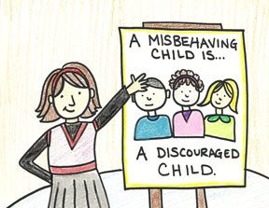

Effective Discipline
What is it?
What does it teach?
Practice of training people to follow rules
Behave well in a social set up.
Self discipline: setting limits
Solving problems in a way that is useful to self & others
Working as a team
Reaching the goals systematically
Interact appropriately with others
).
IAP-Adolescent Health Academy: T-TEACH MODULE
11

Slide 12
Effective Discipline
Promotes growth
Helps Problem solving
Builds Self esteem
Teaches Proper Social Interaction
Inculcates ‘Self’ Discipline
IAP-Adolescent Health Academy: T-TEACH MODULE

Slide 13
What Has Changed?
Students
Behavior
Rules
School
Home & Gadgets
Techniques of disciplining have to change!
Teacher who teaches discipline also has to change!
IAP-Adolescent Health Academy: T-TEACH MODULE
Notes:
With changing times, lot of things have changed… The upbringing of students, their behavioral patterns, the rules and regulations about punishments schooling, the milieu of school administration, the homes and parents and the battery of gadgets…. Hence classroom and school discipline also needs to change. Right ?

Slide 14



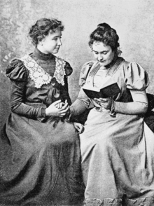
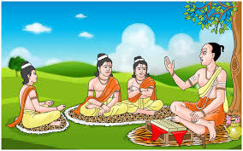
Discipline
Self Respect, Values
Focus, setting goals
Self Awareness
Self Esteem of student
Making learning interesting
IAP-Adolescent Health Academy: T-TEACH MODULE
Notes:
Let us identify these images of gurus….Chanakya (was known to be firm, Assertive and follower of rules and values, but not democratic
Dronacharya… taught focus, but very harsh and got upset with smallest mistake, was partial
Helen Kellers’s teacher Anne Sulivan…. Appeared a bit strict, was very particular about regularity in work but built self esteem of her student, gurus with their unique teaching style make learning impactful and interesting
That’s why being self aware is so important for teachers. Let us know our strong and ‘not so strong’ qualities as a teacher: SWOT analysis

Slide 15

Why disciplining Teen mind is difficult?
Seeks instant pleasures/ rewards
Can’t plan, think of consequences
Unable to inhibit /control urges
Can”t read others’ emotions
Problems in interactive communication
Not self aware of one’s potentials & limits
Gets bored, tired easily & requires more sleep
15
IAP-Adolescent Health Academy: T-TEACH MODULE
Notes:
Understanding these typicality of teen brain helps us in inculcating discipline

Slide 16
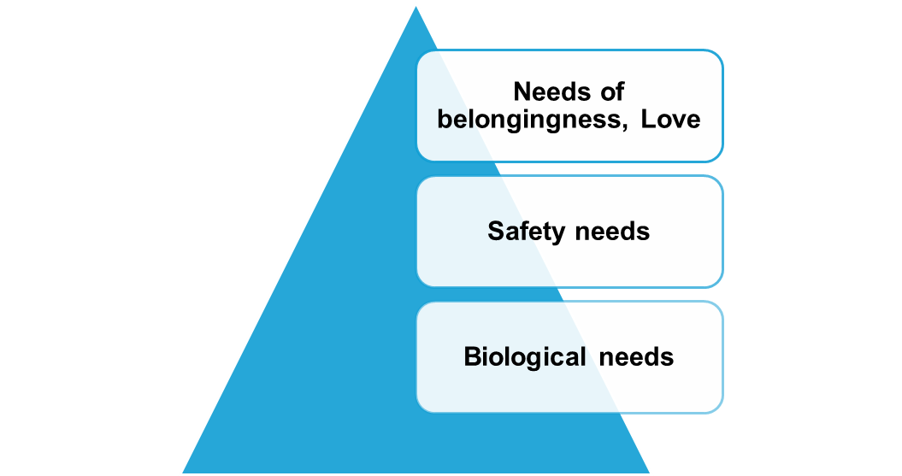
Knowing needs of an adjusting Adolescent
Biological Needs
Sleep, hunger, attraction to opposite gender
Safety Needs
Warm & secure environment to express discomfort or commit mistakes
Psychosocial Needs
Self esteem, Love, Respect, Appreciation
Connect to these needs before correcting behavior !
IAP-Adolescent Health Academy: T-TEACH MODULE
Notes:
Students have these needs in descending order, as shown in the pyramid a teacher has to be constantly aware about these needs so that the students become more receptive and relate to the instructions. Insults, taunts, belittling may work as ashort term measure but may create a long term harmful impact

Slide 17


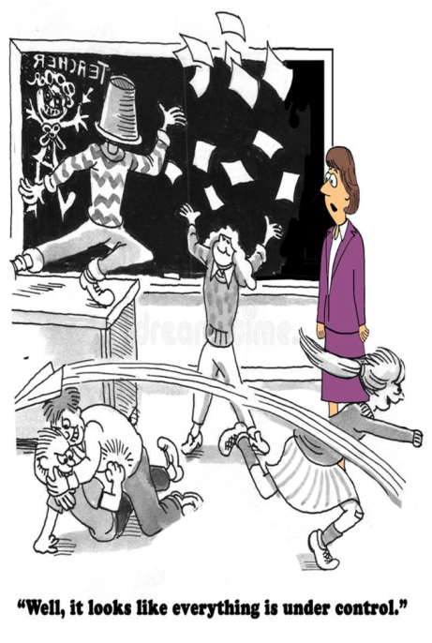
Some common misbehaviors
Stubborn silence/
overtalkative
Refusal to participate
Spreading rumours
Boasting
Manipulation
Trying to shoot you down
Attention seeking
Exhibiting physical Power
Making fun, taunting
Resistance – anger, violence
Wandering
Rambling
Mass misbehaviour
IAP-Adolescent Health Academy: T-TEACH MODULE
Notes:
These are some common misbehaviours. Can you think of some more ?

Slide 18
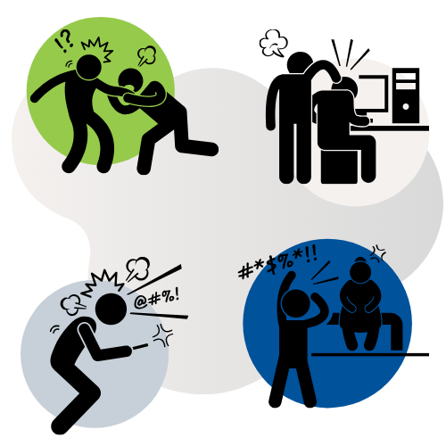
Learn the Science of Misbehaviour
Nobody is born with bad behaviour
Every misbehaviour occurs for a reason
Better behaviour is ‘effectively learnt’ by:
A kind but firm teacher
Long term behaviour change is possible
Shaping, modeling, extinction techniques
Can use her energy positively
IAP-Adolescent Health Academy: T-TEACH MODULE
Notes:
Keeping in mind why students misbehave, behavioral shaping, modeling, and extinction are the techniques used in positive discipline to change behavior:
Shaping
This technique involves rewarding a behavior as it approaches in small steps towards the desired behavior. For eg a child who perpetually disturbs the class if he sits quiet is praised if he sits quietly for increasing time intervals.Shaping requires patience and the ability to recognize small changes.
Modeling
This technique involves learning new skills or acceptable behaviors by watching someone else perform them. The teacher can be arole model for so many things like taunting, shouting, using insulting words etc
Extinction
This technique involves withholding reward for a behavior with the goal of making that behavior fade away. For example, if a class is rewarded with a story every time they demand it by shouting( out of boredom) , withholding the story when they shout for a story can help extinguish the behaviour of shouting.
Some other points to consider when using these techniques include:
Consistency: Consistency is essential for extinction to work.
Patience: Mistakes and setbacks are common when changing behavior, so patience is important.
Reward schedule: Initial learning is usually best when reward is given immediately after every example of the correct behavior.
Behavior plan: A behavior plan should be consistent and long-term.

Slide 19
Issues behind Adolescent Misbehaviour
DISCIPLINE
Adjustment issues: parents, peers, school
Learning Difficulties/ADHD
Inability to manage Anger, Anxiety Negative emotions/Urges
Adventure seeking,
Risk taking/thrill to defy rules
Independent thinking Vs Influence of Peers & Media
IAP-Adolescent Health Academy: T-TEACH MODULE
Notes:
These are some common issues behind the misbehaviour of adolescents. Dissorders like specific learning disorders (SLD) : reading ( dyslexia) / writing (dysgraphia) / Math( dyscalculia) or ADHD ( Attention Deficit Hyperactive Disorder) or intellectual disability (ID) can be the possible reason for frequent misbehaviours

Slide 20
Misbehavior is more in a Classroom when…
Students don’t know the teacher’s expectations
Students don’t know how to exhibit expected behavior
Students unaware that they are engaged in misbehavior
Misbehavior provides student the desired outcome
Teacher unintentionally displays insensitivity
Teacher appears unkind or biased
Teacher's approach seems less inclusive.
Teacher's communication lacks clarity.
IAP-Adolescent Health Academy: T-TEACH MODULE
Notes:
When are misbehaviours more common ? Some causes are in students while some are in teachers!

Slide 21
Misbehavior is used for
Exhibition of Power
Seeking Revenge
Seeking Attention
Disinterest/ Feeling inadequate
As a faulty coping strategy to handle stress
IAP-Adolescent Health Academy: T-TEACH MODULE
Notes:
Teachers should try to explore and understand the immediate reasons or possible purpose behind any misbehaviour

Slide 22
Development of Antisocial Behavior
Rejection by peers teachers
Poor parental Discipline / Monitoring/ Neglect in school/ home
Commitment to a deviant peer group
Conduct
Problems
Delinquency
Academic Failure
Early
Childhood
Middle
Childhood
Late Childhood
Adolescence
Good news :
We can take kids off this developmental pathway !
IAP-Adolescent Health Academy: T-TEACH MODULE
Notes:
Let us understand how uncontrolled misbehaviour in childhood can turn into an antisocial, deviant behaviour in adolescence
Bad news: Long-term risk increases with each stage

Slide 23
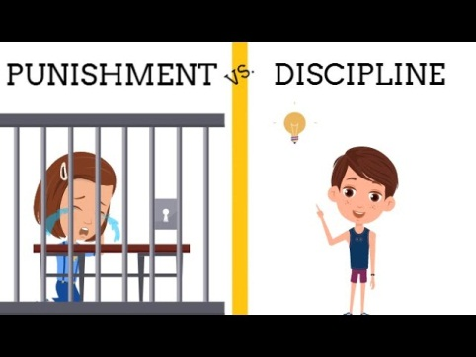
Punishment v/s Discipline
 | Punishment | Discipline
Purpose | Makes a child “pay for” by inflicting pain, emotional suffering | Gives choice for correct behavior & encourages personal growth
Long term aim | Paying for something done in the past , often the penalties are unrelated | Inculcates good behavior , problem solving, Self control
Attitude in which it is done | Anger/ Frustration/ teaching a lesson | Kind concern & Firmness
How it makes children feel | Fearful, angry, hostile, guilty, ashamed | Secure & Hopeful
IAP-Adolescent Health Academy: T-TEACH MODULE
Notes:
Let us understand how punishment is different from discipline

Slide 24
What is Positive Discipline?
Positive Discipline ( PD) Model
Focuses on positive points of a behavior
There are no good or bad children
There are only good or bad behaviors
Good behavior taught by praising good efforts
Negative behavior weaned without physical/ verbal hurt
Teacher remains calm, kind but firm in disciplining
IAP-Adolescent Health Academy: T-TEACH MODULE

Slide 25

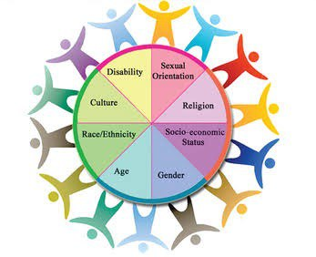

Diversity and Inclusivity
Activity
IAP-Adolescent Health Academy: T-TEACH MODULE
Notes:
Activity to be conducted by the presenter of this ppt…. Activity : Ask teachers: Where is indiscipline more common ? In same gender classroom ? It is ! They make gangs and are more difficult to manage !
Let our classrooms be diverse ! Building inclusivity in diversity is essential as it builds active interaction. Children of various faiths, religions, languages,, culture, capacity, disability, Socioeconomic status are present in our classrooms. It is Mini India !
Let us provide opportunities to learn about different cultures, customs, traditions and celebrate them by making our classrooms more inclusive.
Use diverse teaching materials and methods which are culturally relevant and sensitive to need of the different students. Be sensitive children coping with learning disability and ADHD. Make yourself a role model of inclusivity
Create safe and welcoming environment and safe space for discussion about diversity,identity and inclusion.
Encourage group learning to encourage inreractions between students from different backgrounds
Focus on students abilities rather than disabilities
Address discriminations and bias to create safe inclusive environment
Foster a sense of community by nurturing shared respect and empathy

Slide 26

How inclusivity can benefit?
More cultural exchange
Improved social skills
Stronger relationships
Better critical thinking/ problem solving
Increased tolerance
Creativity boost
Enhanced learning
Improved performance
IAP-Adolescent Health Academy: T-TEACH MODULE
Notes:
Inclusivity builds better humans and better performance

Slide 27
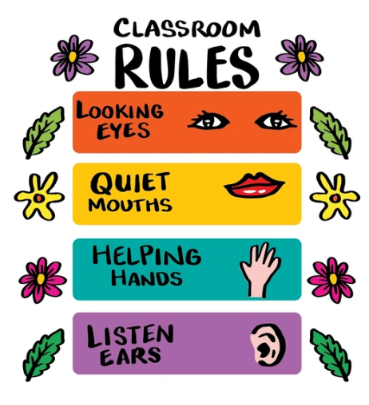
Inculcating positive discipline
Rules of the game…
Set Limits & Democratize Rules with children
Get in advance contract of behavior
Clarify consequences & follow through firmly
Give choices for correcting misbehavior
Within boundaries give independence & let go
Always ‘Listen’ to underlying schema of misbehavior
IAP-Adolescent Health Academy: T-TEACH MODULE
Notes:
Let us understand rules of the game….. How to build positive discipline ?

Slide 28

Positive Discipline: Steps
Step 1:
Involve children in framing clear & fair rules
Step 2:
Clarify expectations consistently
Step 3:
Show trust that problems can be solved together
Step 4:
Reinforce appropriate behavior
Keep a record of good and bad behaviors
Step 5 :
Use Extinction or shaping while being kind & firm
IAP-Adolescent Health Academy: T-TEACH MODULE

Slide 29

Positive Discipline Techniques:
Do’s
Know students well
Treat with respect Don't humiliate
Keep a record
Withdraw few privileges, if Misbehavior
Get students engaged with appropriate body language
Move around the classroom involving everyone
Help students work on their social-emotional skills.
Be fair, consistent & cool
Have a positive attitude towards change
No compromise
on Teaching skills
IAP-Adolescent Health Academy: T-TEACH MODULE

Slide 30

Positive discipline:Don’ts
Discuss negatives in staff room
Judge & label, threaten
Give Excuses/ Blame
My Way is the Best!
Keep Rules very rigid
Negative attitude
Constant complaining
IAP-Adolescent Health Academy: T-TEACH MODULE

Slide 31
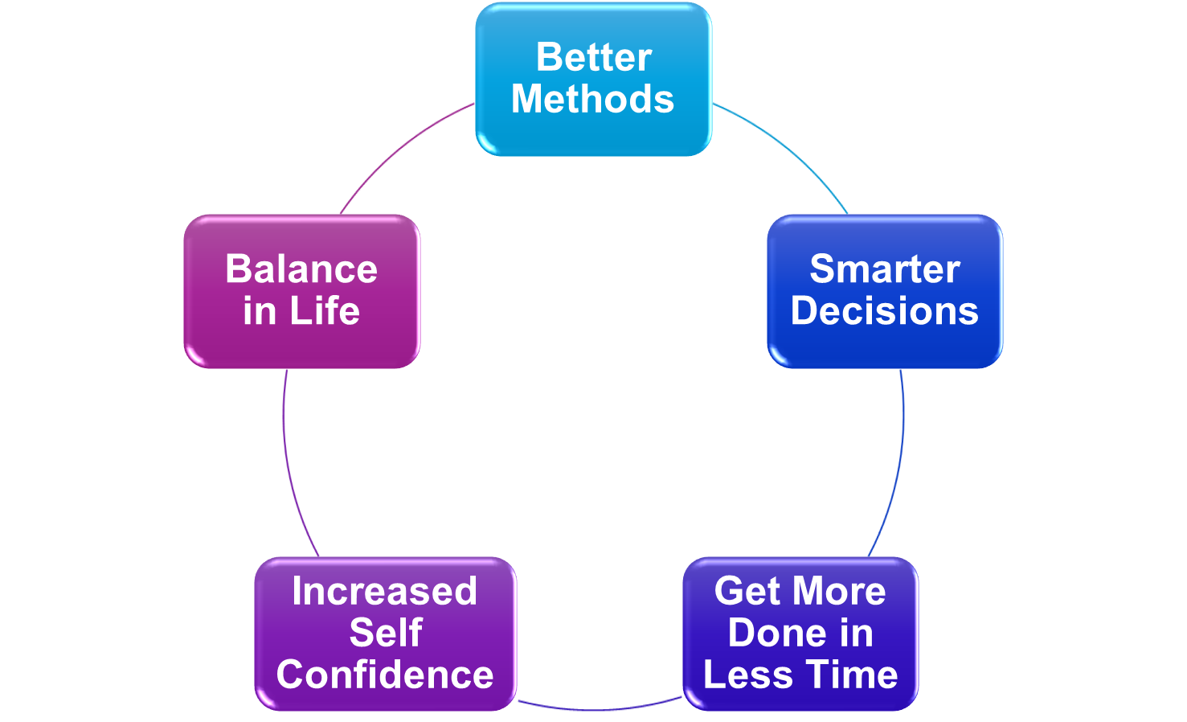
Positive Disciplining is a Skill…
Sustained
Knowledge
Internalization
Learning
Life’s Challenges
IAP-Adolescent Health Academy: T-TEACH MODULE
Notes:
To learn any skill, remember the acronym: S K I L L ! We need Sustained efforts, new Knowledge, build a process to Internalize them, be ready to Learn to deal with Life’s new challenges ! Use of positive discipline gives you better disciplining methods , helps you make smarter decisions in difficult situations, makes you more confident, you get things done in lesser time and gives you a good work life balance

Slide 32
Case
Rohan is a 15 year old disruptive student
Talkative - often makes fun of peers in class
Behaves rudely with teachers
Passes comments & generally has a challenging attitude
His parents shifted him to this English medium school last year.
Understand:
Rohan, as adolescent has reasons to misbehave
He lacks skills to behave
He is student with problems & not a problem student
Back yourself :behaviors change if appropriately tackled
Know: More about him by talking, engaging with him daily (2 by 7)
IAP-Adolescent Health Academy: T-TEACH MODULE
Notes:
Engaging daily for just 2 minutes on all 7 days will help the teacher to build rapport with an adolescent who has problems so that he/she opens up and together they can solve the problem which was causing the misbehaviour. A teacher skilled in positive discipline techniques is better able to design and execute her action plan. In this case, Rohan was finding it difficult to understand many terms of English language in social science and science classes. The teacher cleared his doubts every Saturday by giving him 15 minutes for few weeks. He helped another student with similar problems and became his mentor! Thus, his misbehaviours reduced and he started acting more responsibly. The teacher praised the change(shaping) and gave her helping and empathic behaviour as a role model to Rohan, which rohan imbibed and in turn helped his classmate.

Slide 33
Steps Involved
I
II
Warn - Give Choices: Move alone to front / Time out of 20 min
III
IV
V
Rohan to be involved in framing rules of the classroom
Remind him of rules & express trust that he will follow them
Clarify stepped up consequences assertively
Take action firmly after explaining that he is capable of change
If he sat quietly for some time, appreciate publicly.
Misbehavior repeats. Repeat the process patiently, firmly
If he has other talents, good deeds, praise specifically.
Let go minor slip ups.
IAP-Adolescent Health Academy: T-TEACH MODULE
Notes:
The teacher followed these steps of Positive Discipline …

Slide 34
How to use Positive Discipline in these situations…
Attention Seeking
Message: I am counted only when I misbehave
Code: Notice me &
Involve me usefully
Incomplete work
Message :I am incapable
I am not interested
Rule breaking is Ok;
Teacher not bothered
Code: Help, Talk to me,
Motivate me
Seeking Revenge
Message: Hurt, Disgust, Insult
How could you do this to me?
Code: Validate feelings
Help me to belong
Redirect to useful tasks
Say what you will do (we will have extra time later)
& Follow it
Frame & Clarify rules assertively
Follow through Connect & Go to root of the problem
Praise effort
Create interest
Acknowledge feelings
Listen well
Avoid retaliation
Use class meetings to build trust
IAP-Adolescent Health Academy: T-TEACH MODULE
Notes:
Blue colour of above boxes denotes the coded message by the adolescent and the pink colour denotes the teacher’s understanding for the action she will be taking

Slide 35
Team up with parents
Establish clear communication channels, dialogues, updates.
Collaborate on recognizing/ reinforcing positive behavior.
Guidance on positive discipline techniques, framing of rules .
Encourage a supportive home environment.
Encourage parent involvement in school activities.
Foster problem solving jointly by building mutual trust and respect.
IAP-Adolescent Health Academy: T-TEACH MODULE
Notes:
- **Establish Clear Communication Channels**:
- Regularly update parents on classroom expectations and behavior management strategies.
- Use various communication tools like newsletters, emails, and parent-teacher meetings to keep parents informed.
- **Collaborate on Behavior Expectations**:
- Involve parents in setting consistent behavior expectations both at home and in school.
- Ensure that both the teacher and parents reinforce the same values, such as respect, responsibility, and empathy.
- **Provide Guidance on Positive Discipline Techniques**:
- Share resources and strategies with parents on positive discipline methods, such as setting clear boundaries, offering choices, and using logical consequences.
- Offer workshops or informational sessions on effective adolescent discipline practices.
- **Encourage a Supportive Home Environment**:
- Advise parents on creating a structured and supportive home environment that complements the discipline strategies used in the classroom.
- Suggest ways parents can model positive behavior and communication at home.
- **Foster Open Dialogue**:
- Encourage parents to discuss their child’s behavior, challenges, and achievements regularly.
- Be open to parents' insights and collaborate on finding solutions to behavioral issues.
- **Recognize and Reinforce Positive Behavior**:
- Share positive feedback about the student’s behavior with parents to reinforce good behavior at home.
- Encourage parents to celebrate their child’s successes and progress in behavior.
- **Involve Parents in Problem-Solving**:
- When behavioral issues arise, involve parents in developing action plans that include strategies to be implemented at home and at school.
- Maintain a consistent approach between school and home to address specific behavioral challenges.
- **Create a Partnership Based on Trust and Respect**:
- Build strong relationships with parents by showing respect for their insights and perspectives.
- Work collaboratively with parents, treating them as partners in their child’s development and discipline.
- **Provide Consistent Updates**:
- Keep parents informed about their child’s progress in meeting behavioral expectations.
- Schedule regular check-ins to discuss ongoing strategies and make adjustments as needed.
- **Encourage Parent Involvement in School Activities**:
- Invite parents to participate in school events, volunteer opportunities, and classroom activities.
- Use these opportunities to strengthen the connection between the school and home, reinforcing shared discipline practices.

Slide 36
Key massages
Nobody is born with misbehaviour, it occurs for a reason
Every adolescent handles needs, desires with competencies & control.
Positive discipline techniques help problem solving, build self esteem.
A kind and firm teacher can use her energy more positively.
Know your student well ,treat with respect, don’t humiliate.
Inclusivity builds better humans and better performance.
Collaborate with parents to establish clear communication channels
and a supportive home environment for students.
IAP-Adolescent Health Academy: T-TEACH MODULE

Slide 37

Positive discipline activity for teachers and students
IAP-Adolescent Health Academy: T-TEACH MODULE
Notes:
Here are some activities for teachers on Positive Discipline. You can scan the QR code to get them. Use them if you have more time. It will make your talk more interesting, interactive and effective !

Slide 38
THANK YOU
IAP-Adolescent Health Academy: T-TEACH MODULE

