Slide 1


T –Teach Module
T –Teach Module
(Teachers’ Training and Empowerment in Adolescent Care and Health)
IAP -AHA’s -Training Module for Teachers
IAP-Adolescent Health Academy: T-TEACH MODULE

Slide 2
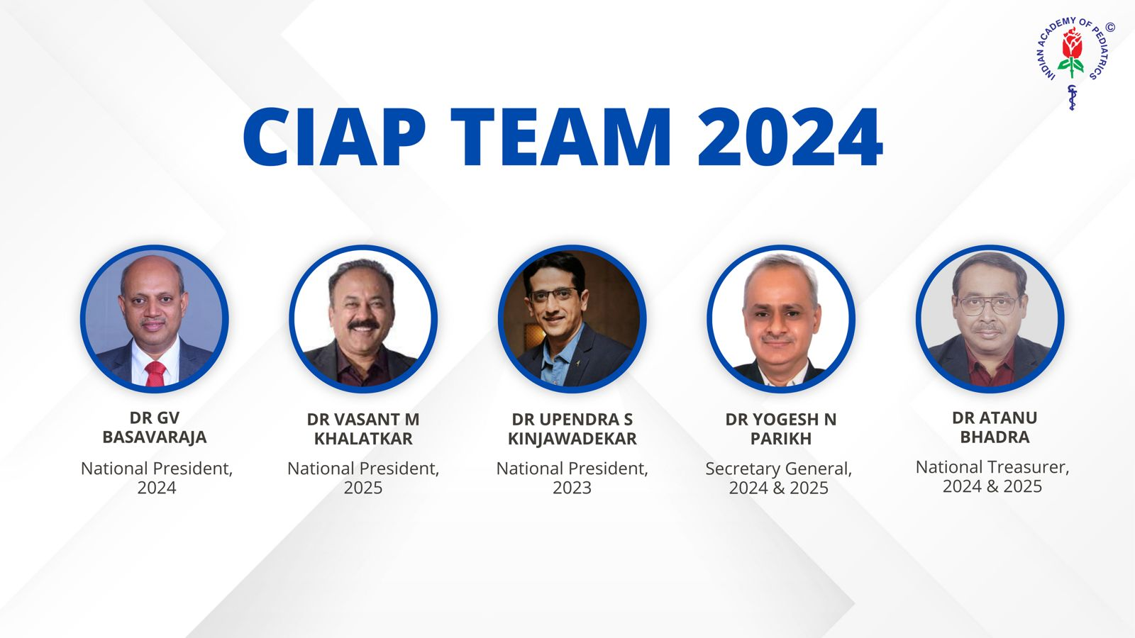
IAP-Adolescent Health Academy: T-TEACH MODULE

Slide 3
Concept
Adolescence is a crucial stage in an individual's life marked by physical, social, emotional, and cognitive changes. During this period, adolescents require guidance and support from various sources, including teachers.
Teachers, as important stakeholders, play a significant role in the overall development of adolescents and their well being, as they spend a considerable amount of time with them in school settings.
Therefore, it is essential to equip teachers with the necessary skills and
knowledge to effectively support and care for adolescents.
IAP-Adolescent Health Academy: T-TEACH MODULE

Slide 4

IAP-Adolescent Health Academy: T-TEACH MODULE

Slide 5
T –Teach Module
Dr Shubhada Khirwadkar (National Convenor)
Dr Swati Ghate (Academic editor)
Dr Nishikant Kotwal (National Co-ordinator)
IAP-Adolescent Health Academy: T-TEACH MODULE

Slide 6
Topics &Contributors
Understanding Adolescent Behaviour: Dr Swati Ghate, Dr Poonam Bhatia
Handling Teens with problematic behaviour: Dr Sushma Desai, Dr Ashim Ghosh
Dealing with silently suffering Teens(Mental Health Concerns): Dr Sunita Manchanda, Dr Geeta Bansal
Dealing with disorders of Learning: Dr Newton Luiz, Dr Chitra Sankar
The good and the bad about Media: Dr Geeta Patil, Dr Prashant Karia
IAP-Adolescent Health Academy: T-TEACH MODULE

Slide 7
Topics &Contributors
Substance abuse - What teachers should know: Dr Chitra Dinakar Dr Shilpa C
Understanding Teen Sexuality: Dr Himabindu Singh, Dr Sushma Kirtani
Positive discipline: Dr Shubhada Khirwadkar, Dr Kalyani Patra
Promote Healthy Life Style: Dr Shamik Ghosh, Dr Shalini Bhasin
Communication Skills and self help: Dr Nishikant Kotwal, Dr Chitra Kulkarni
Prevent , Empower , Stand Strong (self defense): Dr. Jayashree Deshpande
IAP-Adolescent Health Academy: T-TEACH MODULE

Slide 8
Reviewers
Dr Swati Bhave
Dr C P Bansal
Dr Sukanta Chatterjee
Dr Preeti Galagali
Dr Samir Shah
Dr Piyali Bhattacharya
Dr Atul Kanikar
Dr Atanu Bhadra
Dr R G Patil
Dr R N Sharma
IAP-Adolescent Health Academy: T-TEACH MODULE

Slide 9
The Good and the Bad about Media
Dr Geeta Patil
Dr Prashant Kariya
IAP-Adolescent Health Academy: T-TEACH MODULE

Slide 10
Learning objectives
What is meant by screen time? Healthy, Unhealthy screen time
Advantages and disadvantages of Internet, Social media
What are the common Issues about screen time?
Screen time guidelines
Parent’s ,Pediatrician’s, Caretaker’s role, TEACHER’S Role
IAP-Adolescent Health Academy: T-TEACH MODULE

Slide 11

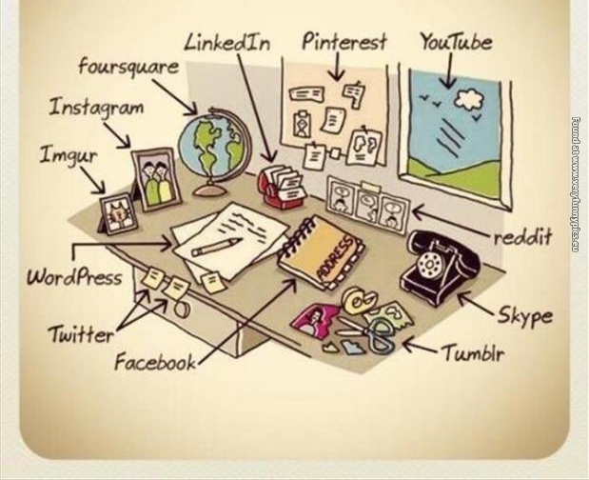

V/S
Can not imagine life without internet & social media
IAP-Adolescent Health Academy: T-TEACH MODULE
Notes:
Traditionally ,parents &teachers are expected to influence the lives of children but now days mass media is playing that role, come to rival parents, school and religion, shapes the trends of society
Most popular and innovative creation within the world of technology widespread interconnected network of
computers and electronic devices(that support Internet).foremost important tool and the prominent resource that is being used by almost every person across the globe.
Connects millions of computers, webpages, websites, and servers. the fastest medium for sending and receiving information.

Slide 12
Healthy v/s Unhealthy screen time
Healthy screen time
For educational purpose, interacting with friends and relatives, enjoying art or music, and other creative pursuits , connecting with like minded people, organization purposes
Unhealthy screen time-
Watching inappropriate TV shows, visiting unsafe websites, playing violent video games
Screen time must not replace other activities such as outdoor physical activities, sleep , family and peers interaction, studies , and skill development, which are necessary for overall growth and development
IAP-Adolescent Health Academy: T-TEACH MODULE

Slide 13

Advantages of Internet and Media
Socialization
Connectivity-globally
Gaining knowledge and information about innovations, ideas,
Entertainment, navigation, google maps, financial transactions
Meaningful online friendship
Healthy co-viewing
Social identity
Adopt healthy behaviour
Advocacy of good causes, crowd funding
Work from home , study from home
IAP-Adolescent Health Academy: T-TEACH MODULE
Notes:
Social media is different from any other media in quality(very palatable,creates craving), frequency and reach, (phenomenal) usability, immediacy( instant availability ) durability(stays in mind for long time) and obviously excessive use leads to addiction.
Co –viewing-viewing with someone (preferably for children with the parents)
Advocacy-propagating your ideas (toolkit)

Slide 14
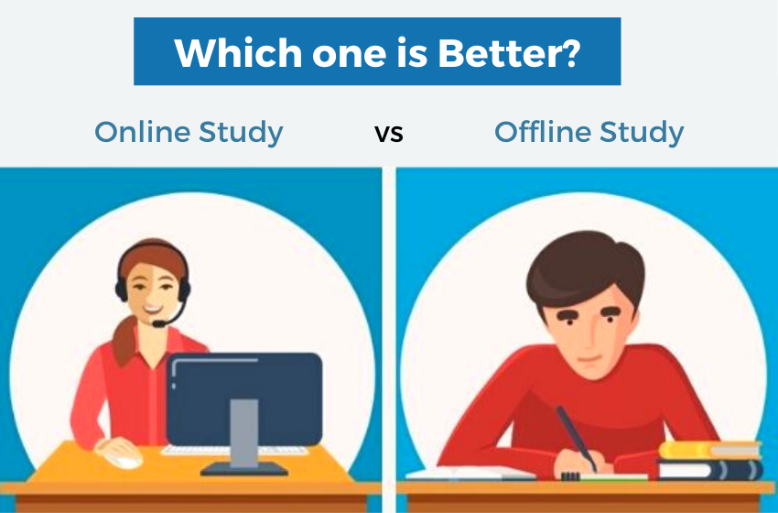
IAP-Adolescent Health Academy: T-TEACH MODULE

Slide 15
Advantages
Disadvantages
Can help during natural
disaster/epidemic
Ecofriendly
Saves time of copying
Excessive screen time
During online studies may go online and us social media
Screen addiction may lead to drop in school performance
Balance in online and offline activities
IAP-Adolescent Health Academy: T-TEACH MODULE

Slide 16

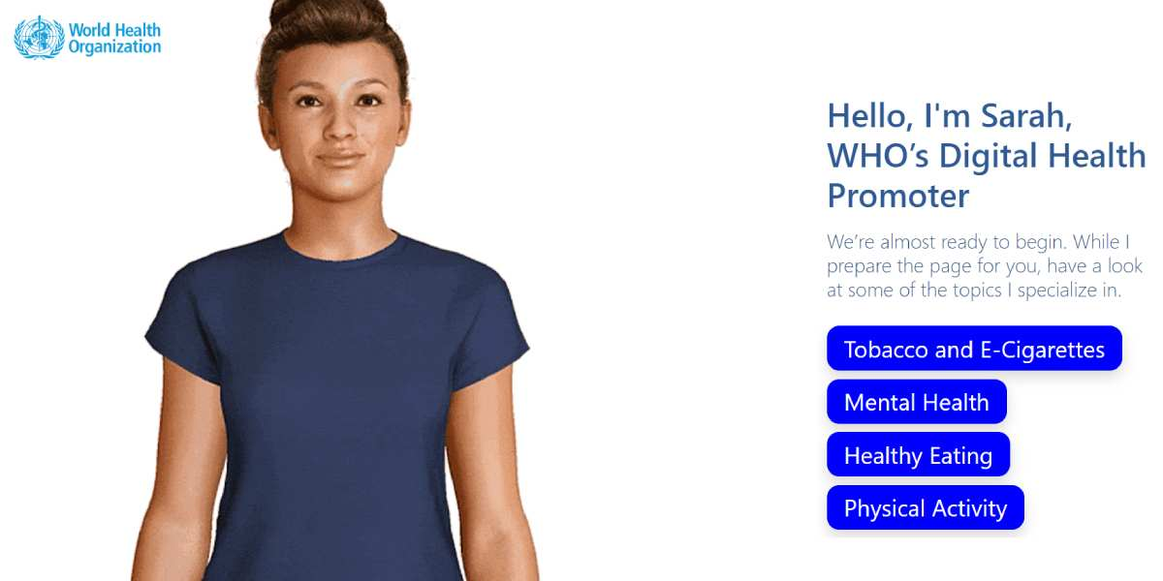
Use of AI
S.A.R.A.H, a Smart AI Resource Assistant for Health
IAP-Adolescent Health Academy: T-TEACH MODULE
Notes:
Social media is different from any other media in quality(very palatable,creates craving), frequency and reach, (phenomenal) usability, immediacy( instant availability ) durability(stays in mind for long time) and obviously excessive use leads to addiction.
Co –viewing-viewing with someone (preferably for children with the parents)
Advocacy-propagating your ideas (toolkit)

Slide 17
Internet/Social Media Hazards
Physical Health
Mental and Emotional Health
Adverse outcomes
Obesity
Non communicable diseases
Eye problems
Inadequate sleep
Headache , body ache neck pain
Road accidents
FOMO, FOBLO
Distorted concepts
Poor school performance
Cyberbullying
Decreased productivity
Disturbance in interpersonal relationship
Aggression , Violence
Anxiety ,depression
Internet gaming addiction
Problematic internet use
Financial frauds
Cyber crimes
Online friendship issues
More than 2 hours per day of screen viewing has been associated with lower
academic performance in children and adolescents.
IAP-Adolescent Health Academy: T-TEACH MODULE
Notes:
There have been growing concerns about the time spent and impact of Social networking sites on their mental &physical health
Half of waking time is spend in front of screen and one third is used to interact on Social Media
Distorted concepts about sexuality and body image
FOMO-Fear of missing out
FOBLO – Fear of being left out
Cyberbullying-Sexting , sexual harrasement , avatars -online rapes in metaverse

Slide 18
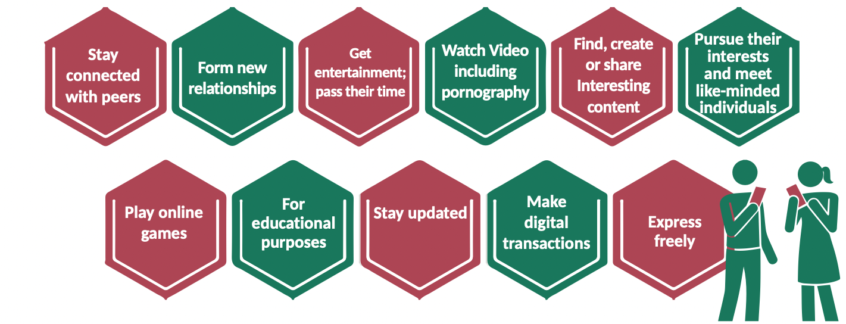
Why adolescents use internet, social media?
RKSK guidelines, Participant’s handbook, for Training of Medical Officers on Adolescent Friendly Health Services,Promotion of safe use of Internet, Gadgets and Social Media) Technology and teenagers https://parents.au.reachout.com/skills-to-build/wellbeing/technology-and-teenagers
IAP-Adolescent Health Academy: T-TEACH MODULE

Slide 19
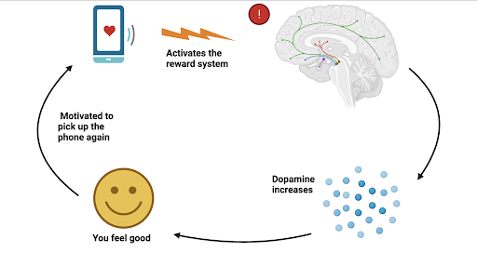
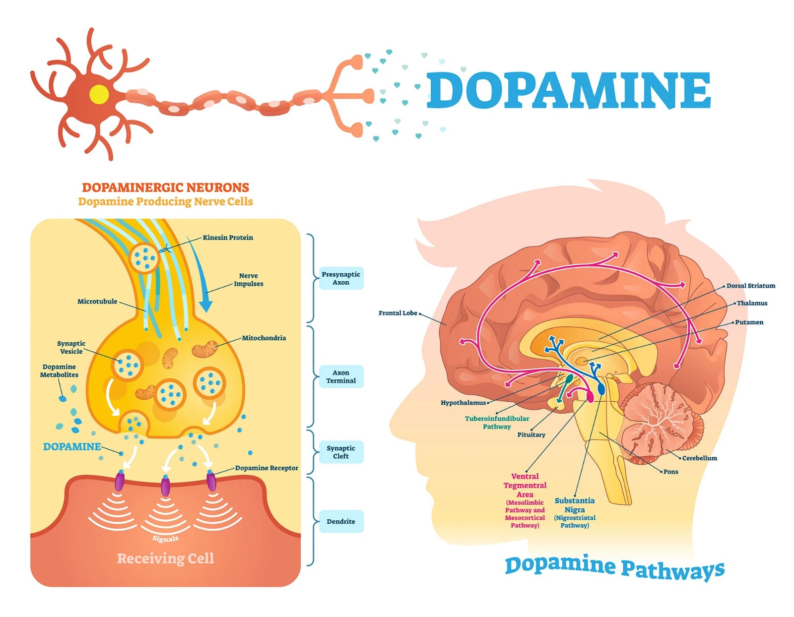
Why adolescents are prime users of
Internet & Digital Media?
Curiosity
Peer pressure
Excitement
Accessibility
IAP-Adolescent Health Academy: T-TEACH MODULE
Notes:
The adolescent brain undergoes significant changes, particularly in the reward center, which is primarily located in the ventral striatum. This area becomes highly active during adolescence, driven by increased dopamine levels and hormonal changes This heightened activity makes adolescents more sensitive to rewards, which can influence their behavior in various ways.
In adolescents brain is under construction .Prefrontal cortex which controls executive function and impulsive behaviour ,decision making is not mature , but limbic system and reward centre is mature When someone experiences something rewarding or uses an addictive substance, neurons
in the dopamine-producing areas in the brain are activated and dopamine levels rise and makes to feel good. This is more active during adolescence . This is observable in social media usage; when an individual gets a notification, such as a like or comment , the brain receives a rush of dopamine and sends it along reward pathways, causing the individual to feel pleasure. Social
media provides an endless amount of immediate rewards in the form of attention from others for relatively minimal effort. Social media use becomes problematic when someone views social networking sites as an important coping mechanism to relieve stress, loneliness, or depression. Social media use provides these individuals with continuous rewards that they’re not receiving in real life,
. When social network users repeat this cyclical pattern of relieving undesirable moods with social media use, the level of psychological dependency on social media increases and leads to addiction.
Brain regions associated with a desire for attention, feedback, and reinforcement from peers (The limbic system) become increasingly sensitive beginnings in early adolescence and regions associated with mature self control: prefrontal cortex is not fully developed until adulthood.

Slide 20

Case 1
Madhavi’s (14 years)parents were asked to meet teacher because of her falling
grades and missing school from last 6 months
She was a bright student and good in extracurricular activities .
Parents mentioned that since last 6 months she was complaining of headache,
abdominal pain and have taken her to neurologist, gastroenterologist, surgeon and
investigated – nothing was detected
Teacher talked to Madhavi who revealed that she resorts to mobile to escape
from parental conflicts
Poor school performance , media addiction
IAP-Adolescent Health Academy: T-TEACH MODULE

Slide 21
Problematic Internet Use(PIU)
PIU
Pervasive sustained and heavy usage of internet and computer technologies
Significantly impacts daily functioning, roles and expectations
Persists despite efforts to reduce usage.
IAP-Adolescent Health Academy: T-TEACH MODULE

Slide 22
If anyone has four or more- indicates need for screening
Craving
Control
Coping
Compulsion
Consequences
5 Cs
IAP-Adolescent Health Academy: T-TEACH MODULE

Slide 23
Age Group | Screen Time Guidelines
Infants (0-23 months) | - No screen exposure .except video chatting - Avoid using screens for feeding. - Do not use screens to calm distressed children. - Avoid incidental screen exposure around the child.
Children (24-59 months) | - Limit screen time to 1 hour per day (sessions of 20-30 minutes max). - Use only one screen at a time. - Always supervise screen time. - Content should be educational, age-appropriate, and non-violent.
Children (5-10 years) | - Limit screen time to less than 2 hours per day. - Prioritize educational and social interaction. - Parents should monitor and prevent screen distractions.
Adolescents (10-18 years) | - Balance screen time with activities like outdoor play (1 hour), sleep (8-9 hours), schoolwork, and family time. - Reduce screen time if it interferes with development, mental health, or school performance. - Consult a pediatrician if overuse persists.
IAP-Adolescent Health Academy: T-TEACH MODULE
Notes:
IAP Guidelines

Slide 24
Judicious Media Use
IAP-Adolescent Health Academy: T-TEACH MODULE
Notes:
Time spent on media should be distributed as depicted in the figure
Maximum for education , creation, learning and minimal for the gaming

Slide 25
Safety measures
IAP-Adolescent Health Academy: T-TEACH MODULE

Slide 26
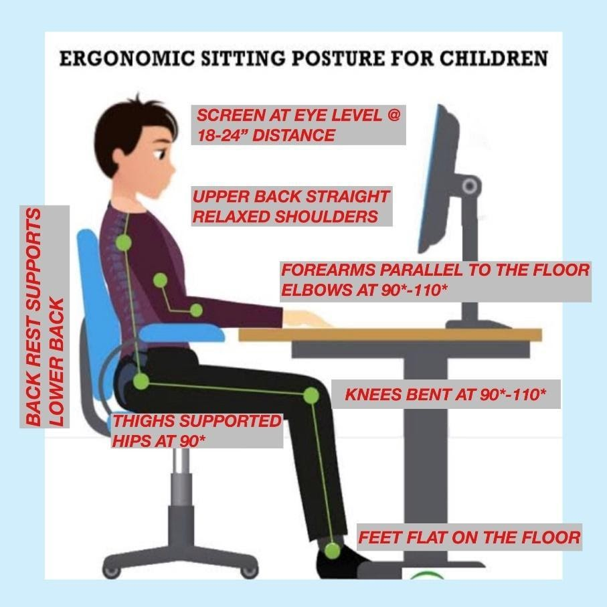
Safety measures
IAP-Adolescent Health Academy: T-TEACH MODULE

Slide 27
How to do a digital detox without unplugging completely ?
1. Schedule Time Away From Screens Throughout the Day
2. Take Periodic Breaks From Technology
3. Downgrade Your Phone
4. Turn Off Your Phone at a Specific Time
5. Adjust Your Phone Settings to Limit Certain Apps
6. Create No-Phone Areas: Bedroom, dining area , toilets
7. Consider Reaching Out to a Mental Health Professional
IAP-Adolescent Health Academy: T-TEACH MODULE

Slide 28
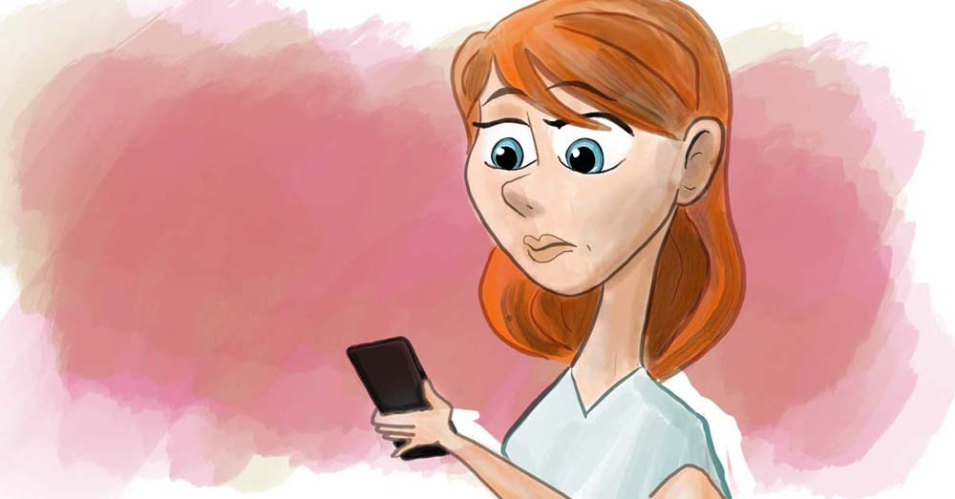

Case 2
15years old Ramya very friendly in nature , average in studies participating in extracurricular activities was noticed by teacher to be looking distressed and was remaining aloof .Teacher proactively enquired if she could be of any help?
Ramya revealed that she has accepted a follow request from an unknown boy on Instagram, believing him to be a new friend. Over time, she shared personal details, including photos, thinking the boy was trustworthy. The boy secretly morphed her pictures into inappropriate images without her knowledge.
He started blackmailing her, threatening to share the morphed images with others if she didn’t comply with his demands.
Teacher asked her , whether she had informed her parents ?She said that her parents did not believe her and scolded for misusing mobile …She was cyberbullied…
IAP-Adolescent Health Academy: T-TEACH MODULE

Slide 29
SMART way of managing
Cyberbullying
Stop interacting with the messenger
Messenger to be blocked
Always preserver the evidence – hide it and don’t delete it
Retaliate – never
Take action – cyber reporting …www.cybercrime.gov.in
or call toll free 1930,1098
IAP-Adolescent Health Academy: T-TEACH MODULE

Slide 30
Case3
A 15-year-old boy experiences a drop in academic performance and social isolation due to excessive online gaming, leading to missed assignments and a lack of participation in school.
Online Gaming Disorder-Needs referral
IAP-Adolescent Health Academy: T-TEACH MODULE

Slide 31
Social Media Rules -1
Verify
Verify Before Accepting.
Limit
Limit Personal Information.
Be
Be Cautious with Photos
Use
Use Privacy Settings
Avoid
Avoid Oversharing
IAP-Adolescent Health Academy: T-TEACH MODULE
Notes:
Verify Before Accepting: Only accept follow requests from people you know in real life.
Limit Personal Information: Avoid sharing personal details like your address, school, or phone number.
Be Cautious with Photos: Never share sensitive or compromising photos, even with people you trust.
Use Privacy Settings: Set your social media accounts to private to control who sees your posts.
Avoid Oversharing: Think twice before posting or sharing anything online; once it’s out there, you can’t take it back.

Slide 32
Social Media Rules -2
Report
Report Suspicious Behavior
Talk
Talk to Trusted Adults
Don’t Engage
Don’t Engage with Strangers
Be
Be Skeptical of Flattery
Educate
Educate Yourself
IAP-Adolescent Health Academy: T-TEACH MODULE
Notes:
Report Suspicious Behavior: Immediately report and block anyone who makes you uncomfortable or asks for personal information.
Talk to Trusted Adults: If something feels off or if you’re being pressured, talk to a parent, teacher, or trusted adult.
Don’t Engage with Strangers: Avoid chatting with or responding to messages from people you don’t know.
Be Skeptical of Flattery: Don’t be swayed by excessive compliments or flattery from unknown people online.
Educate Yourself: Stay informed about online risks, including cyberbullying, phishing, and grooming.

Slide 33
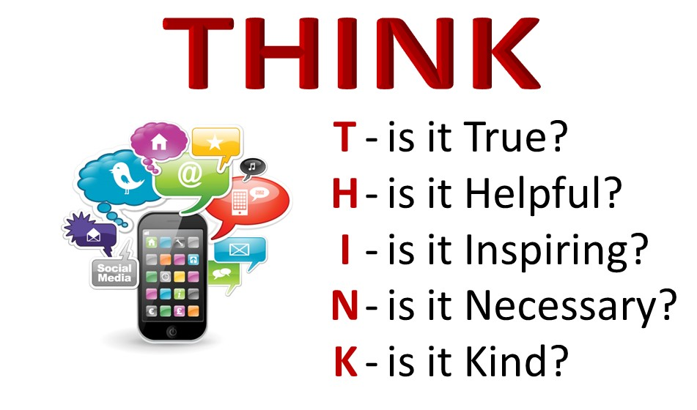
Before you Post
IAP-Adolescent Health Academy: T-TEACH MODULE

Slide 34

APPROACH
WWW
Who they meet online
Known or strangers
Bully
Where do they go online
Porn sites
Risky gaming
Bullying
What they do online
Cyberbullying
Cyber hacking
Social media addicts
Online games and gambling
IAP-Adolescent Health Academy: T-TEACH MODULE
Notes:
They can empower the parents by suggesting to monitor media use by using WWW approach

Slide 35

E -Waste
Mobile addiction in Adolescents
Unmanaged and improperly managed e-waste is polluting soil, water and air, harming the health of communities, especially children.
E-waste includes refrigerators, washing machines, computers, cellphones and other electronics items
IAP-Adolescent Health Academy: T-TEACH MODULE
Notes:
The unscientific disposal of e waste is hazardous.
Developed countries: Strict regulatory regimes and increasing cost. Do exportation to developing countries which is more profitable than recycling in their own countries. Also illegal trafficking, donations or charity is also issue.
India: More than 95% is illegally recycled by informal waste pickers .Workers operate independently, hence, enforcement of regulations is difficult.
Recycling is often rudimentary in nature, hence, release toxic pollutants. No protective measures to the workers.
India is World’s 5 ^{th} in e waste
India is one of the country with highest consumption of electronic gadgets, E waste management 2011 guidelines were issued,2016 revised
But implementation is poor ,
Lack of infrastructure specially in rural area in formal way
Lack of awareness is a challenge
Children should remember that excessive use increases green house gases and increases carbon foot print
Urgent challenge to safeguard environment

Slide 36

Digital Well Being
Maintaining health of the individual user and the community, in all spheres while using digital media and tools for personal, professional, educational, or recreational purposes.
It includes safe and responsible digital behaviour for self , others and environment
Balance online and offline activities.
IAP-Adolescent Health Academy: T-TEACH MODULE

Slide 37
Activity
IAP-Adolescent Health Academy: T-TEACH MODULE

Slide 38
Tips
Tip 1
Encourage balanced schedules
Tip 2
Promote healthy hobbies
Tip 3
Foster social interaction
Tip 4
Educate on consequences
Tip 5
Involve parents and care givers
IAP-Adolescent Health Academy: T-TEACH MODULE
Notes:
Encourage Balanced Schedules: Help students create a daily routine that balances schoolwork, extracurricular activities, and leisure time, including setting limits on gaming.
Promote Healthy Hobbies: Suggest engaging in alternative activities such as sports, arts, or social clubs. By encouraging students to explore various hobbies, teachers can help them develop diverse interests and reduce the temptation to spend excessive time on gaming.
Foster Social Interaction: Encourage students to participate in group activities and build relationships outside of the gaming environment. Social interactions with peers can help reduce isolation and provide a sense of belonging that might be missing from online interactions.
Educate on Consequences: Discuss the potential negative impacts of excessive gaming, such as its effects on academic performance, physical health, and social relationships. Awareness of these consequences can motivate students to adopt healthier gaming habits.
Involve Parents and Caregivers: Recommend that parents set clear rules and limits on gaming at home and monitor their child's gaming habits. Teachers can provide parents with resources or workshops on managing screen time and recognizing signs of gaming disorde
Emphasize the importance of managing time effectively to ensure that academic responsibilities and personal interests are both addressed.

