Slide 1


T –Teach Module
T –Teach Module
(Teachers’ Training and Empowerment in Adolescent Care and Health)
IAP -AHA’s -Training Module for Teachers
IAP-Adolescent Health Academy: T-TEACH MODULE

Slide 2

IAP-Adolescent Health Academy: T-TEACH MODULE

Slide 3
Concept
Adolescence is a crucial stage in an individual's life marked by physical, social, emotional, and cognitive changes. During this period, adolescents require guidance and support from various sources, including teachers.
Teachers, as important stakeholders, play a significant role in the overall development of adolescents and their well being, as they spend a considerable amount of time with them in school settings.
Therefore, it is essential to equip teachers with the necessary skills and
knowledge to effectively support and care for adolescents.
IAP-Adolescent Health Academy: T-TEACH MODULE

Slide 4

IAP-Adolescent Health Academy: T-TEACH MODULE

Slide 5
T –Teach Module
Dr Shubhada Khirwadkar (National Convenor)
Dr Swati Ghate (Academic editor)
Dr Nishikant Kotwal (National Co-ordinator)
IAP-Adolescent Health Academy: T-TEACH MODULE

Slide 6
Topics &Contributors
Understanding Adolescent Behaviour: Dr Swati Ghate, Dr Poonam Bhatia
Handling Teens with problematic behaviour: Dr Sushma Desai, Dr Ashim Ghosh
Dealing with silently suffering Teens(Mental Health Concerns): Dr Sunita Manchanda, Dr Geeta Bansal
Dealing with disorders of Learning: Dr Newton Luiz, Dr Chitra Sankar
The good and the bad about Media: Dr Geeta Patil, Dr Prashant Karia
IAP-Adolescent Health Academy: T-TEACH MODULE

Slide 7
Topics &Contributors
Substance abuse - What teachers should know: Dr Chitra Dinakar Dr Shilpa C
Understanding Teen Sexuality: Dr Himabindu Singh, Dr Sushma Kirtani
Positive discipline: Dr Shubhada Khirwadkar, Dr Kalyani Patra
Promote Healthy Life Style: Dr Shamik Ghosh, Dr Shalini Bhasin
Communication Skills and self help: Dr Nishikant Kotwal, Dr Chitra Kulkarni
Prevent , Empower , Stand Strong (self defense): Dr. Jayashree Deshpande
IAP-Adolescent Health Academy: T-TEACH MODULE

Slide 8
Reviewers
Dr Swati Bhave
Dr C P Bansal
Dr Sukanta Chatterjee
Dr Preeti Galagali
Dr Samir Shah
Dr Piyali Bhattacharya
Dr Atul Kanikar
Dr Atanu Bhadra
Dr R G Patil
Dr R N Sharma
IAP-Adolescent Health Academy: T-TEACH MODULE

Slide 9
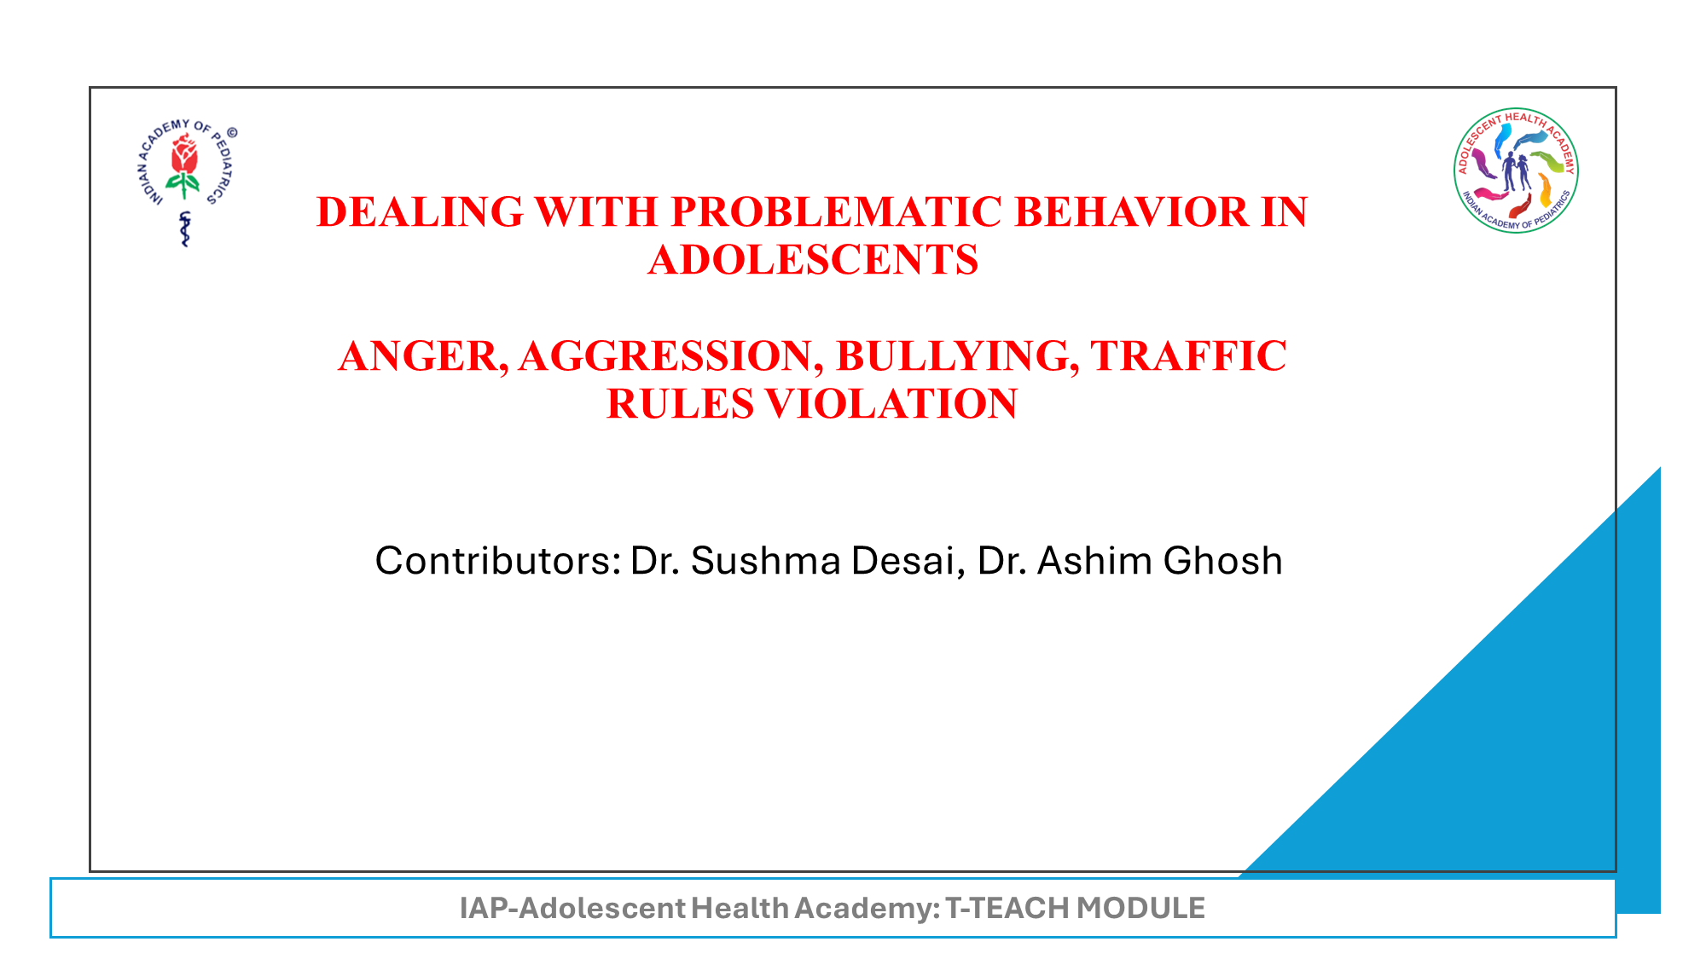

Slide 10
Learning Objectives
Empowering teachers
About understanding adolescent anger, aggression & bullying
Strategies to handle them in schools
Sensitizing students about traffic rules

Slide 11
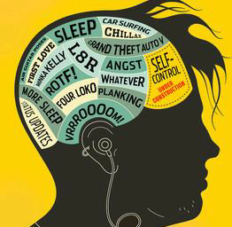
Reasons for Heightened Emotions in Adolescents
Neurobiology
Hormonal dance
Concerns about physical changes
Irregular meal patterns
Inadequate sleep
The normal ups and downs of social relationships
Notes:
Neurobiology* - Brain Re modelling: emotional brain is fully developed but brain part required for reasoning and logical thinking is yet to develop.
Hormones, influence the physical changes at puberty, and affect moods and teen emotionality
Concerns about physical changes are a source of sensitivity and heightened emotions.
Irregular meal patterns, skipping breakfast, and fasting to lose weight can affect mood.
Inadequate sleep can lead to moodiness, irritability, gloominess, and tendency to overreact.
The normal ups and downs of social relationships, especially Romance & Family , can influence a teen feeling anything from elation to abject despair.

Slide 12
Normal v/s Problematic behaviour
Normal
Becoming easily annoyed
Emotional reactions off & on temporarily
Irregular Sleeping and eating pattern
Concern for appearance
Spending more time with friends
Experimentation with recreational drugs and sexual acts
Stress or upset by life’s challenge: Usually able to handle
Normal functional abilities
Problematic
Angry/ violent outbursts with little provocation
Emotional reactions are prolonged’ worsen over time
Too much or too little sleep/appetite
Obsessed with body image
Avoids being with family and even friends
Frequent alcohol/drug use/ sexual acts
Uses faulty coping strategies including self-harm to handle stress
Deterioration in functional abilities
Notes:
Can be taken as an activity involving the teachers
Normal
Becoming easily annoyed by daily events
Sleeping and eating more during growth spurts, especially with physical activity or involvement in sports
Concerned with health, appearance, and fitting-in
Wanting to spend more time out with friends
Emotional reactions that improve over time
Light experimentation with recreational drugs and sex
Becoming stressed or upset by difficult circumstances
Normal functional abilities
Problematic
Angry or violent outbursts with little prompting
Regularly sleeping 12+ hours/experiencing extreme insomnia
Obsessively dieting or exercising to lose body fat, binging /purging food, cosmetics, make up …. Spends lots of time and money on getting the desired look
Avoiding spending time with family and friends
Sadness or anxiety that gets worse over time
Heavy alcohol/drug use or sexual promiscuity
Engaging in self-harm or suicidal thoughts/tendencies
Impaired/deteriorated functional abilities

Slide 13

What Is Anger ?
Anger is a ‘Feeling’ or Emotion.
It is Natural & Normal to feel angry.
Intensity varies from annoyance to rage
Types:
State anger: Temporary emotional response
Trait: Tendency to react angrily to trivial provocations
Notes:
Emotional State, which varies in intensity from mild annoyance to intense fury & rage- typically accompanied by physical, psychological & biological changes.
State Anger : Temporary emotional response
Trait : Tendency to React angrily to perceived situation (Physical response)

Slide 14
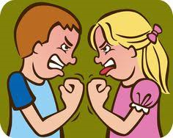
What is Aggression?
An expression of Anger
Destructive or hurting Behavior directed
towards others/ self
ANGER + AGGRESSION (-VE) = VIOLENCE
Positive aggression: A positive force used to
achieve something
e.g. Sports, Academics
Notes:
Aggression implies destructive or punitive(intended to hurt) Behavior directed outwards towards others/inwards towards self.
It can be an expression of Anger.
Proactive aggression: A positive force used to achieve something, e.g. Sports, Academics.
If negatively used, can lead to VIOLENCE.
ANGER + AGGRESSION (-VE) = VIOLENCE

Slide 15
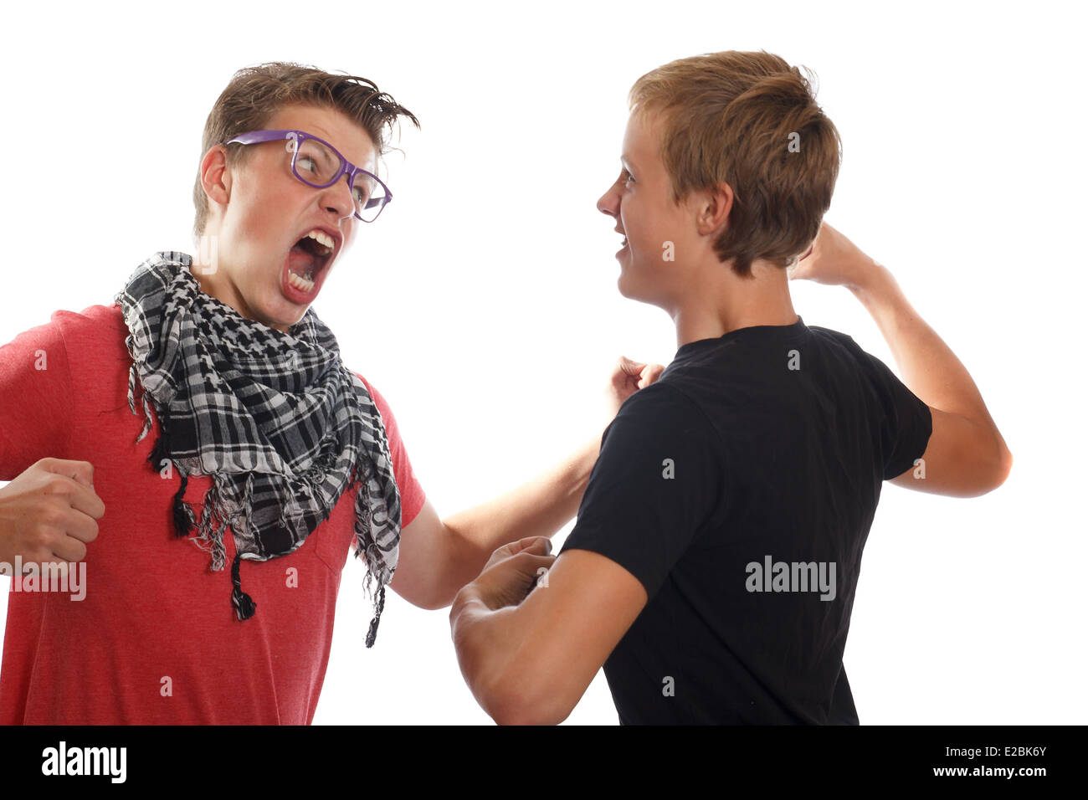
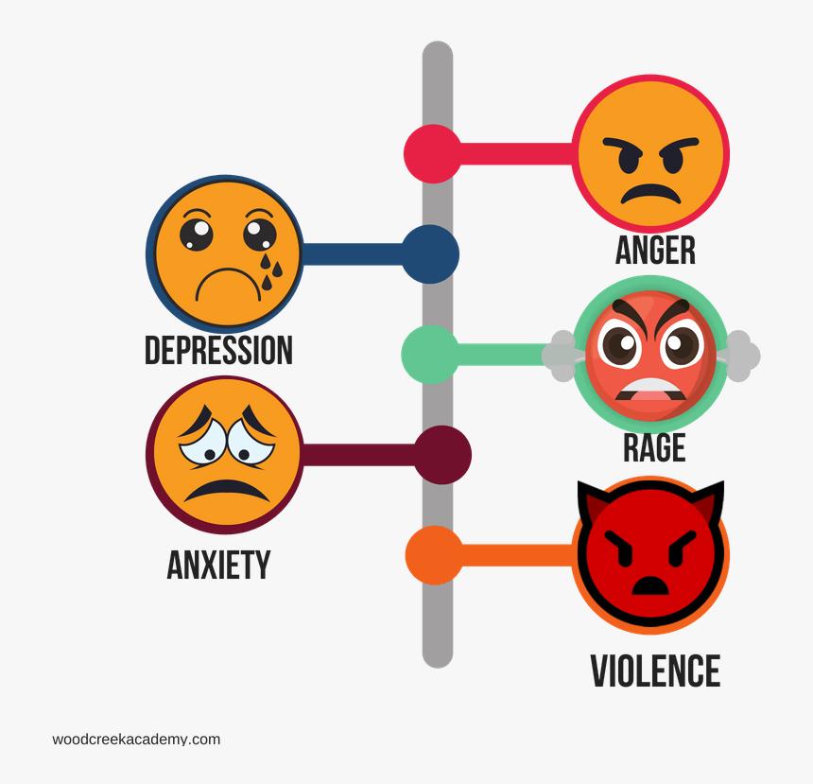
Poorly managed anger and aggression can lead to:
1 Conflicts in Family, School, Peer group & other social
fronts.
2. Antisocial behavioral issues- Violence & Sexual
offenses, Terrorism, Bullying
3. Legal issues: Conduct problems, Delinquency and crime
4. Poor concentration & Academic deterioration
5. Increased Health Risk* –high B.P., Heart attack,
Stomach Ulcers, aggravation of Asthma & allergies
6. Mental Health Problems: Depression, Anxiety,
Suicidality

Slide 16
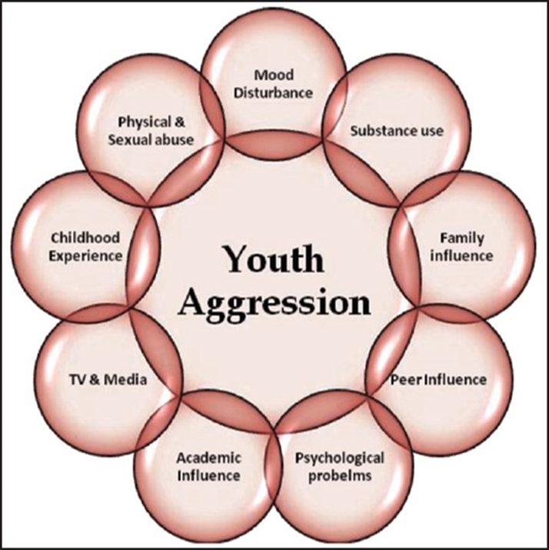
What Causes Problematic Anger In Teens ?
Childhood Traumatic experiences
Long-standing exposure to Multiple stressors
Academic pressure & Unrealistic expectations
Familial and Relationship issues
Identity & Self-esteem struggle
Negative School environment,
Bullying, Social Exclusion
Technology & Social Media
Substance Abuse disorder:
Traumatic experiences at home / In school :
Underlying mental Health disorder:
Notes:
Childhood Traumatic experiences : broken family, domestic abuse, hunger, poverty, humanitarian emergencies, epidemics,
Long standing exposure to Multiple stressors
Academic pressure & Unrealistic expectations
Familial and Relationship issues
Identity & Self esteem struggle
Negative School environment , ( rigid discipline, insensitive teachers, etc. )Peer pressure
Bullying ,Social Exclusion
Technology & Social Media
Substance Abuse disorder:
Traumatic experiences at home / In school :
Underlying mental Health disorder:

Slide 17
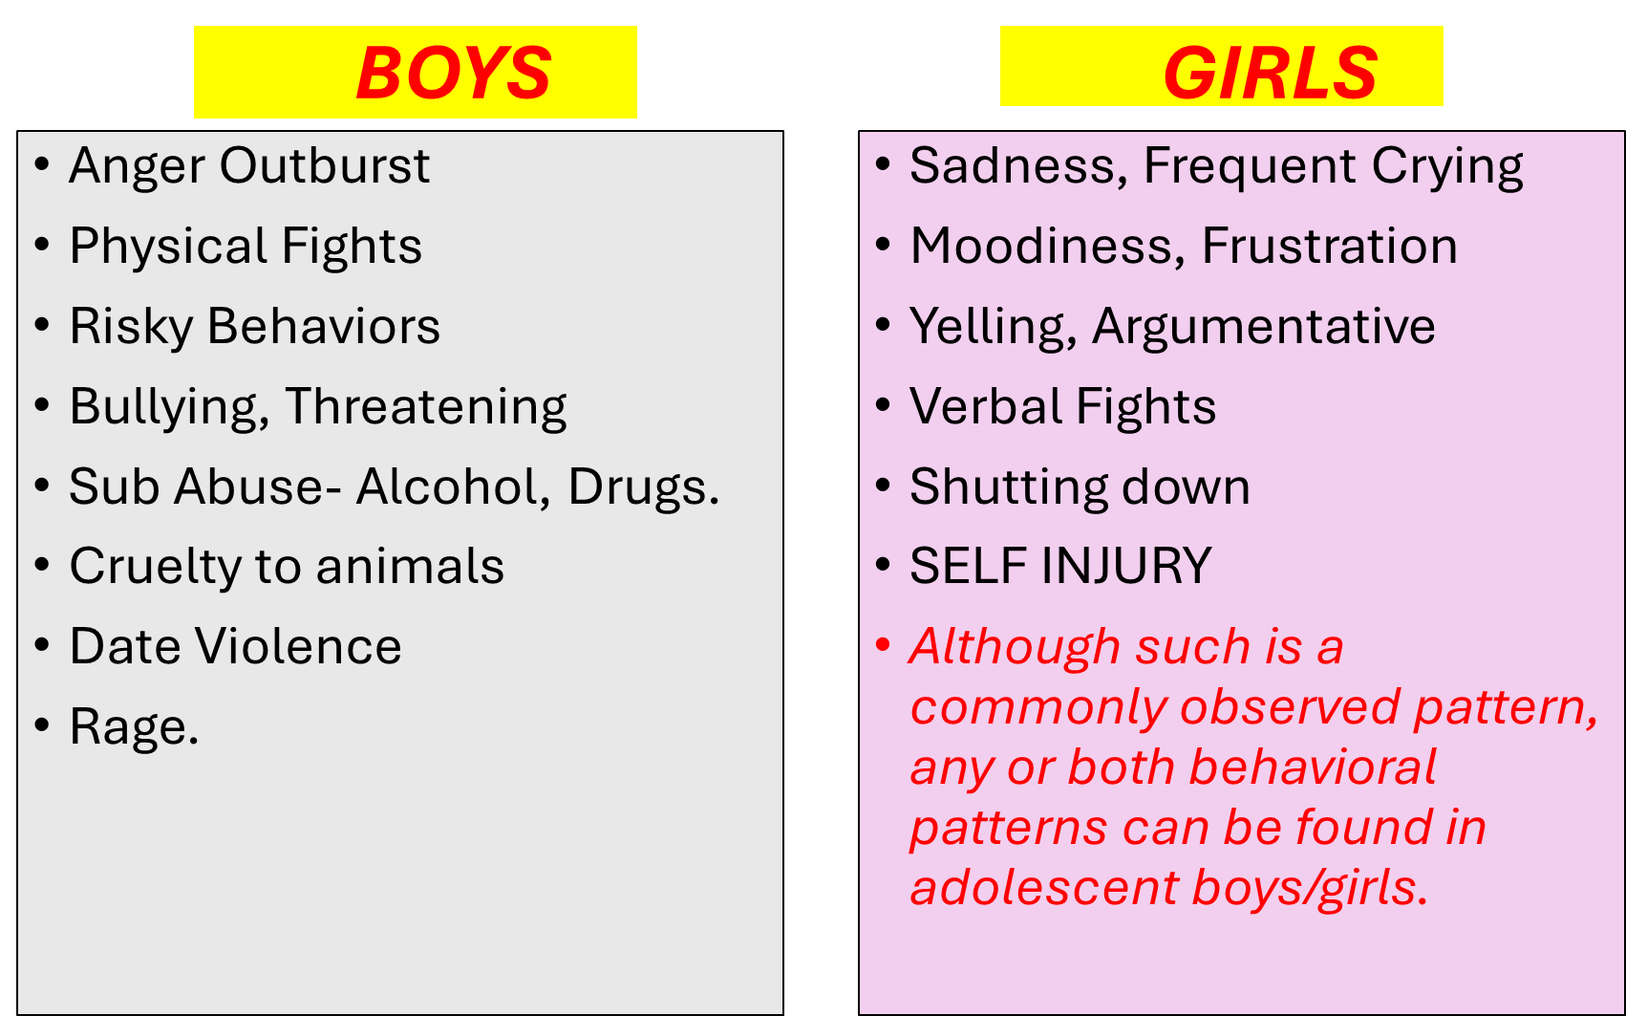
Notes:
Boys mostly exhibit overt anger while girls have a tendency to internalize the feelings.
Boys: Externalizing behavior
Girls : Internalize their Feelings

Slide 18

How do we identify maladaptive anger/ aggression?
Socially inappropriate
Either in the absence of or a minimal provocation
Intensity, frequency, duration &/or severity
disproportionate to the cause.
Doesn’t terminate within an appropriate timeframe
Unable to control despite efforts to calm down

Slide 19
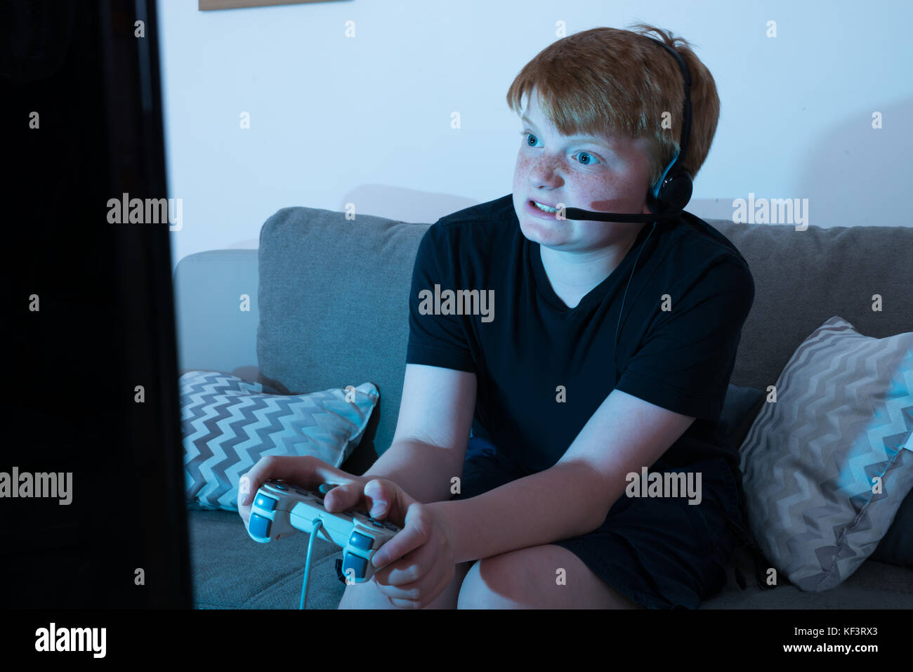
Cues for Violent Behavior
Obsessively playing/watching violent video
games, enjoying websites that promote violence
Threatening or bullying others
Fantasizing about committing a violent act
Cruelty to pets and animals
Playing with weapons

Slide 20
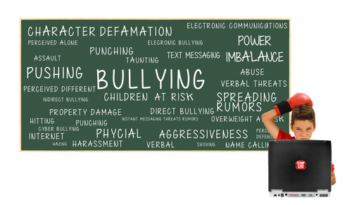
Types of Students Aggression In School
Verbal aggression
Physical aggression
Aggression directed towards self
Group aggression
Notes:
Verbal aggression: Defiance, Continuous Arguing, Verbalizing Threats, Name calling, Swearing, Bossing, Sarcasm, Teasing, Bullying, Screaming the slogans in group,.
Physical aggression : Kicking, Hitting, Fighting, Spitting, Throwing materials with intent to do harm (either to a person or to objects e.g. a window)/ damaging school property, Snatching the things etc
Aggression directed towards self : Self Harming behavior, Non Suicidal Self Injuries, Skipping Class despite being in the school.

Slide 21

Causes of Group Aggression In School
All the causes of problematic anger in youth, in
addition to school-related issues like :
Harsh / Inconsistent Disciplinary methods
(Lack of positive Discipline )
Feeling of being a victim of Discrimination /
Favouritism
Unclear directions about the school curriculum
Lack of basic facilities/ recreational activities
Notorious students/ gang disturbing the class
Notes:
Harsh & Punitive Disciplinary methods OR Inconsistent Punishments
Discrimination / Favouritism amongst the students
Lack of Clear Directions about the study patterns leading to confusion/ frustration amongst the students
Lack of recreational activities / Basic facilities for students
Ineffective teaching ( aggression towards the particular teacher)/ harsh or humiliating disciplinary methods in the class.
Aggressive/Notorious group of students intending to disturb entire class/school.

Slide 22

5 “ Rights” about Anger Expression..
It is important to vent out the gush of anger appropriately
Observe Aristotle’s 5 ”Rights”
With the Right person
To the Right degree
At the Right time
For the Right purpose
In the Right way
Notes:
Children need to learn appropriate ways to express their strong emotions like anger.
Activity: Role play
A Student shares his book with a classmate. When it comes back, it is torn. He is rightfully angry.
How the student should express his anger using 5 R ?

Slide 23
Basic Anger Management steps
Identify the Triggers: Make a list – Avoid or find the skills to handle them effectively
Be Aware of the Anger Clues: Start Practicing Relaxation Techniques
Find Your Anger Type: Try to apply Aristotle’s “ 5 Rights About Anger”
Long Term Management:
Healthy Lifestyle: Time Management
Inculcate Life skills in the day to day life
Relaxation techniques:
Incorporating Life skill lessons and relaxation techniques during day-to-day class activities helps a lot.
Notes:
These anger management tips apply to all the adolescents in general.
Triggers: Something ( some behaviour/words/actions/situations) which provokes anger. A trigger for one person may not be a trigger for another person.
e.g. Tanish is very sensitive about his glasses.. Any comment – even the most trivial will make him angry.
Anger clues: make a person aware that he is getting angry .e.g. flushing / sweating/ thumping in the chest/ rapid breathing/ clenching of teeth/ feasting etc ..
Suggests that anger may go out of proportion and he is about to lash out.
Faulty Anger types: 1) Acting Out (Out of Control) 2) Dumping (Displaced Anger) 3) Burying(Ignoring)
Relaxation techniques: Mindful Meditation, Progressive Muscle Relaxation, Guided Imagery, Regular Physical Exercise & Outdoor sports, Hobbies, Group Projects & Community Services.
Incorporating Life skill lessons and relaxation techniques during day-to-day class activities helps a lot.

Slide 24
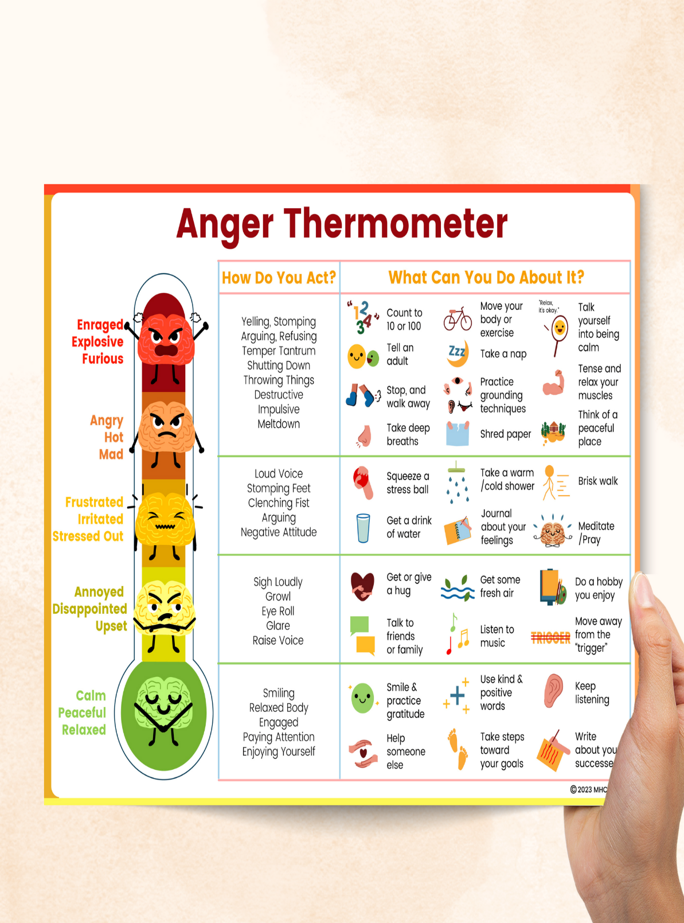
Handling Angry Teen: Tips for the teachers
In the Moment
Take a few deep breaths & handle the situation calmly.
Evaluate & ensure the safety of other students.
Encourage Conversation with the teen. Listen Attentively. This allows the student to vent some of his anger.
4) Acknowledge and Validate the Feeling.
5) Help him cool down
Notes:
1 ) It is better if your initial reaction is calm. If you meet anger with anger, you will most likely escalate the situation.
2) Are the other students safe? If not, clear the room before addressing the angry student or take him outside the class.
3) Talk to the teen empathetically, in non judgmental way.Listen attentively. Recognize that the student is upset and ask what is troubling him,. If the student tells you the issue, encourage them to give details. This allows the student to vent some of their anger.
4)Acknowledging the feeling will make them feel understood.
Assessing the intensity of anger with the help of anger thermometer will help to get some idea about how serious the issue is.
Validate Their Emotions
Never tell an angry student that there is nothing to be angry about. This will make him angrier. Typically, angry students are being irrational. It is not necessary to agree with students’ anger to validate it. Simply tell the student, “I bet that would make a lot of people angry.” You cannot reason with an angry student. You must drain off the anger first, and then talk about what to do next time.
5) Past experiences with the student may create grudge in the mind of teachers.
6) implementing breathing exercise/ relaxation techniques. Can be done for the entire class if the class is disturbed due to the anger episode or can be done individually with the affected student..

Slide 25
Handling angry Teen, Tips for the teachers
After an angry outburst
Express Concern.
Recognize the underlying problem.
Make consequences logical and restorative, not punitive.
Help the teen identify the triggers and plan for the triggers.
Notes:
Here are strategies that you can use after an angry outburst has occurred and the student is calm.
Express Concern: Do not lecture. Try to Build a trusting relationshipDiscuss what happened with the student. Tell the student that their behavior is concerning to you. Do not use this time to lecture. If you start lecturing the student, they will shut down almost instantly—or it may lead to another angry outburst.
Recognize the underlying problem, empathize, and help him handle it. Recognise that a student who is presenting with aggressive behaviour may have underlying issues such as frustration, fear, or a lack of coping skills. By acknowledging their emotions and demonstrating genuine concern, you can build trust and establish a foundation for positive change. One effective strategy is to validate their feelings without condoning their actions. Let them know that you understand they may be feeling angry or overwhelmed but emphasize the importance of expressing themselves in a more appropriate manner. This approach helps students feel heard while also setting clear boundaries.
Make consequences logical and restorative, not punitive. If the student made a mess, have them clean it up. If the student said something hurtful, have them apologize
Help the teen identify the triggers and plan for the triggers. Discuss with him to figure out the way to handle the unavoidable triggers.Once you know a student’s triggers, you can plan accordingly to help them overcome their anger. For example, if a certain activity creates frustration that leads to anger, be sure to plan a preferred activity before and after it. Tell the student about all activities ahead of time. This kind of planning can help the student work through the difficult activity.

Slide 26
Handling angry Teen, Tips for the teachers
5) Provide Space and Time if he needs, till he is ready to talk.
6) Help them find constructive ways to channel Anger energy.
7) Try to incorporate Life skill training as a part of regular lessons.
8) Be a Positive Role Model.
Notes:
5) Provide Space and Time if he needs, till he is ready to talk.
I see that you need a little time to collect yourself. Let me know when you are ready to talk…. I will be over here. Come over when you are ready.
5) Help them find constructive ways to channel Anger energy.
Anger is very strong emotion. Instead of negative aggression, the energy can be channelize to sports, physical exercise, arts, music, social work / helping needy people , group projects etc.
7) Try to incorporate Life skill training in lessons: Coping skills, Thinking skills, self-awareness, problem-solving skills. Can be imparted with the help of practical examples, storytelling.

Slide 27
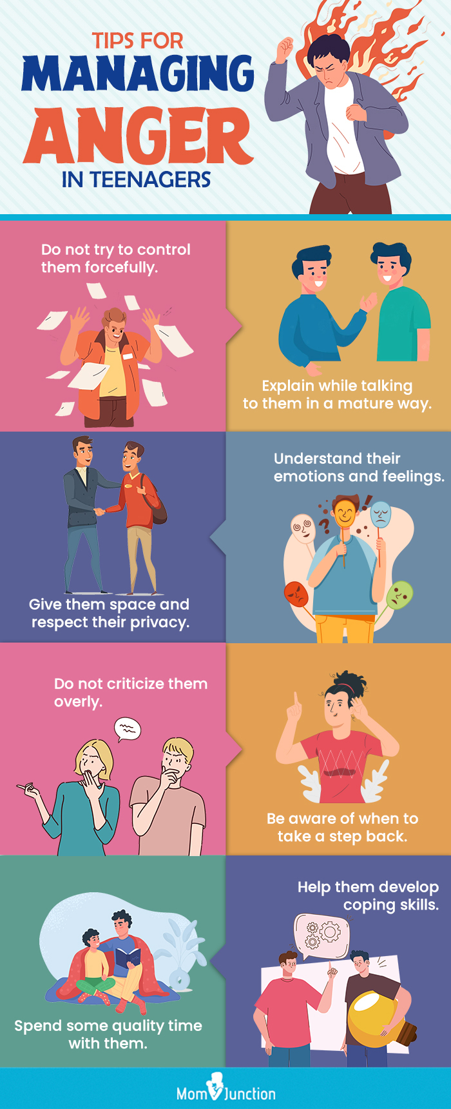
Managing Anger in Teen
Further Steps :
Communicate with the parents/guardian.
Consult the School Counsellor for further help if needed.
Refer the student to a specialist if required
4) Incorporate Relaxation techniques in Classroom Activities
5)Group Activities
Notes:
3)Refer the student to a specialist if you find features of violent behavioral patterns / maladaptive Anger-Aggression
4)Incorporate Relaxation techniques in Classroom Activities:
Progressive Muscle Relaxation, Guided Imagery, Mindfulness Meditation
5)Group Activities: Keep them busy with recreational yet useful projects on Lifestyle, Science, Social services, and Environmental health

Slide 28
Handling Angry Class
Recognise signs of escalating aggression
Foster an open communication channel
Show Empathy, understanding & concern
Setting up Structured routine study patterns and clearly stated
rules/regulations, taking students’ opinions.
Positive reinforcement practices help
Notes:
Recognize signs of escalating aggression: Try intervening before the situation goes out of control.
Foster an open communication channel, frank & non-judgemental discussion helps.
Show Empathy, understanding & concern about their stressful or overwhelming situation.
Setting up Structured routine study patterns and clearly stated rules/regulations, taking students’ opinions.
Positive reinforcement practices, Verbal praise, and small rewards/privileges to promote desirable behaviour.

Slide 29
Implementing De-Escalation Techniques during Confrontation
Remain Calm Speak softly and maintain a neutral tone.
Active Listening.
Empathy & Understanding. Validate their emotions.
Non Threatening body language.
Assure them to take appropriate action regarding their genuine complaints.
Inviting their unanimously appointed representatives to talk
Notes:
Remain Calm Speak softly and maintain a neutral tone.
Active Listening. Show Genuine interest in what students have to say ,allowing them to express their feeling without interruption.
Empathy & Understanding. Validate their emotions.
Non Threatening body language.
Give them assurance to take appropriate action regarding their genuine complains.
Inviting their unanimously appointed representatives to talk helps to handle situation more effectively.

Slide 30
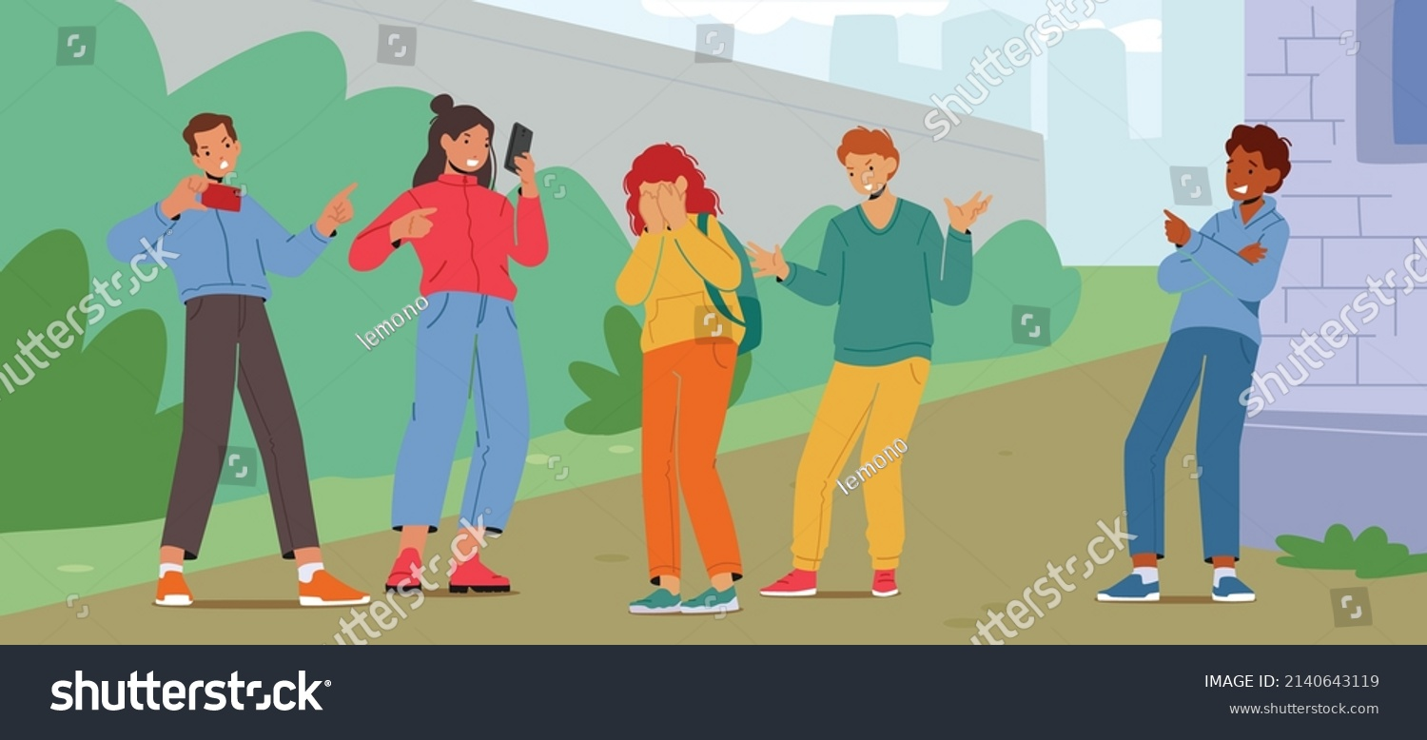
Bullying
It is an act of Physically/verbally/ mentally or emotionally harassing someone.
PEOPLE INVOLVED
Bully: The person/group who harasses someone.
Victim or Target: A person who is being bullied.
Bystanders: who are neither bullies nor victims, but are involved by watching and doing nothing,
Upstanders: who are trying to save or help the victim.
Notes:
Bullying is the commonest form of Violence seen in school.
Bully: The person/group who harasses someone.
Victim or Target: A person who is being bullied.
Bystanders: who are neither bullies nor victims, but are involved by watching and doing nothing,they may encourage the Bully by laughing or making funny gestures.
Upstanders: who are trying to save or help the victim.

Slide 31
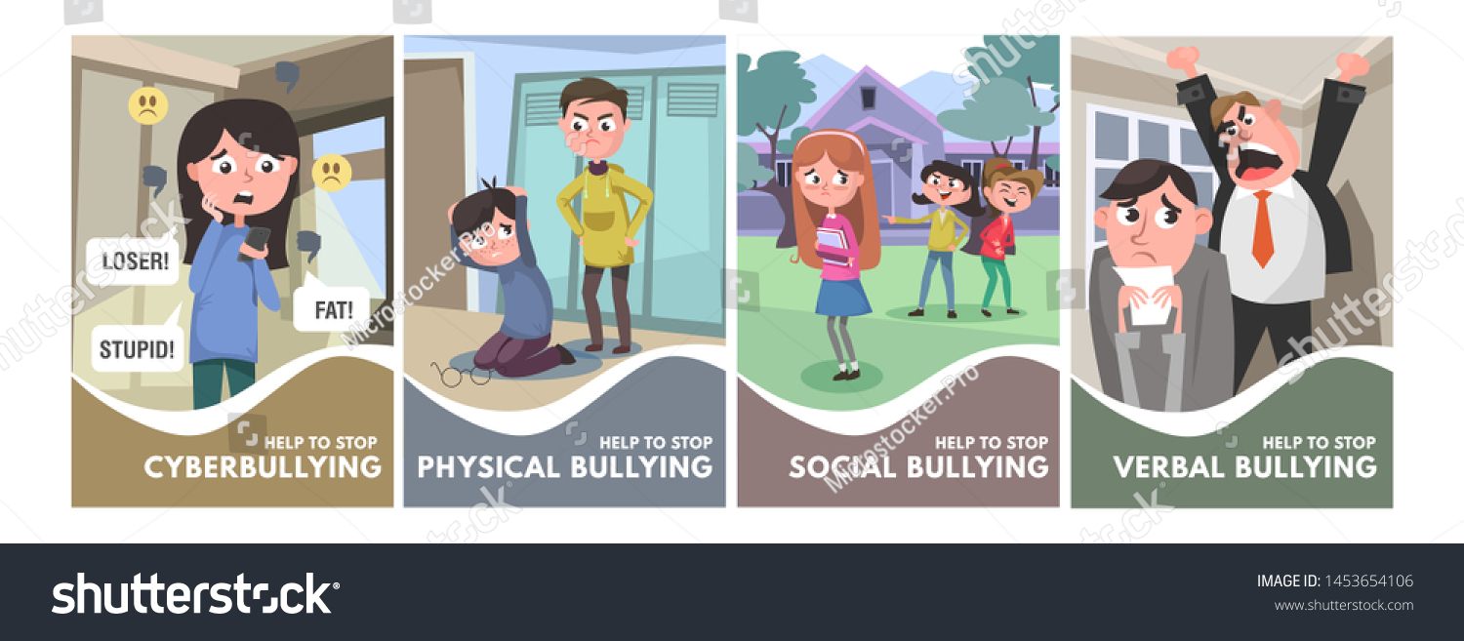
Types of Bullying in School:
1)Amongst the student,
2) Student to teacher & vice versa
Notes:
Other types are Sexual harassment , Emotional torture, Racial, Religious,

Slide 32
Charecteristics of victims
Have low self esteem/ lack self confidence to seek help
Often lonely, unappealing to peers/teachers due to poor in academics.
Have Poor social skills, esp. communication skills
May be physically or mentally challenged or different sexual orientation
Desperate to “Fit in”
May have mental health problems like depression
Characteristics of Bullies
Dominating ,Self cantered, attention seekers
Like power and want to impress other peers, often a gang leader
Quick to anger, intolerant of people who do not accept their power.
May have experienced bullying or seen violence, or may have underlying psychiatric/psychological problem

Slide 33
Consequences of Bullying
Victim
Deteriorating academic performance, School refusal
Psychosomatic symptoms
low self-esteem, impaired personality development
Long-term emotional and behavioural problems.
PTSD, Depression, Anxiety, Suicidality
May become bullies themselves.
Bully
May end up being an aggressive adult, intolerant of fellow civilians who enjoys oppressing others
Tend to get involved in gang violence, and delinquency.
Chances of having serious mental health problems like depression, anxiety, suicidality.
Notes:
Being bullied makes young people incredibly insecure: When you're being bullied, you can feel constantly insecure and on guard. Even if you're not actively being bullied, you're aware it could start anytime. It has a big mental and emotional impact—you feel unaccepted, isolated, angry, and withdrawn.
No single indicator will tell you that your child is definitely being bullied, but there are some signs to look out for, including:
Belongings getting lost or damaged.
Coming home with physical injuries, like unexplained bruises.
Torn clothes.
Being afraid to go to school.
Being mysteriously 'ill' each morning.

Slide 34

Role of a teacher
Ensure protection if the child is at risk of harm.
Encourage the child to talk & listen attentively
Take every report of bullying very seriously
Keep in mind, that ‘Bullying behaviour’ has to be addressed.
Respond as per the school’s anti-bullying policy.
Don’t Stop until the incident is resolved.
Keep communicating with students & parents about the actions taken.(work with parents as a team)
Make sure the students have clear information about reporting & a Support System.
Keep a track of behavioural change in students involved.
Notes:
Assess if the child is at risk of harm. If so, ensure protection.
Encourage the child to talk about what happened & listen attentively. Reassure that together the problem can be resolved.
Keep in mind, that ‘Bullying behaviour’ has to be addressed. Blaming or accusing the victim/bully will not help resolve the problem.
Be clear on your response to bullying incident according to school’s antibullying policy.
Make sure you take every report of bullying very seriously
Keep a record of what has taken place & type of action taken.
Make sure the students have clear information about how to report bullying and the availability of a Support System.
Do not stop until the incident is resolved & then keep going.
Don’t stop communicating with students & parents about the actions taken. Keep a track of behavioral change in students involved.
Work with Parents as a Team.

Slide 35

Role of School Authorities
Make a clear conduct code about disciplinary actions for bullying.
Create “Bullying Prevention Squad”
Arrange BULLYING Awareness programs
Facilitate reporting with convenient visiting hours for parents AND simple, quick reporting policies for students.
Protect and Support victims of Bullying & those who report.
Provision of behavioral counseling for the students involved
Notes:
Make a clear conduct code about disciplinary actions for bullying .
Create “Anti bullying squad” or “Bullying Prevention Squad” consisting of Students, Teachers and Parents as well as school authorities.
Arrange BULLYING Awareness programs with clear information about School Anti Bullying Policy and contact details of Anti Bullying Squad Periodically & frequently.
Facilitate reporting with convenient visiting hours for parents who want to report AND simple, quick reporting policies for students.
Protect and Support victims of Bullying as well as those who report.
Provision of behavioral counseling for the students involved ( the bully as well as victim both).

Slide 36
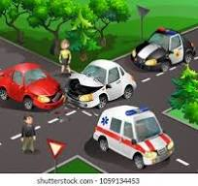
TRAFFIC RULES - IMPORTANCE OF ROAD SAFETY
Road Traffic Accidents(RTA) are a leading cause of death for Adolescents in India and the world. According to WHO it is the leading cause of death for children and young people aged 5-29
India has the highest number of RTA deaths in the world -11% of the global total.
Every year India loses 1.5 million lives to RTAs. In India the majority of RTAs are in the 18-30 age group.
According to the AAA Foundation for Traffic Safety, drivers between the ages 16-17 Has the highest accident rate.

Slide 37
RISK TAKING BEHAVIOUR (RTB) IN ADOLESCENTS
Adolescents have more accidents because
They are too young to understand road safety
They are just starting to get independent
Exposure is high
Over-speeding
Drinking and driving
Non-usage of helmets and seat belts while driving
Distracted driving using mobile phones

Slide 38

TRAFFIC RULES AND REGULATIONS WHILE DRIVING
For Learner’s License :
Age : 16 Non-gear motorcycle with engine capacity 50cc
18 Gear motorcycle or LMV
Supervision
Learner’s license
Restrictions
Documents
Consent

Slide 39
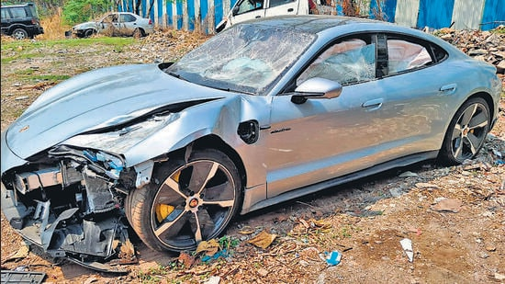
Driving License
Vehicle Registration
Traffic signals
Speeding
Lane discipline
Emergency vehicles
Seat belt
Mobile phone
Drinking and Driving
Teenage son of prominent Pune builder in speeding luxury car hits bike, two killed May 2024

Slide 40

10 Crucial Road Safety Rules for Children/Adolescents
Always Hold Hands While Crossing: ...
Look Left-Right-Left: ...
Stay Visible with Reflective Gear: ...
Understand Traffic Signals: ...
Stay on the Sidewalks: ...
Be Cautious Around Parked Vehicles: ...
Stay Away from Stray Animals on the Road: ...
Use Proper Safety Gear for Cycling:

Slide 41

Be alert and watch out for hazards
Don’t take risks around roads
Avoid peer pressure
How to cross the road safely in 5 steps
Find a safe place to cross
Stop
Look both ways
Listen
Safely cross

Slide 42

CONSEQUENCES OF NOT FOLLOWING TRAFFIC RULES
Accidents
Traffic jams
Penalties and fines
Harm to animals and property

Slide 43

TRAFFIC RULES AND REGULATIONS WHILE DRIVING
Do not drink and drive. .
Always wear a seat belt
Don’t use a mobile phone while driving.
Avoid over speeding
Follow traffic signals
Make way for emergency vehicles
Have a car insurance
Number plate
Riders of two wheelers must wear helmets

Slide 44
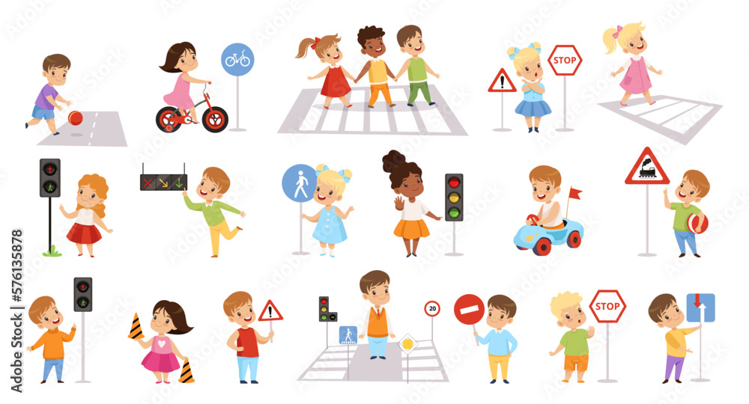
WHAT IS THE ROLE OF THE TEACHER AND SCHOOL
AUTHORITIES
Teachers and schools play a vital role in teaching children about traffic
rules and regulations, which can help ensure their safety and help
them grow up into responsible citizens.
Teach the language of road safety.
Provide role models
Provide Interactive sessions.
Help children learn safe behaviour
Help children develop empathy
Help children understand the importance of road safety
Help children make better driving decisions

Slide 45
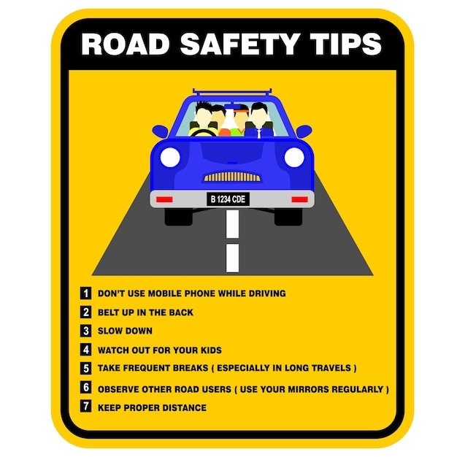
GUIDELINES FOR SCHOOL ADMINISTRATION
Teach traffic rules
Follow traffic rules
Use proper safety gear
Be cautious
Be visible
Monitor and report

Slide 46
Key points
Adolescent Anger and aggression is the most important public health problem with serious health risks.
Teachers can play a very crucial role in prevention as well as management of maladaptive anger & aggression in adolescents.
Bullying is the commonest form of violence exhibited by adolescents in school ,with life time effects on adolescent health & development.
Teachers and school authorities can play crucial role in prevention of bullying.
Road traffic accidents is the leading cause of mortality in adolescents.
Imparting knowledge about traffic rules helps adolescents drive safely on the roads. .

Slide 47
THANK YOU

Slide 48

Role of a teacher
Ensure protection if the child is at risk of harm.
Encourage the child to talk about what happened & listen attentively
Keep in mind, that ‘Bullying behaviour’ has to be addressed.
Response to bullying incidents according to the school’s anti-bullying policy.
Take every report of bullying very seriously
Notes:
Assess if the child is at risk of harm. If so, ensure protection.
Encourage the child to talk about what happened & listen attentively. Reassure that together the problem can be resolved.
Keep in mind, that ‘Bullying behaviour’ has to be addressed. Blaming or accusing the victim/bully will not help resolve the problem.
Be clear on your response to bullying incident according to school’s antibullying policy.
Make sure you take every report of bullying very seriously

Slide 49

Role of a Teacher
Keep a record of what has taken place & type of action taken.
Make sure the students have clear information about reporting & a Support System.
Do not stop until the incident is resolved & then keep going.
Keep communicating with students & parents about the actions taken.
Keep track of behavioural change in students involved.
Work with Parents as a Team.
Notes:
Keep a record of what has taken place & type of action taken.
Make sure the students have clear information about how to report bullying and the availability of a Support System.
Do not stop until the incident is resolved & then keep going.
Don’t stop communicating with students & parents about the actions taken. Keep a track of behavioral change in students involved.
Work with Parents as a Team.

