Slide 1


T –Teach Module
T –Teach Module
(Teachers’ Training and Empowerment in Adolescent Care and Health)
IAP -AHA’s -Training Module for Teachers
IAP-Adolescent Health Academy: T-TEACH MODULE

Slide 2

IAP-Adolescent Health Academy: T-TEACH MODULE

Slide 3
Concept
Adolescence is a crucial stage in an individual's life marked by physical, social, emotional, and cognitive changes. During this period, adolescents require guidance and support from various sources, including teachers.
Teachers, as important stakeholders, play a significant role in the overall development of adolescents and their well being, as they spend a considerable amount of time with them in school settings.
Therefore, it is essential to equip teachers with the necessary skills and
knowledge to effectively support and care for adolescents.
IAP-Adolescent Health Academy: T-TEACH MODULE

Slide 4

IAP-Adolescent Health Academy: T-TEACH MODULE

Slide 5
T –Teach Module
Dr Shubhada Khirwadkar (National Convenor)
Dr Swati Ghate (Academic editor)
Dr Nishikant Kotwal (National Co-ordinator)
IAP-Adolescent Health Academy: T-TEACH MODULE

Slide 6
Topics &Contributors
Understanding Adolescent Behaviour: Dr Swati Ghate, Dr Poonam Bhatia
Handling Teens with problematic behaviour: Dr Sushma Desai, Dr Ashim Ghosh
Dealing with silently suffering Teens(Mental Health Concerns): Dr Sunita Manchanda, Dr Geeta Bansal
Dealing with disorders of Learning: Dr Newton Luiz, Dr Chitra Sankar
The good and the bad about Media: Dr Geeta Patil, Dr Prashant Karia
IAP-Adolescent Health Academy: T-TEACH MODULE

Slide 7
Topics &Contributors
Substance abuse - What teachers should know: Dr Chitra Dinakar Dr Shilpa C
Understanding Teen Sexuality: Dr Himabindu Singh, Dr Sushma Kirtani
Positive discipline: Dr Shubhada Khirwadkar, Dr Kalyani Patra
Promote Healthy Life Style: Dr Shamik Ghosh, Dr Shalini Bhasin
Communication Skills and self help: Dr Nishikant Kotwal, Dr Chitra Kulkarni
Prevent , Empower , Stand Strong (self defense): Dr. Jayashree Deshpande
IAP-Adolescent Health Academy: T-TEACH MODULE

Slide 8
Reviewers
Dr Swati Bhave
Dr C P Bansal
Dr Sukanta Chatterjee
Dr Preeti Galagali
Dr Samir Shah
Dr Piyali Bhattacharya
Dr Atul Kanikar
Dr Atanu Bhadra
Dr R G Patil
Dr R N Sharma
IAP-Adolescent Health Academy: T-TEACH MODULE

Slide 9
Dealing with
Disorders of Learning
Dr Chitra Sankar
Dr Newton Luiz
IAP-Adolescent Health Academy: T-TEACH MODULE

Slide 10


Learning objectives
Equip teachers to recognize early signs of disorders of learning
Familiarize teachers with the developmental disorders that can
contribute to poor scholastic performance
Provide teachers with practical strategies to support such students.

Slide 11
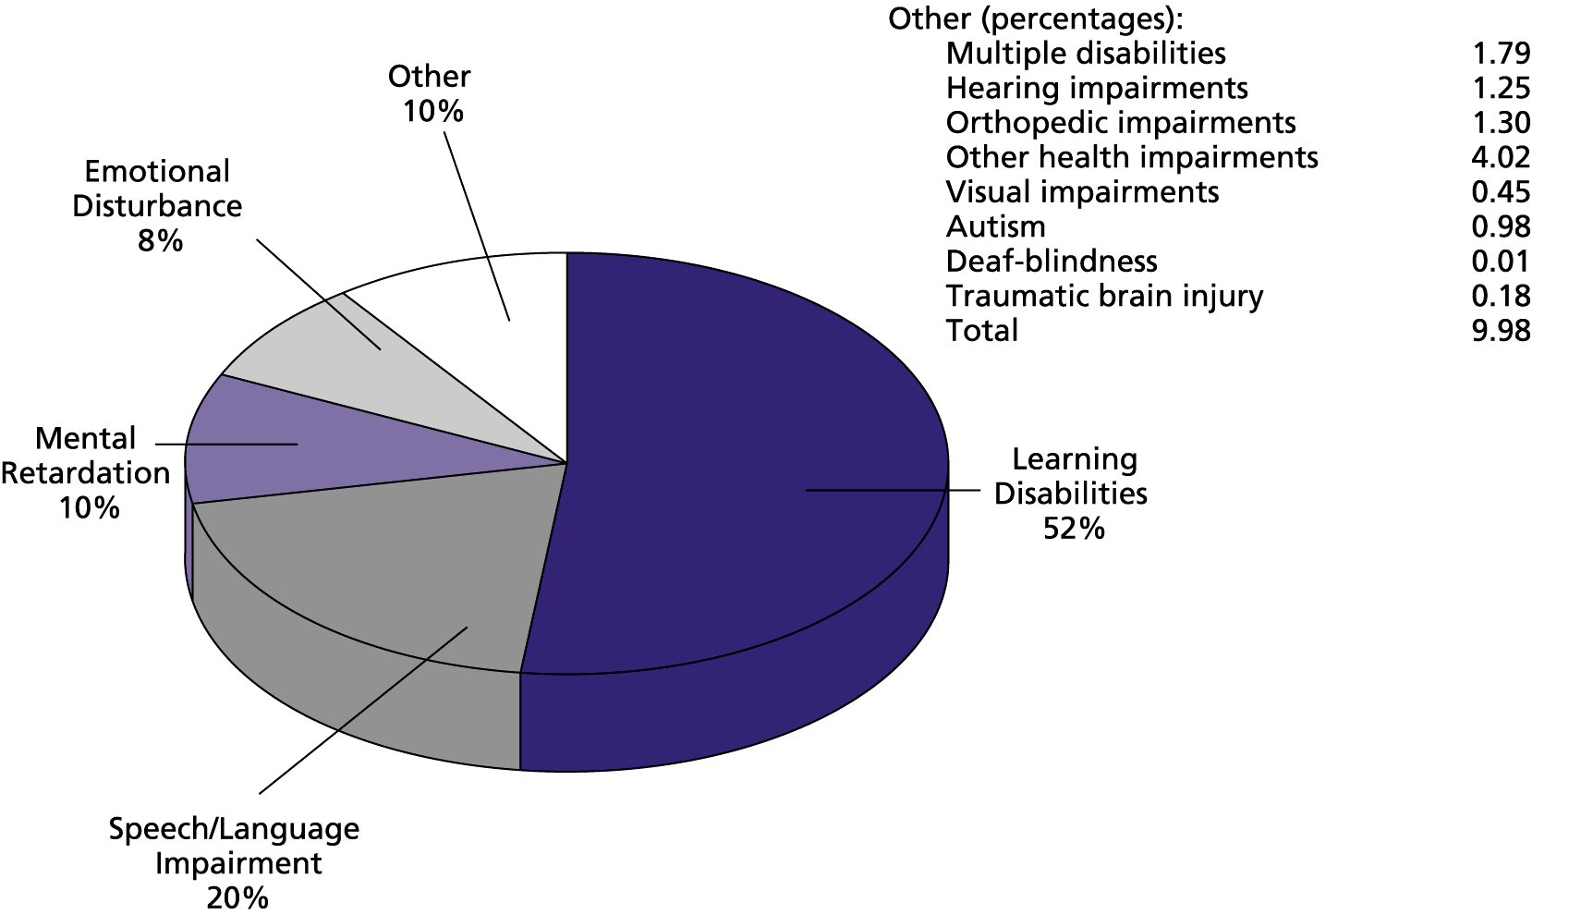

Disorders that affect Studies
Notes:
Many people think that a low IQ is the predominant cause of poor performance in studies. This is not true. Many developmental disorders can affect the ability to study. Of all these, the predominant cause is Learning Disabilities, which are responsible for 52%. Other than these, some students have academic difficulties due to other causes such as unrecognised hearing or vision problems, environmental problems, abuse, neglect, traumatic brain injury

Slide 12
Learning is brain-based.
Developmental conditions start in early childhood
They affect understanding, learning, memory, attention, behavior, social life, and work.
They can affect a child's ability to pay attention, interact with peers, and perform well academically.
Usually persistent
Early identification and intervention can help the child by reducing severity.
Notes:
some examples are specific learning disabilities, ADHD, ASD, ID. These conditions start in early childhood but may not be identified much later until the child starts school or enters middle school oe even adolescence due to various reasons. Symptoms can include problems with language, speech, motor skills, behavior, memory, and learning. They can also include reduced emotional regulation, low muscle control, and problems with social integration

Slide 13
Specific Learning Disorder
(Learning Disability)
“An unexpected discrepancy
between a child’s intelligence
and his expected scholastic performance”
Notes:
Since this is the most important cause of learning difficulty in adolescence, we shall discuss the topic in some detail. In this condition the child is bright and intelligent, upon testing his IQ is average or above average, yet he struggles academically.

Slide 14
Specific Learning Disorder
Reading Disability ‘Dyslexia’
Writing Disability ‘Dysgraphia’
Math Disability ‘Dyscalculia’
Varying severity—may be mild, moderate, or severe
Primary school teachers are often the first to suspect these conditions.
Notes:
There are many types of learning disabilities: these are the commonest and the most important of them, from the viewpoint of studies.
Many of us are pathetic when it comes to singing, or dancing or acting, or connecting ball to bat in cricket – these are all genuine difficulties, but do not interfere with learning. 1000 years ago, a man who could throw a spear straight and far would have been a star at hunting and at war, and it would not have mattered if he could not read or do Math. While an ability to sing or dance is not essential to most of us, a would-be actor would feel deficient without such skills.
In short, abilities and disabilities are numerous and highly varied; each of us has a mix of some strong abilities, some moderate abilities, and some weaknesses (disabilities). In the modern world, a difficulty in reading, writing or Math can have serious implications, while the others do not matter that much.

Slide 15
Reading Disability (‘Dyslexia’)
READS SLOWLY
Makes mistakes
Reads word by word, placing a finger under each word
Spells out words
Omits words, ignores punctuation
Reversals (SAW = WAS)
Does not understand what he has just read.
HOWEVER
Vocabulary is good
Grammar is good
Listening comprehension is good
Memory is good.
Notes:
The most distinctive feature of Reading Disorder is that he reads very slowly, and often inaccurately, if asked to read a passage. He doesn't like or enjoy tasks that involve reading. This is despite that fact that he is obviously of normal intelligence, with good vocabulary and understanding and has been taught to read. (as opposed to someone who did not get reading instructions and therefore can not read). Difficulties started from the beginning and have persisted in spite of adequate teaching.
Accurate and fluent reading and good reading comprehension are essential for academic performance.
Since a student has to read a lot, even mild dyslexia will cause problems right from the beginning. In younger classes, students learn to read and in higher classed they read to learn. Therefore, if a students is not reading fluently by grade 4, then higher classes will be difficult for him. If a student is not able to read fluently, then he is concentrating too much on the reading process and not on the meaning of what he is reading therefore affecting his reading comprehension.
SLD affects the normal pattern of learning academic skills. This affects the learning of other subjects such as science, social studies, history, geography and languages.

Slide 16

Reversal of letters a warning sign?
b
d
p
q
Notes:
Incident: The LKG child who could not differentiate b from d or p from q. This is a common problem in KG, and corrects spontaneously by 2nd Std. It is believed to be due to a temporary delay in the brain wiring. The child is mistakenly punished for laziness and carelessness. Making her write pages after pages of b and d will not help at all.
While letter reversal may be an isolated and benign problem, it may also be the earliest sign of Reading and Writing Disability. Persistent and frequent reversals of letters and numbers along with poor spelling after Grade 2 is a red flag sign.

Slide 17
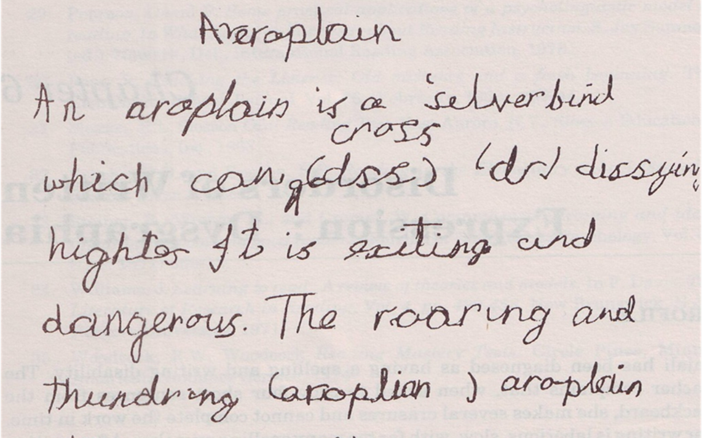
Writing Disability (Dysgraphia)
Writes slowly—incomplete classwork
Poor handwriting
Irregular Spacing
Poor punctuation
Poor spelling and grammar
Poorly organized paragraphs
that lack clarity
Reading and Writing Disability
often go hand in hand
Notes:
Writing Disability is characterized by VERY SLOW WRITING, which is also often illegible. It usually accompanies Reading Disability.
The child frequently misspells even commonly used words like ‘have’.

Slide 18

Poor writing skill (Mechanical)
Arm too near body
Tight grip, loose grasp, or awkward position of pen and paper, poor coordination
Fingers too far from or too close to tip of pen
Paper slant incorrect
Hand direction incorrect
Can be corrected by Occupational Therapy
Notes:
Occasionally, poor writing may not be due to dysgraphia, but may be a purely mechanical disorder. A poor pen-holding technique may cause hand fatigue or pain, making it difficult to write for longer periods, resulting in refusal to write. In such cases, it is easier to correct.

Slide 19
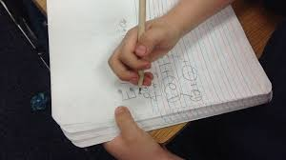
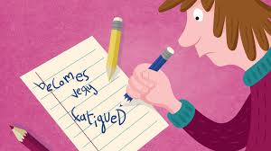

Slide 20
Math Disability (Dyscalculia)
25 + 19 + 71 -
36 17 15
---- --- ---
511 2 64
May not carry over correctly
Confuses + and –
Subtracts larger number from smaller
Counting on fingers beyond Grade 2.
Notes:
Typical examples of Maths Disorder: Failing to carry over, subtracting instead of adding, subtracting the smaller number from the bigger number.
They lack number sense, cannot carry out accurate or fluent calculations, have problems in learning arithmetic facts and reasoning.
Calculators help a lot – if they develop a clear concept of when to add, when to subtract, when to multiply or divide.
Poor reading can affect word problems that involve reading, even if there is no difficulty in numerical calculations or reasoning.

Slide 21

Management of SLD
Refer for LD assessment
Explain the problem to parents
Modify the curriculum
Remedy the weakness - reading, spelling and maths
Strengthen strengths - encourage interests like art, music, sports
Study skills training
Notes:
The first and most important step is a detailed LD assessment by a qualified person.
Explain that it is not laziness or carelessness but a true problem. This relieves the anxiety of the parent and child, and they start treating the child instead of punishing him.
Modify the curriculum: Under the IEP (Individualized Education Programme), it is possible to replace the tough subject by another subject.
Remedy the weakness: if it is a fundamental skill (i.e. Reading, Writing or Math, a Remedial Teacher is needed to provide intensive special training, and this will reduce the future impact.
If it is a less important skill, ignore it, and focus instead on his strengths e.g. art or athletics or mechanical ability.
Psychotherapy may be needed for associated anxiety or depression.
Medications make a big difference in ADHD.

Slide 22
Some Specific Steps
A flexible syllabus and lenient marking. For example, don't cut marks for spellings in math papers. Dont give complicated problems for the child to learn or solve. Keep the notes simple and easy to follow.
Allow students to record lessons whenever possible.
Give oral tests until the student develops better reading and writing abilities.
Give extra time for completion of assignments and examinations.
Use spellcheckers to correct spelling and grammar
Calculators for Math
Notes:
Management needs time and a multipronged approach.
A flexible syllabus is a great boon; audio books avoid the need for reading. Oral tests avoid the need for writing; allot extra time for reading about and writing up projects; computers correct spelling and grammar mistakes automatically; a scribe from a lower class can help speed up writing in the exam hall; a calculator can be provided in Maths class, and will help if he has understood concepts e.g. when to divide, what to multiply. However for board exams, permissions for such provisions have to be obtained from the educational boards. CBSE, ICSE and various state educational boards may have different provisions and concessions. Teachers need to become familiar with the exemptions and provisions that apply to the Board they work under.

Slide 23
Some Specific Steps
First step: refer to the relevant specialists for assessing the child’s difficulties in learning, including IQ
Educational boards have provisions and concessions for students with SLD.
Teachers need to become familiar with those in their Board.
Notes:
Management needs time and a multipronged approach.
A flexible syllabus is a great boon; audio books avoid the need for reading. Oral tests avoid the need for writing; allot extra time for reading about and writing up projects; computers correct spelling and grammar mistakes automatically; a scribe from a lower class can help speed up writing in the exam hall; a calculator can be provided in Maths class, and will help if he has understood concepts e.g. when to divide, what to multiply. However for board exams, permissions for such provisions have to be obtained from the educational boards. CBSE, ICSE and various state educational boards may have different provisions and concessions. Teachers need to become familiar with the exemptions and provisions that apply to the Board they work under.

Slide 24
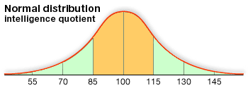
Intellectual Disability
(‘Mental Retardation’)
Severe ID
Mild ID
BIF
Average
Intelligence
Notes:
The higher a child’s IQ, the easier it is for him to study.
The mean IQ is 100, and 68% of children are of average intelligence i.e. their IQ is in the range of 85-115.
Those who have a borderline IQ of 70-85 are labelled as ‘Borderline Intellectual Functioning’ as they can be taught, though with difficulty. As they enter the higher classes, their scholastic performance tends to deteriorate. Thus a lower IQ is an important cause of poor study performance. Not only academic learning, there will also be problems with reasoning, logic, abstract thinking, judgement and learning from experience and in the social domain.
An IQ < 70 is labelled as an Intellectual Disability (it was formerly called Mental Retardation). These children struggle even in the preliminary classes. Most of them are in the 55-70 range i.e. Mild ID. They are poor in studies, but can be taught to look after themselves, and as adults they will usually get married and lead independent lives as unskilled labourers. The focus should be on vocational training.
2% of children have a Severe ID i.e. <55; they are unteachable, but can be trained to look after themselves.

Slide 25
Borderline intellectual functioning
BIF (IQ of 70 to 85) - do not have an intellectual disability but have low IQ.
They face academic as well as social challenges.
Limited cognitive capacity, slow learning, grade retention, overall poor performance Significant problems with arithmetic and written expression, poor reasoning, memory, motivation, attention deficit, aggression, poor social skills, and a lack of common sense.
Notes:
Management needs time and a multipronged approach.
A flexible syllabus is a great boon; audio books avoid the need for reading. Oral tests avoid the need for writing; allot extra time for reading about and writing up projects; computers correct spelling and grammar mistakes automatically; a scribe from a lower class can help speed up writing in the exam hall; a calculator can be provided in Maths class, and will help if he has understood concepts e.g. when to divide, what to multiply. However for board exams, permissions for such provisions have to be obtained from the educational boards. CBSE, ICSE and various state educational boards may have different provisions and concessions. Teachers need to become familiar with the exemptions and provisions that apply to the Board they work under.

Slide 26

Attention Deficit Hyperactivity Disorder
(ADHD)
Inattentive, Hyperactive, Impulsive
Incidence is 5-10%, more in boys, inattention type is more in girls
Noted in school, home, at work
Not due to inadequate sleep, stress, disobedient personality, anxiety, depression, poor parenting, drug use, low IQ etc.
Notes:
ADHD is common, 5-10% of boys in some reports.
The main features are an inability to pay sustained attention, hyperactivity and an inability to sit still, and a tendency to impulsive action.
These behavioural issues are noticeable not only at home but also in school and at work.
Medications help a lot, so a medical consultation is essential.
It is also important to ensure that these behavioural issues are not due to mental stress due to a toxic atmosphere at home or in school, inadequate sleep and excess screen use, a personality disorder, drug use, and so on.

Slide 27
Attention Deficit Hyperactivity Disorder
Poor Attention: Inattentive; distractible; cannot concentrate
Hyperactive: Fidgety; leaves seat frequently; always on the go
Impulsive: Blurts out answers; interrupts others
Management:
  Make them sit in the middle of the first row
  Give movement breaks
  Clear instructions and firm monitoring
  Vigorous physical exercise
  Medications have a big impact
Notes:
Give clear instructions, breaking them down into multiple specific steps

Slide 28
Untreated ADHD in Adolescence: manifest mainly as behavioural issues
Unable to study or work
Less popular among peers
Low self-esteem
Prone to anxiety and depression
Prone to accidents
High risk of smoking, alcohol, drugs
Illegal activities
Notes:
The hyperactivity, inattention and impulsivity may persist for life. But as they grow older, they can be taught to control their hyperactivity and impulsivity, and their attention may improve. Those who do not receive treatment will have multiple problems as they grow older. In the adolescent ADHD manifests not so much as an academic issue as with a wide variety of behavioural issues.

Slide 29
Some Do’s and Don’ts
Don’t overwhelm with too many instructions. Try to make the assignments simple and easy.
Don’t punish or scold the child in the classroom
Don’t give unnecessary writing assignments or rote learning
Don’t compare with other students
Keep the child in the front of the classroom, give some clear instructions
Encourage and motivate the child. Be lenient
Communicate with parents and specialists
Be helpful - share notes and other materials
Focus on strength and talent
Teachers have a huge positive role in helping struggling students
Notes:
Eg., Use simple, concise language and break down tasks into manageable steps. Example: Instead of saying, "Finish your math assignment," say, "First, complete the first three questions, then let me know when you're done.“
Recognize and reward effort and achievements, no matter how small, to encourage positive behavior and self-esteem.
Regularly share observations and collaborate with parents and specialists to ensure a consistent support system for the student.
Example: Have a quick chat with parents at pickup or send a weekly email update to discuss progress and strategies.
Share notes, give feedback to parents, assign a study buddy, simplify concepts so that student can learn more easily

Slide 30
Autism Spectrum Disorder (ASD) in Adolescence
Poor Social Interaction
Prefers to be alone
Does not share interests with others
Does not participate in games and team activities
May laughs or cry out of context or inappropriately
Poor Communication
Not interested in interacting or having a conversation with others
Talks in single words or short sentences
May repeat what is said to him
Repetitive and Stereotyped Behaviour
Motor mannerisms (e.g. flapping hands, tapping)
Sensitivity to sudden loud sounds
Notes:
Autism is usually diagnosed in toddlers, and persists throughout life.
The most obvious features are poor social interaction, poor communication skills and repetitive and unusual stereotyped behaviour and play.
They cannot study as they do not pay attention to the teacher or the subject.
Most of these children require intensive lifelong training to improve their social interaction.
The presentation is modified in adolescence.

Slide 31
Red flag signs for teachers
Persistent poor marks in one or more subjects is a symptom of underlying learning problem.
Grade retention
Repeated failures
Overall poor performance
Lack of focus, attention, hyperactivity
Poor communication skills, vocabulary, social skills

Slide 32
Provisions for students with learning problems
All educational boards allow special concessions and exemptions for students with learning disabilities for class X and XII exams. The rules may differ between different boards and the states.
CBSE boards allow
Scribe or reader
Additional time for completion of exams
Flexibility of choosing subjects
Exemption from learning a third language
Notes:
Disability Certificate(s) issued by Government hospitals, Recognized institutes of national level viz National Association for the Blind, Spastic Society of India etc;Non-governmental Organizations/practitioners registered with Rehabilitation Council of India/Central Government/State Government of the Respective State.
Permitted to use a Scribe or allowed Compensatory time as given below or both : For paper of 3 hours duration 60 minutes For paper of 2½ hours duration 50 minutes For paper of 2 hours duration 40 minutes For paper of 1½ hours duration 30 minutes

Slide 33
How to avail such exemptions?
Step 1: Parents get the child examined by the Competent Medical Authority and obtain the requisite Medical Certificate of Disability.
Step 2: For availing any exemption, parents will have to make a request to school along with copy of the certificate of disability.
Step 3: The school will forward the request to the concerned regional office of the board within 07 days of its receipt alongwith specific recommendations.
Step 4: The regional Office will examine the request in accordance with the rules of the board and make a decision In case of rejection, reasons for the same will be intimated.

Slide 34
Key Messages
Learning disabilities are the most important disorders of learning,
that contribute to poor scholastic performance.
Other major developmental disorders that interfere with studies include ADHD, ASD and borderline intellectual functioning.
It is important to recognize these disorders early and manage them appropriately. They need help, not punishment.
Children with ADHD benefit greatly from medication.

Slide 35
QUIZ TIME!
Try to identify these Disorders of Learning
Bottom 10% of the class, dislikes school, the ‘class clown’
Tries very hard, but weak in one or more subjects
Bright student, good orally but avoids studies, test paper has very brief answers with lots of spelling errors
Enthusiastic, loud, talks a lot, annoying, disturbs class often -- disorganized, does not complete projects on time
Silent, mostly alone, a bit odd, has no friends, makes inappropriate comments, socially inappropriate behaviour
A slow student, poor overall performance, repeated failures, retained in one or more grades, lacks common sense
Notes:
1, 2 AND 3: SLD
4. ADHD 5. ASD 6. Borderline Intellectual Functioning

Slide 36
DISCUSSION
Could some of you tell us of your experience in handling students who seem to be
struggling academically despite sincere effort?
We would love to learn from you.

Slide 37

Thank You !

