Slide 1


T –Teach Module
T –Teach Module
(Teachers’ Training and Empowerment in Adolescent Care and Health)
IAP -AHA’s -Training Module for Teachers
IAP-Adolescent Health Academy: T-TEACH MODULE

Slide 2
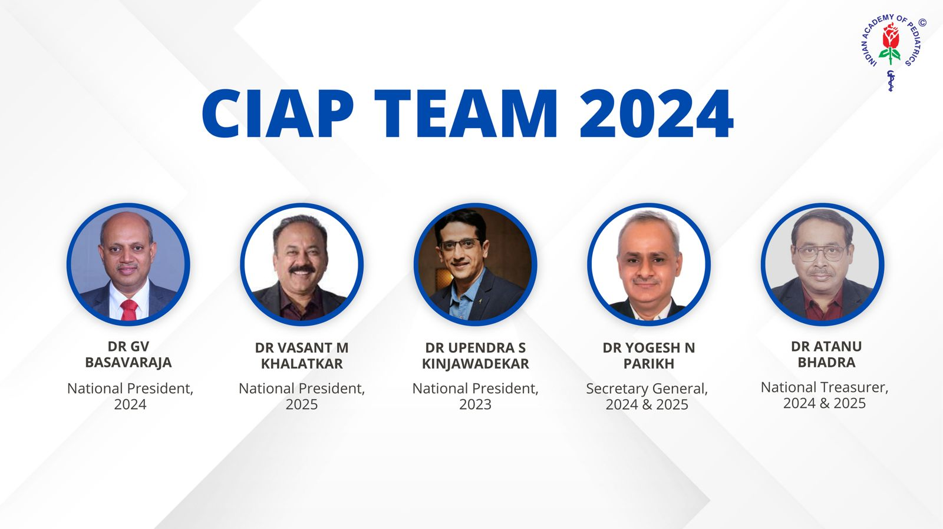
IAP-Adolescent Health Academy: T-TEACH MODULE

Slide 3
Concept
Adolescence is a crucial stage in an individual's life marked by physical, social, emotional, and cognitive changes. During this period, adolescents require guidance and support from various sources, including teachers.
Teachers, as important stakeholders, play a significant role in the overall development of adolescents and their well being, as they spend a considerable amount of time with them in school settings.
Therefore, it is essential to equip teachers with the necessary skills and
knowledge to effectively support and care for adolescents.
IAP-Adolescent Health Academy: T-TEACH MODULE

Slide 4

IAP-Adolescent Health Academy: T-TEACH MODULE

Slide 5
T –Teach Module
Dr Shubhada Khirwadkar (National Convenor)
Dr Swati Ghate (Academic editor)
Dr Nishikant Kotwal (National Co-ordinator)
IAP-Adolescent Health Academy: T-TEACH MODULE

Slide 6
Topics &Contributors
Understanding Adolescent Behaviour: Dr Swati Ghate, Dr Poonam Bhatia
Handling Teens with problematic behaviour: Dr Sushma Desai, Dr Ashim Ghosh
Dealing with silently suffering Teens(Mental Health Concerns): Dr Sunita Manchanda, Dr Geeta Bansal
Dealing with disorders of Learning: Dr Newton Luiz, Dr Chitra Sankar
The good and the bad about Media: Dr Geeta Patil, Dr Prashant Karia
IAP-Adolescent Health Academy: T-TEACH MODULE

Slide 7
Topics &Contributors
Substance abuse - What teachers should know: Dr Chitra Dinakar Dr Shilpa C
Understanding Teen Sexuality: Dr Himabindu Singh, Dr Sushma Kirtani
Positive discipline: Dr Shubhada Khirwadkar, Dr Kalyani Patra
Promote Healthy Life Style: Dr Shamik Ghosh, Dr Shalini Bhasin
Communication Skills and self help: Dr Nishikant Kotwal, Dr Chitra Kulkarni
Prevent , Empower , Stand Strong (self defense): Dr. Jayashree Deshpande
IAP-Adolescent Health Academy: T-TEACH MODULE

Slide 8
Reviewers
Dr Swati Bhave
Dr C P Bansal
Dr Sukanta Chatterjee
Dr Preeti Galagali
Dr Samir Shah
Dr Piyali Bhattacharya
Dr Atul Kanikar
Dr Atanu Bhadra
Dr R G Patil
Dr R N Sharma
IAP-Adolescent Health Academy: T-TEACH MODULE

Slide 9
Communication skills and self help
Dr. Nishikant Kotwal
Dr. Chitra S Kulkarni
IAP-Adolescent Health Academy: T-TEACH MODULE

Slide 10
Learning objectives
Aims -
To discuss process and way of communication,
To develop skills of communicating with adolescents
To identify stress of teaching and deal with it
IAP-Adolescent Health Academy: T-TEACH MODULE
Notes:
Begin with game of Chinese whispers
It is a well known quote that well begun is half done. Beginning is the most important part of any work.
Teachers are like morning sun rays. They shower their effusive energy in their student’s minds through communication.
So, the process of communication starts with –
thought process about it in teachers mind.
Action, conversation with others with language and expression.
Has it been received correctly.
Whatever we have told, is it understood in the same way with its content to the receiver. So, key choice of words is very important in message in conversation.
Wait for feedback or response from the receiver.
Whenever the thought process has to be converted to message, it has to go correctly to become a conversation or two way dialogue.

Slide 11
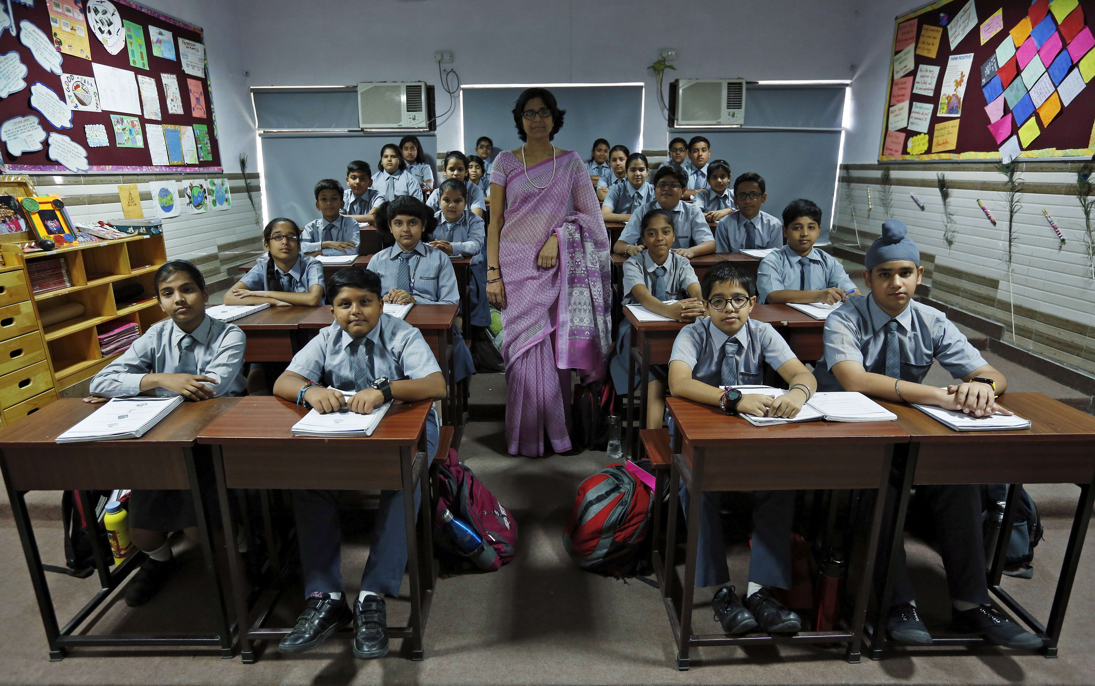
Are you listening?
75% of students are attentive to what
teacher says
Only 30 attention is influenced by
factors other than teacher’s way of
communication (environment, biological
needs etc)
More likely to listen to teacher when
lessons are relevant to their lives
IAP-Adolescent Health Academy: T-TEACH MODULE
Notes:
The greatest power a person has is the power to choose, so 75% students listen to you and their attention is always short lived.
How to grab that attention, for 30 minutes in a go – where in classroom, other distractions like peers, outside noises, teachers' personality, etc are external factors and the internal thought process in students mind which are going on continuously to disrupt the learning process.

Slide 12
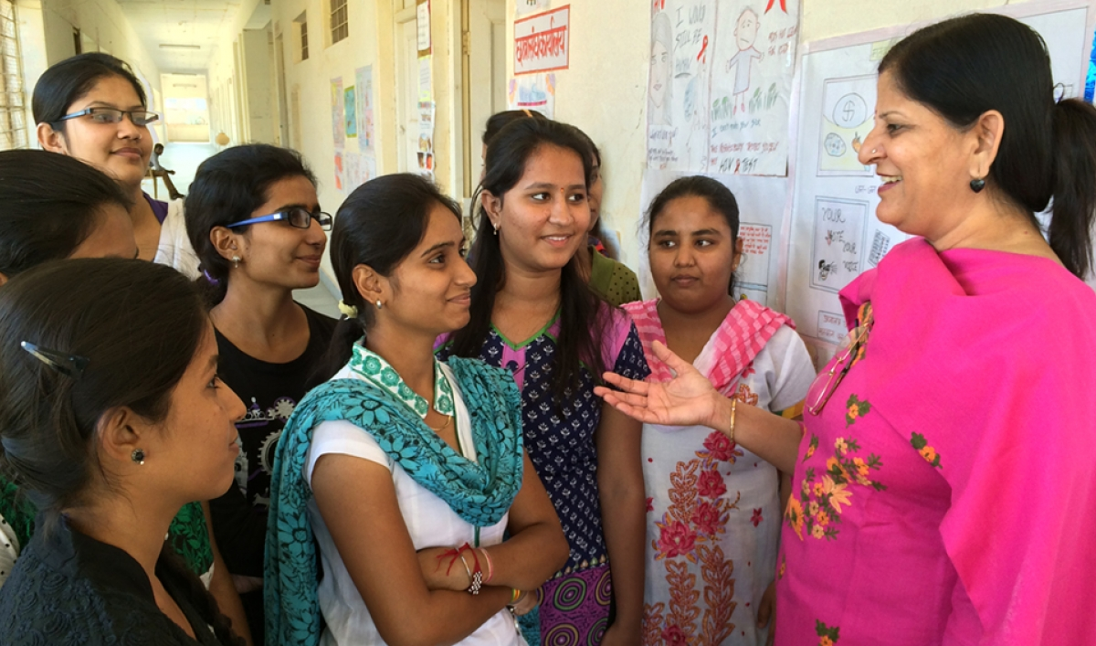
Communication: A skill to be learnt & practised
Efforts required to inculcate
Not to be taken for granted
Results in -
1. Happier teen and better relation /
bonding
2. Better academic returns for both –
students & teachers
IAP-Adolescent Health Academy: T-TEACH MODULE
Notes:
This is a skill. Is it a god given gift? When we choose to be a teacher. Where we are supposed to perform various tasks in building future of the next generation. how you think and how you feel sets the entire day. It is not to be taken for granted, we have to work on these communication skills, to get happier teenagers and better relationships throughout the school years and a life long bond ! All of us still remember our teachers names fondly.

Slide 13

Effective communication
IAP-Adolescent Health Academy: T-TEACH MODULE
Notes:
In the process of evolution, all animals and human body for millions of years has been using signals through gestures, hand movements, the way you stand and look at other person before the development of language.

Slide 14

Non-verbal communication
More important
Distance, stance & attitude
Eye contact
Movement of arms, gestures
Facial expressions
Active listening
IAP-Adolescent Health Academy: T-TEACH MODULE
Notes:
Non-verbal is more important in teenagers ! They judge you. More important is caring and I am there for you expression on your face ! Diction, tone of voice and the way in which the words are pronounced when you talk,
Before directing “listen” with all your 5 senses ( “vision, hearing, taste, smell and touch” ) directed towards the listener, it is one to one communication.
You can reiterate the salient points which student has just shared to you, to show that you have understood what they have shared, with one to one eye contact in the personal space in an unhurried way.

Slide 15

Verbal Communication
Tone and Diction
Choice of words
Contents of message
Depends on situation/ place
Classroom/ staff room/ play ground
Group/one to one
Presence of other teachers/ family members/ peers
IAP-Adolescent Health Academy: T-TEACH MODULE
Notes:
In doing communication with words, choose the words which will give message correctly, not only words but the tone of your voice will decide what you mean out of that word. It is most of the time situational, then when a teacher takes a lesson or gives an instruction – is it to a single person or group? Suppose you want to scold a student, and you do it in front of peers or in staff room. It is a wrong place; others may interfere or be judgemental! As against when you want to appreciate a student, we have to choose a place where friends, peers, other teachers & family members are present.

Slide 16

Effective conversation
Active listening skills :
Appropriate physical Distance, Eye contact, Facial expressions
Avoiding distractions (using mobile phone)
Gesture: head nodding
Short response in between
affirmations like yes, right, okay, achchha
Empathising : I understand
Encouraging, Leading questions to open up
Allowing Pauses, Bringing back to point of discussion
IAP-Adolescent Health Academy: T-TEACH MODULE
Notes:
Whole conversation depends on our active listening skills. Show that you are interested in their talk. Avoid seeing your screen or looking out over their head or window. Maintain an eye contact. Give short responses in between. Ask open ended questions. Empathize. Give enough time. Don’t cut short the talk. Summarize what you have understood. And avoid wavering from main point of discussion.

Slide 17
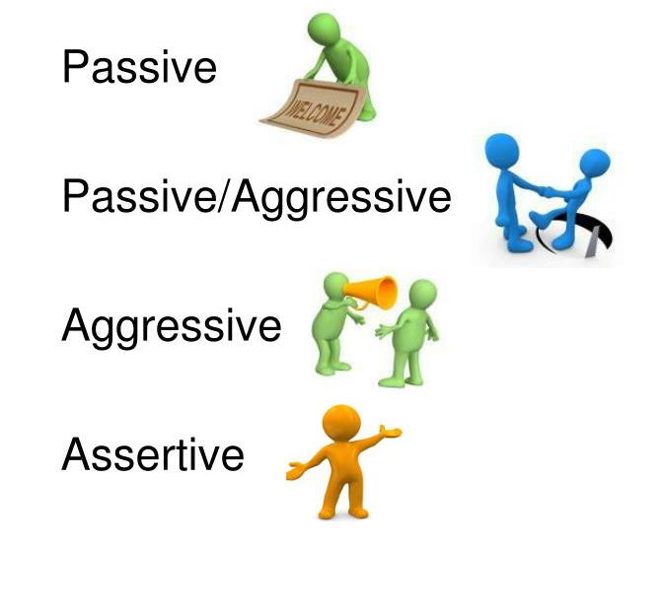
Types of communication
Passive – May change according to others opinion or wish/ doormat attitude
Passive aggressive – Resentful, Tense, actions don’t match words
Aggressive – Forceful, Loud, Threatening, listen-to-me-or-else….
Assertive – Cooperative, confident, to-the-point, firm, win-win
IAP-Adolescent Health Academy: T-TEACH MODULE
Notes:
Now, in general we see these 4 types of communication –
Mostly you feel in class that while handling 50 students – aggressive or threatening, “orders” type of communication will help, but will it be a communication?
It may work but will give your students a dictator type of impression.
In passive aggressive type your conversation will look like you want to listen to others opinion, but you want them to act or do the things according to your wish – this will make you unpopular
Don’t be a doormat by accepting whatever the other person or students wish by being passive
Best is assertive type of communication – it is two way exchange and helpful for both, listen appreciate exchange, find out shortcomings from conversation and suggest for appropriate action.

Slide 18
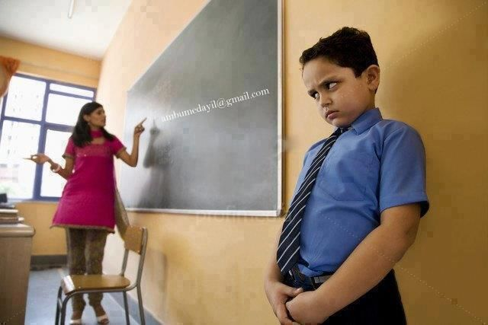
Positive discipline
Mutual respect
Sensitive to students’ needs
Democratic rule setting
Set boundaries and clarify consequences
Teacher- Kind, firm, assertive
Partnering with parents
IAP-Adolescent Health Academy: T-TEACH MODULE
Notes:
To become an adorable person in a teenager’s heart, what a faculty or a person in power like a teacher can do?
Show respect by using words like ‘we’ instead of you
Start with democratic rule setting
On this earth, all human beings are equal
All of us have right to express
Give example of Olympic rings
Ask how many rings are there? Let them answer
Different colours, all of equal size and inter-linked with each other, like our personalities – ( body and mind ) though different are inter-linked and if one breaks, other four will be affected and cannot function as one unit.
Next example of democracy in school – Lokmanya tilak in his childhood – I did not eat those peanuts, I will not clean the husks
Teacher is firm on the rules like giving time bound tasks and kind to give extra attention to weak students and create an inclusive environment.
You have seen one has to be strict on mischiefs and giving punishments like writing extra lessons or stay back for cleaning the mess, which will bring awareness about the wrong deeds. This will set boundaries and clearly convey the message of consequences of breaking rules to rest of the class.
Ask parents for the type of behaviour in home and is it same in school or different – convince them that it is a shared responsibility for the benefit of child development and not the blame game

Slide 19
How to communicate with Problem teens
Misbehaviour- “I have a story to tell – Are you listening?”
Troublemaker – Allot responsibility
Clear language – consequences of breaking the rule
Be open for communication
Appreciate smallest positive behaviour/deeds
Praise them to nourish their self-worth
Criticize the act, not the child
No labelling/ no judgement
IAP-Adolescent Health Academy: T-TEACH MODULE
Notes:
Here the basic requirement of a teacher’s mind is – this misbehaving teen is having some issues which have to be solved with our sincere efforts
Be empathetic and try to find out the root cause
- Troublemaker – Extra energy – make him/her Monitor
Let them express – future depends on us – we can make them incompetent or Competent
If they are satisfied that their version of the story is heard properly, they will accept our suggestions and their self-esteem is preserved
Don’t label them as troublemakers, bullies, rowdies and hooligans.
Criticize the act, not the child
A bend in the road, is not end in the road

Slide 20
What adolescents want from teachers while talking ?
Adult like dealing , not like to be treated as children
Respect
High on emotions.. Get easily upset: use words carefully
Easily distracted
High ego and feel insulted easily
Be non-judgmental
IAP-Adolescent Health Academy: T-TEACH MODULE
Notes:
Teens ego have never been discussed so far ,they look grown up behave as if they understand every thing ,because of puberty hormonal surges they r very high
on emotional brain activity .so mood swings ,emotional outbursts, happy n energetic or sad n depressed depends upon a caretaker or teachers approach .so please use words carefully , they expect respect judge ur body language, n may get hurt easily feel insulted, so be non judgemental . For example not to say .,how r u not able to solve this simple problem /others have done it in1min . This may shut off the door of communication to help out that teen

Slide 21
Learning the art of communication
Wrong way
Right way
You are a fool
You are a failure
You are always disturbing the class
You will be a rickshaw puller
I do not like this behavior
Let us see why you could not do good this time
Let us finish class and then we can talk
I am concerned about your future
IAP-Adolescent Health Academy: T-TEACH MODULE
Notes:
This slide is self explaining, avoid labelling the child , explain what act was not appreciated ,why not to say let us find out instead of blame n use word you, they may not open in public or in class , out of respect may not be able to speak a single word in class but may open up in one to one conversation.

Slide 22
Motivation – Case #1
Low performance – Appreciate small deeds, offer personal
academic support
Troublemaker – Can you take the lead for new task?, Make class
monitor
Place and time
SWOT analysis of the student
Helping to generate options
Personal Academic support /Study skills
Encouragement /Motivation
IAP-Adolescent Health Academy: T-TEACH MODULE
Notes:
Here is an example .,previously bright student, but for this term has not performed well in exams …..find a quiet place after school hours in classroom ,where one to one dialogue is possible, appreciate his previous marks ask about his/her time table from morning to night , any family issues ,with your empathetic attitude ,let them speak they may find out n identify their own weaknesses while talking with u ….offer personal academic support .
discuss the other alternatives or solutions ,identify any threats in their progress like fear,, bully, health issues. Once identified start open ended questions ,what we should do?to continue conversation to maintain a hope n positive attitude about current problem solving .encourage with praise ,promise to share day to day .activities,n plan for further meeting time .

Slide 23

Parent – teacher meeting – Case #2
Approach, mannerism matters
Empathetic, Ask, Accepting
Analyzing, Options
Choice, Pros and Cons
Avoid blame game
Parents come with complaint.
Less marks
Punishment
IAP-Adolescent Health Academy: T-TEACH MODULE
Notes:
Ptm you hav to plan your steps of conversation in meeting to face various situations ,do home work for that .
greet parents n child by their name.hand shake , introduce yourself , offer them seat,
communicate slowly , ask them an open ended question ,r u aware of present situation /hear their version ,then explain ur version.
Angry parents ,listen their story , u hav to be composed ,r they afraid of some thing in future ,ask for their fear and anxieties,.say that I acknowledge the anger n understand ur concern ,with empathy try to explain the fact ….let them come in cooperation mood /mode, tell them what is needed rt now ,give accurate information what is going on,n we r there to help the child . Make a mutually acceptable plan discuss pros n cons of their decisions,can jot it down on a paper . Avoid blame game. If the parents r fighting among themselves and blame each other u hav to stop .here childs performance in school is a combined responsibility of parents.

Slide 24
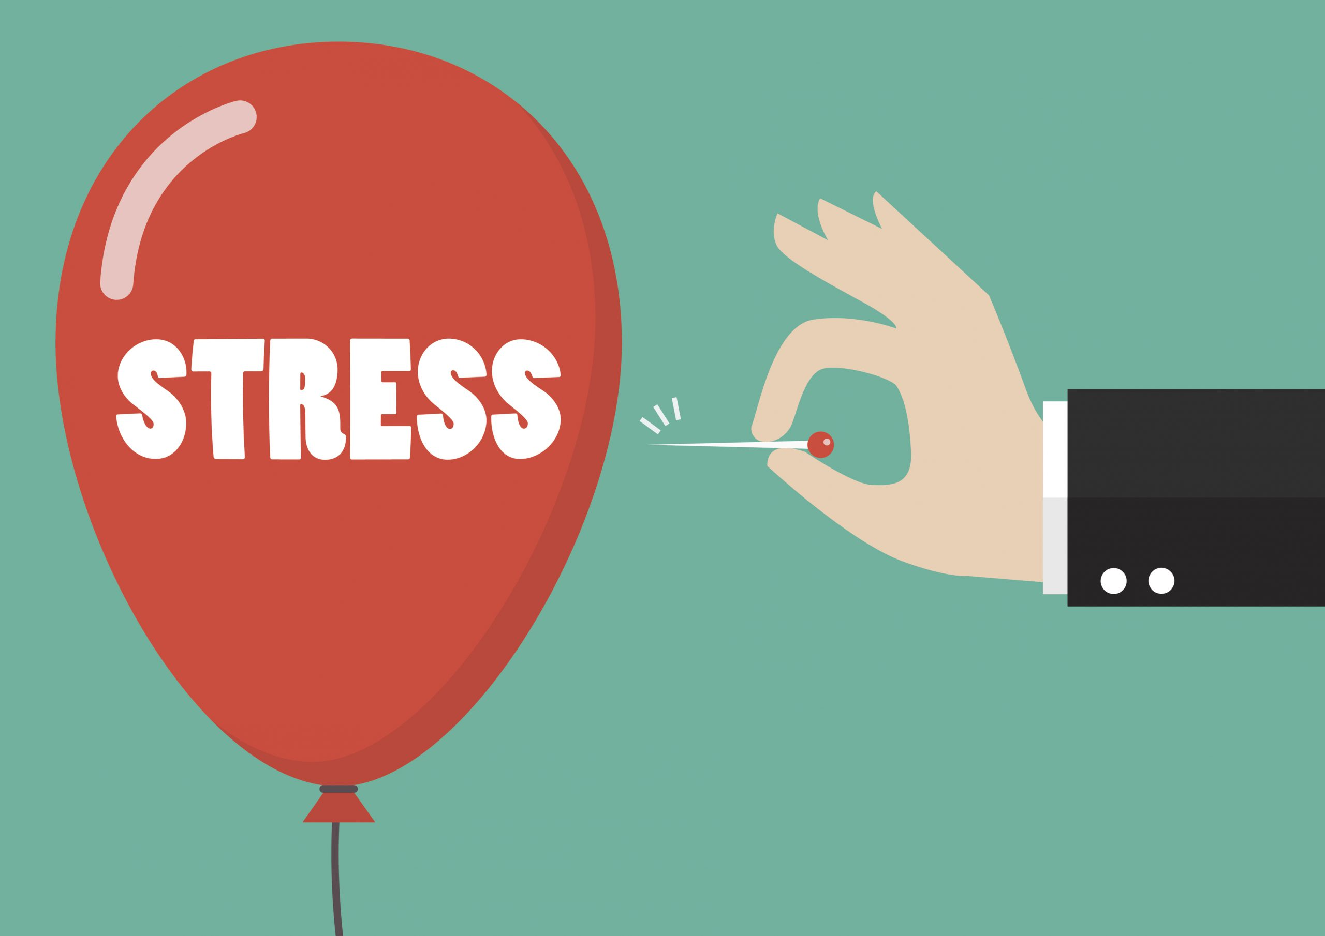
What is stress?
When coping skills are not
enough to handle the situation
Stressors : students, parents or self.
Take Self-care and learn destressing
techniques while with adolescents
IAP-Adolescent Health Academy: T-TEACH MODULE
Notes:
Being teacher is a enjoyable yet demanding job .it may be overwhelming some times ….stress can be from work place or parents n students especially adolescents,self care is required try to relax by doing yoga exercise , music ,dance, hobbies or do social work ..gratitude helps.ss

Slide 25
Teachers are stressed: Why?
Increased speed of life
Too many responsibilities
Work pressure
Constant dealing with developing (yet to mature) minds
Keeping pace with frequent changes in educational systems
Handling latest technologies
No time for rest and recreation
Burden of expectations from school authorities, parents, family, society
IAP-Adolescent Health Academy: T-TEACH MODULE
Notes:
These r various causes of stress in teaching profession , ask 1by 1 if any thing is remaining … apart from personal reasons/relationship issues.

Slide 26
Identify your stress
Physical Feeling weak and tired Aches and pains | Mental
Headache | Restlessness
Palpitation/ dryness of mouth Tremors Sweating Altered sleep/appetite | Sadness Poor concentration Irritability/anger Constant worrying Frustration Feeling on the edge
IAP-Adolescent Health Academy: T-TEACH MODULE
Notes:
Stress management includes ,5steps for self counselling ,
1 accept I m stressed
2 identify the stressor sinle or multiple
3analyse find out
4 trusted person with whom u can share
5apply de stressing technique .if no improvement in15 days take professional help.

Slide 27
Stress management
Accept the stress
Identify stress/
stressor
Analyse the situation
Apply destressing techniques
Talk to trusted adult/self talk
IAP-Adolescent Health Academy: T-TEACH MODULE
Notes:
How to identify that u need help , it is mind n body interplay …. Physical bodily symptoms of anxiety n irritability , feeling low ,unable to complete a task loseing interest in daily dayto day activities in school as well as home….ask for help

Slide 28
Take Home Message
Communication is an Art and Skill
Effective communication needs to be learnt & practiced
thoughtfully
Active listening is a key to communication with adolescents
Non-judgmental respectful & empathetic approach
Plan situational communication
Teachers should address their stress
You have the right to be happy
IAP-Adolescent Health Academy: T-TEACH MODULE
Notes:
Enumerate . Read aloud by any delegate .

Slide 29
THANK YOU
IAP-Adolescent Health Academy: T-TEACH MODULE

