Slide 1
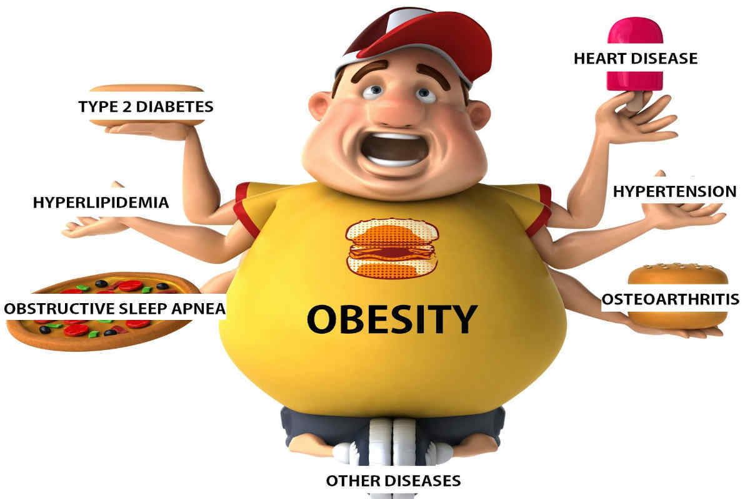
Adolescent Friendly Dietary Interventions for Obesity
Surbhi Pareek
Consultant Dietitian & Nutritionist
Founder- Nutrisaga by Surbhi
M.Sc. (Foods & Nutrition), NDDY,
Certified Diabetes Educator(ADA), APCCN (UK)
Metabolic Balance Consultant (Germany)
Specialist: Ketogenic Diet, Sports Nutrition, Inborn Errors of Metabolism, Nutrigenetics, FODMAP Diet for IBS (Australia)

Slide 2
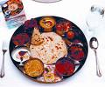

Energy Balance
HOW TO MANAGE OBESITY IN ADOLOSCENTS
Intake = Output
Positive energy balance
Negative energy balance
As per the studies, the target weight reduction should not be exceeding 800 gms per week for Children and Adolescent aged 6-18 years.
Notes:
Positive energy balance leads to weight gain because Energy intake is greater than energy expenditure.
For weight reduction we need to maintain Negative energy balance means energy expenditure is greater than energy intake.
Sudden weight reduction may leads to lots of nutritional deficiencies in body and it will not give us permanent result also.

Slide 3





How to manage Obesity in Adolescents
Diet
Eating Routine
Physical Activity
Sleep Cycle
Water Intake
Stress Management

Slide 4

1. Diet
Moderate deficit diet (MDD)
Low calorie diet (LCD)
Very low calorie diet (VLCD)
MDD and LCD:
Carbohydrates 50 %-55% of total
calories, prefer complex carbohydrates
Proteins 15%-25% of total calories.
Fat not more than 30% of total calories.
Extra fiber included (satiety).

Slide 5

Basic principles of Balanced Diet
Regularity: Small & Frequent meals are preferred than large bulky meals
Quantity: Portion size should be controlled as per Energy Expenditure
Quality: All food groups to be included in order to make food nutritionally adequate

Slide 6

Cut down on Alcohol and Caffeine
Alcohol and caffeine leads to metabolic disturbances, hormonal imbalance, disturb sleep cycle and also gives you empty calories which further leads to weight gain.
Notes:
Most of the studies says that there should be complete absentees of alcohol consumption and caffeine consumption should be limited in daily routine.

Slide 7
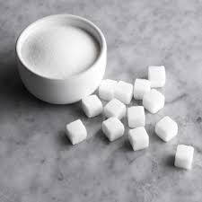
Cut down on added Sugars
Sugars contribute zero nutrients but lots of calories to your diet.
So limit the sugar intake in your daily diet.
Avoid use of artificial sweeteners in your daily routine.

Slide 8

“EAT SMART” STRATEGIES
Take time to chew your food:
Chew slowly
Savore every bite
The joy of eating.

Slide 9
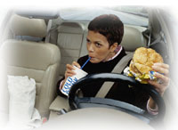

Avoid Stress while Eating
Avoid eating while working, driving, arguing,
watching TV.
Take deep breaths
Play soothing music

Slide 10
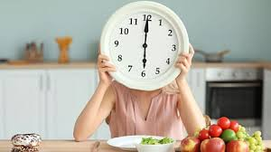
2. Proper eating routine
As per WHO, Proper eating routine means is simply eating adequate amount from each food group, eating on time and well-balanced meals to support your body’s needs.
Maintains healthy weight
Improve Gut health & Digestion
Enhance energy levels
Lowers the risk of diseases
Boosts immunity
Improves confidence

Slide 11

3. Physical Activity
As per World Health Organization, Children and adolescents aged 5-17 years-
Should do at least 60 minutes of moderate to vigorous-intensity physical activity daily. (Brisk walking, Jogging, Running, Fast Cycling, Sports Activity, Power Yoga, Swimming, Dancing etc.)
Physical activity of amounts more than 60 minutes daily provides additional health benefits.
Should include activities that strengthen muscle and bone, at least 3 times per week.

Slide 12

Physical Activity Benefits
Helps people achieve and maintain a healthy body weight.
Reduces risk of Heart disease, Stroke, Type 2 diabetes, Hypertension and Cancer.
Reduces feelings of depression, anxiety and promotes psychological well-being.
Helps build and maintain healthy bones, muscles, and joints.
Promotes flexibility and balance.
Everyday Activities
Take the stairs
Walk to work
Walk and talk
Sit less, move more

Slide 13

4. Importance of Sleep Cycle
The National Health and Nutrition Examination Survey (NHANES) showed significantly higher rates of obesity and other chronic diseases (Type 2 DM, Dyslipidemia, Hypertension and other cardiovascular diseases) in adolescents and adults who reported an average of less than 7 hours of sleep at night.
Other studies suggested that A chronic pattern of sleep duration of ≤6 hours at night has been associated with a higher body mass index.

Slide 14
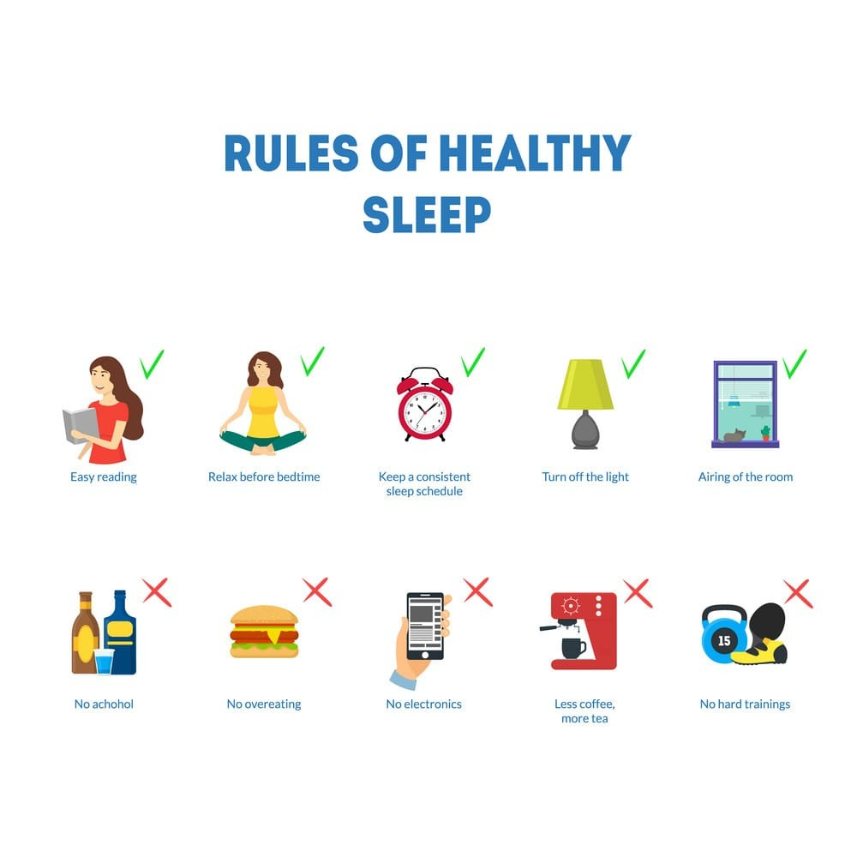

Slide 15

5. Water Intake
Water is our most essential nutrient with zero calories….
Function
Vital component of our diets
Dissolves nutrients and transports them around the body
Need for growth and body maintenance
Helps to remove toxins from our body through sweat and urine.
Water intake Recommendations (As per The Institute of Medicine)-
Child between 4-8 years- 1.7 litre/ day
Boys between 9-18 years- 2.4-3.3 litre/ day
Girls between 9- 18 years- 2.1-2.3 litre/ day
Anyone engaging in physical exercise requires more water daily than the recommendations to replace bodily fluids lost through sweat.

Slide 16
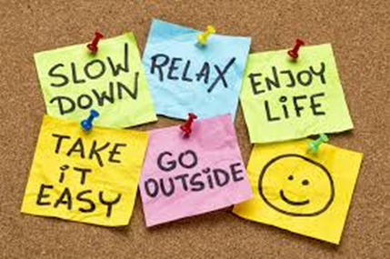
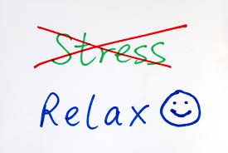
6. Stress Management
According to researches, stress can lead to obesity among adolescents. This means that stress due to biological changes, psychological issues and faulty eating habits can increase body weight and lead to obesity among adolescents.
Stress management steps-
Identify stressors in your life
Schedule personal relaxation time
Good nutrition
Exercise regularly
Sleep more

Slide 17
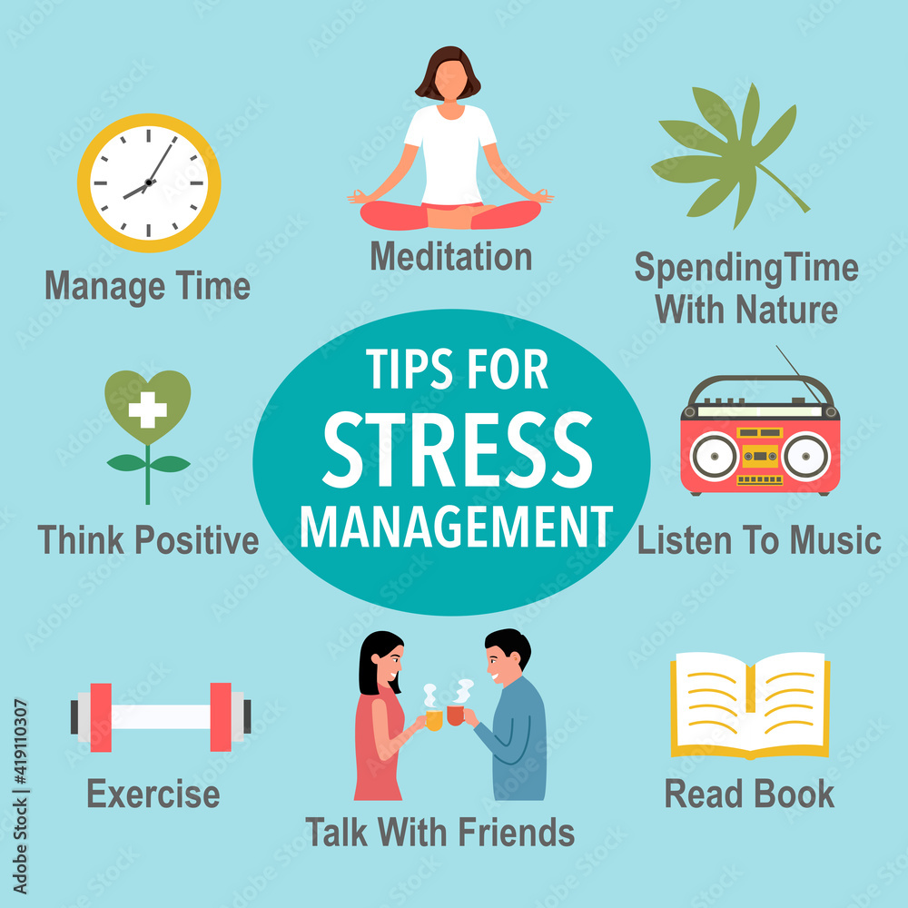

Slide 18
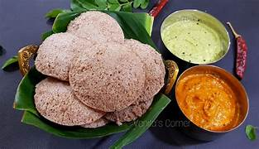

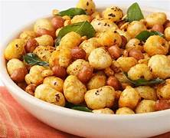
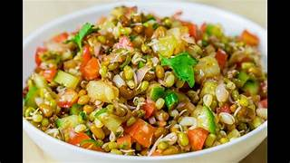
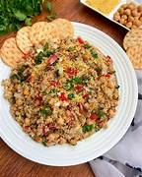
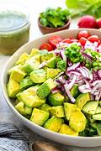
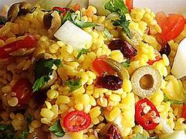
Healthy Snacking options……
Makhana Chaat
Crunchy Moong dal Chaat
Millet Salads
Makhana Walnut Tikki
Paneer Apple Sandwich
Sprout Chaat
Roasted veggie Sandwich
Avocado salad
Oats paneer kababs
Nachos with Curd sprout dip
Bhelpuri
Quinoa Chaat
Whole wheat or Millet Pasta
Vegetable Ragi Idli or Uttpam
Notes:
As adolescents always attracts towards junks or chatpata food and ended up with high calorie consumption. So we can suggest them some good nutritious snack options which will not leads to weight gain.

Slide 19
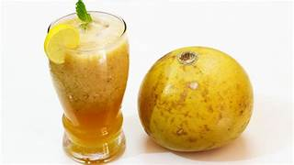
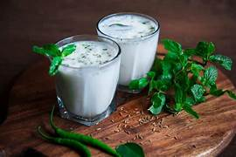
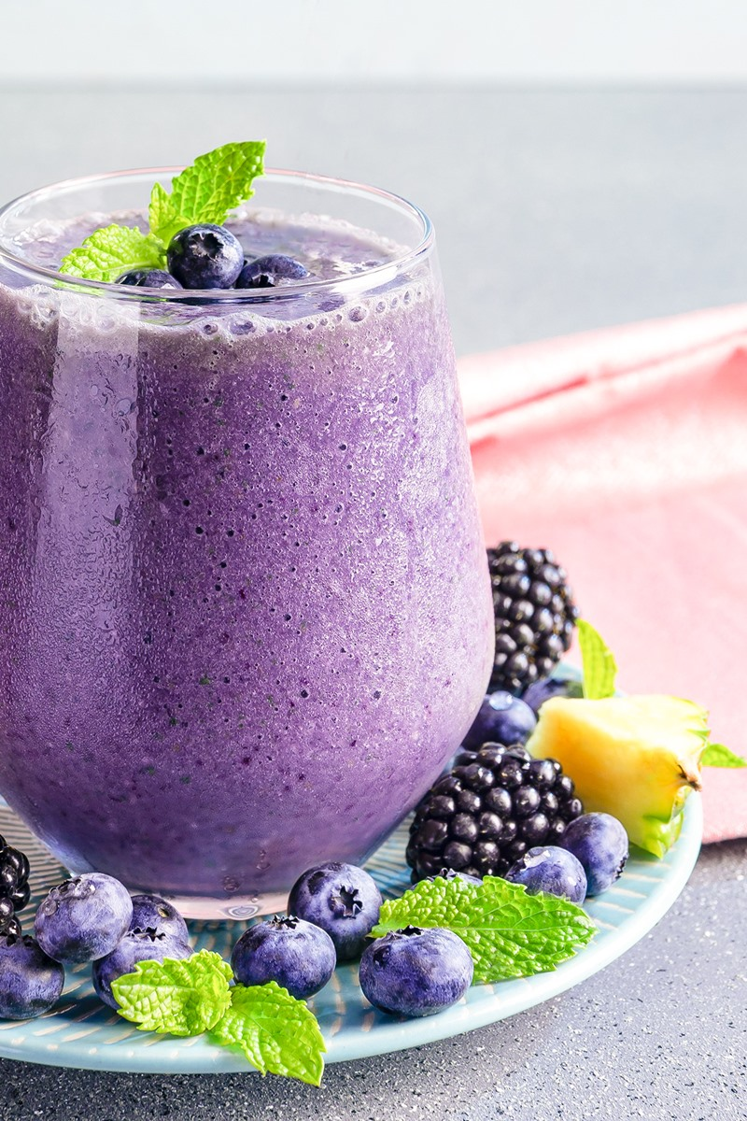


Healthy Drink options…….
Coconut Water
Lemon Water
Butter Milk
Cucumber Mint Chach
Masala Chach
Nuts and Berries Smoothie
Oats Smoothie
Sattu Drink
Kairi Chach/ Aam Pana
Beal Juice
Cucumber Cooler
Green Tea
Salty Ice Tea
Lemon Mint Mojito
Watermelon Mint Cooler
Notes:
As summers are approaching, our liquid requirements increases and intake of aerated drinks or other high calorie drinks increases. So we can cut down excess calories consumption with these healthy drink substitutes.

Slide 20

Tips for Eating Out
Fill your stomach with 50% of fruits and salads before going out.
Choose small portion size.
Go for whole grain food options instead of refined one.
Avoid extra toppings of cheese, mayonnaise, ketchup or other sauces.
Use salsa instead of mayonnaise and oil.
Est green chutneys instead of sauces.
Avoid fried vegetables and go for baked vegetables.
Instead of fried choose grilled, baked or roasted food options.
Choose low gat yogurts over sour creams.
Replace aerated soft drinks with fresh lime soda.
Replace sharbat with buttermilk.
Go for skimmed milk in place of whole milk.
Choose fresh fruits instead of sugary, high fat desserts.

Slide 21
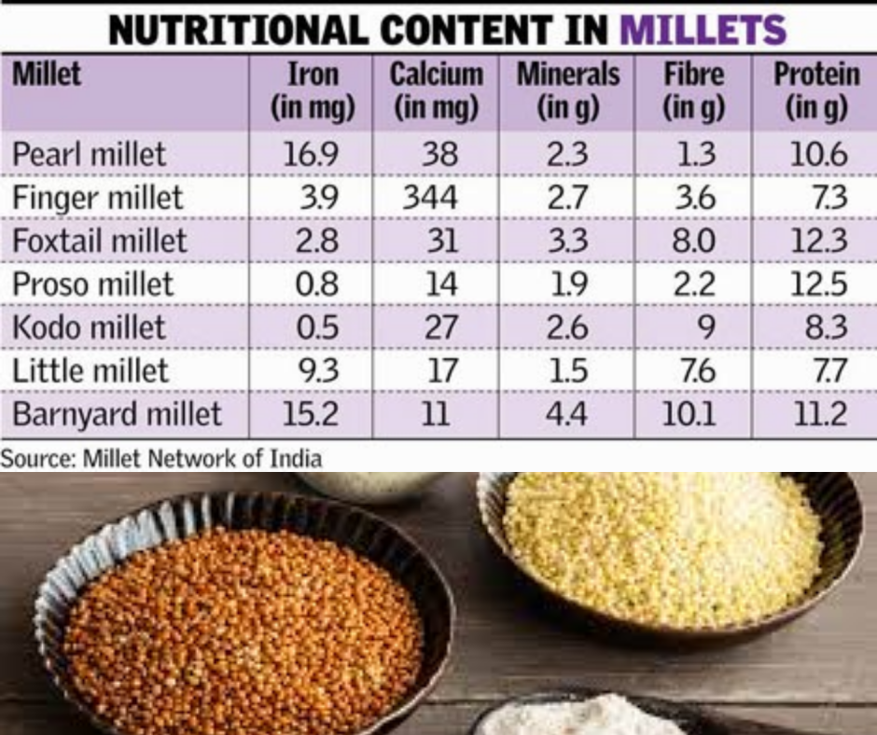
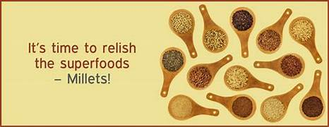
Health benefits of MILLETS
Millet is considered one of the Worlds Healthiest Foods and is packed full of Nutrients.
Packed with Nutrition
Less Calorie Count
It is a Gluten Free alternative
Easy to Digest
Supports Brain Development
Rich in Antioxidants
Boosts Immunity
Lowers the Bad Cholesterol
Helps to regulate Blood Sugar Levels
Keeps your Heart strong
Helps in Weight Management
Good for your Gut Health

Slide 22
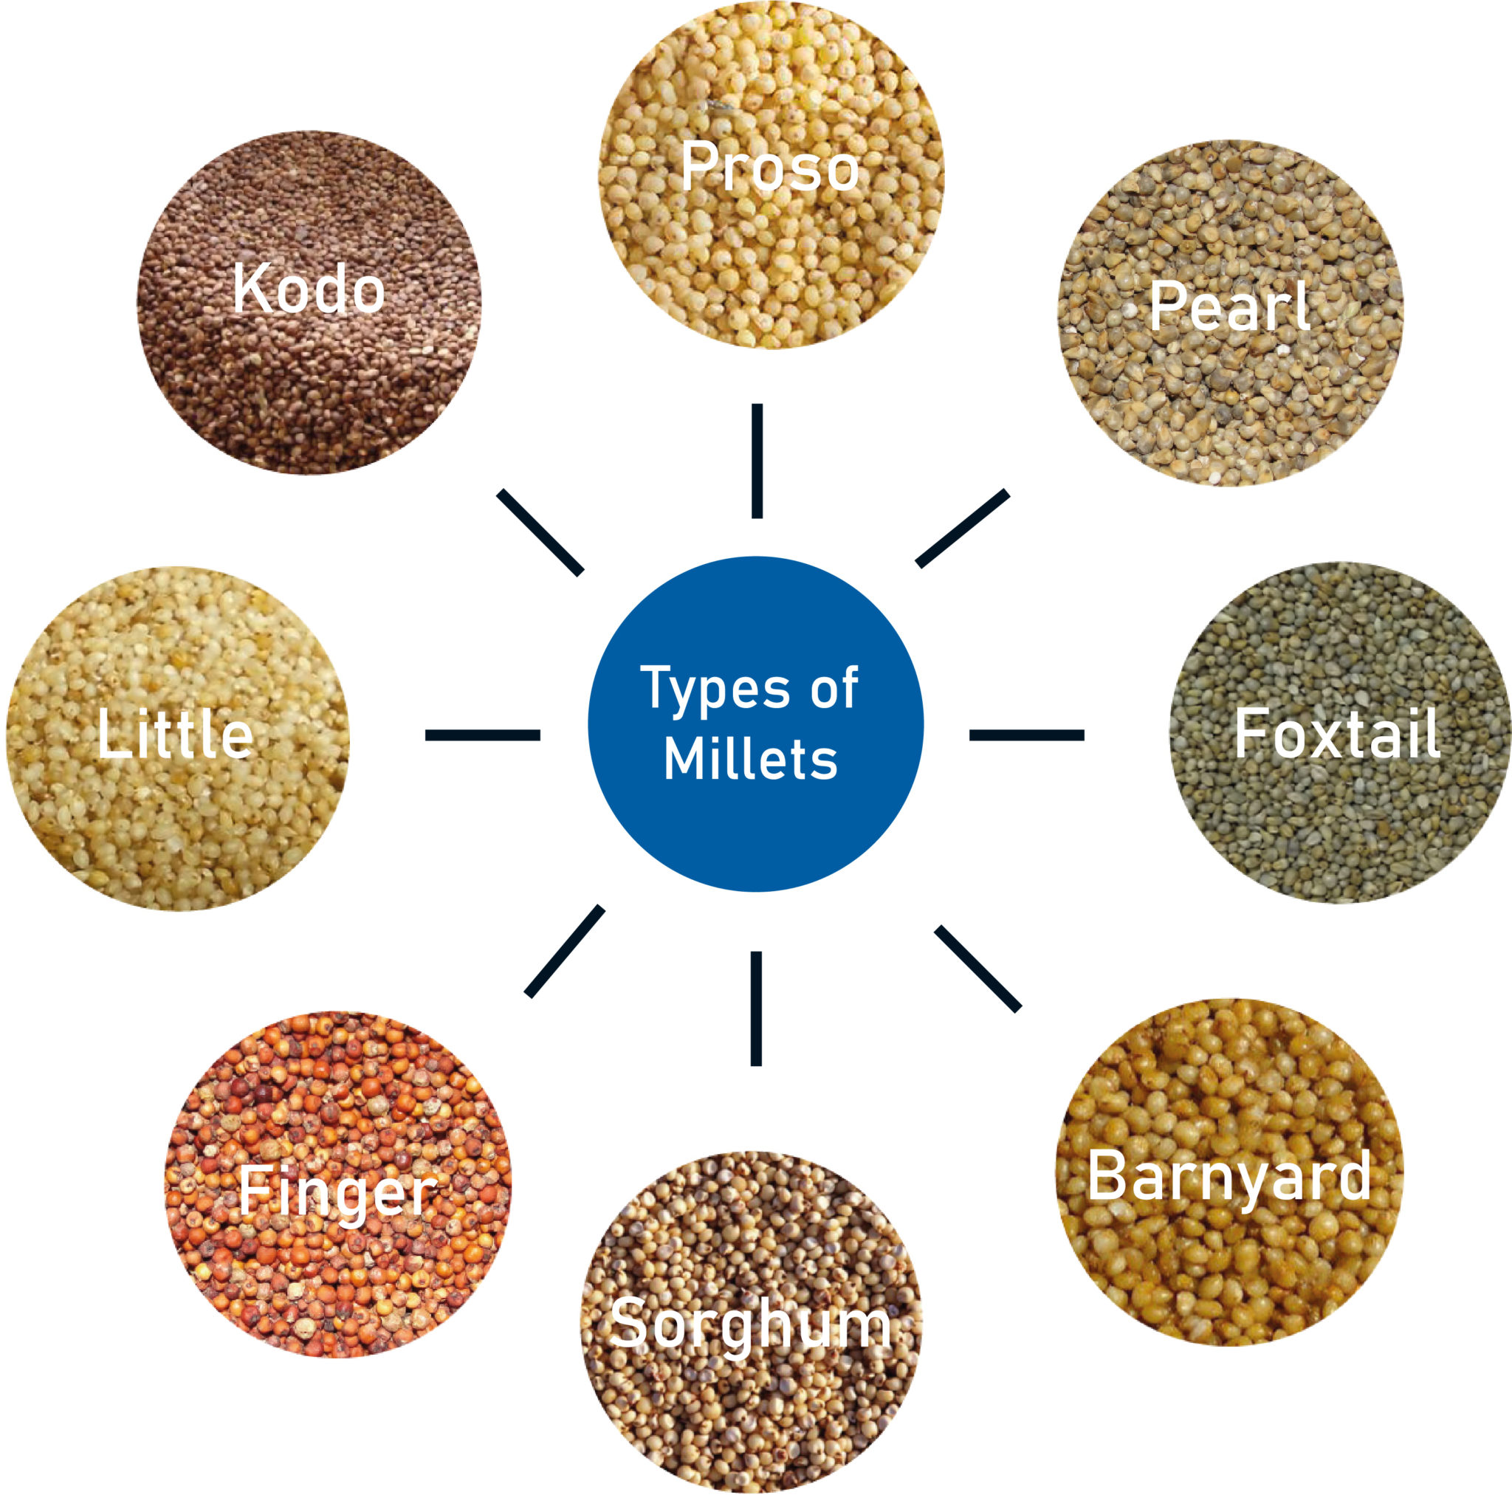
Incorporate Millets in routine diet:
Jowar Porridge/ Upma/ Puffs/ Chapati/ Rabri
Ragi Porridge/ Upma/ Idli/ Uttpam/ Chapati/ Biscuits, Breads
Quinoa Salad/ Puffs/ Dosa
Foxtail Millet Khichri/ Pulao
Spiced Millets Salad
Millet Breads/ Falafel
Bajra Chapati/ Raab
Millet Vegetable Tikki
Puffed Millets Breakfast Cereal
Mixed Millet Bhelpoori
Kodo Millet Pizza
Millet Granola
Millet Energy Bars
Millet Tofu Bowl
Millet Crackers

Slide 23
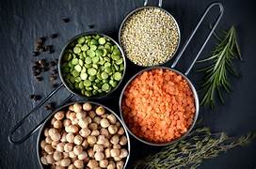
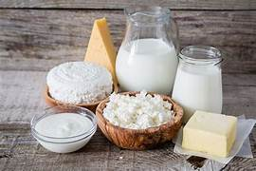
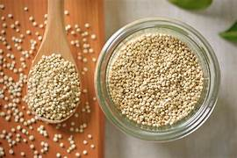
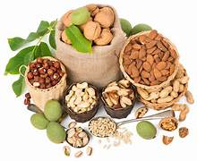
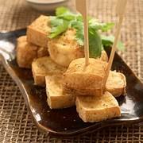
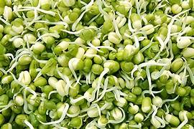
Protein Rich Vegetarian Options…..
Pulses and Lentils
Sprouted Dals
Beans
Nuts and Seeds
Quinoa
Low fat dairy products- Milk, Yogurt, Paneer etc
Tofu and other soy based products
Home made Protein powders

Slide 24
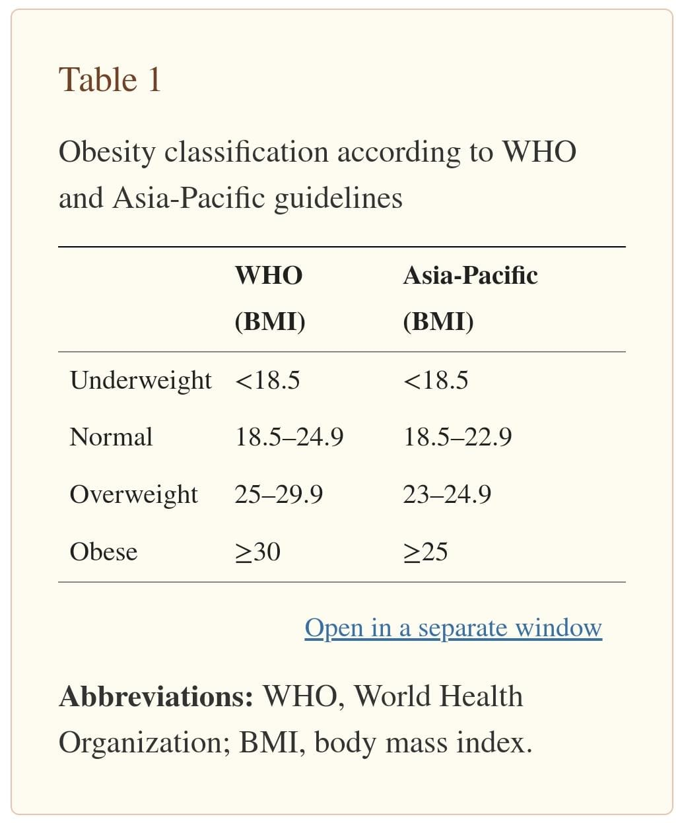
Case Study..
Age- 15 years boy
Height- 165 cms
Weight-90 kg
BMI- 33.05 kg/m2
Eating Habits- eggetarian
Lifestyle- Sedentary
Family History-
Father & Grand Father- Obese and Diabetic (uncontrolled Hba1c
>10% from last 1 year)
Mother- Obese & Gout

Slide 25

Diet Recall was taken……
Calorie consumption was high in daily routine through junk foods and simple sugars (minimum one meal is out on daily basis).
Consumption of seasonal fruits and vegetables was less.
Caffeine consumption was also high (2 cold coffee & one chocolate/ chocolate brownie per day)
Screen time- 5-6 hours per day
Sleep cycle- 4-5 hours/ day
Fluid intake was less.
No physical activity in daily routine.

Slide 26

1st Diet Counselling
Nutritional Requirements for 24 hours-
Ideal body weight- 49 kg
Adjusted body weight- 70 kg
Calories= 70*20= 1400 kcal / day
Carbohydrates= 190 gms/ day (50-55% of total calories)
Proteins= 1 gm/ kg/ day= 70 gms/ day (20-25% of total calories)
Fats-=30 gms per day (visible+ invisible both) (20% of total calories)
(calculated as per RDA, 2020)

Slide 27
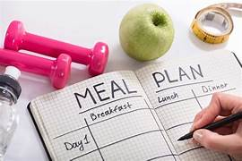
Calorie Distribution
Major Meals- 3 (Breakfast/ Lunch/ Dinner)
Snacks- 1-2 (Mid Meal+ Evening Snacks as per the convenience)
Calorie distribution was done in between 3 major meals-
33% from Breakfast
33% from Mid meal + Lunch
33% from Evening Snacks+ Dinner

Slide 28
Food group | Exchanges | Amount (gm/ml) | Household measure
Cereals- whole wheat flour / Brown rice/ wheat porridge/wheat bread/Steel cut oats/Ragi/ wheat flakes/ quinoa/ barley/ millets | 5 | 150 gm | 4-5 chapati
Pulses/ Legumes/ Soya- Red beans, white beans, chickpeas, black chana, lentils | 2 | 60 | 2 Medium Bowl
Milk/Curd (double toned) | 4 | 400 | 2.5 cups
Egg white/Paneer/Non veg | 1 | 50 | 2/ 4-5 pcs/ 1-2 small pcs
Roots and tubers | 0 | 0 | 0
Green leafy and Seasonal vegetables | 7 | 700 | 6-7 servings
Fruits- apple/ pear/ orange/ sweet lime/Peach/cherry/ strawberry/ kiwi/ pineapple/ grapes/papaya | 2 | 200 | 2 Medium/20-25 pcs
Nuts | 2 | 30 | 20-24 almonds/ 10-12 walnuts
Seeds (Flax seeds/ Chia seeds) | 1 | 10 | 2 tsp
Oil/Fat | 3 | 15 | 3 tsp
Sugar/ jaggery/ honey | 0 | 0

Slide 29
Day-To-Day Diet
Food group | BREAKFAST | MID MORNING | LUNCH | EVENING SNACKS | DINNER
Cereals- whole wheat flour / Brown rice/ wheat porridge/wheat bread/Steel cut oats/Ragi/ wheat flakes/ quinoa/ barley/ millets | 2/1 | 0 | 2 | 0 | 1
Pulses/ Legumes/ Soya- Red beans, white beans, chickpeas, black chana, lentils | 0 | 0 | 0 | 1 | 1
Milk/Curd (double toned) | 2 | 0 | 2 | 0 | 0
Egg white/Paneer/Non veg |  | 1
Roots and tubers | 0 | 0 | 0 | 0 | 0
Green leafy and Seasonal vegetables | 1 | 0 | 3 | 1 | 2
Fruits- apple/ pear/ orange/ sweet lime/Peach/cherry/ strawberry/ kiwi/ pineapple/ grapes/papaya | 0 | 2 | 0 | 0 | 0
Nuts | 1 | 0 | 0 | 1 | 0
Seeds (Flax seeds/ Chia seeds) | 0 | 1 | 0 | 0 | 0
Oil/Fat | 1 | 0 | 1 | 1 | 0
Sugar/ jaggery/ honey | 0 | 0 | 0 | 0 | 0

Slide 30

Practical Tips were given……
6-7 hours sleep is necessary to maintain healthy body weight, so improve sleep cycle.
Do not skip Breakfast. And have it on time.
Take time to chew your food properly.
Avoid using TV, Mobiles, Laptop and any Electronic gadget while have your meal.
Start your meal with first 2-3 bites of proteins and have carbs and other food groups.
Make your plate as colorful as possible.
Limit fat in daily diet.
Avoid refined sugars and alcohol.
Use plant foods providing complex carb’s and fiber.
Make meal time a chance to slow down and relax.

Slide 31

Practical Tips were given…….
Cut down on caffeine.
Keep portions moderate.
Limit sugary foods, salt and refined grain products.
Use salt in moderation.
Drink lots of water.
Avoid crash diets and fast foods.
Avoid Mindless munching.
Choose herbs and lemon dressing instead of mayonnaise. etc.
Avoid eating outside more than once a week.
Choose the RIGHT Food while eating outside.
A gradual reduction of 2-3 kgs in a month is desirable.

Slide 32

Follow up visit after 15 days
Weight reduction- 2 kgs with Inch loss.
Lots of improvement was seen in daily routine.
40 minutes of daily brisk was started 6 days in a week.
Improvement was there in sleep routine also.
Water intake was also better than before.
He was feeling more active and energetic throughout the day.

Slide 33
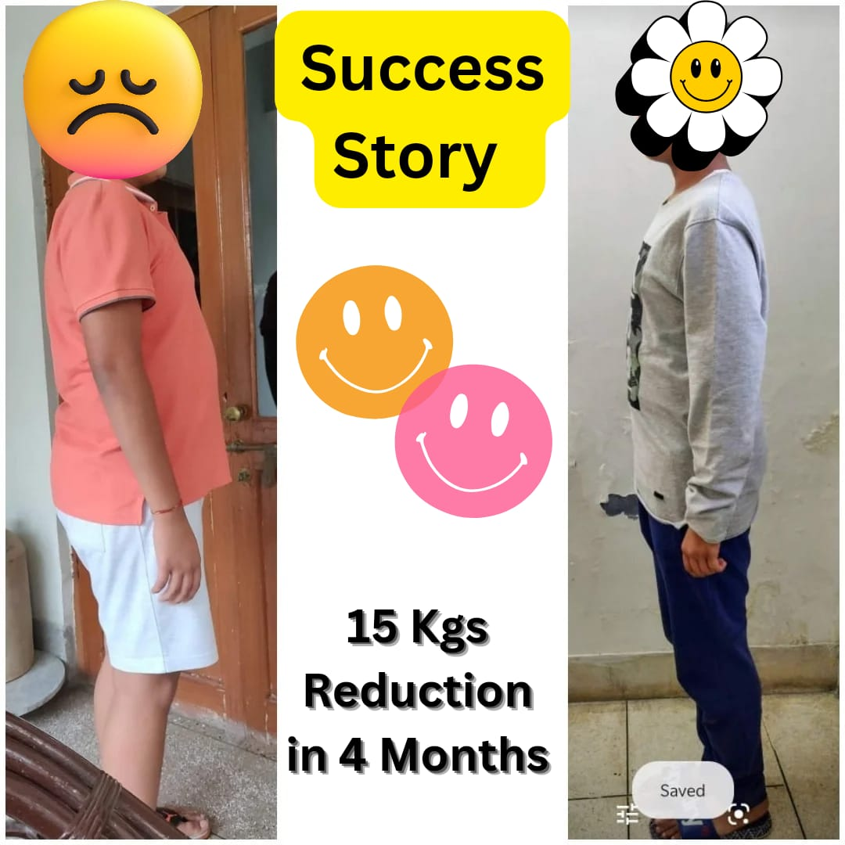
Again calorie distribution was revised and per changed adjusted body weight in every 15 days.
Some changes were made as per the preferences on every sitting.
After 4 months 15 kgs weight reduction was seen with good inch loss.
Child and his parent were happy, satisfied and highly motivated.
He was ready to continue with diet regime to achieve his target weight.
Notes:
So this is how we work on obese adolescents.
I generally call them in every 10-15 days for follow ups so that I can keep a close eye on their weight loss journey.
Regular counselling's keeps them motivated and help in their weight loss journey.
We can save them from destructions also.

Slide 34

“HEALTH IS A PRICELESS WEALTH, INVEST WHILE YOU CAN”
Thanks for your Patience.

